Slide 1

Chronic Absenteeism
Newark Public School System
Hassan Bilal Siddiqui

Slide 2

WHY IS STUDENT ATTENDANCE IMPORTANT?
Chronic Absenteeism occurs when a student is absent for more than 10% of the days enrolled in school
Chronic Absenteeism is a noteworthy concern for the Newark Public Schools since it is bound to have a significant impact on student learning and overall performance
Existing data provides us insight into student attendance at three district schools for 2015-16
Furthermore, it allows NPS to make concerted and targeted efforts to shore up student attendance

Slide 3
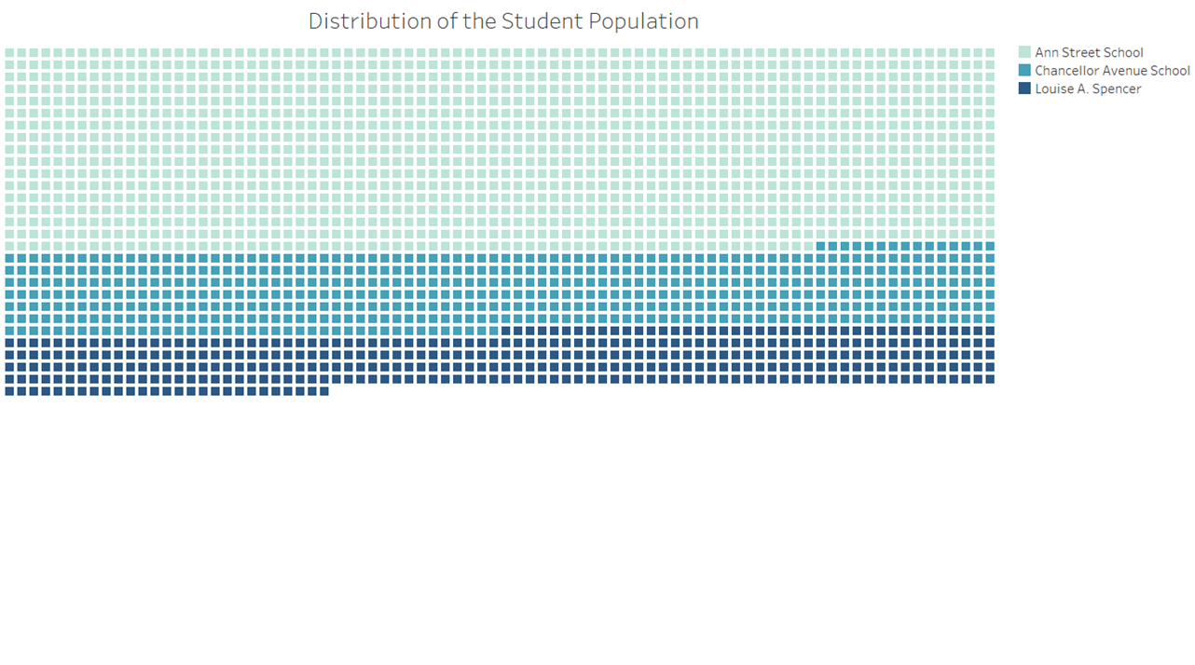

STUDENT ABSENTEEISM – A BIRDS EYE VIEW
Around 60 % of the student population is enrolled in Ann Street School
More than half of all students have been absent less than 5 % of the enrolled days, demonstrating punctual attendance of class
However, measures need to be taken to curtail falling attendance amongst a third of the student population
59 %
24 %
17 %

Slide 4
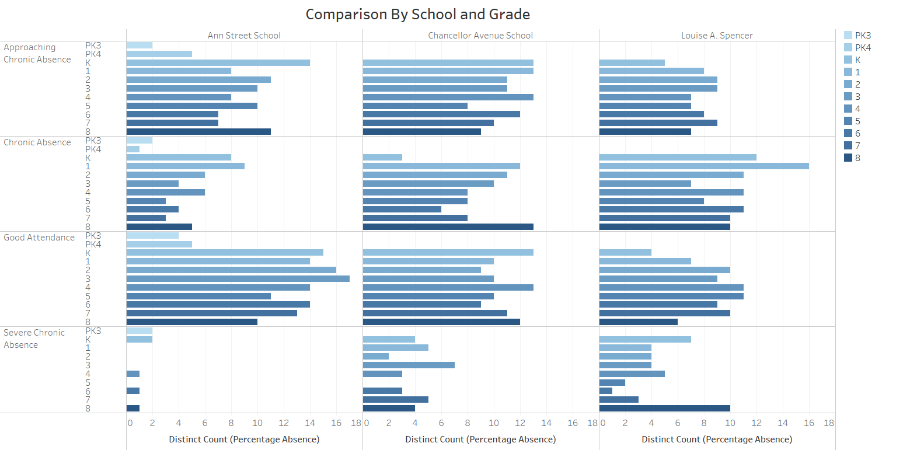
STUDENT ABSENTEEISM- A COMPARATIVE ANALYSIS
When we compare across schools , we see that Ann Street School shows lower levels of absenteeism when compared to the other schools.
This is significant since more than half of the student body is enrolled at Ann Street.
Counterintuitively ,schools with lower enrollment numbers fare poorly

Slide 5
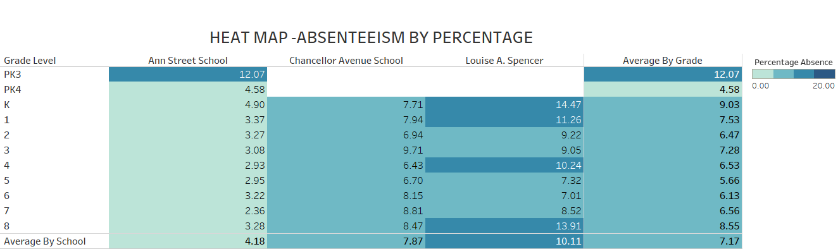
IMRPOVING STUDENT ATTENDANCE- A DEEPER ANALYSIS
Heat Map- Average Percentage Absenteeism
Louise A. Spencer School, on an average has a higher level of student absenteeism than other schools
Student Absence is particularly high in Grades K and 8 across all the schools
By focusing efforts on improving attendance in schools and grades showing chronic absenteeism, overall student attendance can be drastically improved.

