Slide 1
2D Fractal Rendering
CSIS0271
C0271-Computer Graphics
2012-9

Slide 2
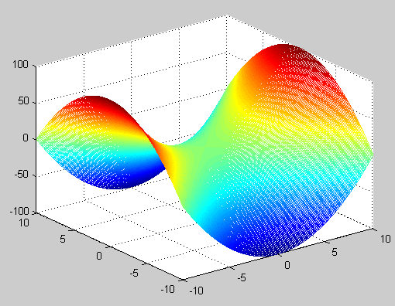
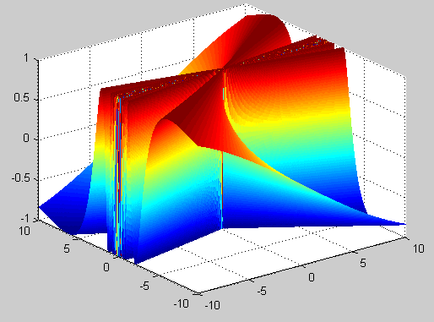
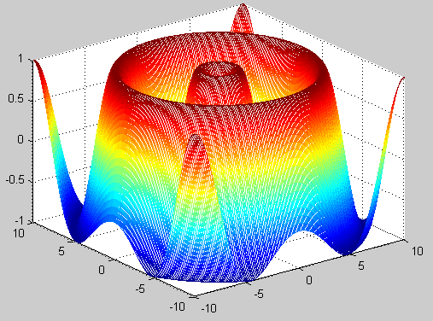
Objectives
Get a picture of computer graphics by turning abstract formulas into visualization.

Slide 3
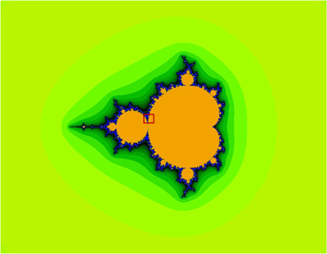
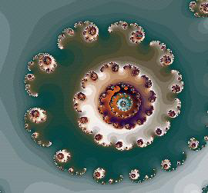
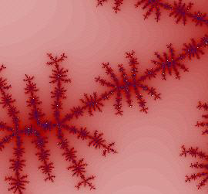
Outline
Concept of Fractal
Mandelbrot Set and Julia Set
2D Fractal Rendering

Slide 4
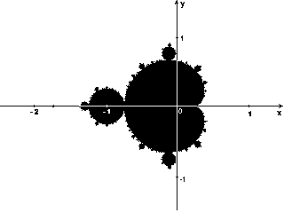
Fractal
Fractal is a set of points that has irregular shapes or boundaries of fractional dimensions.
For example, the Mandelbrot fractal is a fractal defined in the complex plane:

Slide 5
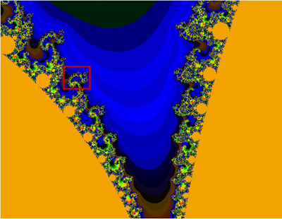
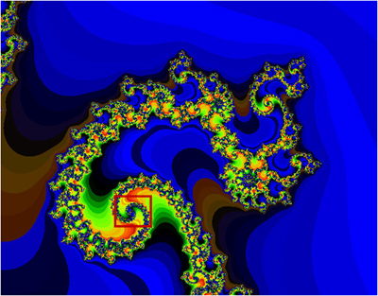
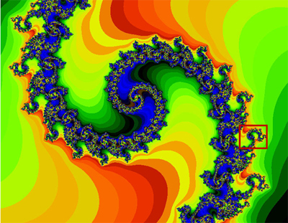
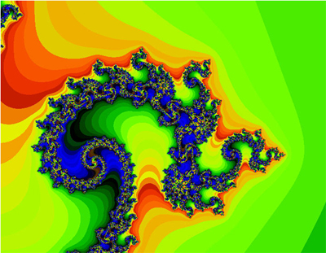
Fractal
Self-similarity is a characteristic property of fractals.
Fractals may be exactly the same at every scale, or nearly the same at different scales.

Slide 6
Review: Complex number
imaginary unit
real part
imaginary part
Operations:
“ + ”:
“ - ”:
“ * ”:
Magnitude:
Complex plane

Slide 7
What is Mandelbrot Set ?
Mandelbrot Set --- the set of all complex numbers c such that z_{n} is finite as n goes to infinity.
Example.1
For c =1+0*i, the sequence is
{0, 1, 2, 5, 26,…}
Example.2
For c =-1+0*i, the sequence is
{0, -1, 0, -1, 0,…}
c
c
Exercise:
c =-1+i
c = 1 -i
{0, -1+i, -1-i, -1+3*i, -9-5*i, 55+91i…}
{0, 1-i, 1-3*i, 7-7*i, 1+97*i, -9407+193*i…}

Slide 8
What is Julia Set?
Fix c
Each Julia Set corresponds to a complex number c
Example
For c =1+0*i, z =1+0*i the sequence is
{1, 2, 5, 26, 677…}

Slide 9
Mandelbrot Set and Julia Set
The rule is:
Defined in complex plane
Present a sequence
Two factors | Mandelbrot | Julia
c | change | fix
z₀ | fix (z₀=0) | change

Slide 10
What do these fractals look like?

Slide 11
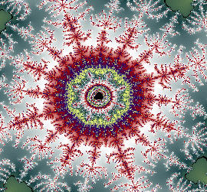
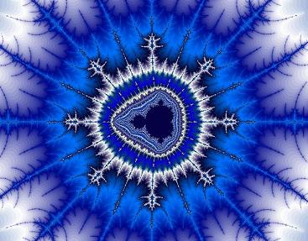

Rendering Mandelbrot set & Julia set

Slide 12
Some Key Points in Rendering
Present a complex number using x, y coordinates

Slide 13
Some Key Points in Rendering
How to determine the divergence?
That is to see whether or not the point(x_{n},y_{n}) goes to infinity.
We cannot iterate the function infinite times to get the exact result.

Slide 14
Determine the Divergence
Set up a large circle x²+y²=R²,
Iterate judging the points from (x₀, y₀) for certain times K.
If one point jumps out of the circle – consider to be divergent;
Else, convergent.
y
y
y
R
R
R
x
x
x
convergent
divergent
divergent

Slide 15
Some Key Points in Rendering
Escape time
number of steps a point takes to get out of the pre-specified range
The less the escape time is, the more rapidly the point goes to infinity.
Color coding
assign a color to the point depending on its escape time

Slide 16
Some Key Points in Rendering
Define the display region of the complex plane
(p_{max}, q_{max})
(p_{max}, q_{max})
height
=q_{max}
height
=q_{max}
(0,0)
(0,0)
width = p_{max}
width = p_{max}
Mandelbrot set
Julia set

Slide 17
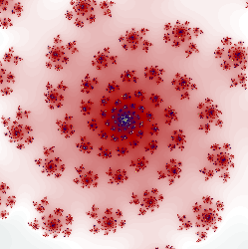
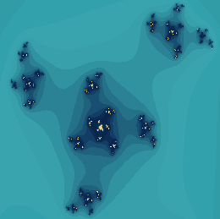
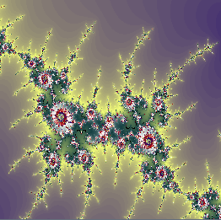
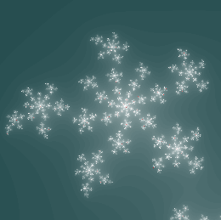
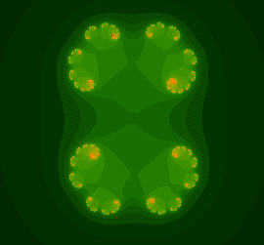
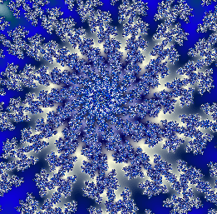
More Rendering Results

Slide 18
Demo

Slide 19
Open GL Introduction
What is Open GL?
Low-level graphics library
A set of commands that allow the specification of geometric objects in 2D or 3D
Device independent

Slide 20
Open GL Introduction
A Sample GL Program
#include “gl.h” // Specify the library to use
int main( ){
OpenAGLWindow(); // Init window to draw
glClearColor(0.0,0.0,0.0,0.0); // Clear screen background
glClear(GL_COLOR_BUFFER_BIT);
glColor3f(1.0, 1.0, 1.0); // Specify object color
glBegin(GL_POLYGON); //Specify object type
glVertex2f(-0.5, 0.5); // Object’s coordinates
glVertex2f(0.5, 0.5);
glVertex2f(0.5, -0.5);
glVertex2f(-0.5,-0.5);
glEnd();
KeepTheWindowOnScreen();
}

Slide 21
OpenGL Background on Color Modes
How is the palette formed?
0
7
4
6
5
5
71
6
2
2
5
7
6
1
7
2⁸=256
1 byte
119
2
3
4
0
167
Palette
215
0
1
2
3
4
5
6
7
255
Color index mode

Slide 22
About the Template
MS-Windows: Use Visual Studio .NET 2008/2010, Interface based on MS Foundation Class (MFC). Written in C++.
Download from the course webpage.
Double-click the file Fractals.sln to open the project.
A sample program Fractals.exe in the folder “bin”.
Template includes:
An interface with functions like resize, zoom in/out, select c, color map import/ edit/ export and file open/save.
OpenGL init and projection setup.

Slide 23
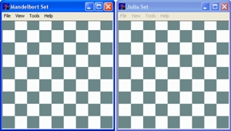
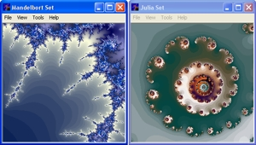
About the Template
Initial View
Finished View

Slide 24
About the Template
Initial GL Setting
Finished
To be finish
Get View Info
Your Task
Pixel Color Calculation
User Interactive
Rendering

Slide 25
Your Task
Fill in two functions Mandelbrot() and Julia() in code.cpp.
void Mandelbrot(double left, double right, double bottom, double top, int winwidth, int winheight, unsigned char *map);
left, right, bottom and top
display region of the complex plane
winwidth, winheight
dimension of the window.

Slide 26
Your Task
“map” here is an array representing pixels of the fractals image, from left to right, bottom to top.
Using color index mode, with the range from 0 to 255.
Each value takes one byte and represents a pixel's color.
It is already allocated by the template.
There are winwidth * winheight bytes in the array.
map

Slide 27
Note! Assign color to Pixel (i, j)
Color index ranges from 0 to 255!
Suppose the escape time for the complex number presented by pixel (i, j) is n, then it should be
map[i+ j*winwidth] = n%256
MOD operation
map

Slide 28
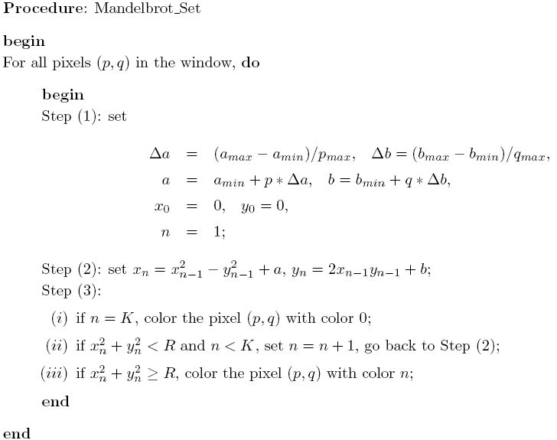
C=a+bi
z₀=0
escape time

Slide 29
Complex plane
Window
∆a
b_{max}
∆b
q_{max}-1
a_{min}
a_{max}
b_{min}
0
0
p_{max}-1

Slide 30
Your Task
void Julia(double left, double right, double bottom, double top, double a, double b, int winwidth, int winheight, unsigned char *map);
Left, right, bottom, top, winwidth, winheight, map, same as Mandelbrot Set.
a , b -- in Julia(), define the complex number c=a+ib.

Slide 31
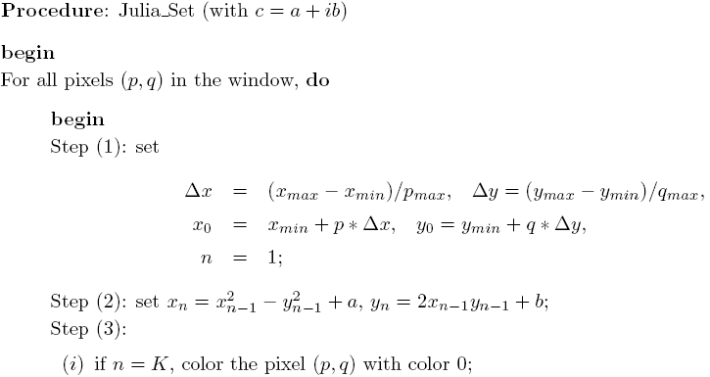
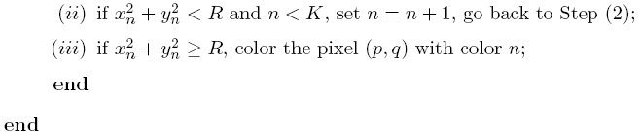

Slide 32
Complex plane
Window
∆x
y_{max}
∆y
q_{max}-1
x_{min}
x_{max}
0
y_{min}
0
p_{max}-1

Slide 33
Thank you!

