Slide 1
Esch384 on FPGA
A hardware implementation of the SPARKLE hash
Henry Su, Nick Ngo
ECE 545, NC State University

Slide 2
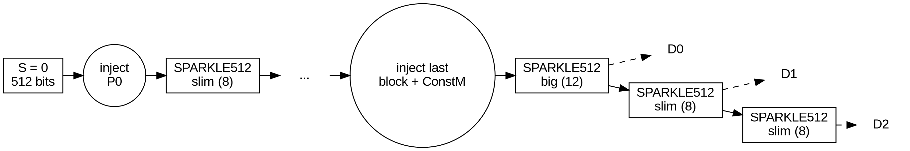
Esch384 overview
- Hash from the SPARKLE family (NIST lightweight crypto finalist)
- Sponge: absorb 128-bit blocks, then squeeze
- State 512 bits, rate 128, capacity 384
- Digest 384 bits (3 squeezes of 128)
- Slim permutation: 8 steps; big (after last block): 12 steps
- Last block padded with 10*; constant marks padded vs. full

Slide 3
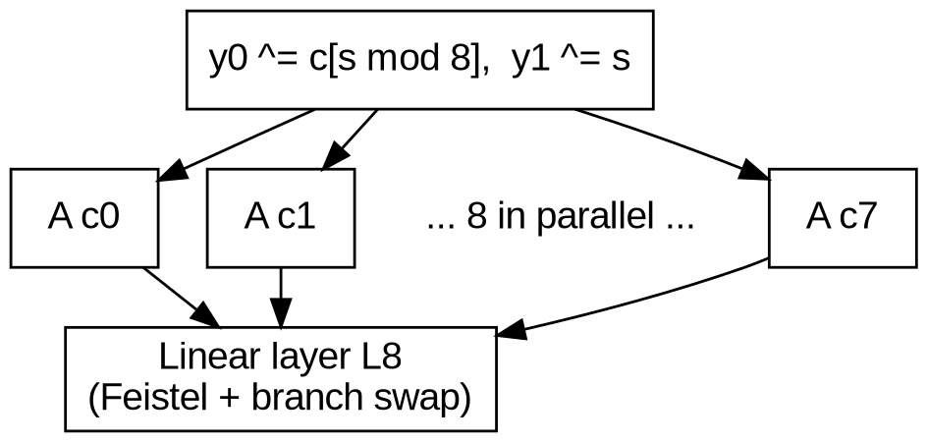
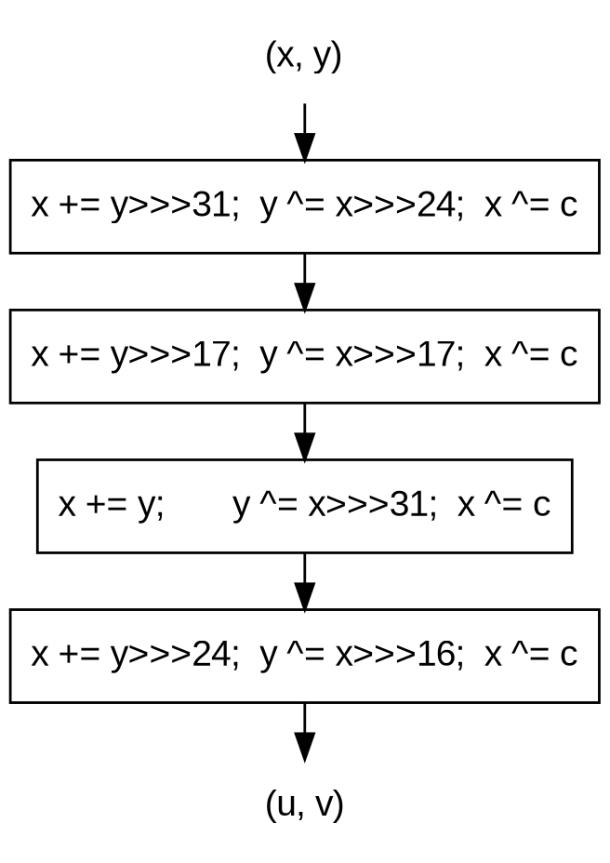
SPARKLE512 and the Alzette ARX-box
- One step = constant, 8 Alzettes, linear layer
- Alzette: 4 rounds of add, rotate, XOR (ARX)
- Each branch has its own constant c_i
- Linear layer mixes the 8 branches

Slide 4
Top-level block diagram
- Coming in Phase 3

Slide 5
Datapath
- Coming in Phase 3

Slide 6
Controller FSM
- Coming in Phase 3

Slide 7
Timing and latency
- Coming in Phase 3

Slide 8
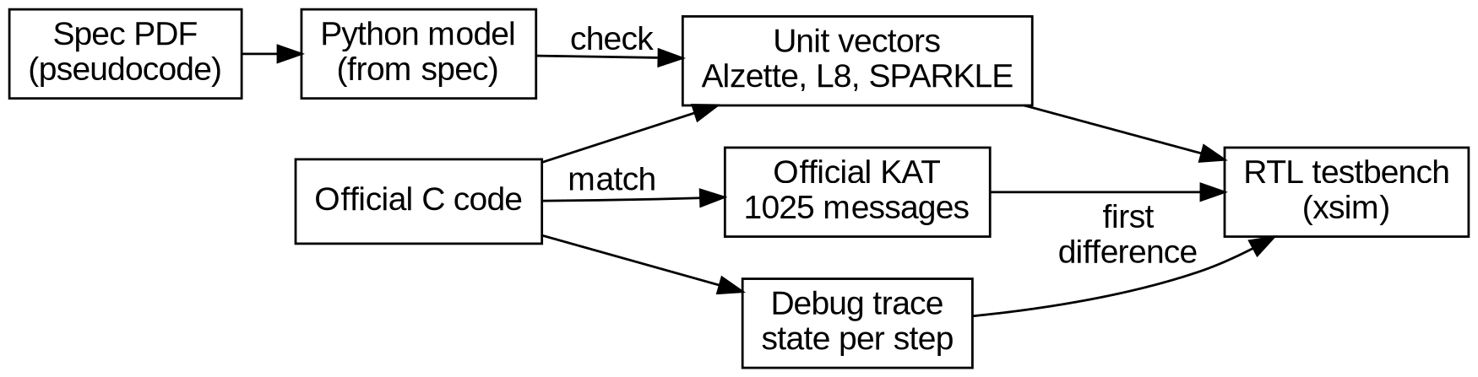
Verification approach
- Official C code reproduces all 1025 official KATs
- Extra KATs at block edges: 0, 1, 15, 16, 17, 32, 33 ... bytes
- Unit vectors double-checked by a Python model written from the spec
- Debug trace prints the state after every step
- Hardware mismatch: compare traces, fix the first difference

Slide 9
Synthesis results
- Coming in Phase 3

Slide 10
Area optimizations
- Coming in Phase 4

Slide 11
AI tool usage and lessons learned
- Claude Code used for setup, reference model, test vectors
- Every AI output checked by running tests
- Full log: docs/ai_log.md

Slide 12
Conclusion
- Coming in Phase 4

