Slide 1
Optimization

Slide 2
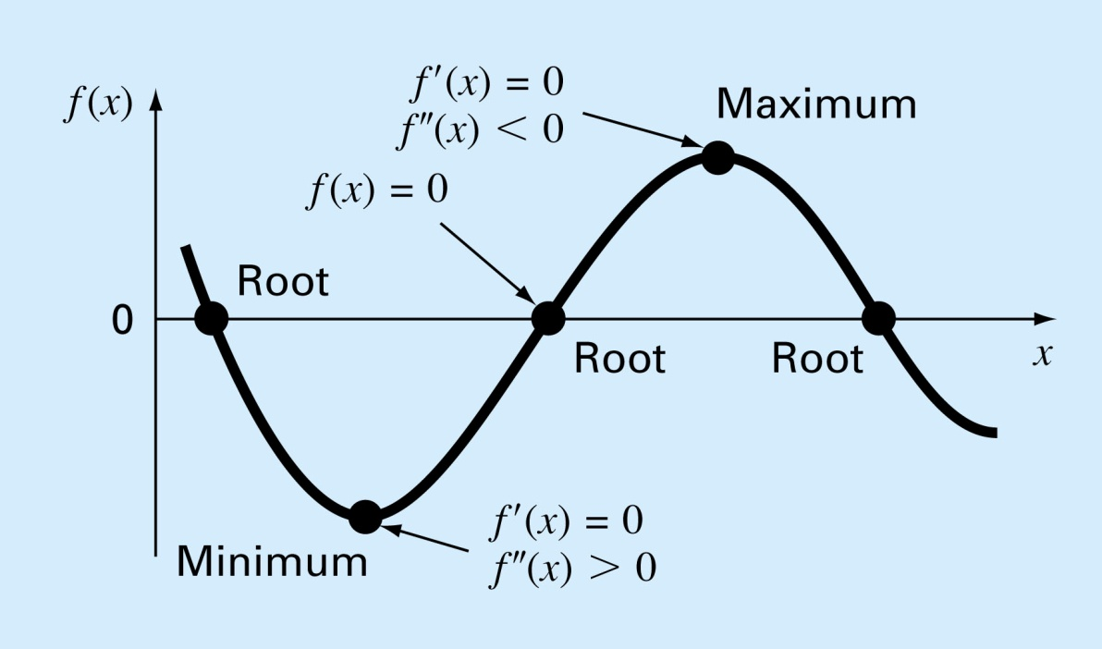
Motivation
Optimizatoin: search for either the minimum or maximum value of a function or functions
For a simple function
  When f’(x) = 0 at x, f(x) ; if f’’(x) > 0 mim, < 0 max

Slide 3
Optimization problems in engineering
Design aircraft for minimum weight and maximum strength
Design of structures for minimum costs
Design water-resources projects to mitigate flood damage while yielding maximum water supply and hydropower
Optimal planning and scheduling
Optimal pipeline networks
Design wastewater treatment plants to meet water quality standards at least cost
Minimization or Maximization problems with constraints that caused by the limitations of the physical world

Slide 4
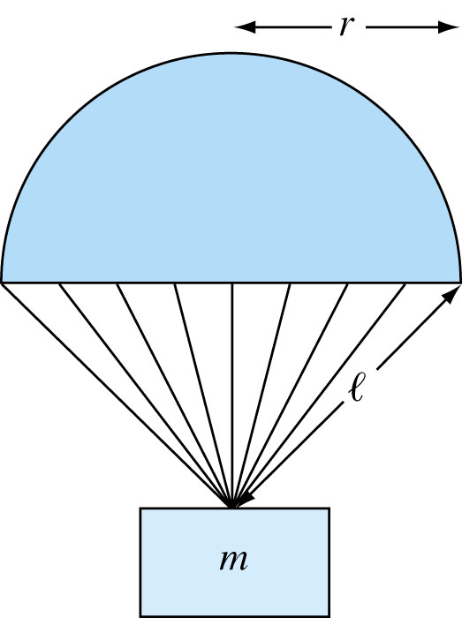
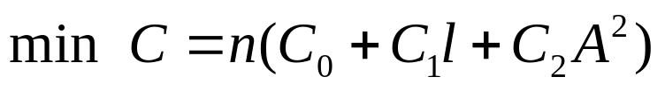
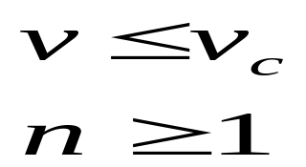
Optimization of Parachute Cost
Problem Statement
전쟁지역 피난민에게 낙하산을 이용하여 지원물자를 공수할 경우, 낙하속도가 허용하는 충격속도 이내를 유지하면서 전체 물량 M_{t}를 낙하할 수 있도록 낙하산의 규격과 갯수를 최적으로 결정하는 문제
Formulization
Objective function(목적함수)
Constraints(제약조건)

Slide 5
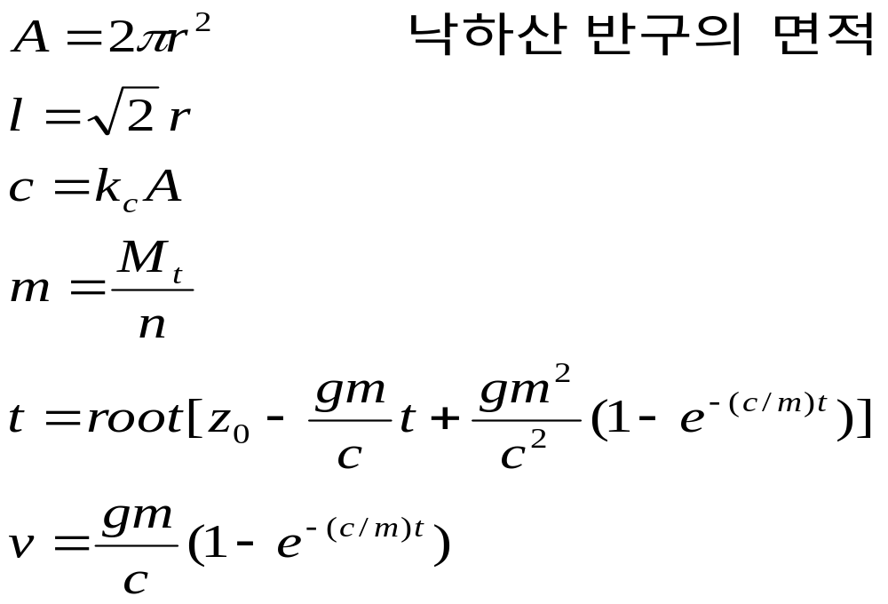
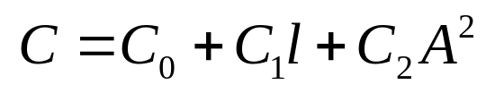
Required equations
낙하산 줄 길이
낙하산 항력계수
낙하산 1개당 비용

Slide 6
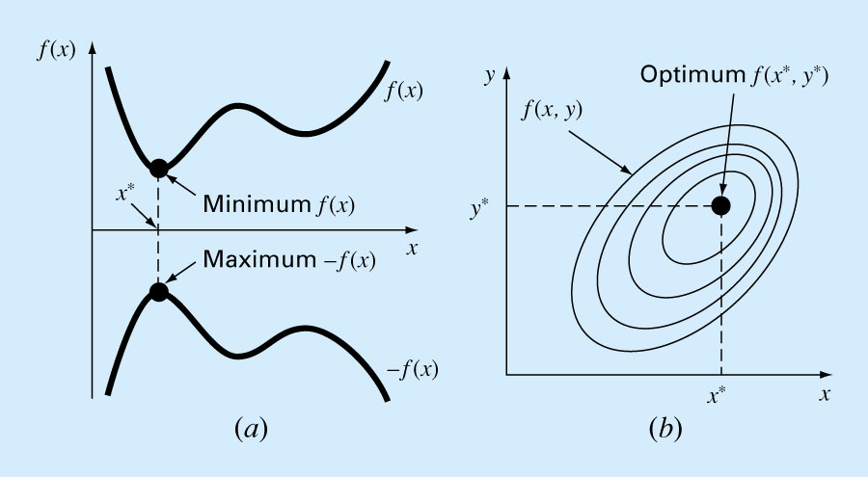
Mathematical Background
1-D Optimization : min. f(x) = max. –f(x)
2-D Optimization : search for min. or max. of contour

Slide 7
Unconstrained Optimization

Slide 8
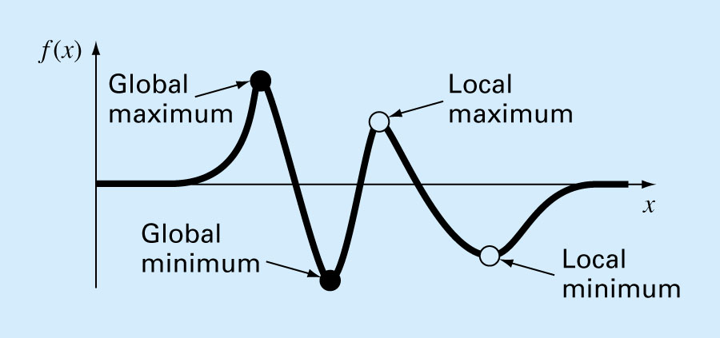
Terminology
Multimodal : local vs. global optimal values

Slide 9
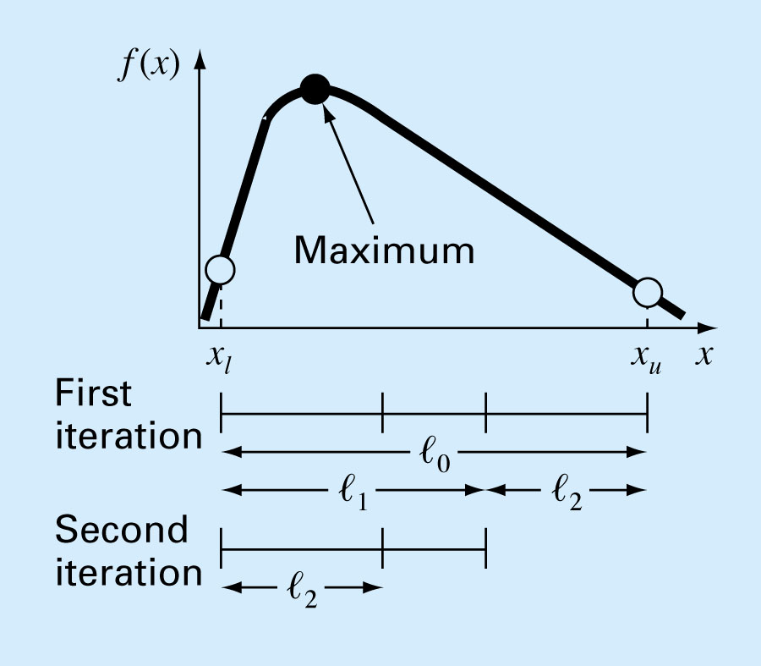
Golden-Section Search(황금 분할법)
Characteristics
Single-variable optimization
the goal is to find the value of x that yield an extremum, max. or min. of f(x)

Slide 10

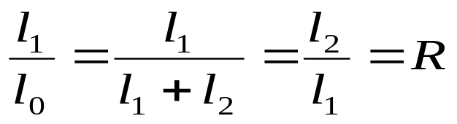
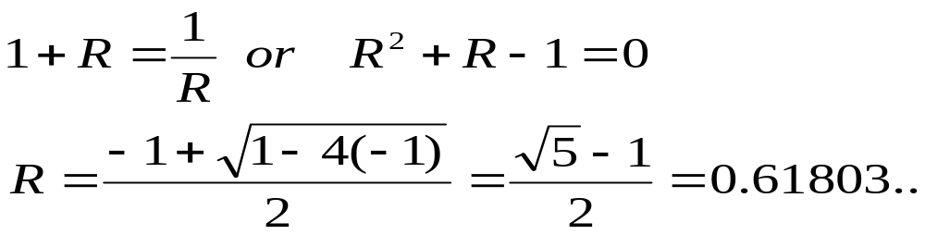
Golden-Section Search
Golden ratio R(황금비)
  condition 1
  condition 2
From condition 2, if the reciprocal is taken and R = l₂/l₁
Golden ratio R = 0.618

Slide 11
Algorithms of Golden-Section Search(1/2)
Guess x_{l}, x_{u} and determine es, maxit
Estimate d = R(x_{u} - x_{l})=0.618*(x_{u} - x_{l})
x₁ = x_{l} + d, x₂ = x_{u} - d, f(x₁), f(x₂) watch out x₁ > x₂
If f(x₁) > f(x₂), eliminate the domain x_{l} ~ x₂
  Old x₂ = x_{l}
  Old x₁ = x₂
  Old x_{u} = x_{u}
  d = R(x_{u} - x_{l})
  x₁ = x_{l} + d
x_{l}
x₂
x₁
x_{u}
x_{l}
x₂
x_{u}

Slide 12
Algorithms of Golden-Section Search(2/2)
5. If f(x₁) < f(x₂), eliminate the domain x₁ ~ x_{u}
  Old x₁ = x_{u}
  Old x₂ = x₁
  Old x_{l} = x_{l}
  d = R(x_{u} - x_{l})
  x₂ = x_{u} – d
If f(x₁) > f(x₂), x_{opt} = x₁, f_{opt} = f (x₁)
If f(x₁) < f(x₂), x_{opt} = x₂, f_{opt} = f (x₂)
7. Repeat step 2~6 until converge
x_{l}
x₂
x₁
x_{u}
x_{l}
x₁
x_{u}

Slide 13
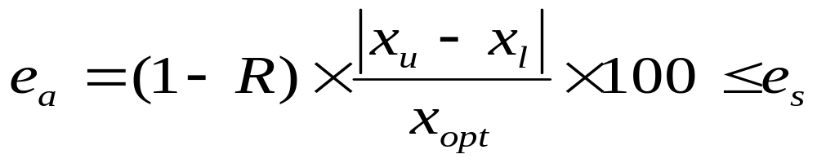
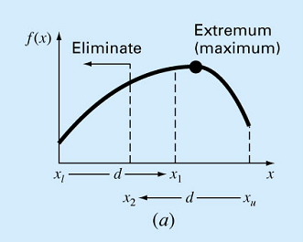
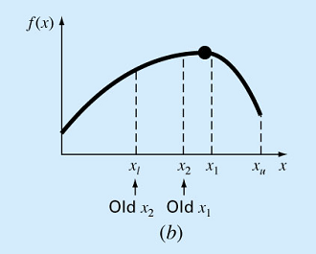
Convergence test

Slide 14
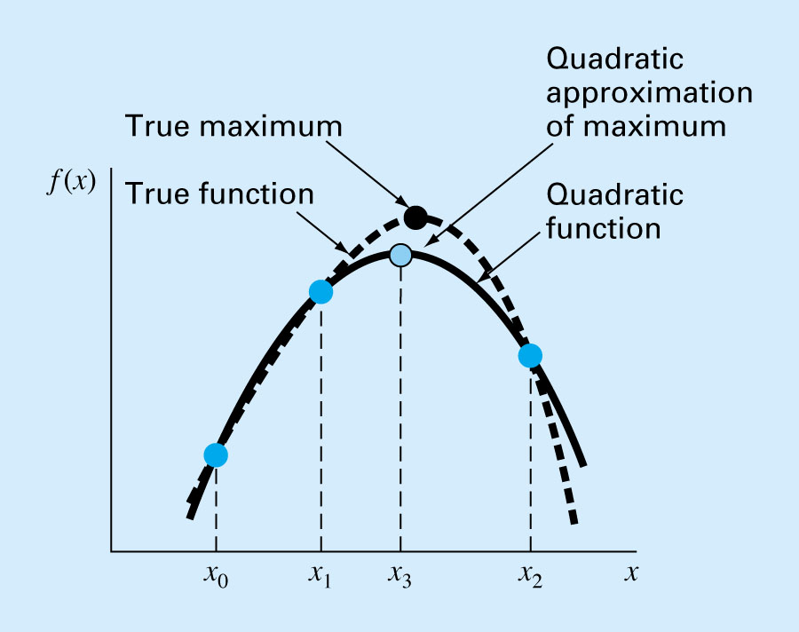
Quadratic Interpolation (2차 보간법)
If we have three points that jointly bracket an optimum, we can fit a parabola to the points. Then differentiate it, and set the results as zero, and solve for an estimate of the optimal x

Slide 15
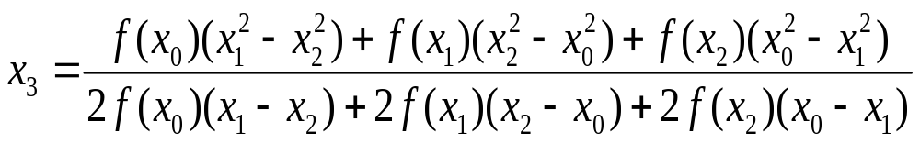
Quadratic Interpolation Algorithms
Initial guess x0,x1,x2
Compute x3
Compute f(x0), f(x1), f(x2), f(x3), and discard x that produces the minimum f value
Using new x0,x1,x2 , compute x3 again
Repeat Step 2~4 until converge

Slide 16
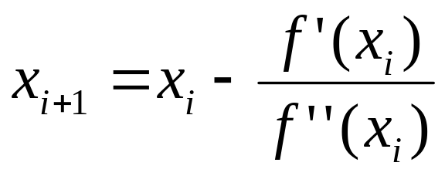
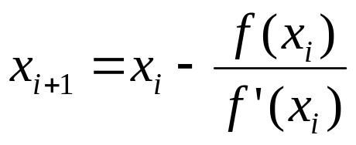
Newton’s Method
Equation
* Recall Newton-Raphson method
Sub NRMx(xguess, xopt, fopt, maxit, iter, es)
Dim ea As Double
iter = 1
Do
xopt = xguess - df(xguess) / d2f(xguess)
iter = iter + 1
fopt = f(xopt)
If xopt <> 0 Then ea = Abs((xopt - xguess) / xopt) * 100
xguess = xopt
If ea <= es Or iter >= maxit Then Exit Do
Loop
End Sub

Slide 17
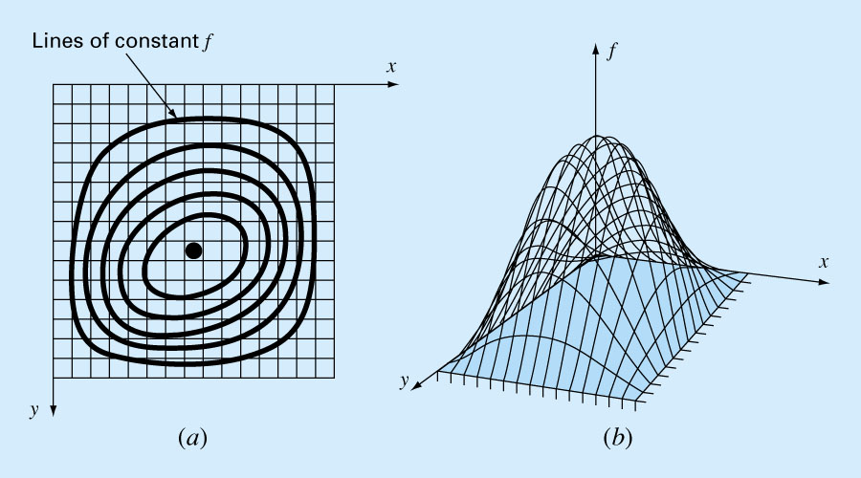
Multidimensional Unconstrained Optimization
Multidimensional problems
Gradient Methods : require derivatives
Non-gradient Methods : do not require derivative evaluations (Direct Method)
2-D topographic Map (Contour)
3-D Mountain : Find a peak point of the mountain (maximization of elevation)

Slide 18
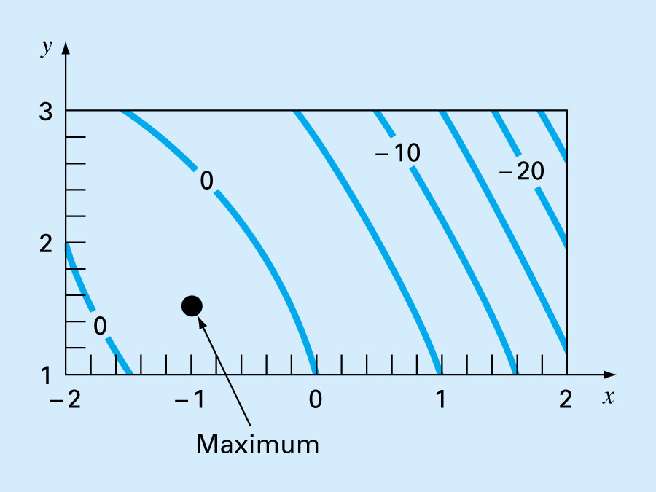
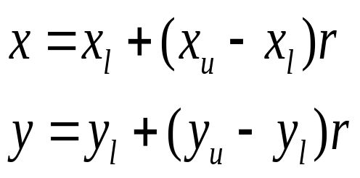
Direct Method (직접법)
Random Search (임의 탐색법)
  A brute force approach
  Repeatedly evaluates the function at randomly selected values of the independent variables
r = random number 0~1
x = x random number
Y = y random number

Slide 19
Random Search VAB 프로그램
Sub RndSrch(n, xmin, xmax, ymin, ymax, maxy, maxx, maxf)
Dim j As Integer
Dim x As Single, y As Single, fn As Single
maxf = -999000000000#
For j = 1 To n
x = xmin + (xmax - xmin) * Rnd
y = ymin + (ymax - ymin) * Rnd
fn = f(x, y)
If fn > maxf Then
maxf = fn
maxx = x
maxy = y
End If
Next j
End Sub
x 난수 발생
y 난수 발생
최대값 추적

Slide 20
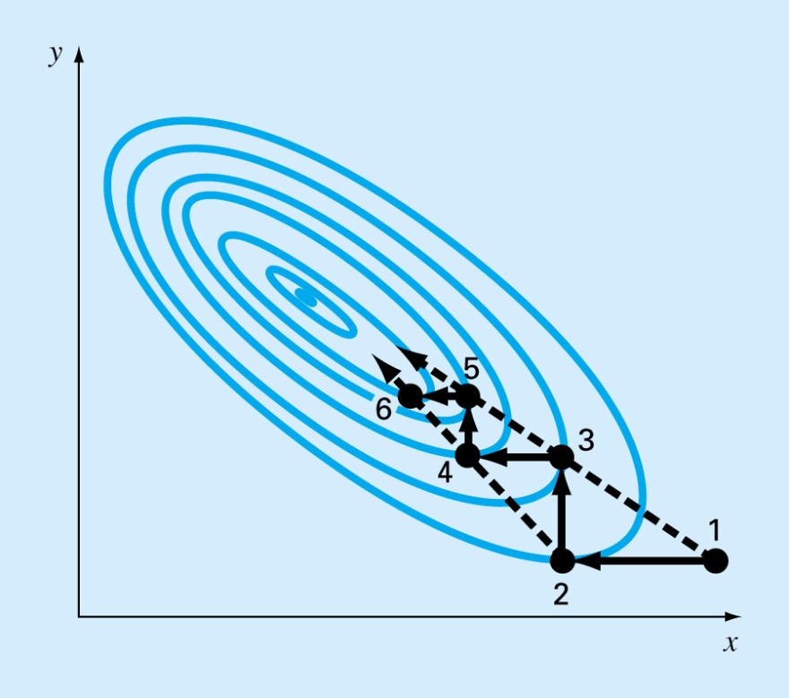
Direct Method (직접법)
Univariate Searchs
  change one variable at a time → become an 1-D problem
  start at point 1, and move along the x axis with y constant to the max. at point 2
  move along the y axis with x constant to point 3
  continue this process generating points 4, 5, 6

Slide 21
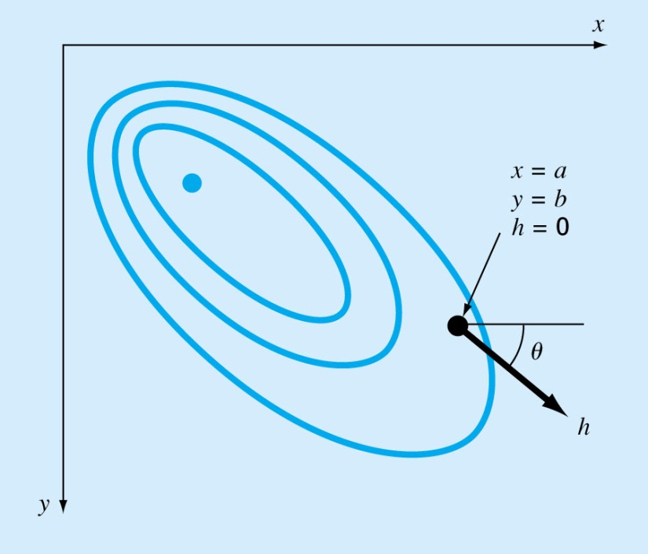
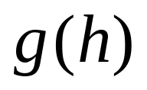
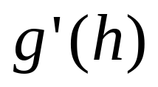
Gradient Methods (구배법)
Gradients and Hessians (구배)
  If you are at a specific location on a mountain (a,b) and want to know the slope in an arbitrary direction
  one way to define the direction is along a new axis h that forms an angle θ with the x axis
  The elevation function along h axis is
f(x, y)
the slope in the direction would be designated as

Slide 22
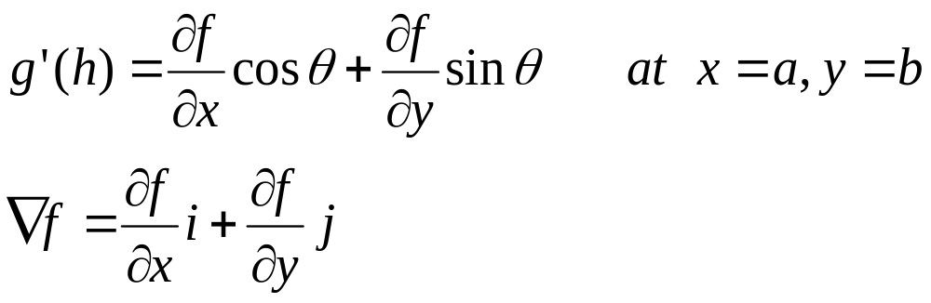
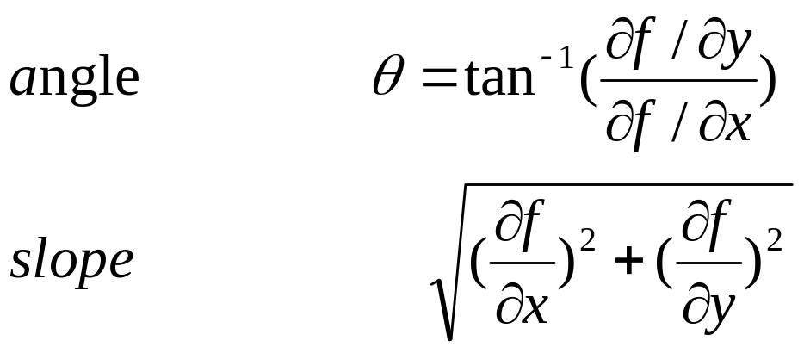
the directional derivative, slope can be calculated from
i and j are vectors
direction angle θ and the magnitude of slope

Slide 23
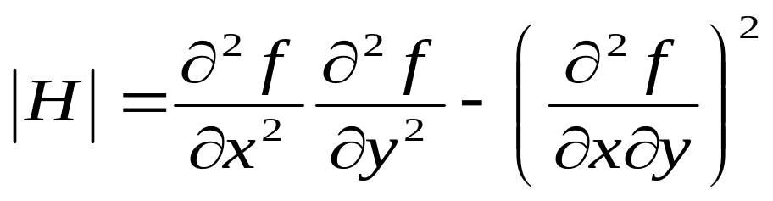
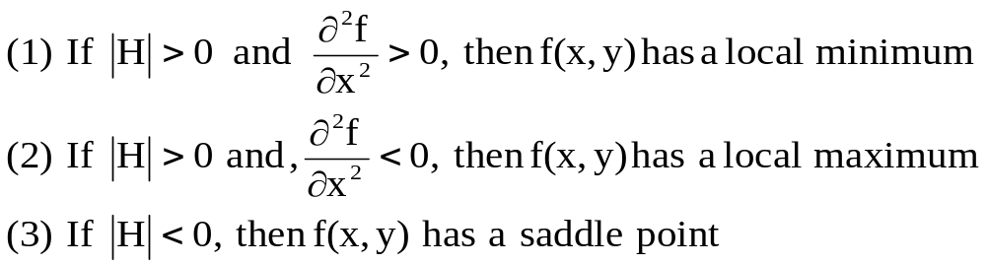
Hessians
Evaluation of Min. and Max. using Hessians

Slide 24
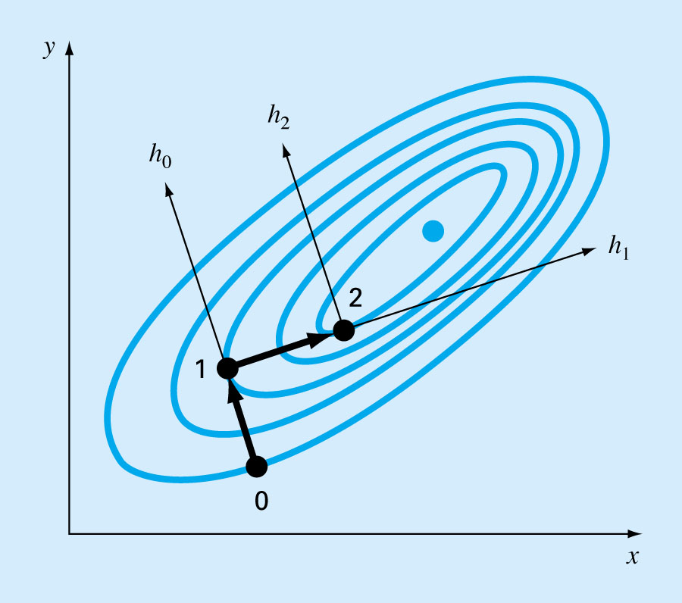
14.2.2 Steepest Ascent Method (최상향법)
Move in a fixed path along the initial gradient until f(x,y) stop increasing, that is, becomes level along your direction of travel
This stopping point becomes the starting point where the directional derivative is reevaluated and a new direction followed.
The process is repeated until the summit is reached
Start from point 0
Determine g(h)
Arrive at point 1 using g’(h) = 0
Re-determine g(h)
Arrive at point 2 using g’(h) = 0
Repeat it until converge

Slide 25
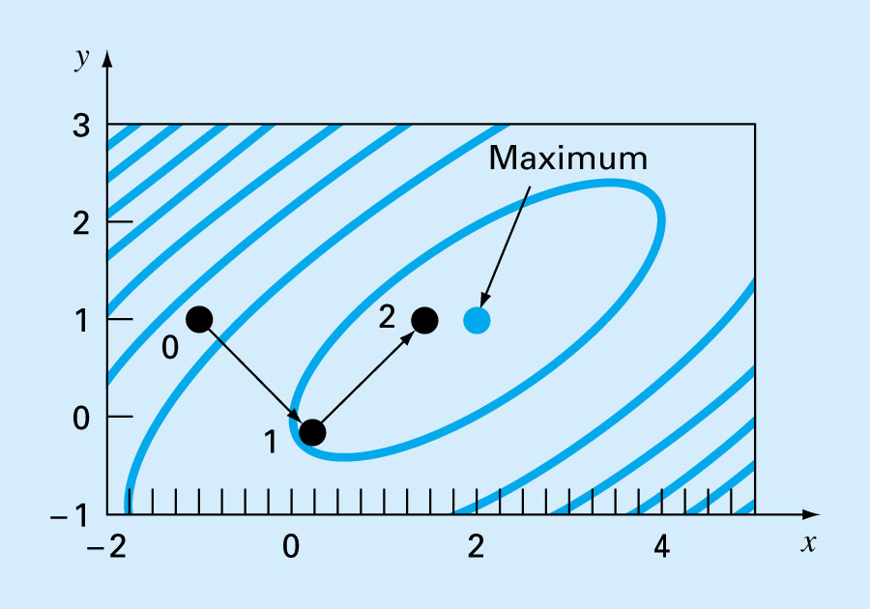
The results of optimal steepest ascent

Slide 26
Optimization
Constrained Optimization
(구속 최적화)

Slide 27

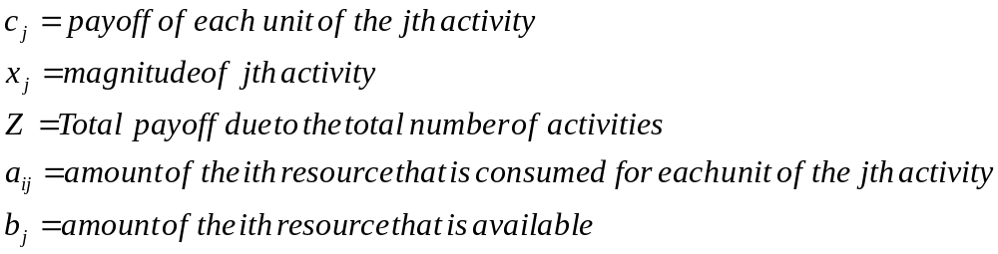
Linear Programming
Linear Programming
  The mathematical functions representing both the objective and the constraints are linear
  Deals with meeting a desired objective such as minimizing cost or maximizing profits in the presence of constraints such as limited resources
Objective function
Constraints

Slide 28
Setting up the LP Problem
Problem : produce product with limited resources
A gas-processing plant receive a fixed amount of raw gas each week
The raw gas is processed into two grades of gas, regular and premium quality
The production have constraints on both time and on-site storage
ton = 1000kg
Resource | Product |  | Resource Abailablility
 | Regular | Premium
Raw Gas | 7m³/ton | 11m³/ton | 77m³/week
Production time | 10hr/ton | 8hr/ton | 80hr/week
Storage | 9 tons | 6 tons
Profit | 150/ton | 175/ton

Slide 29
Ex. 14.1 Setting up the LP Problem
LP Formulation
If the amounts of regular and premium produced weekly are designated as x1 and x2, the total profit Z must have maximum
Objective function
maximize profits max Z = 150x₁+175x₂
Constraints
  Total gas used = 7x₁ +11x₂ ≤ 77
  Time constraint = 10x₁ +8x₂ ≤ 80
  Regular storage constraint = x₁ ≤ 9
  Premium storage constraint = x₂ ≤ 6
  positivity constraint x₁ ≥ 0
  positivity constraint x₂ ≥ 0

Slide 30
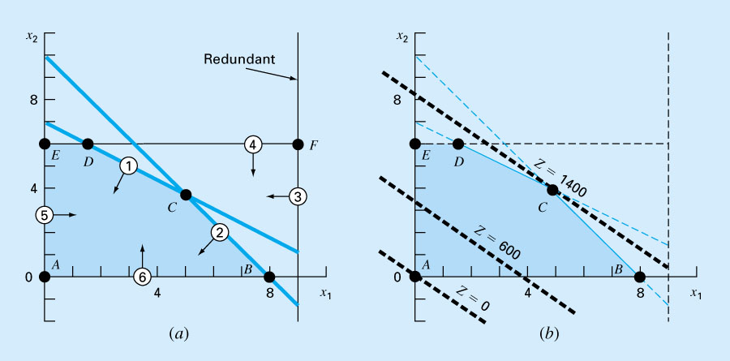
Graphical Solution of LP Problem
Extreme Points: A, B, C, D, E
Feasible solution space

Slide 31
Neural Network: Back-propagation

