Slide 1
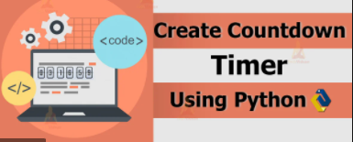
Count Down Timer
Coders: Horace
Original Coder: https://github.com/Count-Down-Timer

Slide 2

Python Libraries
Graphical User Interface (GUI) - Tkinker
Current Time – Time
Python Language version 3.9

Slide 3
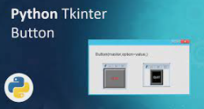
Tkinter
This library allows us to be able to import the utility for creating a Graphical User Interface (GUI).
The ease of use of this library imported into python makes the development process much easier due to encapsulation.

Slide 4
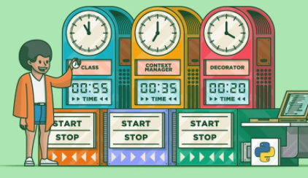
Timer
This library allows me to get the current system time no matter the respective time zone the host device is running in.
Here the application will denote a user specified time that will coincide with the actual time of the device using Inheritance.

Slide 5
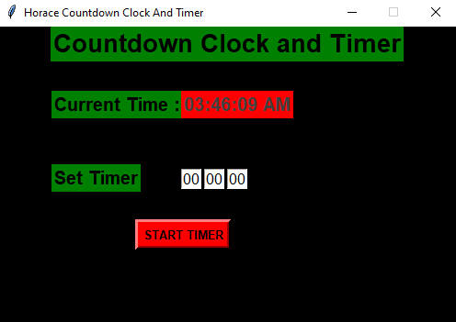
Running Application
This application is extremely user friendly. With very easy steps that allows any user to implement a functioning countdown.
In addition, if the user wanted to wait until a specific time to set the timer. He/She could by utilizing the active digital clock displayed above.

Slide 6

Principle Developer : Horace Buckle

