Slide 1
Week-12-FRI

Slide 2
Logistics...
Exam2? 4 vs. 5 Progams?
Make a decision Lillis!

Slide 3
Exam-2 ??
Take-Home?
Sorry...no...
WHEN: Monday,April 23, 6pm-8pm
WHERE: BSB 250
WHAT: Trees, Heaps/Priority Queues
(radix sort also fair game)
WHY: ...
Fall-2017 exam posted.

Slide 4
4 programs or 5 ?
Program 4: "optional"
Let s[i] be score on program i (as a %)
Let i_sad = ARG MIN(s[1], s[2])
s[i_sad] replaced with (1.5*s[4]+s[i_sad])/2.0

Slide 5
Prog 4
so...
not quite extra credit.
only upgrades p1 or p2
Even your p1, p2 were perfect, you can still boost one of them to 125% (up to about 1.75% toward your final grade)

Slide 6
Prog 4
Priority Queues / Heaps
Written in C
No nonsense in grading - don't submit junk hoping for a few points.

Slide 7
Prog 4
Summary:
adding map features to a priority-queue ADT.
Entries: <id, priority>

Slide 8
back to hashing...
string
x
h()
natural number
h(x)

Slide 9
Hashing a string to array idx
0
.
h(x)%T
string
x
h(x)
h()
%T
T-1

Slide 10
"Universe of Strings"
0
.
x
h()
%T
y
p
z
T-1

Slide 11
Collisions
In previous example:
h(p)%T == h(z)%T
This is called a "collision"

Slide 12
Collisions
... are unavoidable!
why? pigeonhole principle

Slide 13
0
.
p
z
Collision Resolution by:
"Separate Chaining"
x
y
p
x
z
y
T-1

Slide 14
General Idea
A "good" hash function:
distributes keys more-or-less uniformly.
Then:
lists are expected to have O(1) length...
O(1) lookup/insert/remove
ON AVERAGE

Slide 15
Here's a hash function
unsigned h0(char *s) {
unsigned h = 0;
while(*s != '\0'){
h += *s;
s++;
}
return h;
}
Can anyone explain what h0 does?

Slide 16
ASCII chars have numerical value
unsigned h0(char *s) {
unsigned h = 0;
while(*s != '\0'){
h += *s;
s++;
}
return h;
}
Can anyone explain what h0 does?
This just adds up the characters in the string

Slide 17
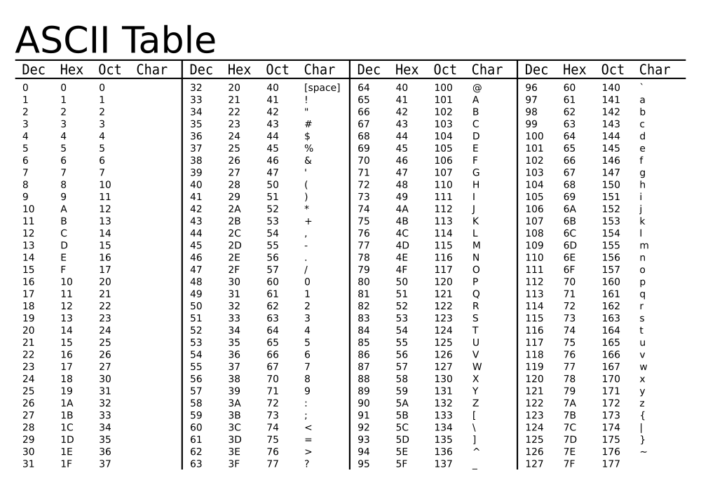

Slide 18
ASCII chars have numerical value
unsigned h0(char *s) {
unsigned h = 0;
while(*s != '\0'){
h += *s;
s++;
}
return h;
}
h0("cat"):
'c': 99
'a': 97
't': 116
--------
312

Slide 19
ASCII chars have numerical value
unsigned h0(char *s) {
unsigned h = 0;
while(*s != '\0'){
h += *s;
s++;
}
return h;
}
h0("cat")=312
= h0("tac")
= h0("act")
= h0("sad")
...

Slide 20
ASCII chars have numerical value
unsigned h0(char *s) {
unsigned h = 0;
while(*s != '\0'){
h += *s;
s++;
}
return h;
}
smallest h0():
h0("A")=65
Here is a "big" h0:
h0("noteworthinesses"): 1764
# words in my 'big' dictionary:
~250k

Slide 21
another hash function
#define BASE <SOME-CONSTANT>
unsigned h1(char *s) {
unsigned h=0;
while(*s != '\0') {
h = h*BASE + *s;
s++;
}
return h;
}
Suppose Base=10
h1("cat") = 100x'c' + 10x'a' + 't'
= 10986
h1("act") = 100x'a' + 10x'c' + 't'
= 10806

Slide 22
Another well regarded hash function
// DJB = UIC's own Daniel Bernstein
unsigned djb(char *str){
unsigned long hash = 5381;
int c;
while ((c = *str++) != '\0')
hash = ((hash << 5) + hash) + c;
/* hash * 33 + c */
return hash;
}

Slide 23
XOR variant
unsigned djbXOR(char *str){
unsigned long hash = 5381;
int c;
while ((c = *str++) != '\0')
hash = hash * 33 ^ c; // xor
return hash;
}

Slide 24
Demos!

Slide 26
A Map ADT: generalization of SET
Collection of (key, value) pairs
keys form a set
values can be duplicated

Slide 27
hmap.h
typedef unsigned (*HFUNC)(char *);
/**
* sets hash function to user-specified hfunc if table
* empty (and returns 1).
* if table non-empty, hash function is unchanged and
* zero is returned.
* \param desc is a string descibing the hash function.
*/
extern int
hmap_set_user_hfunc(HMAP * map, HFUNC hfunc, char *desc);

Slide 28
from client test.c
// NOTE: djb and djbXOR both defined in test.c
HMAP *dict2 = hmap_create(0,1.0);
HMAP *dict3 = hmap_create(0,1.0);
hmap_set_user_hfunc(dict2, djb, "DJB hash function");
hmap_set_user_hfunc(dict3, djbXOR, "DJB XOR hash function");

Slide 29
hmap.c internals
typedef struct node_struct {
struct node_struct *next;
char *key;
void *val;
unsigned hval;
}NODE;
typedef struct {
NODE *members;
int n;
} TBL_ENTRY;

Slide 30
hmap.c internals (cont)
struct hmap {
TBL_ENTRY *tbl;
int tsize;
int n;
double lfactor;
int max_n;
HFUNC hfunc;
char *hfunc_desc;
};
typedef struct {
HFUNC hfunc;
char *description;
} HFUNC_STRUCT;

Slide 31
hmap.c internals (cont)
/***** GLOBALS TO THIS FILE ******/
static HFUNC_STRUCT HashFunctions[] =
{
{h0, "naive char sum"},
{h1, "weighted char sum"}
};

Slide 33
A Map ADT: generalization of SET
map_set(map, key, val);
<val-type> map_get(map, key);

Slide 34
A Map ADT: application ex
Given: some text
Determine: frequency of each word.
Map: strings -> int

Slide 35
A nifty application
Given: dictionary
Objective:
Build a data structure for easily solving the "JUMBLE"

Slide 36
JUMBLE
ESTAK
Anagrams in Dictionary
STAKE STEAK TAKES SKATE

Slide 37
Sneaky Trick...
Sort string at the letter-level.
AEKST
All anagrams sort to the same string!
STAKE STEAK TAKES SKATE

Slide 38
Comments
The collection of letters in a word is a
"Multi-Set" (duplicates allowed).
Anagrams: re-orderings of the same multi-set.
Sorted version: "canonical" representation of multi-set

Slide 39
Map Idea
KEY:
given string str sorted at letter-level
VAL:
list of all dictionary words that are anagrams of str

