Slide 1
Week 12 - WED

Slide 2
Building a Heap From n given elements: TOP-DOWN
// "top-down"
void td_build_heap(double h[], int n){
int i;
for(i=2; i<=n; i++)
perc_up(h, i);
}

Slide 3
Top-Down

Slide 4
Building a Heap From n given elements: BOTTOM-UP
// bottom-up
void bu_build_heap(double h[], int n){
int i;
for(i=n/2; i>0; i--)
perc_down(h, i, n);
}

Slide 5
Bottom-Up

Slide 6
Worst-case runtime of top-down build-heap?
Θ(Nlog(N))
Θ(N)
Θ(N²)

Slide 7
Bottom-Up: why O(N)
Idea:
Time/perc-down:
at most height of
subtree.
Total:
sum of all subtree
heights.

Slide 8
2x4+3=11
h | S(h) | 2^{h}
0 | 0 | 1
1 | 1 | 2
2 | 4 | 4
3 | 11 | 8
4 | 26 | 16
5 | 57 | 32
6 | 120 | 64
7 | 247 | 128
8 | 501 | 256
3
1+1+2=4
2
2
1+1+2=4
0+0+1=1
1
1
1
1
0+0+1=1
0
0
0
0
0
0
0
0
S(h): sum of subtree heights for a
complete binary tree of
height h.
Recurrence Relation:
S(0) = 0
S(h) = 2S(h-1) + h for h>0
S(h)=2^{h+1} - (h+2)
(Easy inductive proof)
CONJECTURE?

Slide 9
Maximum Work for Bottom-Up Build-Heap:
S(h) = 2^{h+1} - (h+2)
Relation to N?
Recall: N=2^{h+1}-1
Hey: S(h) < N
TOTAL RUNTIME:
O(N)

Slide 10
Bottom-Up Build Heap
Θ(N) worst-case runtime !!!
Many ways to see this...
Let’s re-write bottom-up as a recursive procedure.

Slide 11
Recursive View of Bottom-Up Build-Heap
Given root of subtree to heapify:
recursively heapify left and right subtrees
perform a percolate-down from root

Slide 12
Recursive View of Bottom-Up Build-Heap
/* r: root of subtree to heapify.
** n: number of elements in tree (h[1..n]
*/
void r_build_heap(double h[], int r, int n) {
if(r > n/2) // leaf (already a heap) or out of bounds
return;
r_build_heap(h, 2*r, n); // heapify left subtree
r_build_heap(h, 2*r+1, n); // heapify right subtree
perc_down(h, r, n);
}

Slide 13
Recursive View of Bottom-Up Build-Heap
Recurrence Relation When Viewed This Way?
T(N) = 2T(N/2) + log N
This turns out to be Θ(N).
Try the Master Thm

Slide 15
Heapsort
So far: “Min-Heaps”
min element at root
supports delete_min operation
Sometimes we want a “Max-Heap” supporting delete_max instead.
Easy enough right?

Slide 16
After build heap, GREEN elements are the heap:
X | z
1
n
z
X
1
n
a[i] = delete_max(a, n);
z
X
z
1
n/i
n/i

Slide 17
Heapsort
void hsort(double a[], int n) {
int i;
build_max_heap(a, n);
i=n;
while(n>0) {
a[i] = delete_max(a, n);
i--; n--;
}
}

Slide 18
Is HeapSort a Comparison-Based Algorithm?
A. YES!
B. NO!
YES!

Slide 19
HeapSort Worst-Case Runtime?
A. Θ(N)
B. Θ(Nlog(N))
C. Θ(N²)

Slide 20
HeapSort Worst-Case Runtime?
A. Θ(N)
B. Θ(NlogN)
C. Θ(N²)
TOTAL:
TIME TO BUILD HEAP
PLUS
TIME FOR N-1 delete_max OPS
O(N)
O(NlogN)
O(NlogN) dominates...

Slide 22
sets of ints: implementations?
IDEA: BIT-VECTOR of length M+1
Example: M=16
{4, 8, 12, 3, 9, 0, 14, 15}
s[i]
idx i
1 | 0 | 0 | 1 | 1 | 0 | 0 | 0 | 1 | 1 | 0 | 1 | 0 | 1 | 1
0 | 1 | 2 | 3 | 4 | 5 | 6 | 7 | 8 | 9 | 11 | 12 | 13 | 14 | 15
x ∈ S iff s[x]==1

Slide 23
sets of ints - implementations?
IDEA: Bit-Vector
Worst-Case Runtime For Each Operation?
insert
contains
remove
O(1)
O(1)
O(1)
YAY!

Slide 24
Bit-Vectors
Great for Subsets of {0..M-1} as long as
M isn't too large and
insert, contains, remove are key ops.
How about sets drawn from other "Universes"?
Sets of arbitrary integers?
Sets of floating point numbers?
Sets of strings?

Slide 25
Sets of Strings?
Some Examples:
Spell checkers
Black/White-listed URLs
Compilers - "symbol tables":
tracking symbols defined in current scope
interpreted languages - tracking variables (and values...) at runtime (e.g., python).
email addresses (spam filters?)
etc., etc., etc.
Same ops:
insert
remove
contains
Tons of Apps:
(brainstorm..)

Slide 26
Set-of-strings Implementations?
Can we get BIT-VECTOR like behavior somehow:
O(1) insert, contains, remove??
We can get close using:
Hashing!

Slide 27
Bit-vector like behavior for strings?
Strings as indices?
Not directly for sure...
But...
Let S be the set of all strings.
Imagine a function:
h: S→N
(from strings to natural numbers)
Bit-Vector:
elements ↔ array indices
Sets of strings?
treat a string as an array (table) index?
somehow?

Slide 28
string
x
h()
natural number
h(x)

Slide 29
Hashing a string to array idx
0
.
h(x)%T
string
x
h(x)
h()
%T
T-1

Slide 30
"Universe of Strings"
0
.
x
h()
%T
y
p
z
T-1

Slide 31
Collisions
In previous example:
h(p)%T == h(z)%T
This is called a "collision"

Slide 32
Collisions
... are unavoidable!
why? pigeonhole principle

Slide 33
0
.
p
z
Collision Resolution by:
"Separate Chaining"
x
y
p
x
z
y
T-1

Slide 34
General Idea
A "good" hash function:
distributes keys more-or-less uniformly.
Then:
lists are expected to have O(1) length...
O(1) lookup/insert/remove
ON AVERAGE

Slide 35
Here's a hash function
unsigned h0(char *s) {
unsigned h = 0;
while(*s != '\0'){
h += *s;
s++;
}
return h;
}
Can anyone explain what h0 does?

Slide 36
ASCII chars have numerical value
unsigned h0(char *s) {
unsigned h = 0;
while(*s != '\0'){
h += *s;
s++;
}
return h;
}
Can anyone explain what h0 does?
This just adds up the characters in the string

Slide 37
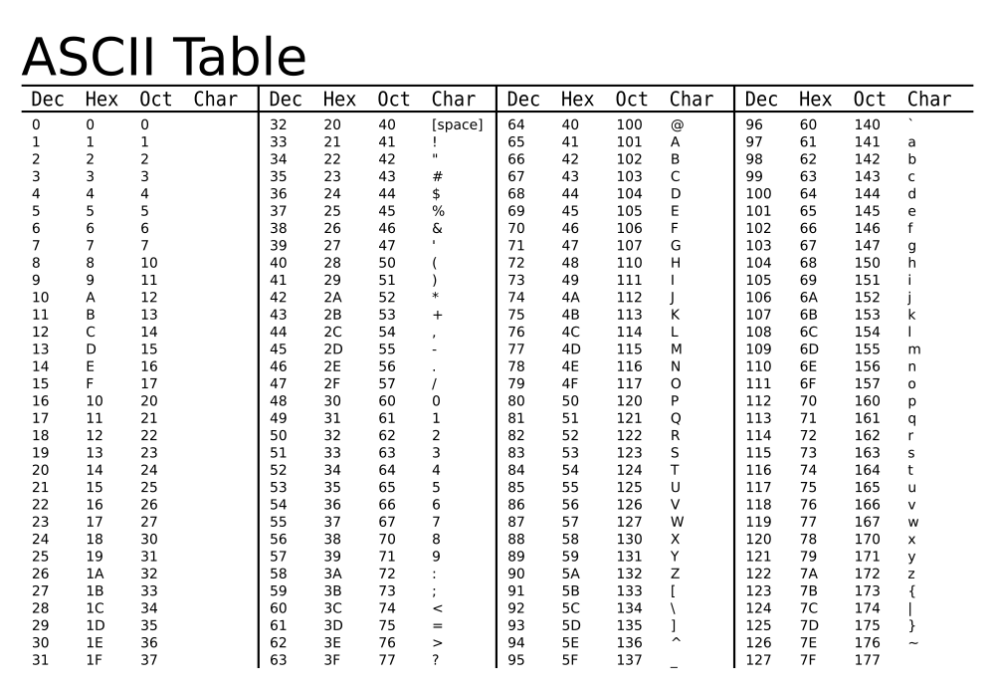

Slide 38
ASCII chars have numerical value
unsigned h0(char *s) {
unsigned h = 0;
while(*s != '\0'){
h += *s;
s++;
}
return h;
}
h0("cat"):
'c': 99
'a': 97
't': 116
--------
312

Slide 39
ASCII chars have numerical value
unsigned h0(char *s) {
unsigned h = 0;
while(*s != '\0'){
h += *s;
s++;
}
return h;
}
h0("cat")=312
= h0("tac")
= h0("act")
= h0("sad")
...

Slide 40
ASCII chars have numerical value
unsigned h0(char *s) {
unsigned h = 0;
while(*s != '\0'){
h += *s;
s++;
}
return h;
}
smallest h0():
h0("A")=65
Here is a "big" h0:
h0("noteworthinesses"): 1764
# words in my 'big' dictionary:
~250k

Slide 41
another hash function
#define BASE <SOME-CONSTANT>
unsigned h1(char *s) {
unsigned h=0;
while(*s != '\0') {
h = h*BASE + *s;
s++;
}
return h;
}
Suppose Base=10
h1("cat") = 100x'c' + 10x'a' + 't'
= 10986
h1("act") = 100x'a' + 10x'c' + 't'
= 10806

Slide 42
A Map ADT: generalization of SET
Collection of (key, value) pairs
keys form a set
values can be duplicated

Slide 44
clickers
QUESTION 1: Number of nodes in a complete binary tree of height h=
A. 2^{h}
B. h²
C. 2^{h+1}
D. 2^{h+1}-1

Slide 45
Question: How many nodes does a complete binary tree of height h have? h 2^{h} h 2^{h+1} -1

Slide 46
Question: How many nodes does a complete binary tree of height h have? h 2^{h} h 2^{h+1} -1

Slide 47
QUESTION: Given a binary heap with N elements/nodes, what is the maximum number of nodes that can have exactly 1 child. N log N 1 0

Slide 48
QUESTION: Given a binary heap with N elements/nodes, what is the maximum number of nodes that can have exactly 1 child. N log N 1 0

Slide 49
QUESTION: Is HEAP-SORT in-place? YES NO

Slide 50
QUESTION: Is HEAP-SORT in-place? YES NO

Slide 51
QUESTION: Is HEAP-SORT stable? YES NO

Slide 52
QUESTION: Is HEAP-SORT stable? YES NO
What happens to equal elements? For simplicity: if all are equal?

Slide 53
QUESTION: The recurrence relation below describes the runtime of which well-known algorithm: T(n) = 2T(n/2) + log n merge-sort AVL rotation bottom-up build-heap top-down build heap

Slide 54
QUESTION: The recurrence relation below describes the runtime of which well-known algorithm: T(n) = 2T(n/2) + log n merge-sort AVL rotation bottom-up build-heap top-down build heap

Slide 55
QUESTION: consider the recurrence relation below: T(n) = 2T(n/2) + log n Which statement is correct? T(n) = ϴ(n²) T(n) = ϴ(nlog n) T(n) = ϴ(n)

Slide 56
QUESTION: consider the recurrence relation below: T(n) = 2T(n/2) + log n Which statement is correct? T(n) = ϴ(n²) T(n) = ϴ(nlog n) T(n) = ϴ(n)

Slide 57
QUESTION: TRUE or FALSE: AVL trees are size-balanced by definition TRUE FALSE

Slide 58
QUESTION: TRUE or FALSE: AVL trees are size-balanced by definition. TRUE FALSE
AVL trees are height balanced

Slide 59
QUESTION: TRUE or FALSE - If an AVL insertion results in a rotation, the node at which the rotation took place is the violating node closest to the root of the overall tree. TRUE FALSE

Slide 60
QUESTION: TRUE or FALSE - If an AVL insertion results in a rotation, the node at which the rotation took place is the violating node closest to the root of the overall tree. TRUE FALSE
The rotation happens at the violating node closest to the insertion point

Slide 61
QUESTION: Worst-case insertion for AVL trees is: Θ(N) Θ(1) Θ(log N)

Slide 62
QUESTION: Worst-case insertion for AVL trees is: Θ(N) Θ(1) Θ(log N)
AVL property guarantees log-height and any rotations on insertion happen along the insertion path.

Slide 63
QUESTION: Worst-case insertion/lookup for Size-Balanced trees is: Θ(N) Θ(1) Θ(log N)

Slide 64
QUESTION: Worst-case insertion for Size-Balanced trees is: Θ(N) Θ(1) Θ(log N)
in the worst case, an insertion results in a re-balance at the root which is a linear time operation.

Slide 65
QUESTION: A sequence of N insertions into an initially empty size-balanced tree will take how long in the worst case? Θ(N²) Θ(N) Θ(Nlog N)

Slide 66
QUESTION: A sequence of N insertions into an initially empty size-balanced tree will take how long in the worst case? Θ(N²) Θ(N) Θ(Nlog N)
the amortized time per insertion is O(log N)

Slide 67
QUESTION: Among all AVL trees of height 1, what is the MINIMUM number of nodes possible? 1 2 3

Slide 68
QUESTION: Among all AVL trees of height 1, what is the MINIMUM number of nodes possible? 1 2 3

Slide 69
QUESTION: Among all AVL trees of height 2, what is the MINIMUM number of nodes possible? 1 2 3 4

Slide 70
QUESTION: Among all AVL trees of height 2, what is the MINIMUM number of nodes possible? 3 4 5 7

Slide 71
QUESTION: Among all AVL trees of height 2, what is the MINIMUM number of nodes possible? 3 4 5 7

Slide 72
QUESTION: Among all AVL trees of height 3, what is the MINIMUM number of nodes possible? 5 6 7 8

Slide 73
QUESTION: Among all AVL trees of height 3, what is the MINIMUM number of nodes possible? 5 6 7 8

Slide 74
QUESTION: let N(h) be the minimum number of nodes in an AVL tree of height h. We know: N(0) = 1 N(1) = 2 Which recursive rule is correct for h>1 ? N(h) = 2N(h-1)+1 N(h) = N(h-1)+ N(h-2)+1 N(h) = 2N(h-1)+h N(h) = N(h-1)+ N(h-2)+ 2^{h} N(h) = N(h-1)+ N(h-2)+ h

Slide 75
QUESTION: let N(h) be the minimum number of nodes in an AVL tree of height h. We know: N(0) = 1 N(1) = 2 Which recursive rule is correct for h>1 ? N(h) = 2N(h-1)+1 N(h) = N(h-1)+ N(h-2)+1 N(h) = 2N(h-1)+h N(h) = N(h-1)+ N(h-2)+ 2^{h} N(h) = N(h-1)+ N(h-2)+ h

Slide 76
QUESTION: Among all AVL trees of height 6, what is the MINIMUM number of nodes possible? 20 64 63 33 127

Slide 77
QUESTION: Among all AVL trees of height 6, what is the MINIMUM number of nodes possible? 20 64 63 33 127

Slide 78
QUESTION: Among all AVL trees of height 6, what is the MINIMUM number of nodes possible? 20 64 63 33 127
N(0) = 1
N(1) = 2
N(2) = N(2)+N(1)+1 = 2+1+1 = 4
N(3) = 4+2+1 = 7
N(4) = 7+4+1 = 12
N(5) = 7+12+1 = 20
N(6) = 20+12+1 = 33

Slide 79
QUESTION: In a Min-Heap, the left child of a node is <= the right child. TRUE FALSE

Slide 80
QUESTION: In a Min-Heap, the left child of a node is < the right child. TRUE FALSE
A binary heap IS NOT A BST!

Slide 81
Brain teaser
Given an array of elements that is “d-nearly-sorted”, sort it in O(nlog d) time.
D-nearly-sorted: if x is given in position i, it will be between indices i-d and i+d in the sorted output.

