Slide 1
Week 13 - MON

Slide 2
Prog-3
A. DONE!
B. Almost...
C. Half-way
D. ¼ way
E. other

Slide 3
A Map ADT: generalization of SET
Collection of (key, value) pairs
keys form a set
values can be duplicated

Slide 4
A Map ADT: operations?
set(Map, key, val) // if key already in map
// update value
// else create new entry
delete(Map, key) // remove entry for key
get(Map, key) // return associated value

Slide 5
A Map ADT: what can be a "value"
Virtually Anything!
Does not have to be a scalar
Can be a complex data structure itself.

Slide 6
Natural Implementation of a MAP:
Hash-Table (hashing on keys).

Slide 8
Discussion: case-studies of applications of hash-tables/maps

Slide 9
Example: word frequency
Given: some text
Determine: frequency of each word.
Map: strings -> int

Slide 10
Example: removing duplicates
PROBLEM: Given a linked list of strings, remove all duplicates.

Slide 11
Example: sorting with lots of duplicates
Formulation: standard sorting formulation.
(Given: N elements to sort).
Extra Info: Lots of duplicates:
Only M distinct values.
M << N.

Slide 12
Example: finding a pair
Given: N integers (in arbitrary order)
Target sum S
Task: Determine if there are two elements
adding up to S.

Slide 13
Example: generating the index of a book
Given: text organized into pages
Task: construct an index for the book
Map? From? To?

Slide 14
A nifty application: JUMBLE
Given: dictionary
Objective:
Build a data structure for easily solving the "JUMBLE"

Slide 15
JUMBLE
ESTAK
Anagrams in Dictionary
STAKE STEAK TAKES SKATE

Slide 16
Sneaky Trick...
Sort string at the letter-level.
AEKST
All anagrams sort to the same string!
STAKE STEAK TAKES SKATE

Slide 17
Comments
The collection of letters in a word is a
"Multi-Set" (duplicates allowed).
Anagrams: re-orderings of the same multi-set.
Sorted version: "canonical" representation of multi-set

Slide 18
Map Idea
KEY:
given string str sorted at letter-level
VAL:
list of all dictionary words that are anagrams of str

Slide 19
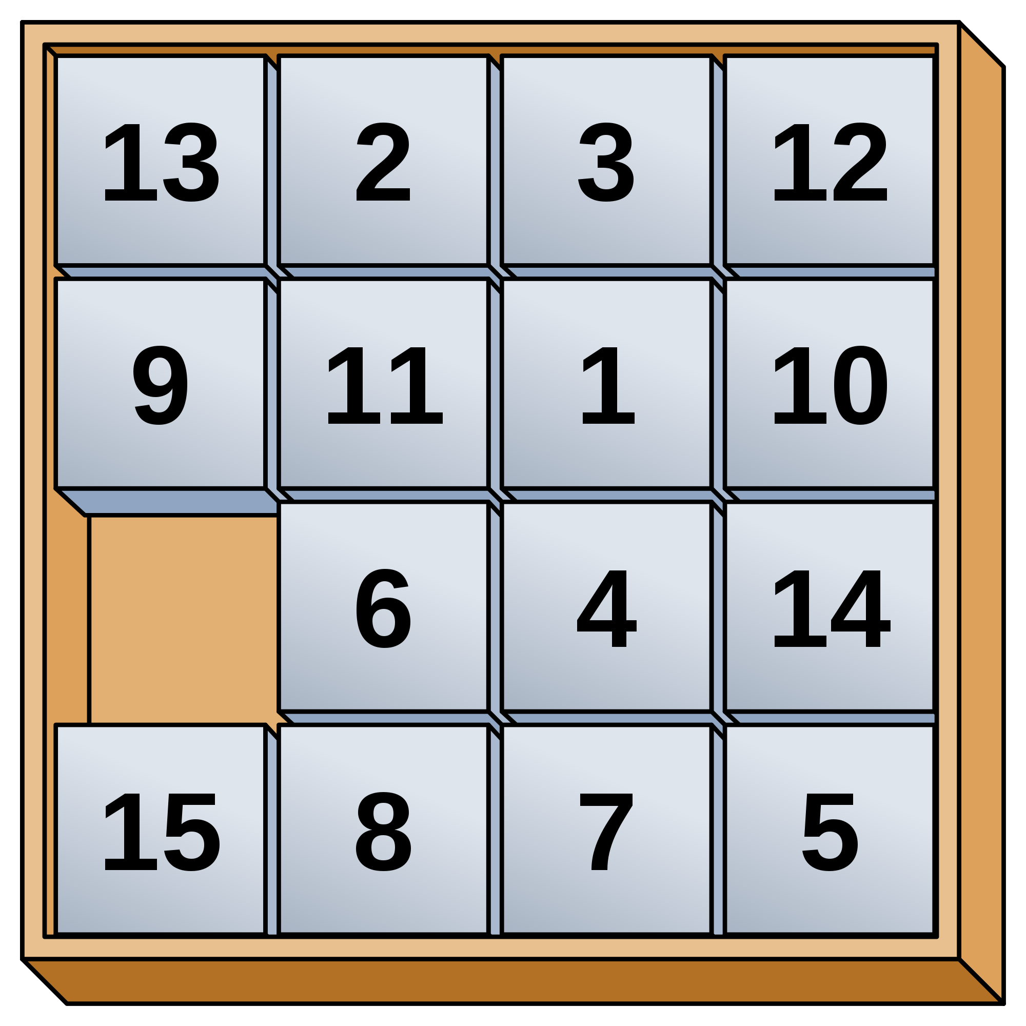
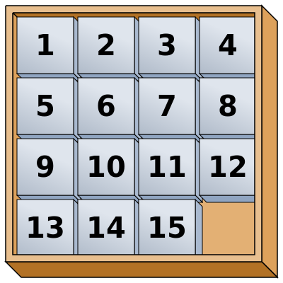
Example: searching
Suppose we want a program to solve the 15-puzzle.
Board configuration : "state"
Goal: sequence of moves ending in goal state / board.
Each board has up to 4 neighboring boards.
Issue: don't want to spin around a loop forever!
Basic question: "Have I visited board X before?"

