Slide 1
CS 3630 Project 5
Team 1
Team 2
Name: Fei Ding
GT username: fding33
GTID: 903444656
Team #: 19
Name: Francis Kim
GT username: fkim30
GTID: 903281773
Team #: 76
Name: Zhen Jiang
GT username: zjiang330
GTID: 903402987
Team #: 19
Name: Eric Yan
GT username: eyan30
GTID: 903195858
Team #: 76

Slide 2
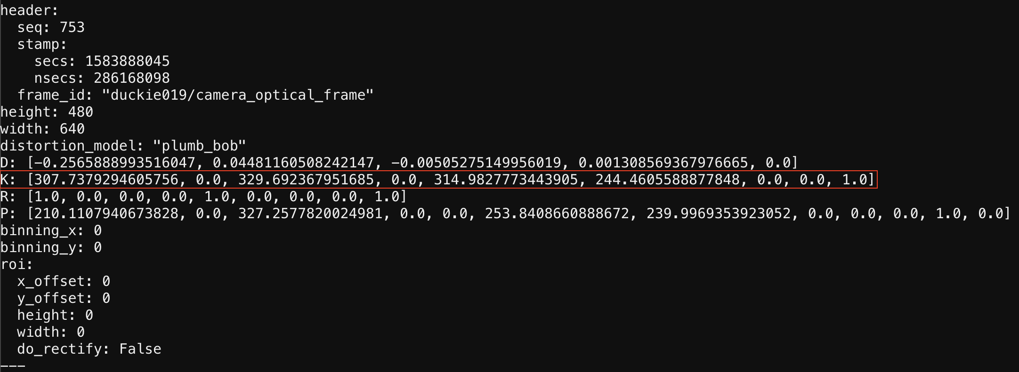
Provide a screenshot of Internal Camera Matrix (K) from the command line and the calculated value of Focal length
i.) <screenshot here>
ii.) (307.737929460576 + 314.9827773443905) / 2 = 311.36035340248327

Slide 3
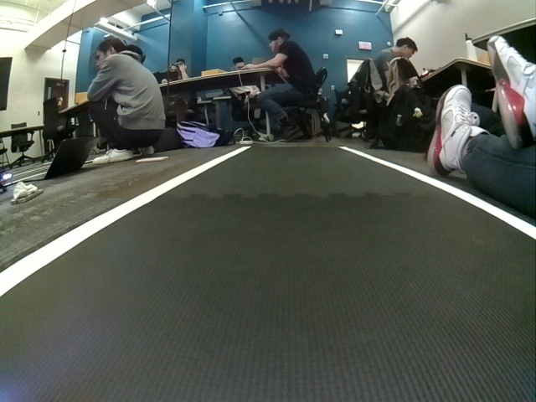
2. Provide a screenshot of one of the 20 images captured by the camera and the link to Google Drive folder with saved images.
i.) <screenshot here>
ii.)
https://drive.google.com/drive/folders/10J2pC23o0iTWFTdcmPer4oQpOavY2pit?usp=sharing

Slide 4
3. Enter the pose of the end point [x,y,theta] (Note: x,y to be entered in cm, theta in degrees)
[-2.86 cm, 107.3 cm, 2 deg]

Slide 5
4. Enter the height of the camera (in cm)
9.8 cm

Slide 6
5. Explain why changing the focal length of the camera affects image quality?
Adjusting the focal length of the camera helps focus on objects from different distances. In other words, the focal length decides the scene depth of the camera view. The pinhole camera example also suggests by varying the focal length we change where the projection materializes. If set incorrectly, the focal length can result in the desired object being projected either behind the image plane or after, producing blurry images. If you can gauge the depth of the object and set the focal length properly, the image produced will be sharp. The focal length can also affect the angle of view. A shorter focal length corresponds to a broader view, whereas longer focal length narrows your view and makes object larger. However, since we only change it slightly, the first effect is more significant than the second, and indeed as we tried in lab even changing the focal length slightly can dramatically affect the image quality yet leave the size of the objects nearly unaffected.

Slide 7
6. Specify the challenges faced during the lab
This lab was indeed the most exciting one I have attended because finally we could truly play around with the Duckie Bot in an artificial setting. However, there were still a few challenges we had to face, but all of them were solved by our ambitious team. First, the lab was quite crowded, so we waited a while before getting our bot onto the “road”. We made use of the waiting time by doing some final adjustments such as ensuring that the camera is set to right focal length. Second, a lot of metrics, such as camera height, camera pitch, and final pose, are quite hard to obtain accurately, but we managed to get as close as possible by taking several readings and confirming with the TAs the way we measured them. Lastly, as always we had to deal with the random motions exhibited by our bot, but thanks to the effective trimming set, it did not take too long before we captured an ideal trajectory. Overall, this lab was both challenging and fun!

