Slide 1
CS 3630 Project 6
Name: Fei Ding
GT email: fding33@gatech.edu
GT username: fding33
GTID: 903444656

Slide 2
1. What data was given to you to complete this project? How did you use it?
I was given 180 LIDAR scans of a car making a left turn and moving on a street in Miami. Each LIDAR scan consists of over 80,000 points that collectively form a point cloud that produces a fuzzy representation of car’s surrounding including roads and obstacles. My goal is to use the continuous stream of point clouds to perform a SLAM on the car. I first implemented ICP algorithm given two point clouds, which will return a transformation from the initial point cloud to the target. Then, I used GTSAM to produce a factor graph, where each transform estimated by ICP becomes a factor between pose variables. Finally, the GTSAM shoes its real power by optimizing the car poses in the world coordinate and mapping them back to the point clouds. As a result, I am able to both view the street map and how the car has moved in the point cloud model, thus the two goals of SLAM.

Slide 3
2. If you used LIDAR information from just one frame to create a map, what would the map be missing that make it not-so-helpful?
The map constructed from one LIDAR scan will lack details: since we have fewer number of points in the cloud and possible noises, we may not know precisely the shapes of all obstacles; meanwhile, without a continuous stream of LIDAR scans while the vehicle is constantly moving and changing its pose, the map will only be partial but not covering all parts of the world the vehicle has travelled, since what the vehicle can see in one scan is limited as the obstacles can block LIDAR signals. Another disadvantage with using only one LIDAR scan is associated with uncertainty: the noise from moving objects may be picked up by the scan, but we are truly interested in the static components of the world, and thus using a stream of scans will hopefully remove such noise when we apply the ICP algorithm.

Slide 4
3. What is the Iterative Closest Point (ICP) algorithm? Explain briefly.
The goal of the ICP algorithm is to estimate the transform between two sets of points. To do this, we will start with a guess of transform, and tentatively apply that transform to the set of initial points. Then, we will assign each point in point set A to their closest neighbor in set B and use this new set of points along with original set B to estimate the transformation parameters using least squares. Once we compute the new transform, we repeatedly apply the calculated transform in each iteration to the current set A to get closer to B until the change is very small. Finally, we stack up (compose) all the transforms applied in sequence to get the direct transform from set A to B. Now the ICP has estimated the one-time transform from pose A to pose B by aligning two point clouds.

Slide 5
4. How did you use the ICP algorithm in this project?
The ICP algorithm is more like a tool helping us determine the transform between two point clouds captured by the LIDAR scan. To accomplish SLAM which is the main goal of this project, we combine ICP with factor graph (another way of modeling Dynamic Bayes Net). Particularly, ICP helps us determine the transform between two frames of poses. In the factor graph, they become the factors between two pose variables. As done in this project, we apply ICP between each two consecutive frames to derive one factor. To get better results, we enhanced the factor graph by applying ICP again between every other pose variables to minimize the effect of noisy LIDAR sensors. This technique is called “skipping” and should make our results consistently reliable. Finally, we will optimize the factor graph to do the SLAM, so ICP is a crucial part of this streamlined process.

Slide 6
5. What is a factor graph? How was it used in this project?
A factor graph is a bipartite graph model of random variables and factors. Factors describe the dependencies and relations of the variables. It is similar to Bayes net and in fact a Bayes net can easily be converted into a factor graph. However, in factor graph each factor is a function of variables it connects to, and by abstracting the relations into functions we analyze the network more easily. The factor graph in this project helps us model the transition of vehicle poses in the real world. After applying the ICP algorithm between each consecutive / every other frame, we add in a new factor between pose variables to complete constructing the factor graph. With the factor graph model, we can optimize the poses by using the powerful GTSAM and finally be able to the SLAM with the 180 LIDAR scans provided in the project.

Slide 7
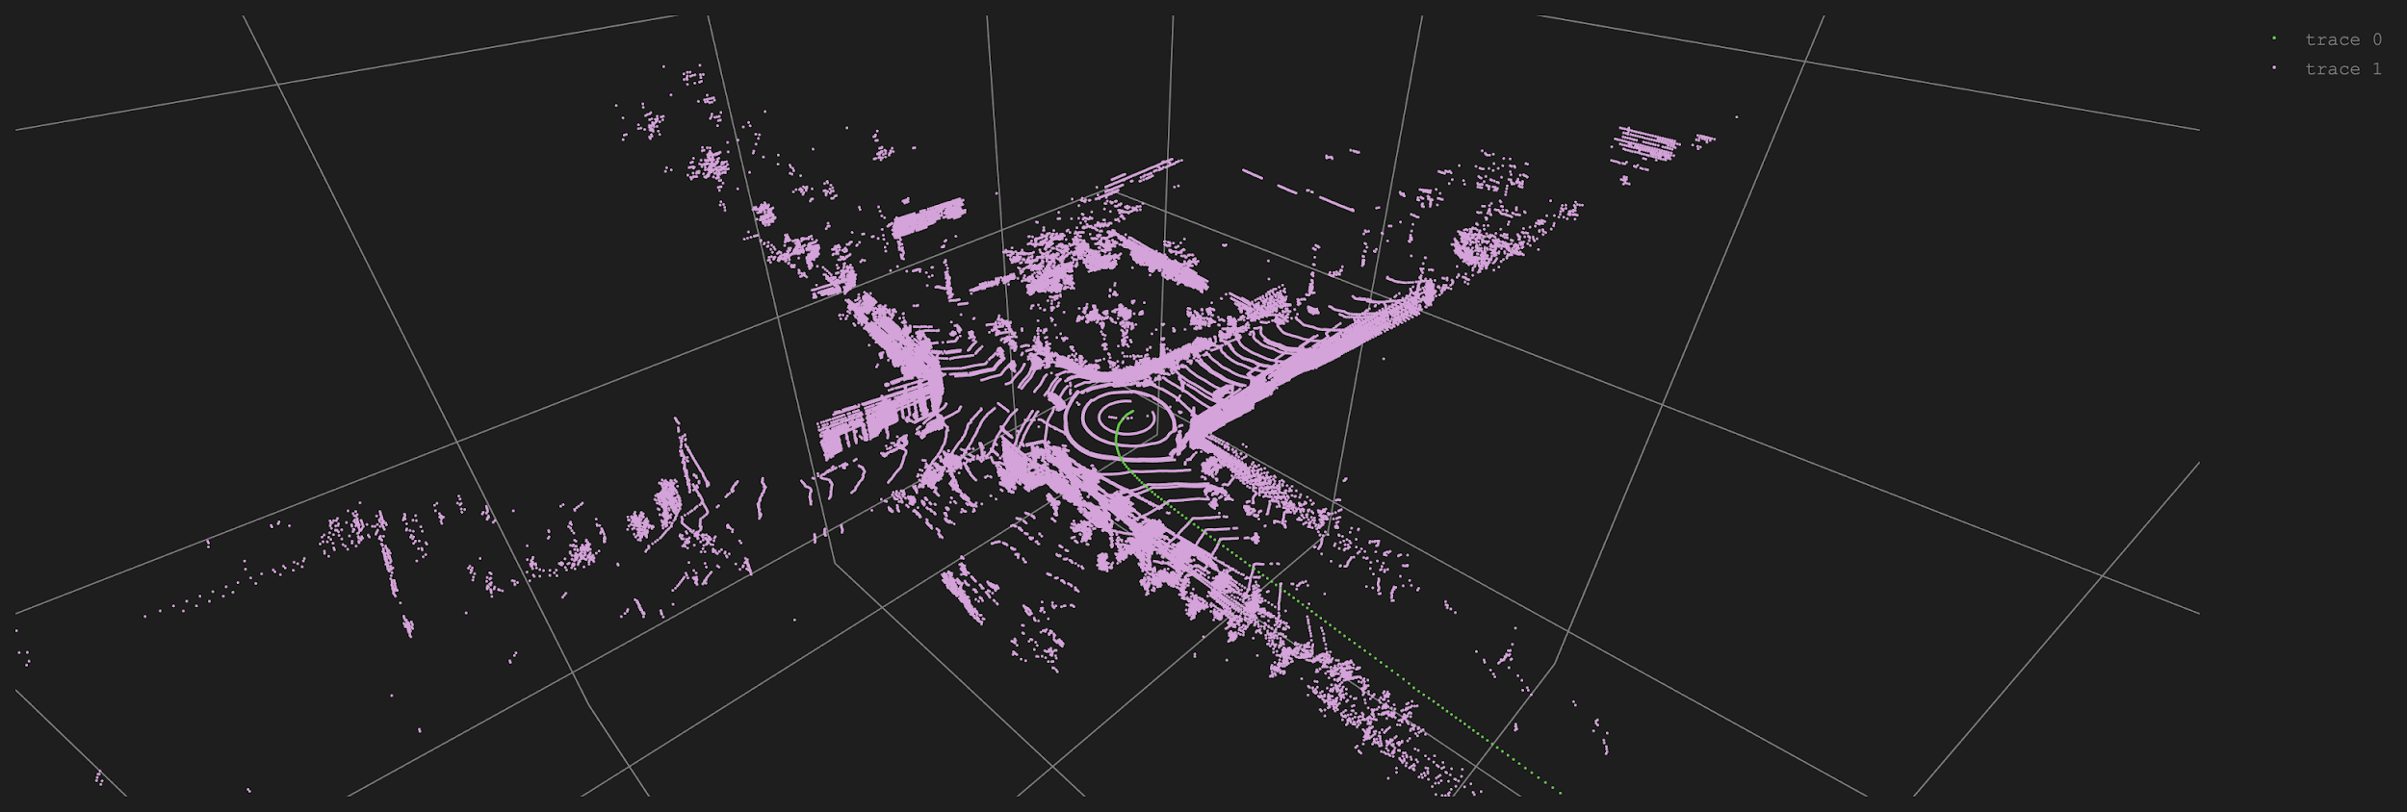
6. Paste a screenshot of the vehicle poses being given as output from the factor graph.

Slide 8
7. In the generated map, what happened to the people and other cars moving around the car collecting LIDAR data?
These are considered to be noises in the point clouds dataset since their movements are independent of the pose changes of our vehicle between each frame. Luckily, our ICP algorithm and factor graph model seems not to be too much affected by the people and moving cars. We compose the final map using multiple LIDAR scans, so any moving things will not be visible in the final map as they dissolve into the background noise (random scattering points in the map). The most thing we can observe is a fuzzy trace. However, the non-mobile things, and particularly the parked cars on the curb, are still visible in the map since they are static. Our algorithm thinks they are parts of the environment and also take those into account when constructing the composite point cloud map.

Slide 9
8. What did you learn about mapping in autonomous driving in this project?
This project is amazing in that it demystifies the whole process of one possible way to do mapping for autonomous driving vehicles which used to be considered very hard from my perspective. The project shows me a pipelined procedure to do mapping, from collecting LIDAR scans as point clouds, to estimating transforms between two point clouds, to construct a factor graph model using the transforms as factors, and finally optimize that model out to produce a sequence of pose predictions while at the same time constructing a map of the surrounding given the point clouds and predicted poses. Though it is not the only way nor the best way to the mapping as I believe, it teaches me a possible way to do it concisely and elegantly. If we decompose a hard task into smaller subtasks, the whole thing may be viable in most cases!

Slide 10
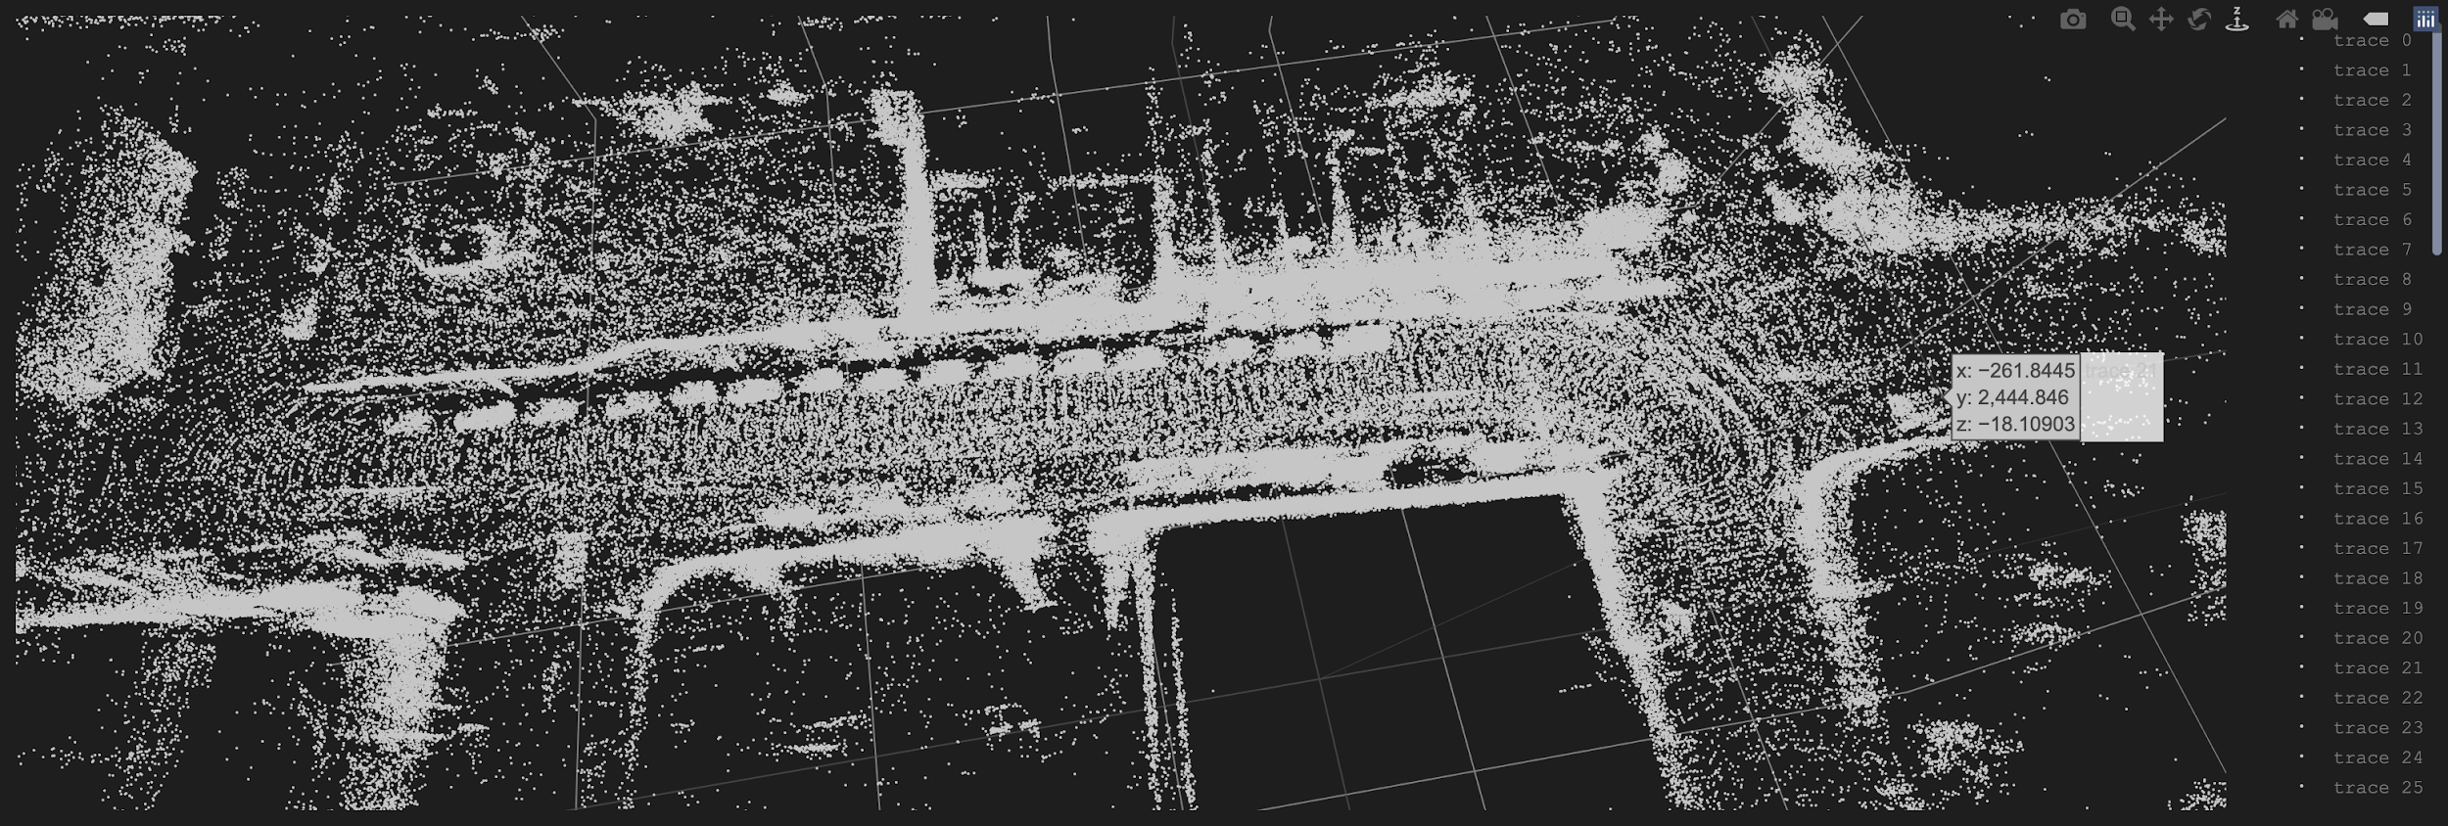
9. Insert the cloud map visible to you after at the end of the project.

Slide 11
10. What do you think you could add or change to make the map better?
There are many ways to make the map better. First, we can include more LIDAR scans to cover a longer range travelled by the vehicle, so we will have a larger map. Second, currently we still consider those points in the point cloud which belong to the pedestrians or other moving vehicles, but these points can be easily identified and removed as they are also outliers in our ICP algorithms for pose aligning (they are not consistent with the general trend of other static points). In fact, if we are able to remove them our map should look much cleaner. Third, a tiny characteristic I notice with the map is that it is more dense where the vehicle starts moving slow and turning right than where the vehicle is travelling fast and straight. However, if we can take the vehicle speed into account while carefully and proportionally choosing the frames to include in the final map, it should look a bit more uniform everywhere.

Slide 12
11. Do you feel confident that you can take up a challenge related to self-driving at ArgoAI?
Quite honestly I think only being able to do SLAM on LIDAR scans with ICP and factor graph is not going to set me apart from solution makers like Argo AI in terms of solving self-driving related challenges. Afterall, they are just a small part of all tasks we need to manage in order to make a fully functioning autonomous driving system. There are issues like decision making, emergency handling, and path planning that also require clear solutions for, and they all require different set of skills that are not demonstrated in this project. Thousands of professional people are trying hard on various fields with their expertise, so the future is still promising. However, the project does offer me an insight that a seemingly hard problem may be solved with simpler decomposed techniques and a different way of thinking!

