Slide 1
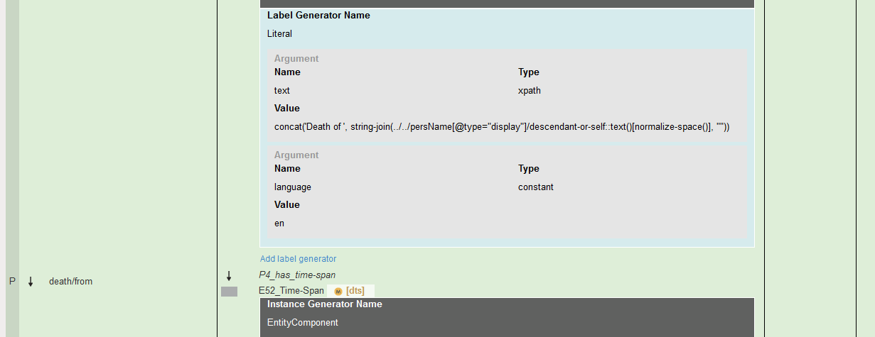
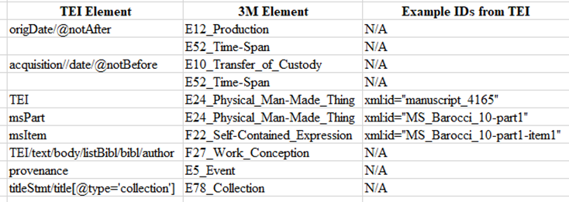
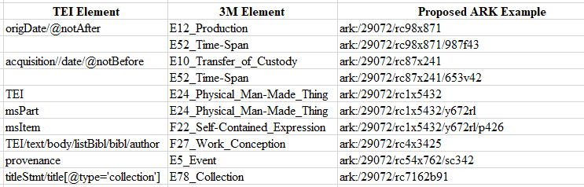
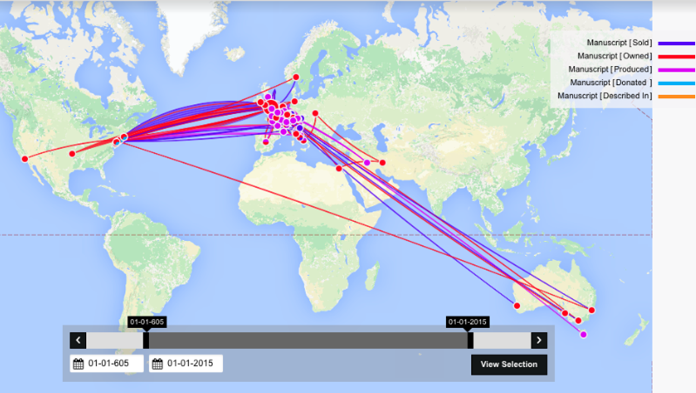
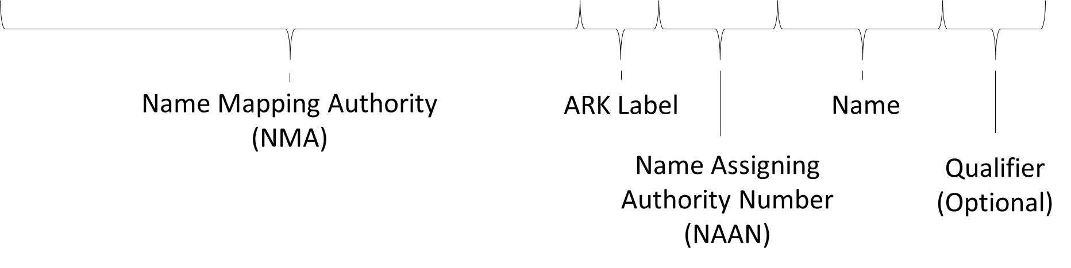
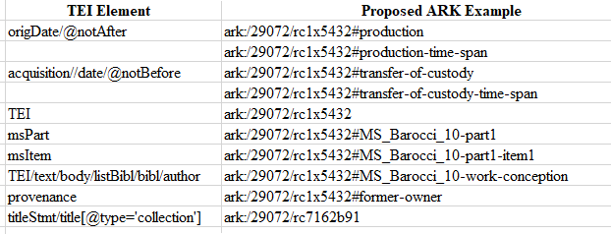
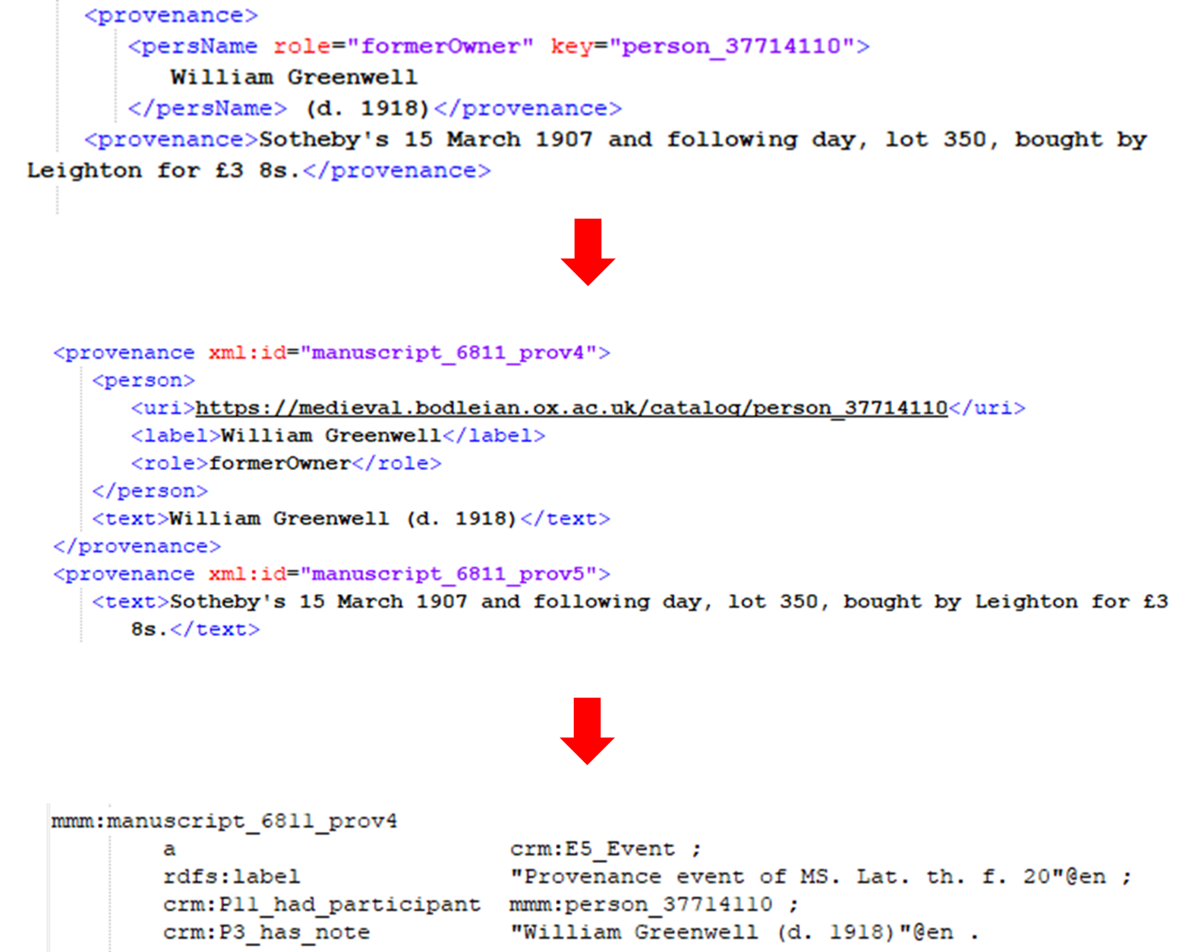
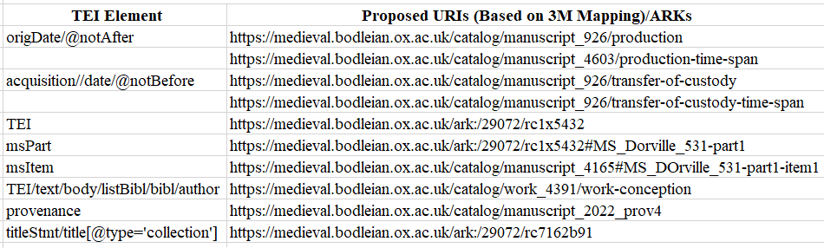

Assessing the practicality of ARK identifier usage in a catalogue of medieval manuscripts
Halle Burns¹, Toby Burrows², J. Stephen Downie¹, David Lewis², Kevin Page², and Athanasios Velios² Department of Library and Information Science, School of Information Sciences, University of Illinois at Urbana-Champaign¹; Department of Engineering Science, Oxford e-Research Centre²
Introduction
We are motivated by the Mapping Manuscript Migrations (MMM) Digging into Data Challenge, which seeks “to combine data from various sources to enable the large-scale analysis of the history and provenance of medieval and Renaissance manuscripts.” MMM poses research questions drawing on the power of linked data as a method of enabling this analysis. Answering these requires disambiguating identifiers, particularly those related to changes in ownership and location of manuscripts. The Bodleian’s Medieval Manuscript catalog is one of the key data sources for the MMM project.
Archival Resource Keys (ARKs) are considered by the Bodleian as a possible solution to tracking and management of manuscripts through different systems. This investigation looked at the suitability of ARKs for the broader set of requirements identified by MMM and examined how they could be implemented in the data trans-formation and mapping processes of the MMM project.
What is an ARK?
Goal of an ARK:
Long-term persistence
An ARK must give users a link from an object to a promise of stewardship
Must give users a link from object to a description of it.
Must give users a link to object (or copy of object) itself.
Anatomy of an ARK:
Name Mapping Authority (NMA)
Replaceable
ARK Label
Indicates to user the persistent identifier being used us an ARK
Name Assigning Authority Number (NAAN)
Number that uniquely identifies the organization assigning the Name
Name
Goal is semantic opaqueness
Check digit should be utilized
Qualifier (optional)
Used to distinguish hierarchy
Potential Solutions
Solution 1
Solution 2
Solution 3
.
Conclusions
Solution 3 would work best in the short-term, though it is not ideal from a long-term linked data perspective. Moving forward, it is integral for MMM to determine what will happen to their data once the project is complete, which will help inform the type of identifier they might wish to use. Solution 3 would also meet the Bodleian Libraries’ specific current requirements in the short term. But it would postpone addressing the wider issues relating to identifiers for TEI elements other than the manuscripts themselves.
MMM (together with the related Oxford Linked Open Data project, OxLOD, uses the mapping tool 3M (pictured above), to transform the simpler XML into RDF triples, based primarily on two ontologies: CIDOC-CRM (for cultural heritage data) and FRBRoo (for bibliographic information).
This table shows the elements required for MMM research questions tracked through the map-ping process from TEI to 3M
References
1. Burrows, T., Hyvönen, E., Ransom, L., Wijsman, H.: Mapping Manuscript Migrations: Digging into Data for the History and Provenance of Medieval and Renaissance Manu-scripts. University of Pennsylvania Press, Volume 3, Number 1, Spring 2018, 249–252 (2018).
2. OxLOD Homepage, https://www.glam.ox.ac.uk/oxford-linked-open-data-pilot, last accessed 2018/09/03
3. 3M Homepage, http://139.91.183.3/3M/, last accessed 2018/08/09
4. CIDOC-CRM Homepage, http://www.cidoc-crm.org/, last accessed 2018/07/28
5. Definition of FRBRoo: A Conceptual Model for Bibliographic Information in Object-Oriented Formalism, https://www.ifla.org/files/assets/cataloguing/FRBRoo/frbroo_v_2.4.pdf, last accessed 2018/07/28
6. N2T Archival Resource Key (ARK) Identifiers, http://n2t.net/e/ark_ids.html, last accessed 2018/08/08
.
7. Kunze, J., & Rodgers, R.: The ARK Identifier Scheme. Berkley Planning Journal, https://escholarship.org/uc/item/9p9863nc, last accessed 2018/08/09.
Image from “Mapping Manuscript Migrations: an international project funded by the Trans-Atlantic Platform” by Dr Toby Burrows
The first solution involves creating ARKs for all possible entities needed for the transformation to RDF.
https://medieval.bodleian.ox.ac.uk/ark:/29072/rc1x5432/985cd
Tracking Provenance Information through Linked Data Mapping
An visual representation of an ARK identifier, utilizing the Bodleian as an example.
Solution two involves creating an ARK for the manuscript, with the rest of the identifiers created within the TEI document as built-in xml:id fields. This would require the TEI metadata to be altered to support additional fields.
Acknowledgments
Thank to the Oxford Linked Open Data Project, Mapping Manuscript Migrations, and mentors at the Bodleian Libraries. Sincerest gratitude to DHOxSS, OeRC, Wolfson College, and the iSchool for this opportunity. Special thanks to associated colleagues, Ryan Dubnicek and Yuerong Hu.
This solution involves creating ARKs only for the manuscript. Remaining identifiers needed for disambiguation will be produced by 3M, mirroring the current process. As with Solution 2, the only ARKs being maintained would be those for each manuscript.
This tracks the mapping process from the Bodleian’s TEI metadata to simplified XML to RDF triples for an event-based entity. Additional elements are created during the XML portion of the transformation to fully describe separate elements of provenance.

