Slide 1

Dogs in Media
Halle Burns
Notes:
Photo credits: corgnelius (Instagram)

Slide 2
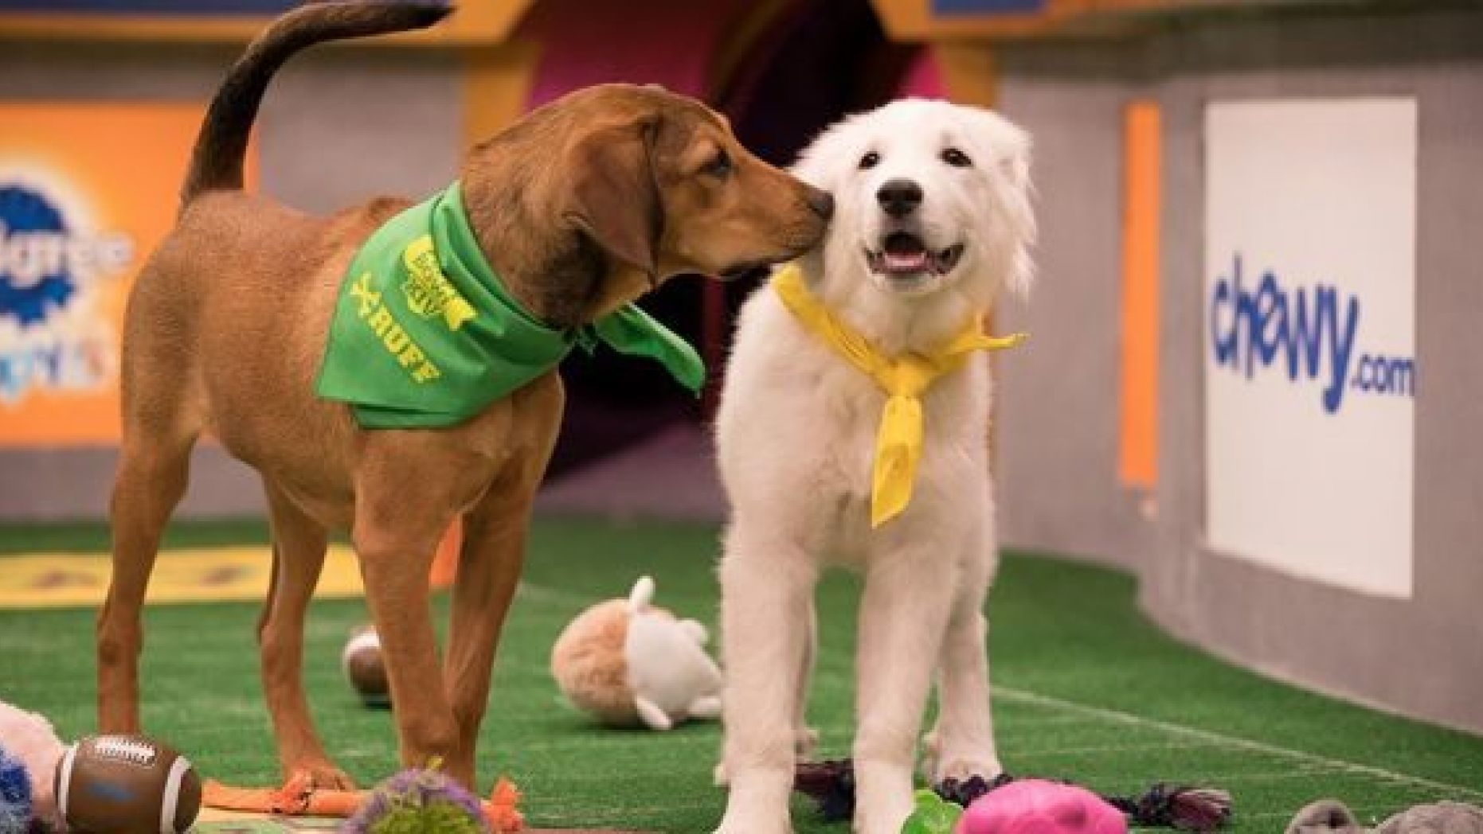
Question
Does media representation of dogs correlate with American Kennel Club popularity? What are the implications of this? Why might this happen?
Notes:
Photo from Puppy Bowl

Slide 3
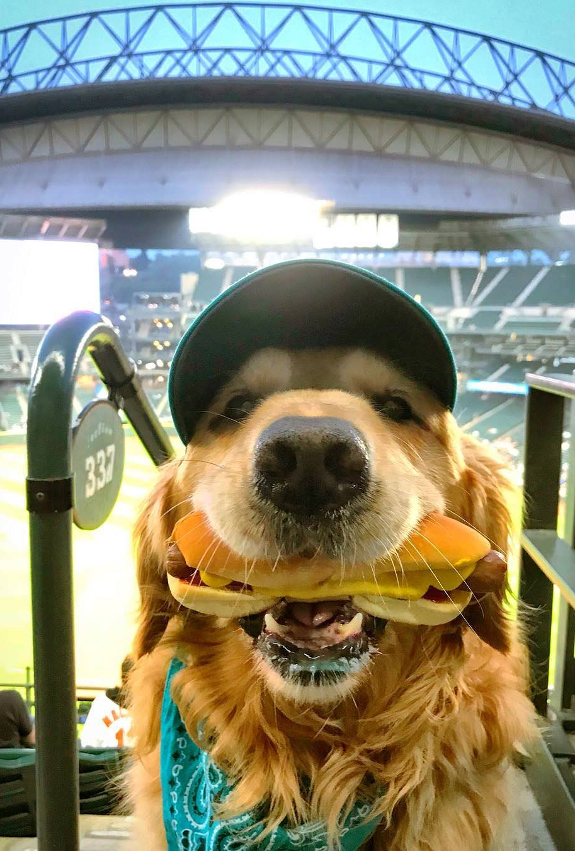
The data sources
American Kennel Club – Most Popular Dog
Westminster Dog Show – Best in Show
The Puppy Bowl – X to XIV
KnowYourMeme
Wikipedia
Notes:
Photo credit: dash.dog (Instagram)

Slide 4

Methods Used
XPath
API / JSON
OpenRefine
Jupyter Notebooks
Pandas
Hand-coding
Notes:
Photo: Doug the Pug

Slide 5
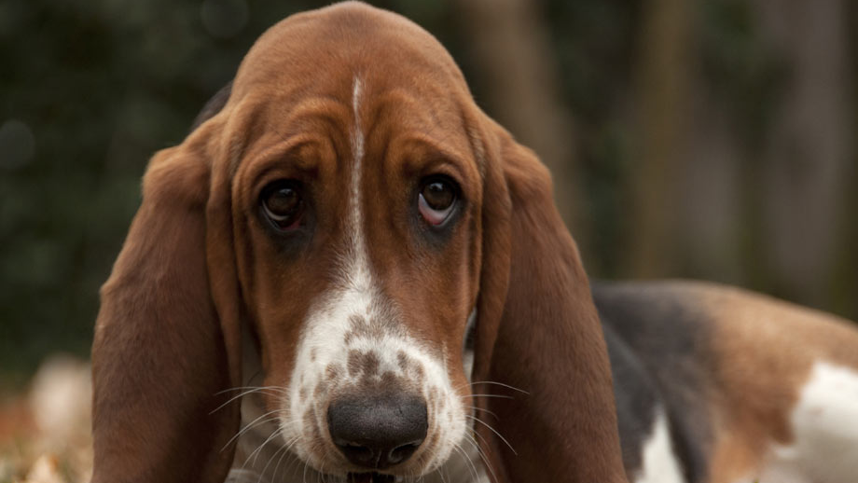
American Kennel Club
Notes:
Photo from AKC Marketplace

Slide 6
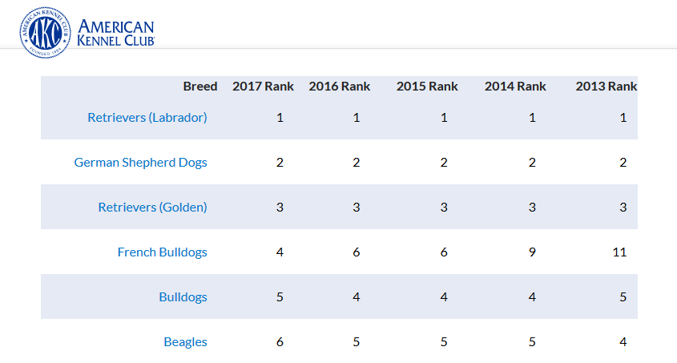
Cleanest Dataset: Most Recent Rankings

Slide 7
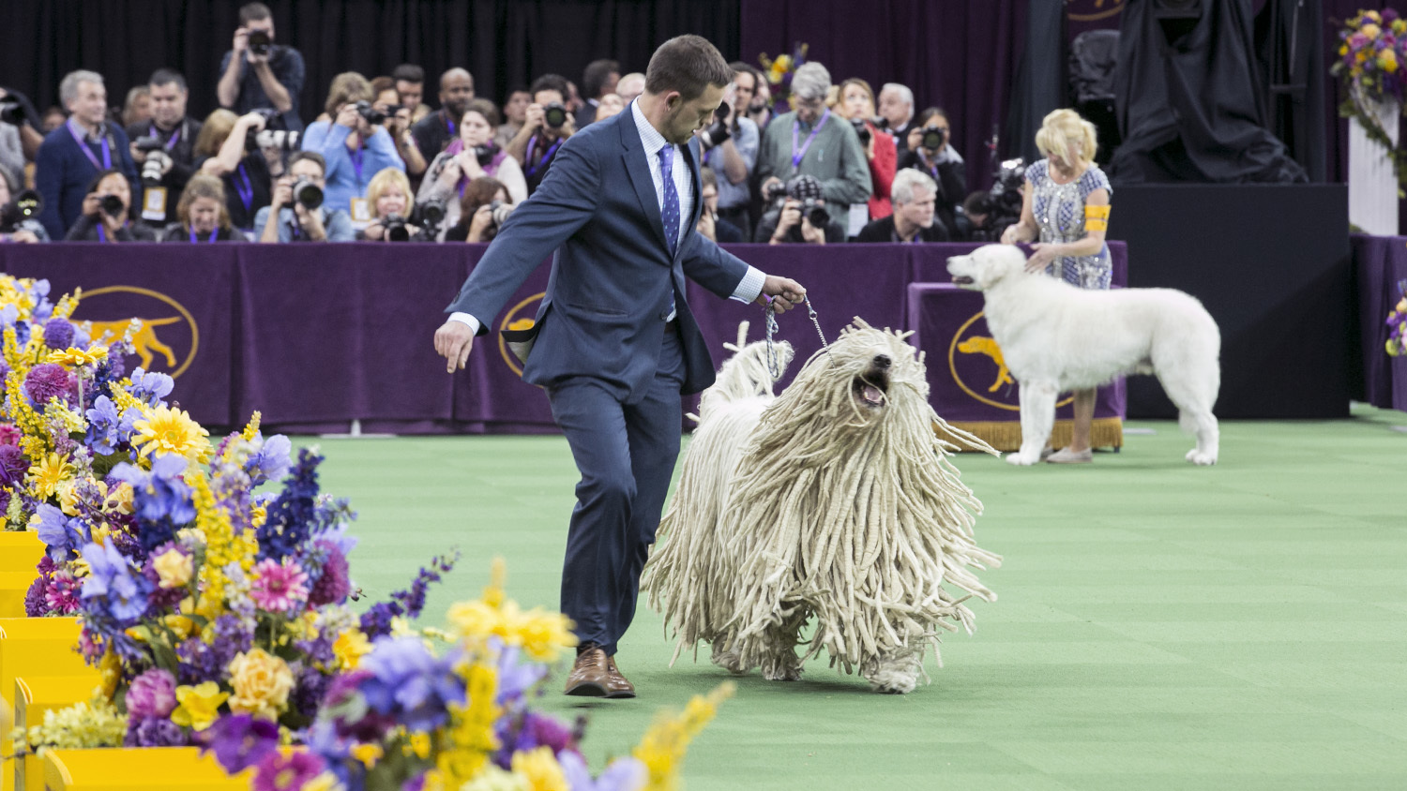
Westminster Dog Show
Notes:
Photo from Westminster Dog Show

Slide 8
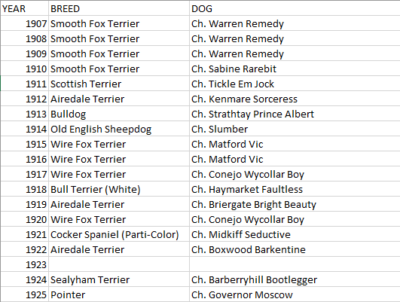
Cleaned Data: Best in Show

Slide 9
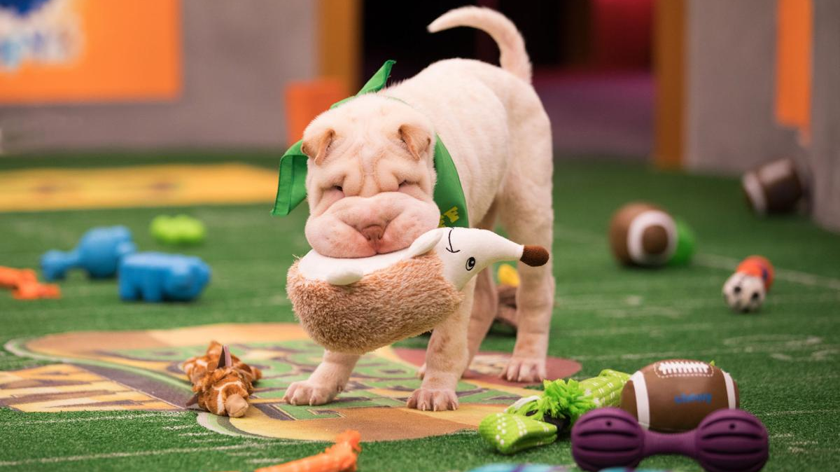
The Puppy Bowl
Notes:
Photo taken from Puppy Bowl

Slide 10
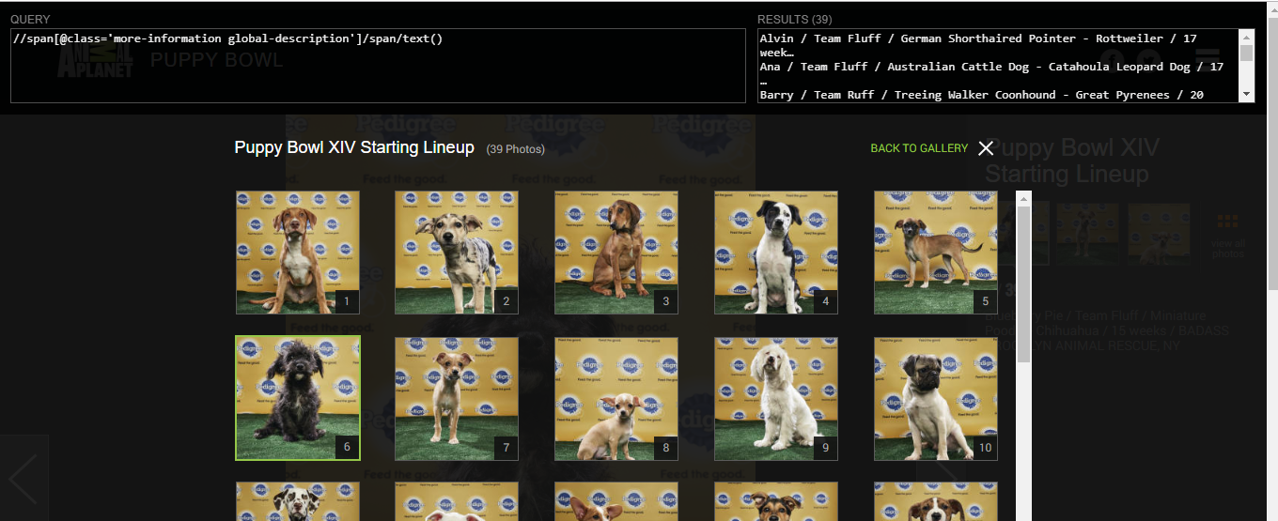
XPath

Slide 11
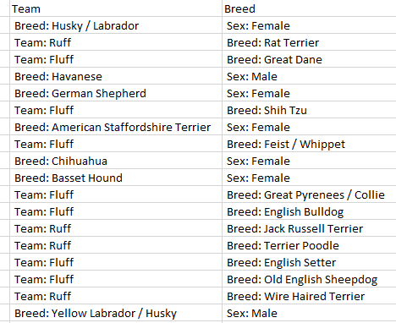
Data Inconsistencies

Slide 12
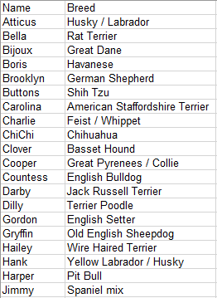
Cleaning (OpenRefine)

Slide 13
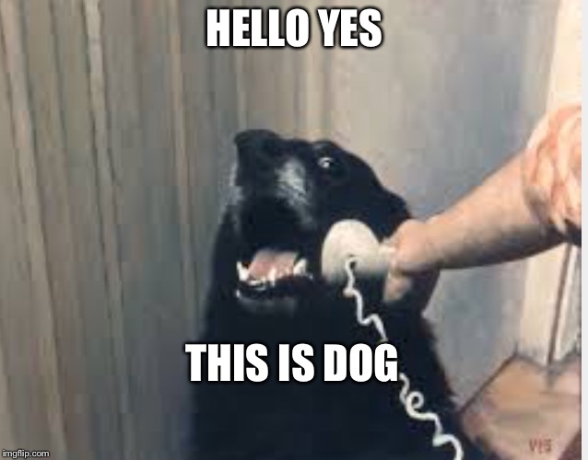
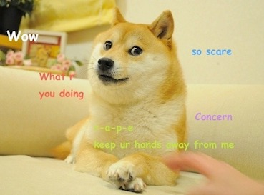
KnowYourMeme
Notes:
Photos taken from KnowYourMeme

Slide 14
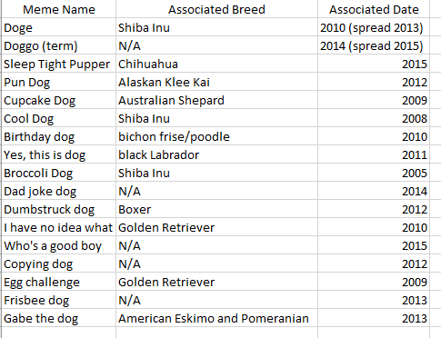
Data gathered

Slide 15
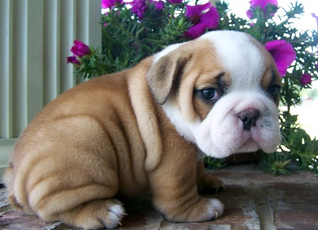
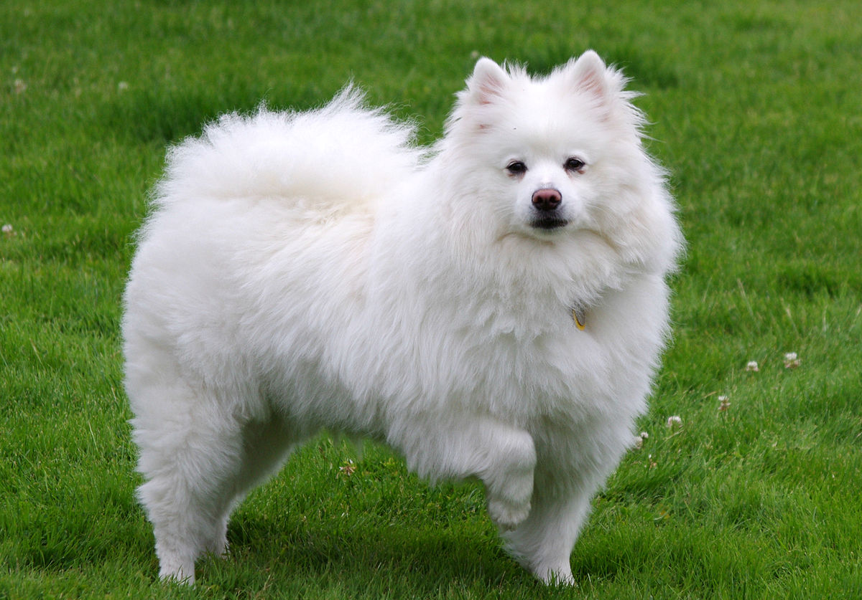
Wikipedia
Notes:
Photos taken from Wikipedia

Slide 16

Extracting data from select JSON files

Slide 17
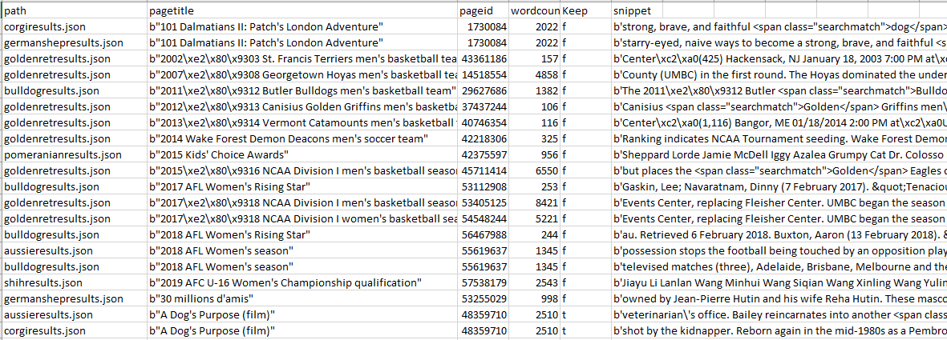
Hand-coding (an adventure)

Slide 18
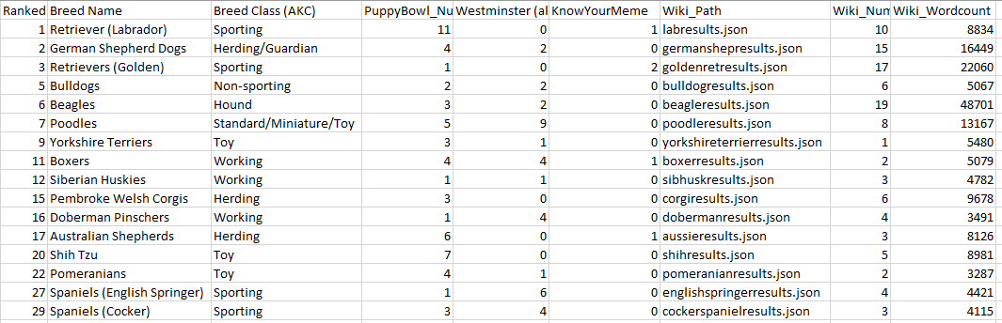
Final Dataset

Slide 19
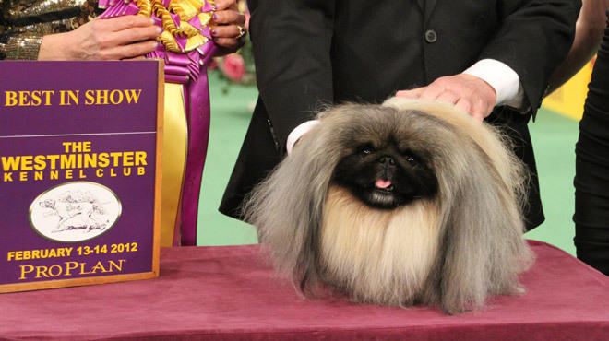
Results

Slide 20
Notes:
Does media rep of dogs correlate with AKC popularity? Why might this happen? Theoretically Wiki is a solid rep of our culture’s media. Expect a positive correlation? I explored the data and Wikipedia is not useful as a media representation.

Slide 21
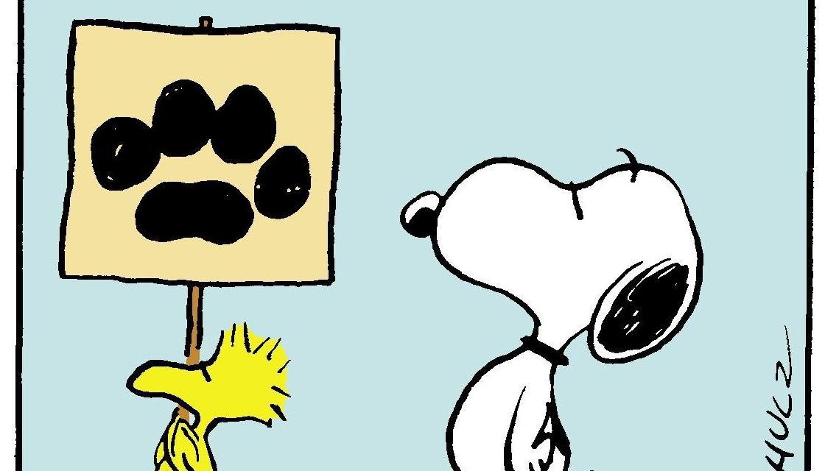
Beagles!

Slide 22
Top Dogs from AKC
Labrador Retriever (1)
German Shepherd (2)
Golden Retriever (3)
Bulldog (5)
Beagle (6)
…
Papillion (53)
Pekinese (88)
Brussels Griffon (94)
Wire Fox Terrier (99)

Slide 23
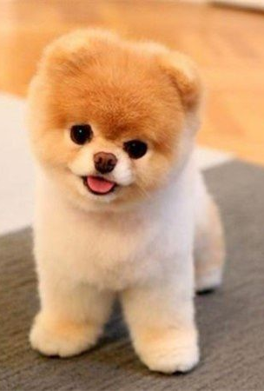
Analysis
Theory: Wikipedia is a solid representation of our culture’s media
Findings: Wikipedia is not useful as a media representation
Sporting vs. Toy
Beagles
Notes:
Photo from buddyboowaggytails (Instagram)

Slide 24
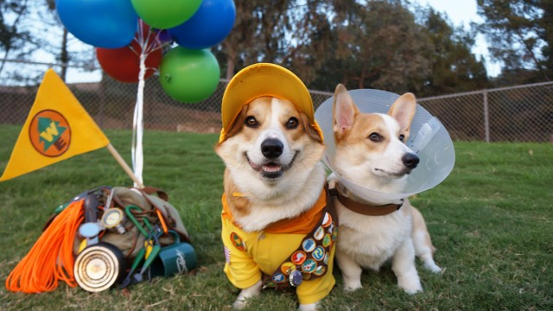
THANK YOU FOR LISTENING
Notes:
Photo from corgnelius (Instagram)

