Slide 1
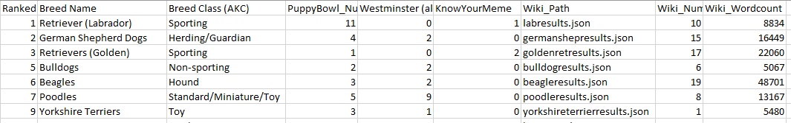

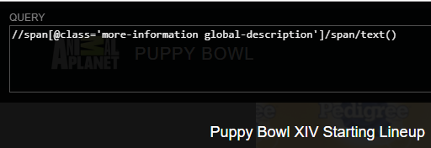
Does media representation of dogs correlate with American Kennel Club popularity?
Halle Burns
FINAL DATASET
Data Sources
Combining outputs
American Kennel Club – Most Popular Dog
Westminster Dog Show – Best in Show
The Puppy Bowl – X to XIV
KnowYourMeme
Wikipedia
Methods Used
XPath
API / JSON
OpenRefine
Jupyter Notebooks
Pandas
Hand-coding
EXTRACTION!

