Slide 1

Stylometry in “A Doll’s House”
Halle Burns

Slide 2
3 Research questions
Looking at play scripts, how does the style of character vs playwright vs translator differ? Is it possible to predict who said which line in the varying languages? Is it easier to predict in one language versus another?

Slide 3
What is Stylometry?
Statistical analysis of linguistic style
Everyone has a unique style of writing
Able to attribute different styles to different authors
How does this impact analyzing play scripts?

Slide 4

A Doll’s House: Background
Henrik Ibsen
Norway, 1870s
Traditional gender roles
Controversy → Differing endings
Original
German
Remade, adapted, translated

Slide 5
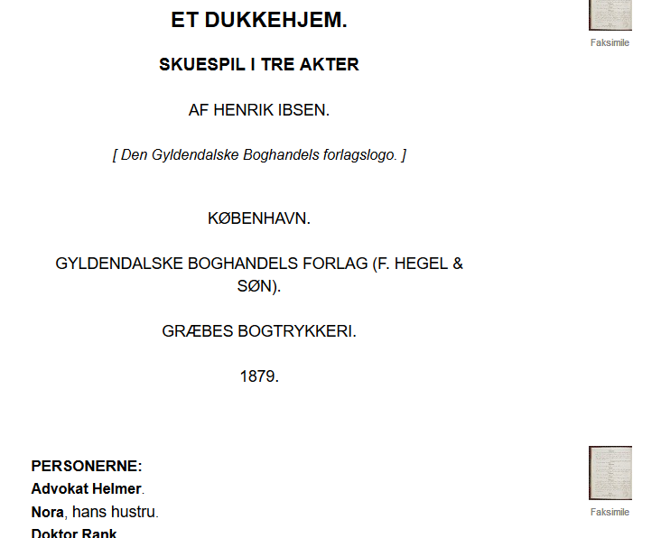
The Play Scripts
A Doll’s House, downloaded from Project Gutenburg, Nov. 2017
Et dukkehjem, first edition, downloaded from Universitetet i Oslo, Feb. 2019

Slide 6
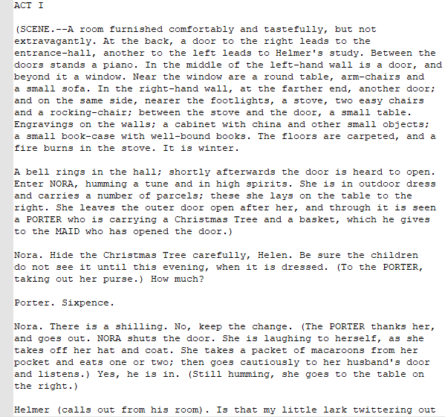
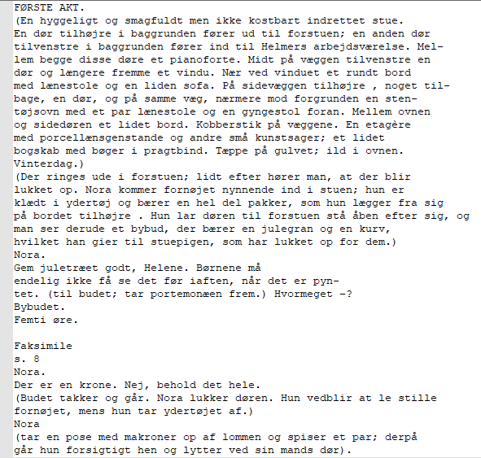
Initial Cleaning and Preparation

Slide 7
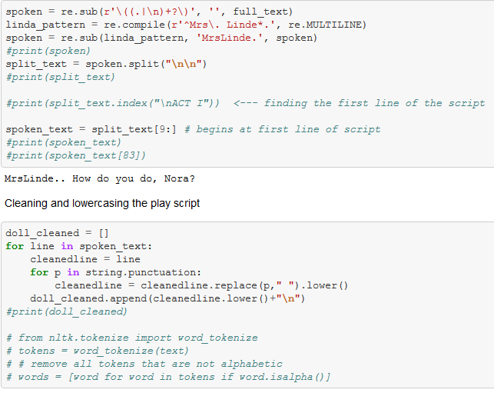
Extracting Data
Python
Regular expressions
Stage Directions
Names
Cleaning punctuation
Creating lists
Output

Slide 8
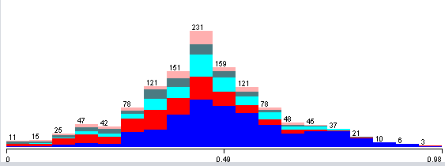
Pre-Processing in Weka
Removing characters with less than 100 speaking lines
NominalToString
StringToWordVector
Word frequency > 5
50 words
Output word count
AddClassification

Slide 9
Questions
Can we tell characters apart within each language? Between languages?
Which characters are hard to tell apart? Which ones are easy? Does this change between languages?

Slide 10
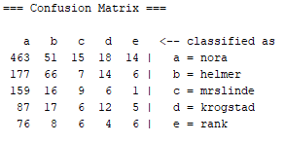
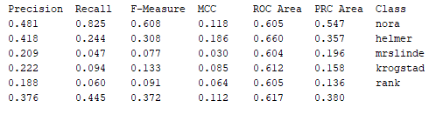
Classification: Logistic Regression, English

Slide 11
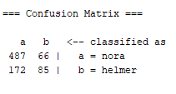

Classification: Logistic Regression, Norwegian

Slide 12
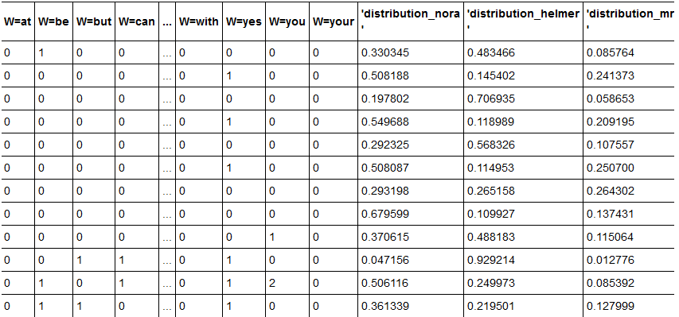
Next Steps
Visualization
Plotting line number vs distribution
Each character
Regression line

