Slide 1
Hotel reviews: Using NLP to predict star rating from reviews
Hussam Busfar
General Assembly

Slide 2
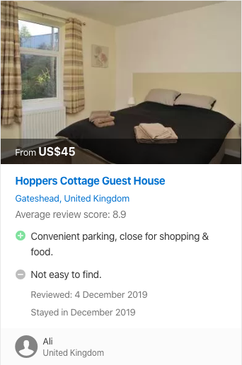


The review process

Slide 3
The Problem
Star ratings that are inconsistent with reviews

Slide 4
The Solution
Develop an algorithm that predicts star rating based on the review of each customer

Slide 5
The Data
515k reviews of 1493 hotels in Europe from Booking.com
17 columns:
Hotel address
Hotel name
Review date
Average score of each hotel
Reviewer nationality
Negative review
Positive review
# of words in negative review
# of words in Positive review
Total # of reviews for a hotel
Tags
Reviewer score
# of reviews for each reviewer
Days since review
# of scores without a review
Latitude
longitude

Slide 6
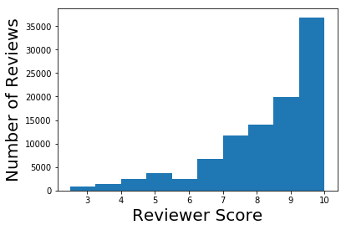
The Data

Slide 7
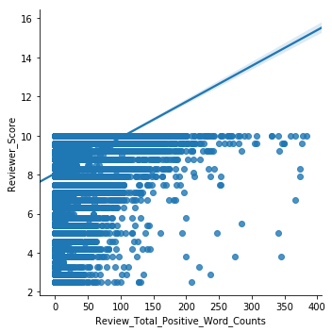
Positive Reviews

Slide 8
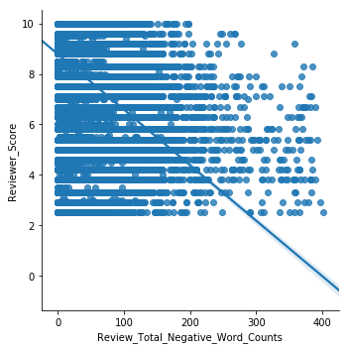
Negative Reviews

Slide 9
Reviewer Nationality
Country | Percentage of Total Reviews
United Kingdom | 47.5%
United States of America | 6.8%
Australia | 4.2%
Ireland | 2.8%
Mozambique | 0.0068%
Cambodia | 0.0066%
Syria | 0.0064%
Bahamas | 0.0062%
Top 4
Bottom 4

Slide 10
Average reviewer score by nationality
Country | Average Score
Equatorial Guinea | 10.00
Tajikistan | 9.35
Central African Republic | 9.30
Saint Martin | 9.27
Nepal | 6.84
Mali | 6.44
Northern Mariana Islands | 5.80
Montserrat | 5.40
Top 4
Bottom 4

Slide 11
Cleaning the data
NaN in latitude and longitude of hotel columns (3268 rows)
Drop rows with no positive AND no negative reviews (127 rows)

Slide 12
Modeling using linear regression
R² scores for Train | Test data
 | TfidVectorizer | CountVectorizer
Lin Reg | 0.61 | < 0 | 0.57 | < 0
Lin Reg + Regularization (Ridge) | 0.61 | 0.58 | 0.57 | 0.53
Lin Reg + Regularization (Lasso) | 0.59 | 0.57 | 0.55 | 0.53
Lin Reg + Regularization (ElasticNet) | 0.59 | 0.57 | 0.55 | 0.53

Slide 13
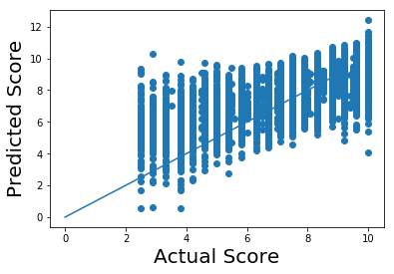
Modeling using linear regression

Slide 14
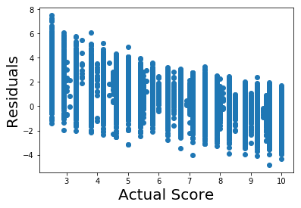
Modeling using linear regression

Slide 15
Modeling using classification
Accuracy scores for Train | Test data
 | TfidVectorizer | CountVectorizer
Logistic Regression (5 class) | 0.73 | 0.72 | 0.76 | 0.74
Multinomial Naive Bayes (5 class) | 0.62 | 0.62 | 0.63 | 0.62
Gaussian Naive Bayes (5 class) | 0.53 | 0.53 | 0.66 | 0.65

Slide 16
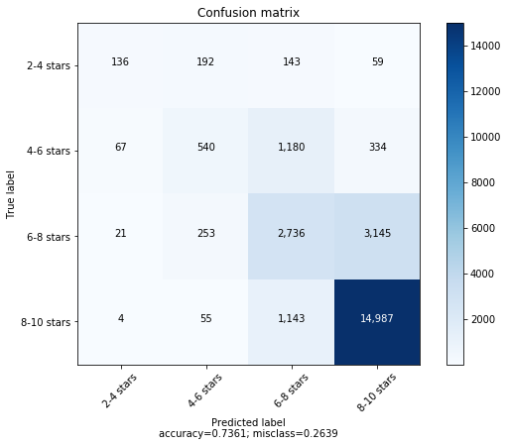
Confusion Matrix

Slide 17
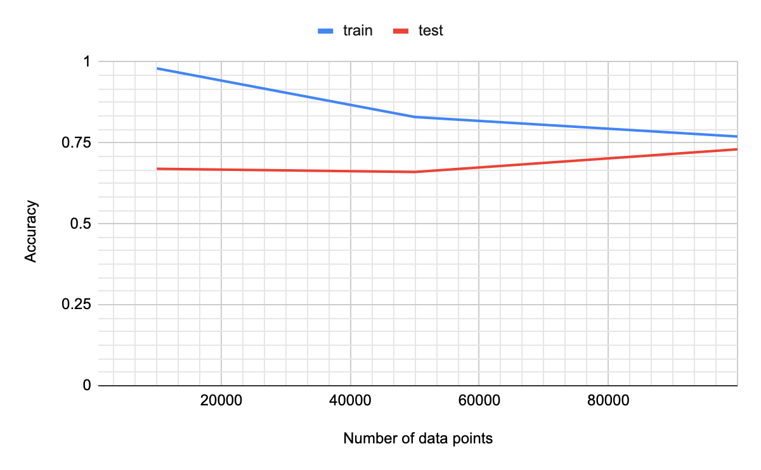
Did we use enough data?

Slide 18
Most important words
2-4 stars category
4-6 stars category
Word | Review | Coefficient
or | + | 2.65
except | + | -1.43
everything | - | 1.19
awful | - | 1.16
options | + | 1.14
dirty | - | 1.16
Word | Review | Coefficient
everything | + | -1.68
negative | - | -1.41
aircon | + | -1.35
findl | + | -1.25
poorly | + | -1.09
properly | + | 1.04

Slide 19
Most important words
6-8 stars category
8-10 stars category
Word | Review | Coefficient
or | + | -1.32
nothing | - | -1.16
negative | - | -1.08
everything | + | -1.03
taken | + | -0.62
instead | + | 0.55
Word | Review | Coefficient
understand | + | 1.85
properly | + | -1.70
everything | + | 1.52
or | + | -1.34
stars | + | -1.21
dirty | - | -1.14

Slide 20
Conclusion and future work
Some reviews are inconsistent
This algorithm can improve the accuracy and usefulness of future reviews
Solve with NN
Apply on all the data

