Slide 1
Partitioned Table Functions with Hive

Slide 2
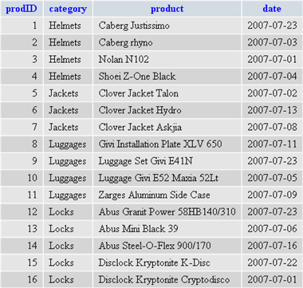
Partitioned Table Function Mechanics
Supported in many Databases: Oracle, DB2, Aster etc.
Node
Partition input into n partitions, optionally order partitions
distribute over set of processing nodes
execute Fn. at each node
merge data from all instances and stream merged result to next Operator
Input DataSet
Partition 0
Func.
Node
Partition and
optionally order
Partition 0
Next Operator
Func.
.
.
.
Node
Why?
for Performance
for providing advanced analytics
Partition 0
Func.

Slide 3
Example: Oracle
CREATE TABLE parallel_test (
id NUMBER(10),
description VARCHAR2(50)
);
-- Define a strongly typed REF CURSOR type.
CREATE OR REPLACE PACKAGE parallel_ptf_api AS
TYPE t_parallel_test_row IS RECORD (
id NUMBER(10),
description VARCHAR2(50),
sid NUMBER
);
TYPE t_parallel_test_tab IS TABLE OF t_parallel_test_row;
TYPE t_parallel_test_ref_cursor IS REF CURSOR RETURN parallel_test%ROWTYPE;
FUNCTION test_ptf (p_cursor IN t_parallel_test_ref_cursor)
RETURN t_parallel_test_tab PIPELINED
PARALLEL_ENABLE(PARTITION p_cursor BY HASH (id));
END parallel_ptf_api;
Notes:
For a Parallel Enabled Function:
Specify Cursor that should be partitioned
Specify column(s) to partition on
Not shown in example, use ORDER p_cursor BY to order rows in a partition.

Slide 4
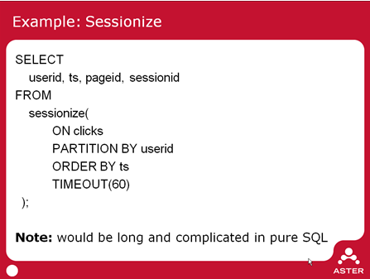
Example: Aster SQL/MR
Group clickstream data in sessions
Consider all rows of a User as a Partition
Order rows by time
Group rows within 60 seconds of each other as belonging to a Session.
Benefits
Work at Scale: designed to work over 100s of terabytes
Usability and Reusability:
  SQL/MR looks like a table, so can be interspersed with SQL
  Enable analysis not expressible in SQL
  Or simplification of existing queries
  Functions are parameterized so usable in wide range of contexts.
Aster Function Library
Time Series Analysis
Graph Analysis
Fraud Detection
Sessionization
....

Slide 5
Hive Script Operators
One can do PTFs in Hive using Script Operators
Form
  (From clicks
  Select transform(userid, pageid, ts)
  Using ‘/bin/cat’
  As (userid, pageid, ts)
  Distribute by userid
  Sort by userid, ts) map_output
Select transform(userid, pageid, sessionId)
Using ‘your java pgm/python script/… pass in args..’
As (userid, pageid, sessionId)
But
Painful for App. Developer to use. Imagine trying to chain functions.
Data streamed across process boundaries.
Type information passing limited: tab separated files.
Limited Usability: hard to pass arguments to scripts
hard to dynamically reshape output.

Slide 6
So Why PTFs?
  Table Functions: enable more interesting Questions more simply
  Partitioned Table Functions enable working at scale by breaking down dataset into manageable Partitions
  Usability and Reusability:
    PTFs look like a table, so can be appear anywhere a table does in SQL
    Enable analysis not expressible in SQL
    Or simplification of existing queries: both syntactically and in performance
      replace self-joins with intra row computations
    Functions are parameterized, so reusable in wide range of contexts
    Functions can define Output Schema at runtime
Notes:
Not MDX
But a slice of a Dimension is a Partition: provide Navigation & Set operations on it.
Key assumption: a meaningful/natural slice is not very large; ok not to do computations across slices.

Slide 7
So Why PTFs?
  Use Cases:
    Time Series Analysis: NPath
    Lightweight Dimensional Analytics
      Ordering: ranking, accumulation, lead, lag
      Hierarchical Navigation: parent, children, sibling
      Assumption Dimension not ‘flat & very large’. Time, Geography, Product classification, Customer, Supplier fit into this mold.
    Market Basket Analysis
    Graph Algorithms: Transitive Closure
    Sessionization
    SQL Windowing Clauses
      Can be treated as a PTF if all windowing clauses are on the same Partition.
Notes:
Not MDX
But a slice of a Dimension is a Partition: provide Navigation & Set operations on it.
Key assumption: a meaningful/natural slice is not very large; ok not to do computations across slices.

Slide 8
SQL Windowing, as a PTF
select channel_desc, calendar_month_desc, sum(amount_sold),
rank() over (order by sum(amount_sold) desc) AS rank,
denserank() over (order by sum(amount_sold) desc) AS drank,
rank() over (partition by channel_desc order by sum(amount_sold) desc) as rank_by_channel
From sales
Group by channel_desc, calendar_month_desc;
Windowing Clauses computed at the end, after Aggregation.
For each Windowing Clause Result Set is partitioned and optionally ordered; then Aggregation Func. applied on Window.
If all clauses have the same
partition & order expression,
then this can be expressed as a PTF
select channel_desc, calendar_month_desc, sum(amount_sold),
rank() AS rank,
denserank() as drank
From sales partition by channel_desc order by sum(amount_sold)
Group by channel_desc, calendar_month_desc;

Slide 9
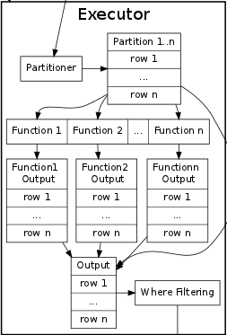
SQL Windowing, as a PTF processing
Node
Input DataSet
Partition 0
Func.
Node
Partition and
optionally order
Partition 0
Func.
Next Operator
.
.
.
Node
Partition 0
Func.

Slide 10
What have we done?
  Query abstraction is a select statement:
    Specify how data is partitioned and ordered
    Windowing clauses
    Table function invocation
    Input to processing is a Hive Table or Query.
  Provided as a CLI & API
    windowingCli: hive service: interperse hive queries with windowing queries.
    Simple API: create WindowingShell, execute Query.

Slide 11
What have we done?
  Picture of CLI and API here

Slide 12
Windowing Examples
  Basic Query
    Rank Parts within Manufacturer by weight
  TopN
    Calculate the Top 3 Tracts(based on land area) by County.
from part_rc
partition by p_mfgr
order by p_mfgr, p_size
with
rank() as r
select p_mfgr,p_name, p_size, r
from <select county, tract, arealand
from geo_header_sf1
where sumlev = 140>
partition by county
order by county, arealand desc
with
rank() as r, sum(arealand) over rows between unbounded preceding and current row as cum_area
select county, tract, arealand, r, cum_area
where <r < 3>
Notes:
Ex 1:
tpch Part table; Rank parts by size within each Mfr.
Ex 2:
Census data; Geo Hdr table: Geo dimension at Census block level (~ 900k blocks in CA)
Select census tract level data; for each County list top 3 tracts
Not shown but possible: % area for Top 3 to total Country area.
Could have done on a Measure from Fact table ( the SF1 table).

Slide 13
PTF: NPath
  Time Series Analysis using NPath table function (Details here)
    List incidents where a Flight(to NY) has been more than 15 minutes late 5 or more times in a row.
from npath(<select origin_city_name, year, month, day_of_month, arr_delay, fl_num
from flightsdata
where dest_city_name = 'New York' and dep_time != ''>
partition by fl_num
order by year, month, day_of_month,
'LATE.LATE.LATE.LATE.LATE+',
<[LATE : "arr_delay \\> 15"]>,
<["origin_city_name", "fl_num", "year", "month", "day_of_month",
["(path.sum() { it.arr_delay})/((double)count)", "double", "avgDelay"],
["count", "int", "numOfDelays"]
]>)
select origin_city_name, fl_num, year, month, day_of_month, avgDelay, numOfDelays
Notes:
Npath:
- Flights data fro TSA (origin,dest, deptime, arrtime, delay)
Define Labels for expressions.
A Path Pattern: moving forward in time.
Output Columns expressions based on selected Path: avgDelay, number of delays.

Slide 14
PTF: Market Basket Analysis
  Used to list the Frequent ItemSets from a set of transactions
  Many Applications:
    The eponymous Super market basket analysis
    Word occurrences in a document
    User visits to web pages
    Student enrollment in classes
from candidateFrequentItemSets(
<select * from basketdata
distribute by basketName
sort by basketName, itemName>
partition by itemset order by itemset,
'basketName', 'itemName', <0.15>)
select itemset
Input is BasketData(basketName, itemName)
Partition data by BasketName; sort each partition by ItemName
Iteratively apply CandidateFrequentItemSets on partitioned data.
Passing it supportThreshold, basket columnName, and item columName. candidateFrequentItemSets
{"items":["apples","baguette"]}
{"items":["apples","corned_b"]}
{"items":["apples","hering"]}
{"items":["apples","olives"]}
{"items":["apples"]}
{"items":["artichok","avocado","heineken"]}
{"items":["artichok","avocado"]}
Sample output.
Itemsets in JSON

Slide 15
PTF: Hierarchical Evaluation
  Hierarchical Evaluation (Details here)
    For a Country,State, City Geo hierarchy compute: % of Country Sales, Top City Sales, Avg. City Sales
from hierarchyEvaluate(
< select Country, State, City, sum(Sales) from Sales group by Country, State, City>
partition by Country
order by Country, State, City,
<['Country', 'State', 'City']>,
<[
["Sales / Ancestor('Country', 'Sales') * 100.0", "% Country"],
["TopN(Descendants('City'), 'Sales', ,1)", "Top City"],
["Avg(Descendants('City'), Sales)", "Avg. City"]
]>)
select Country, State, City, '% Country', 'Top City', 'Avg. City'
Notes:
Hierarchical Evaluation:
- Data is Sales on Country, State, City, Sales
Param 1: specify level based hierarchy
Output expressions: can navigate hierarchy, apply set functions: Sum, Avg, TopN
Market Basket Analysis
Basket data is (TxnId, ItemName)
2 phase algorithm:
phase 1 compute candidate Itemsets independently at each Mapper; create distinct list of candidates in Reducer
phase 2 count each candidate Itemset at each Mapper; aggregate counts at Reducer, o/p ones that are greater than support threshold.

Slide 16
PTF: Transitive Closure

Slide 17
How ( details here )
  Partitions are containers of Rows.
    Represented as a Spillable List of Writables + ObjectInspector
  Rows exposed as Groovy Binding; Partition exposed as Groovy iterable.
  All Evaluation in context of Row + Partition [+ Window]
  A PartitionedTableFunction (PTF) given a Partition computes an output Partition.
    An invocation of PTF can also specify how input dataset should be partitioned and ordered.
    A PTF defines shape of Output.
    A PTF may operate on raw data before it is partitioned and ordered.
  A Query is a chain of PTFs.
    Input of chain is a Hive Query or table
  Windowing clauses are syntax sugar for the special Windowing Table function.
  .Query translated to a series of Jobs. Each Job executes part of the entire Function Chain
    In the Map side the first function in the subchain can optionally reshape the Raw data.
    The Reduce side streams partitions through a chain of PTFs.
    The output is written to hdfs and exposed as a Temporary Table to be used by the next Job in the Chain.
Notes:
Windowing clauses are syntax sugar for the special Windowing Table function. (How)
There is only one partitioning.
Support for multiple partitions requires move to a branch model.

Slide 18
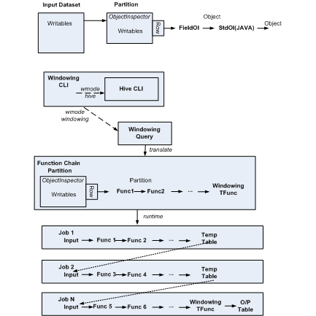
How

Slide 19
How: Market Basket Analysis
  based on the 2 pass SON algorithm as described in the Mining Massive Datasets book.
Job 1
Node
Apply Dynamic Item Counting with support appropriately scaled down.
Output Candidate IS from each Mapper.
Output Candidate IS
Input Basket DataSet
Partition 0
Node
Partition 0
Map
Reduce
.
.
.
Distribute by itemset
Partition by basket
Order by basket, item
Candidate
ItemSets
Job 2
Node
Partition 0
Node
Scan baskets for Candidate Itemsets
Partition 0
Map
Reduce
Candidate
ItemSets
Distribute by itemset
Notes:
Phase 1
assume input data is already stored bucketed by basket. In our case it assumes that the rows are ordered on the basketId and itemId.
Map phase
read the entire partition into memory
apply the A-priori (or one of the variation) on the partition; the support is proportionally scaled down based on the ratio of the number of baskets in this parition to the total number of baskets.
The Output of the Map phase is (ItemSet, NullWritable)
Reduce phase output a row for each candidate ItemSet. Since the number of candidate ItemSets will be small, the number of reducers can be small, even 1.
Phase 2
scans the input Basket dataset again.
Map phase
each mapper reads the entire output of Phase 1 into a data struct. For each Basket outputs the list of candidate ItemSets that it contains.
The Output is (Itemset, 1)
Reduce phase
sum up all rows for an ItemSet
Output the ItemSet if the count > support argument
Output from Phae is a table of the form (Itemset)

Slide 20
How: Transitive Closure
Sample invocation
From transitiveClosure(<select X, Y from InputTable cluster by Y>
partition by X)
Select X, Y;
First Pass:
Cluster:
Create ith Partition of R
Distribute by X
Node j
Node i
Map Function:
O/P (X, Row)
ReduceFunction:
O/P Row
R(i, Y)
T(X, i)
repeat
ith Pass:
Cluster:
Read in R(i, Y)
Perform dRnext – R
Add dR rows to R
Create ith deltaR file
in R(i, Y)
Read in dR(I, Y)
Perform dR join T
Node j
Node i
Structure of Table R
Map Function:
O/P (X, Row)
ReduceFunction:
T(X, i)
3. Distribute by X
Directory for
Partition 0
Directory for
Partition 1
……
deltaR
After iter 1
deltaR
After iter 2
……

Slide 21
Performance

Slide 22
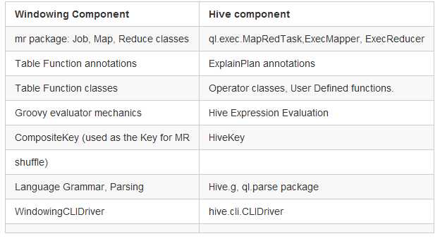
Fold into Hive
  Mapping concepts/components to Hive
  A Path to moving into Hive ( Details here)
  Step 1: Move to Hive MR mechanics for Job execution
  Step 2: Move to Hive Evaluators and Expressions
  Step 3: Introduce the concept of Pure Table Functions in Hive
  Step 4: Allow Table function invocations to appear in Table Expressions
  Step 5: Extend HQL with Windowing Clauses
Notes:
Step 1:
Use MapRedTask, ExecMapper, ExecReducer. For Job execution.
define PTFMapOperator and PTRReduceOperator to bridge to Windowing Engine
Map-side PTFMapOp -> ReduceSinkOp; Reduce-side: PTReduceOp -> TableOutput
Step 2:
Replace Groovy Hive Evaluator & Exprs
introduce notion of Partition & navigation in Hive Evaluator
Generalize Partition management; today it is jointly held by engine & PTF
Step 3:
In HQL exec ptf(…)
Step 4:
Allow select .. From ptf(..)
But AST transform to exec ptf(..) into TempTable; select on TempTable
Step 5:
Allow windowing clauses
AST transform to: insert into TT select w/o windowing clauses; exec WTF()

Slide 23
Summary
Partition Table Functions for basic Dimensional Analysis in SQL; open for other use cases, possibly Iterative algorithms.
Currently on top of Hive; possibly fold into Hive (gradually)
Available at https://github.com/hbutani/SQLWindowing/wiki

