Slide 1

Unit Testing in Python
A Practical Introduction
Patrick Gavigan
Data Science Team, OCDO

Slide 2
Why test?
function(a,b) = c
Goal: Detection
Normal and Abnormal Conditions

Slide 3
Types of Testing
Black Box
White Box
Regression
Integration
Stress
Acceptance
Many more!

Slide 4

Testing Frameworks!
Inversion of control
Repeatable
Can be integrated with Source Control
Contributes to Documentation

Slide 5
Implementing Tests
Test Cases
Assert an expected result
Parameterized Tests
One test, many cases
Test Fixtures
Setup and tear down tests
Other Features
docs.pytest.org

Slide 6
Examples
Code
Code + Test Case
Code + Test Case + Test Fixture
Code + Parameterized Test Fixtures + Test Cases

Slide 7
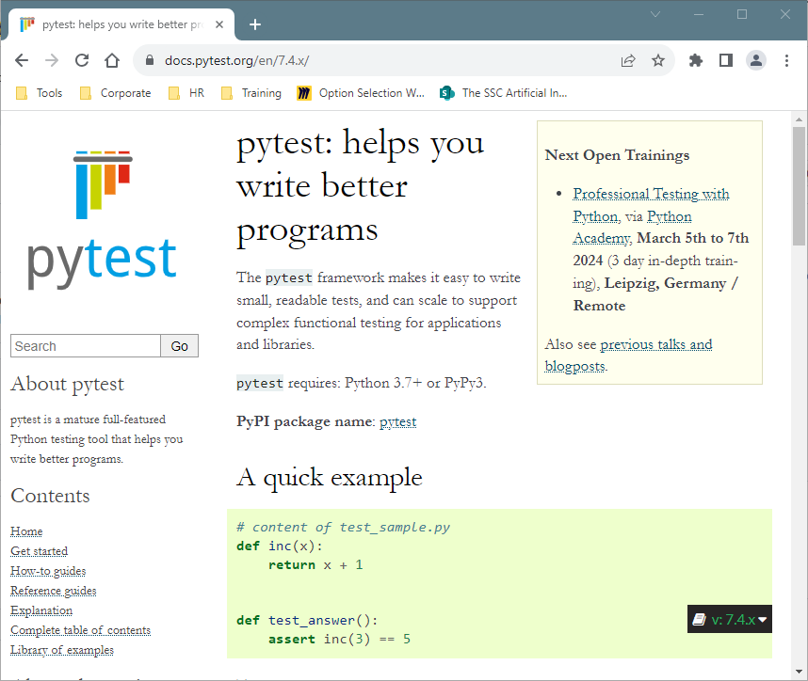
Resources

Slide 8
Test Driven Development
Write a Failing Test
Make the Test Pass
Refactor

Slide 9
DEMO!

