Slide 1

Unit Testing in Python
A Practical Introduction
Patrick Gavigan
Data Science Team, OCDO

Slide 2
Why test?
function(a,b) = c
Goal: Detection
Normal and Abnormal Conditions

Slide 3
Types of Testing
Black Box
White Box
Regression
Integration
Stress
Acceptance
Many more!

Slide 4

Testing Frameworks!
Inversion of control
Repeatable
Can be integrated with Source Control
Contributes to Documentation

Slide 5
Implementing Tests
Test Cases
Assert an expected result
Parameterized Tests
One test, many cases
Test Fixtures
Setup and tear down tests
Other Features
docs.pytest.org

Slide 6
DEMO!

Slide 7
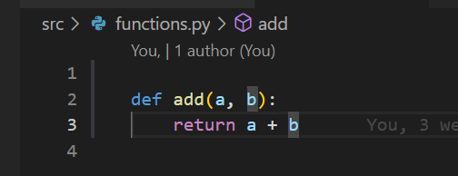
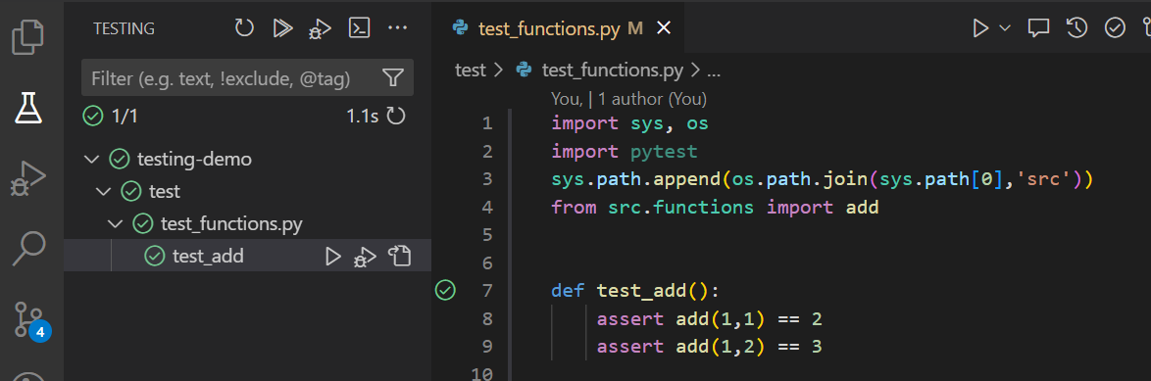
Example 1: Single Test Case
Assert expected result
Can be run in any order

Slide 8
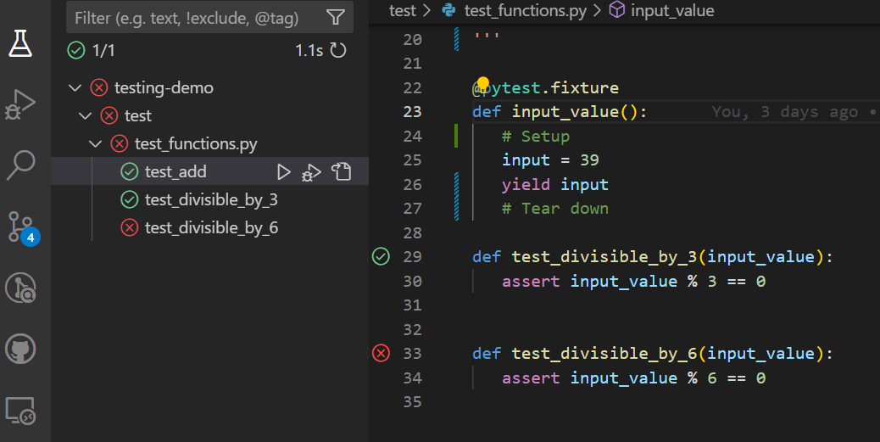
Example 2: Test Fixture
Setup for test
Tear down after a test
Runs regardless of if test fails
Can be reused

Slide 9
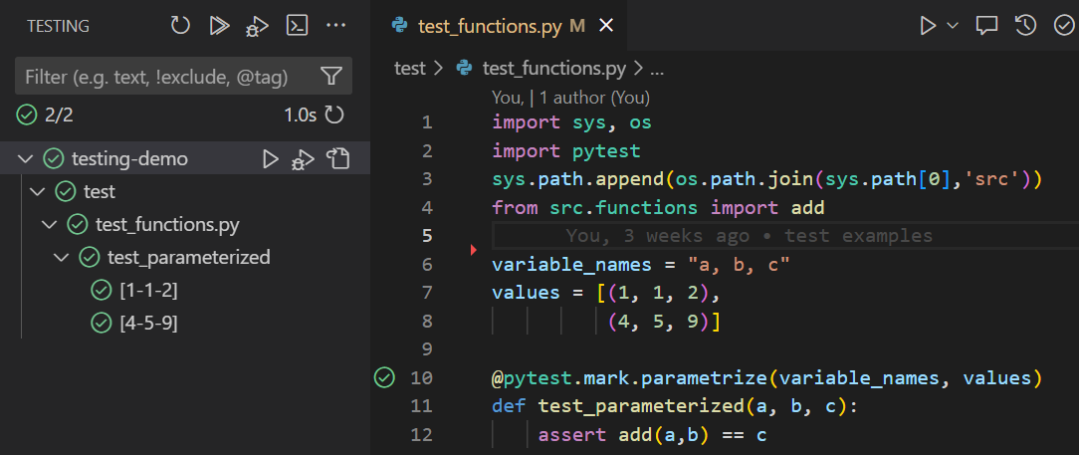
Example 3: Parameterized Test Fixtures
Many cases, one test
Decorator specifies variable names and values
variable_names: String list of variable names
Values: list of tuples containing values for the variables

Slide 10
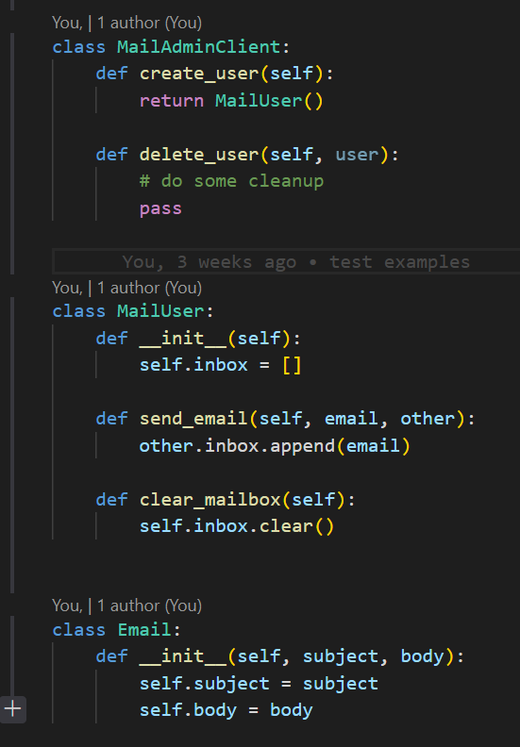
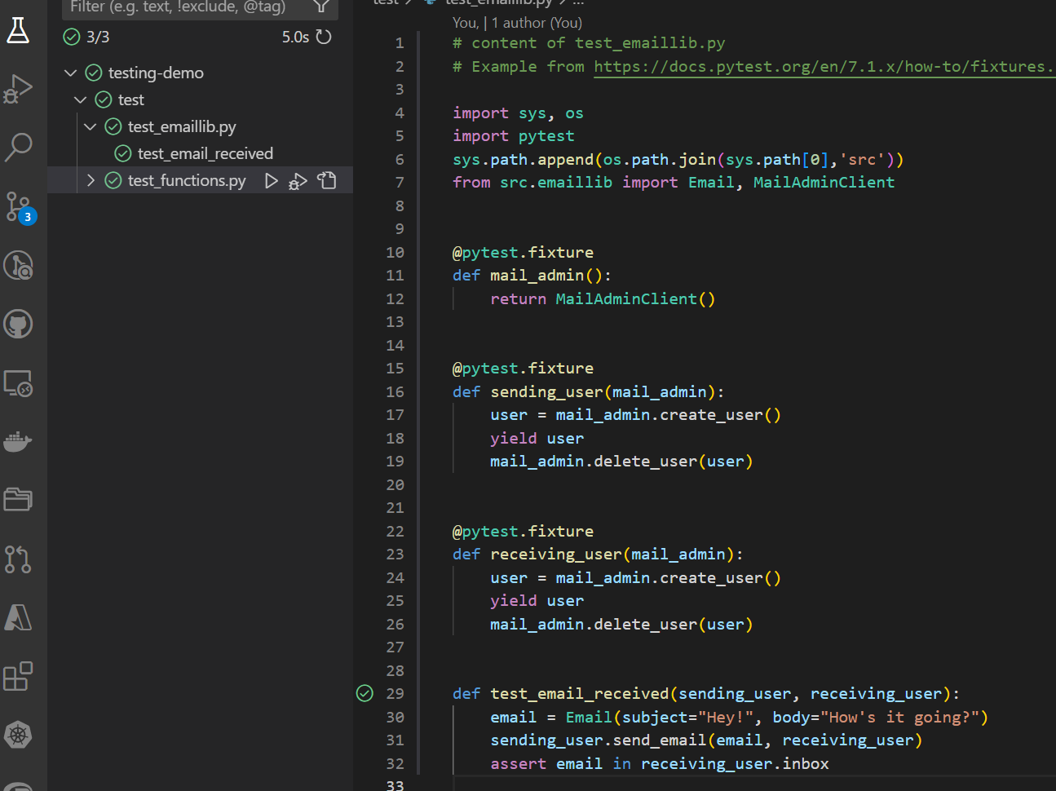
Example 4: Scale it up
Fixtures can use other fixtures
Can use many fixtures
Fixtures can setup and teardown

Slide 11
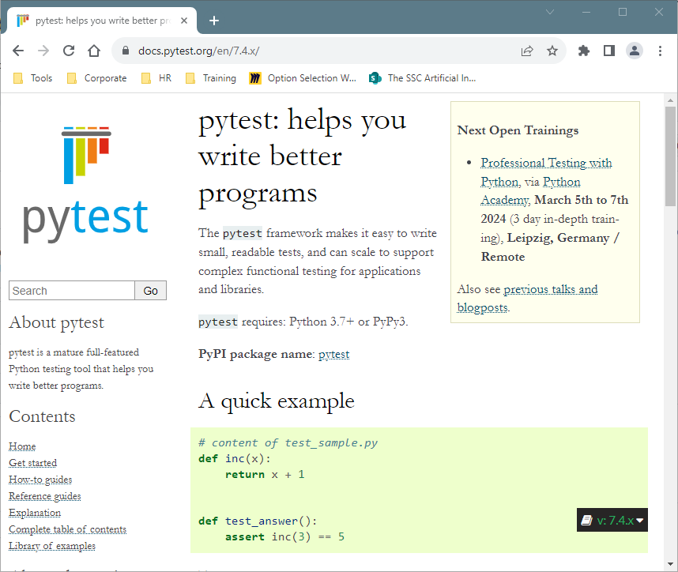
Resources

Slide 12
Test Driven Development
Write a Failing Test
Make the Test Pass
Refactor

Slide 13
Questions?

