Slide 1
SFE-IMSD Chatbot Survey Results
March 5 2020

Slide 2
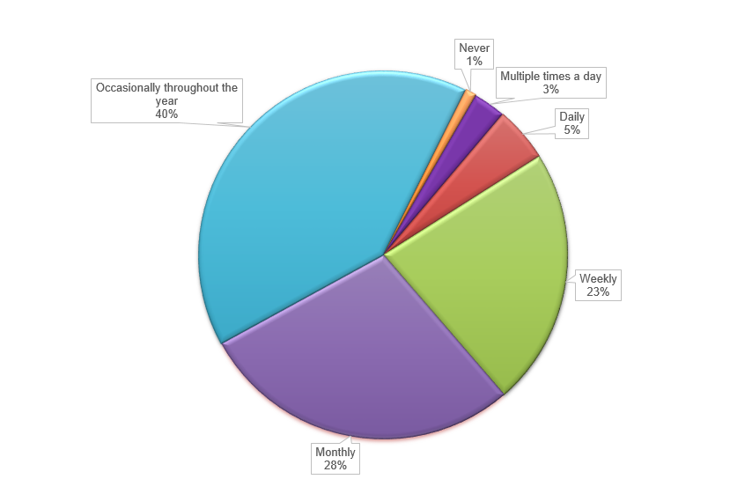
How often do you engage with the NSD (National Service Desk)?

Slide 3
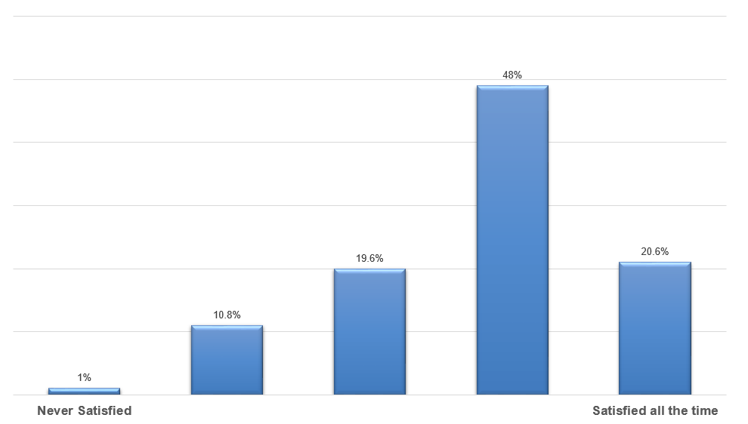
How satisfied are you with current methodas available to contact the NSD?

Slide 4
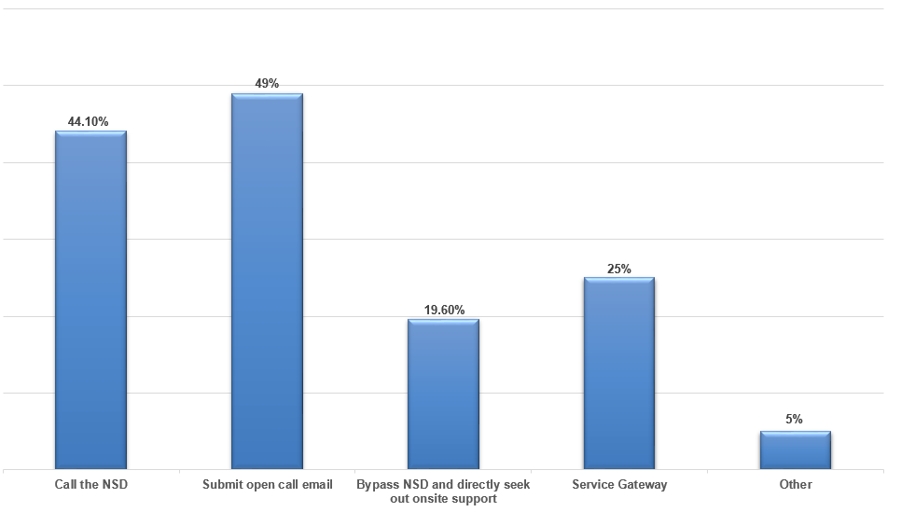
How do you currently go about making a request with the NSD? Multiple selection possible

Slide 5
Identify your top 3 reasons you contact the NSD
1. Password Related (Outlook, network, software)
2. Software Support (Software requests, installation, issues)
3. Hardware (peripherals, mobile, phone)

Slide 6
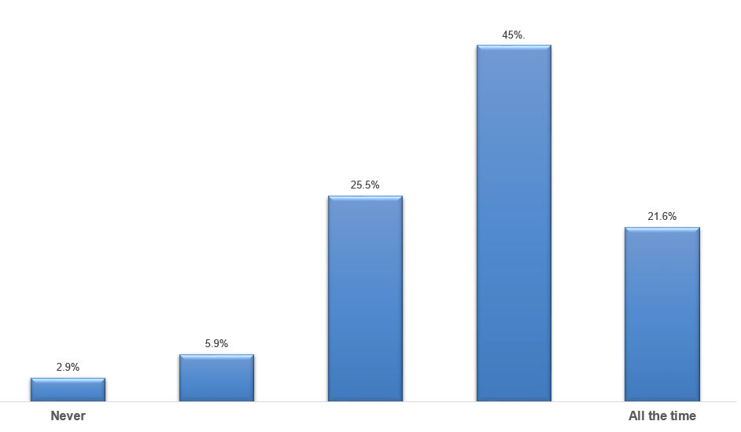
Does the NSD meet your support expectations?

Slide 7
How could the NSD have exceeded your expectations
Timeliness
Establish call back mechanism
Easier processes for clients

Slide 8
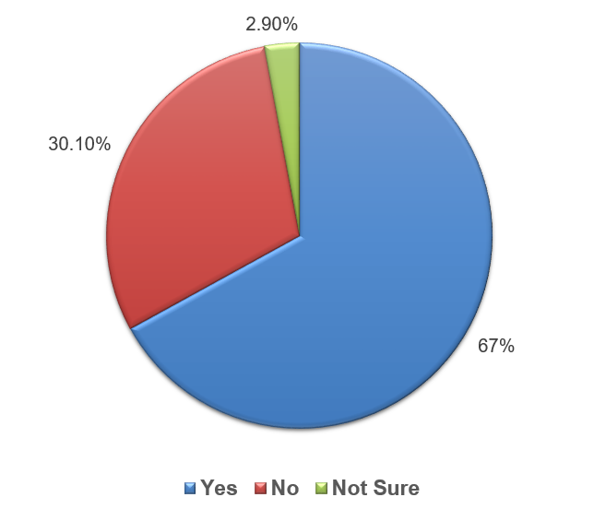
Have you used a chatbot before?

Slide 9
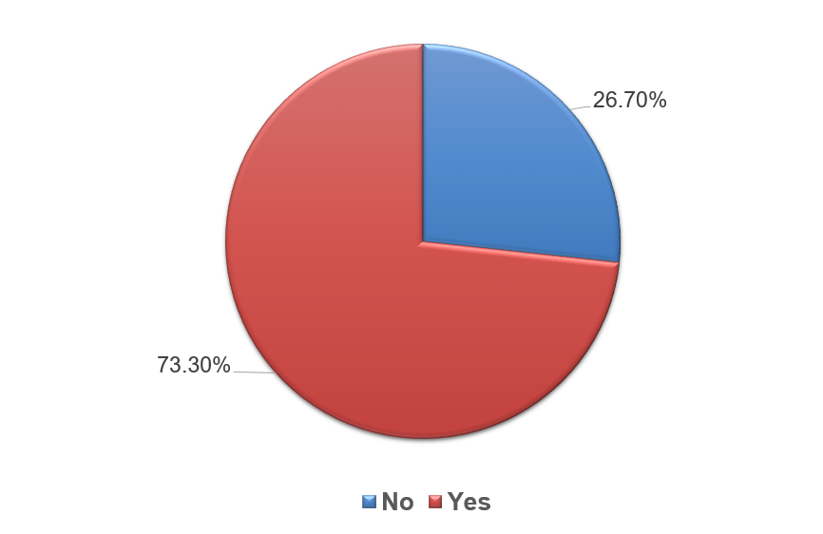
Would you prefer to use a web chat to contact the NSD?
If no, please explain:
Concerned about efficiency
Rather speak to live agent

Slide 10
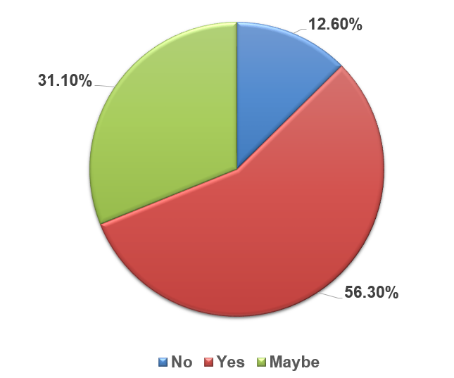
Would you be comfortable seeking support from a web chat if the first interaction was an automated assistant?

Slide 11
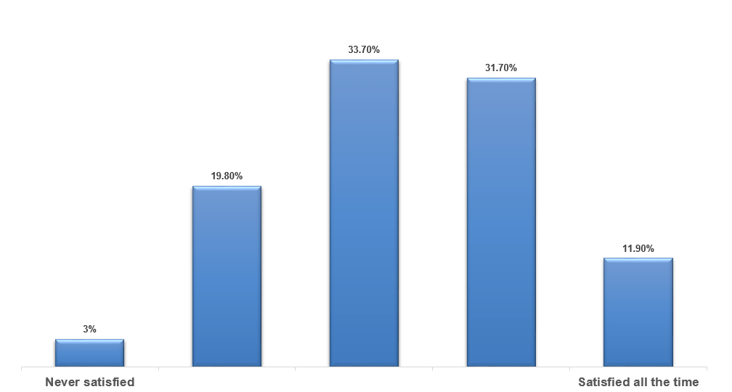
How satisfied are you with the amount of time it takes to resolve a problem?

Slide 12
Can you think of a task, submitted to the NSD that you think could be automated
1. Password Resets (+50%)
2. Software install / Requests
3. Information gathering (How to)

Slide 13
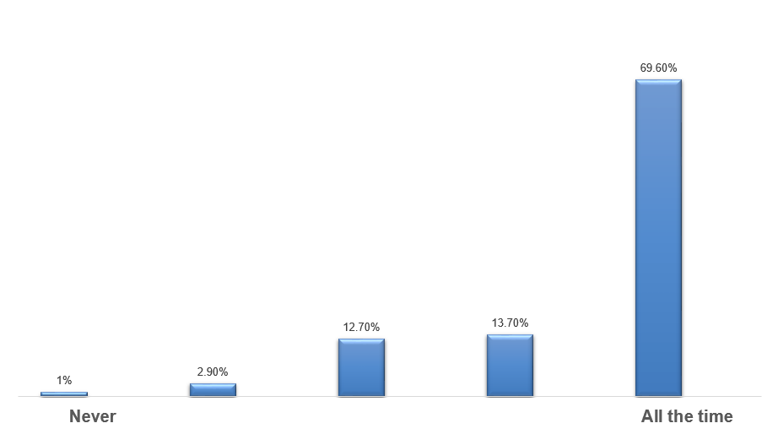
Do you attempt to resolve problems on your own before contacting NSD for support?

Slide 14
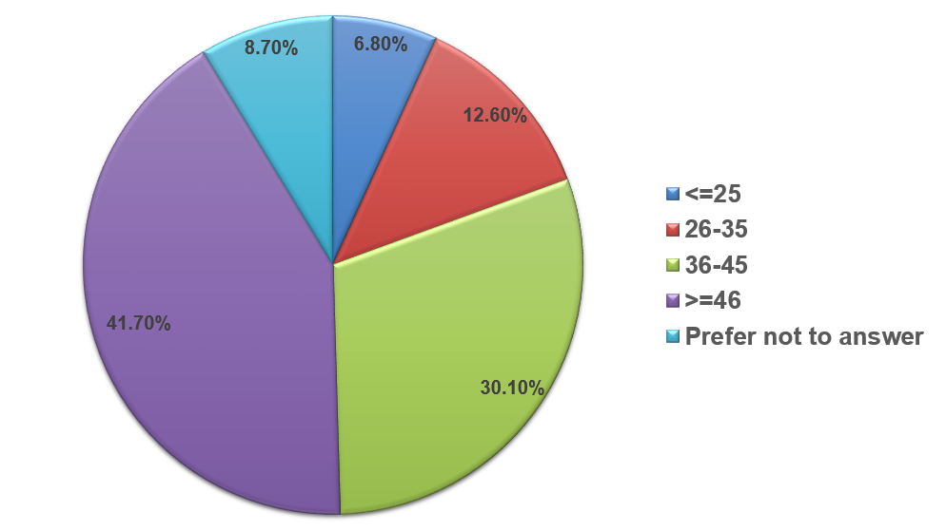
What is your age group?

Slide 15
Key Points
Overall positive feed back encourages the need to continue exploring chat bot options for the NSD.
Password requests must be address to ensure success
Even with users concerns, they are still willing to try the chat bot
Over 100 responses
French accounts for less than 2% of the results

