Slide 1
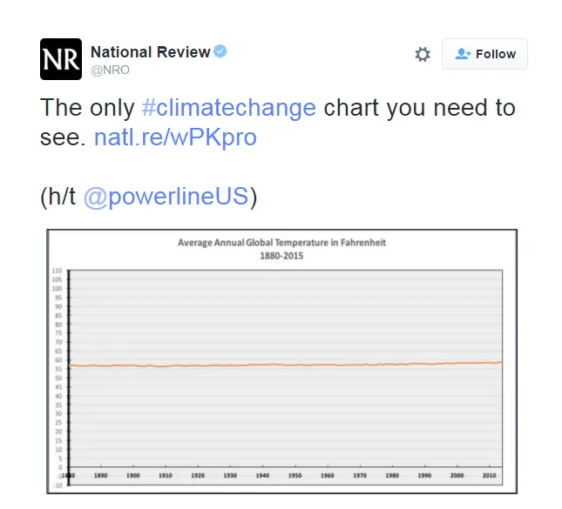
What’s wrong with this plot?

Slide 2


What’s wrong with this plot?
110 degrees Fahrenheit = 43 degrees Celsius
Recall these are average temperatures!
0 degrees Fahrenheit = -18 degrees Celsius
Notes:
Not exactly a reasonable range when looking at GLOBAL AVERAGE temperatures in recent years. If the average were anywhere near 43 degrees or -18 degrees, we would all be dead. (could argue over much longer time periods it might be reasonable…)
As a Canadian, my first question is why are we using Fahrenheit at all, this is not a baking class, but then I recalled the US uses F….
While you could argue that starting at 0 is good charting practice, it really depends on the nature of the data. Over these 144 years we have never reached either of those extremes bc this is an average temp across the whole world.
Also, which temperature metric (land surface, ocean, both)? Why are axes labels invisible and not titled? What’s the data source?

Slide 3
How to improve upon this plot?

Slide 4
How to improve upon this plot?
Some ideas:
Cite the data source
Select an appropriate y-axis range given the data
Label the y-axis and x-axis
Specify temperature metric
Increase legibility
Show variability
Consider anomaly approach?
Notes:
Ensure the data source is reliable – ok but I’m doing sketchy calcs…
Or consider simply what range of change we’re concerned about if don’t want to do anomaly – for e.g. we know we were concerned about 1, 1.5, and 2 degrees increases, so perhaps consider a ya xis that reflects this. Or, see what your max and min is and plot accordingly!
Consider an anomaly approach instead, as that is really what we’re interested in
Land, ocean, both…

Slide 5
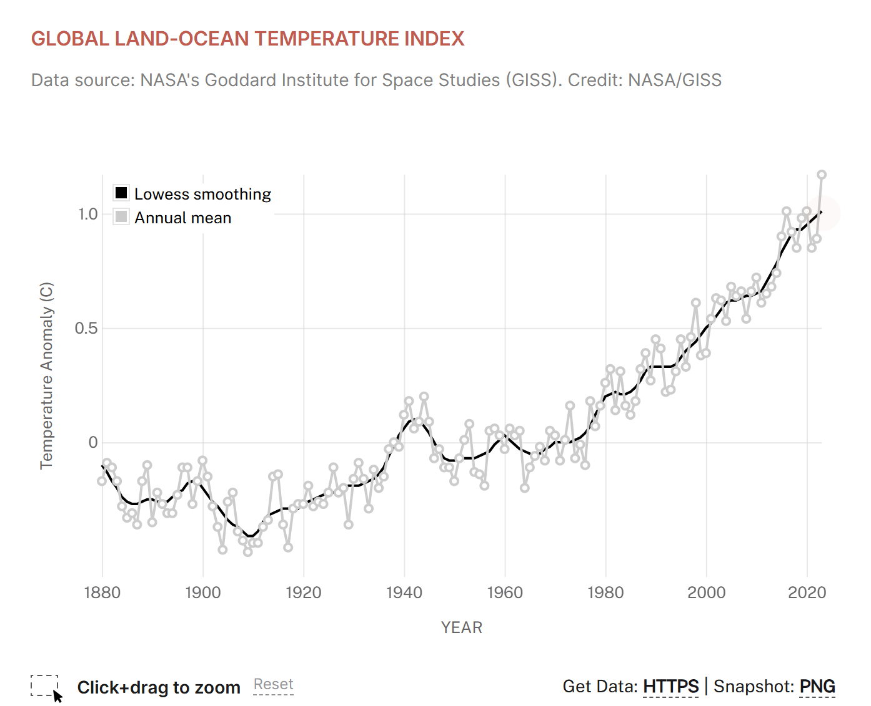
An alternate approach
https://climate.nasa.gov/vital-signs/global-temperature/?intent=121
Notes:
Can’t see here but also interactive – zoom in and out, hover w data

Slide 6
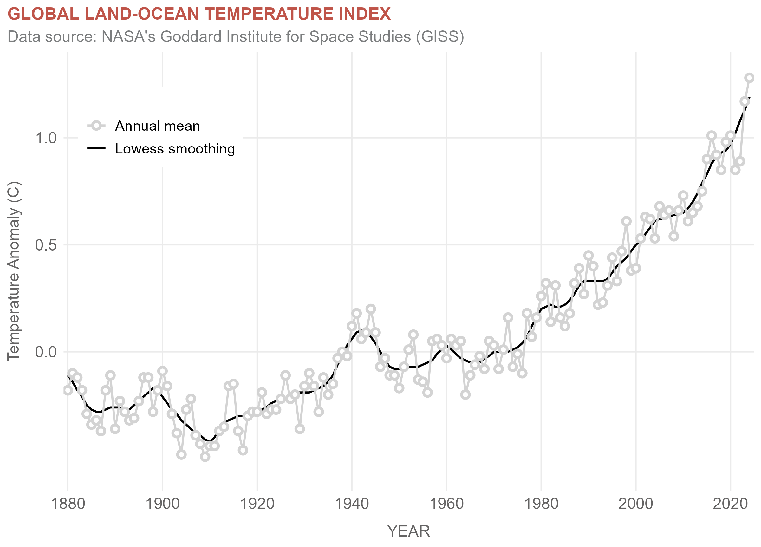
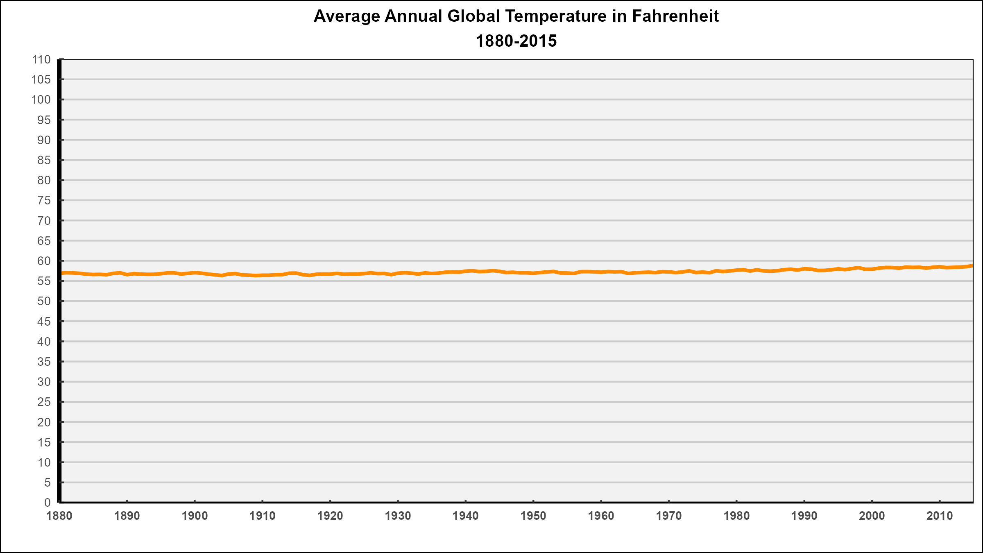
Let’s recreate both!

Slide 7
How would you present this data?
Notes:
Both these graphics are misleading in their own ways. How would you present this data? You can consider aspects such as the time scale, how the data is described, how variability is shown, the use of a reference period, etc.
What are some things to consider?
Plot on a longer time scale (but 1880 is direct measurement)
Heavily influenced by reference period (e.g. chose recent one
No mention of type of loess… 5 in df
Some indicator of variability?
Do a better job with the title and y axis – eg change in mean annual global surface temperature, as compared to the 1951-1980 average.
Caption describing data manip

