Slide 1
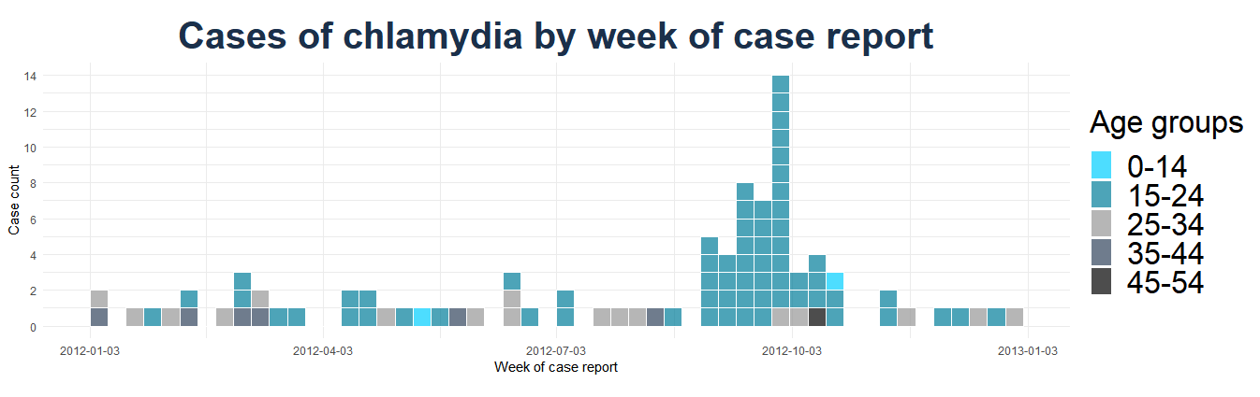
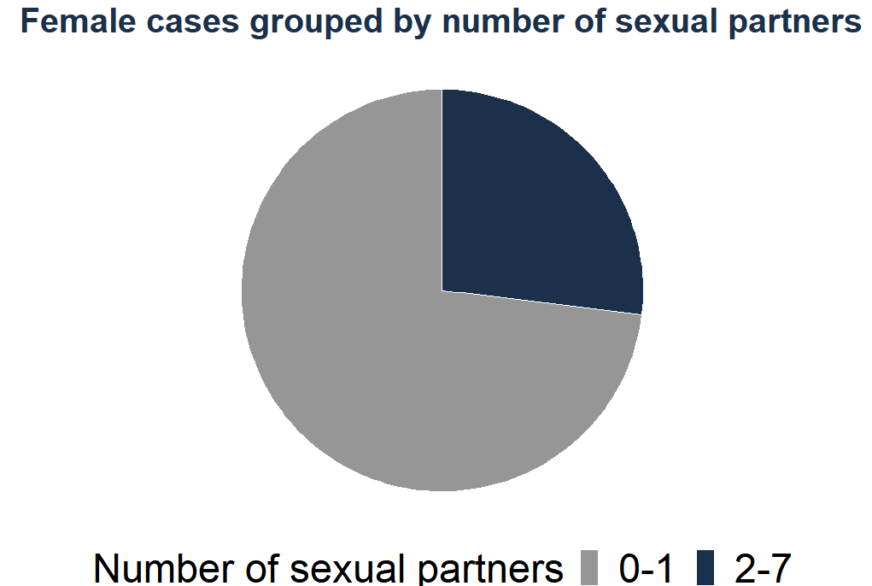
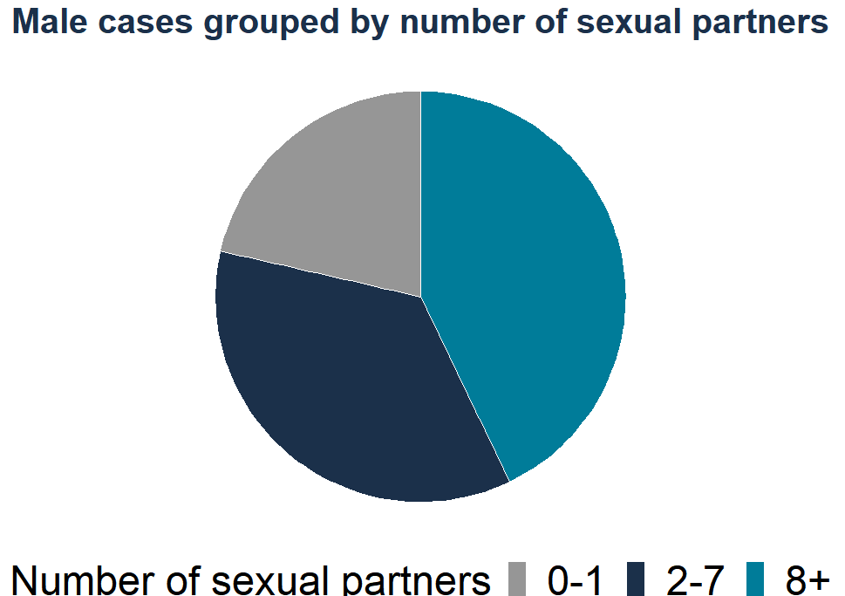
Chlamydia outbreak in region c
Chlamydia is a bacterial infection spread by sexual contact with infected individuals.
Chlamydia infections peaked towards the end of September.
Chlamydia infections peaked towards the end of September.
72%
of cases were 15 to 24 years old.
Recommendations
Prevention measures should target young males aged 18 to 34
Prevention messaging should target university population through social media such Instagram and TikTok
INDICATOR SOURCE: Mock chlamydia dataset created by Linda Vrbova and modified by the TDU for training purposes.

