Slide 1
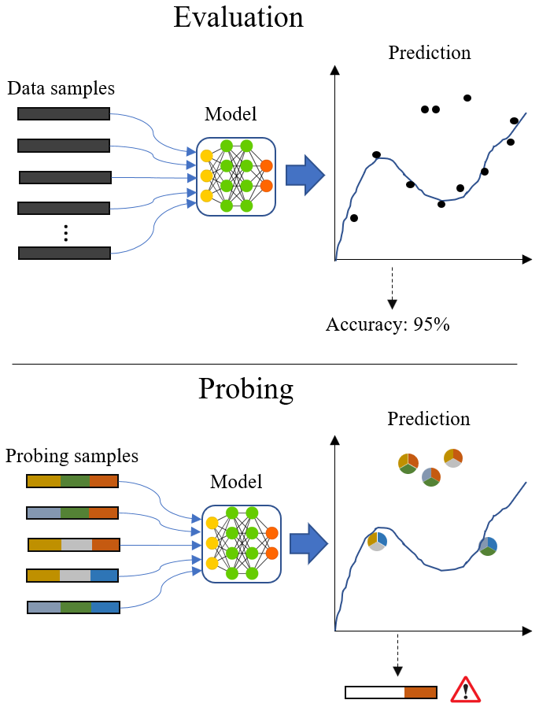
DetGen
Aim:
Provide controllable traffic data from different settings
Ground truth labels on what the traffic micro-structures "represents"
Reproducible
Why:
Originally to build software models
Now to understand and explore models

Slide 2
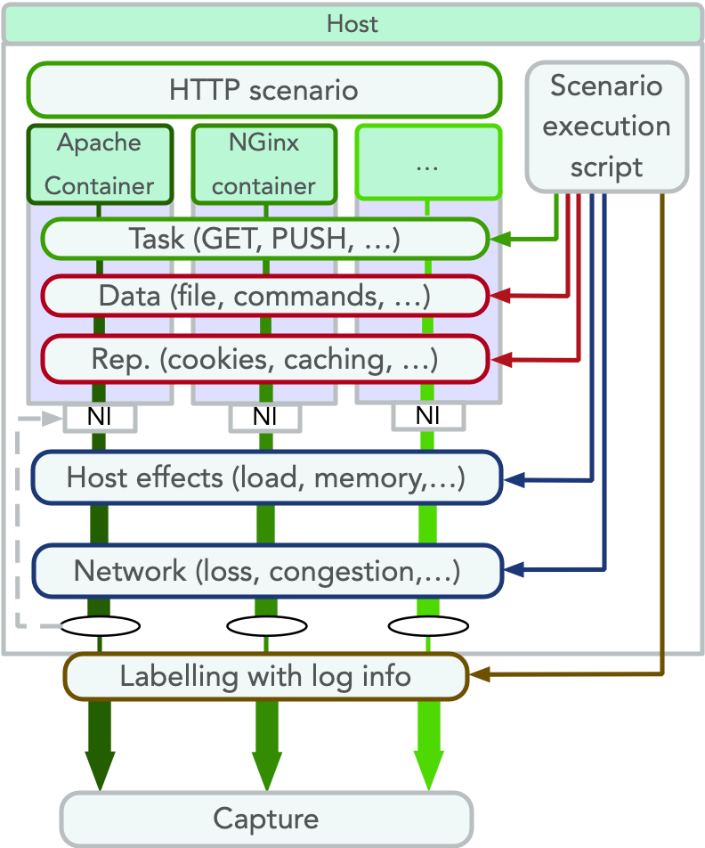
Design
Containerisation
- Traffic separation
- Isolation from other processes
- Reproducible and easy to modify setting
Scripted scenarios generate traffic
Execution script controls different settings
PCAP-file with labels after each run
26 scenarios so far

Slide 3
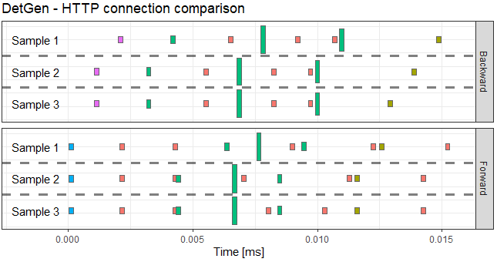
Publications
Materials not used:
Description of framework
Focus on control over structures
Determinism experiments
Diversity experiments
Drawing comparison to other NIDS datasets
2.5 papers so far:
DetGen for ML at DYNAMICS workshop
Some experiments to verify ML-usefulness
Probing demonstrations submitted to WTMC workshop
Usage of stepping-stone data for NSS-paper

Slide 4
Checklist for strong contribution:
Make repo more usable for others
Potentially graphical interface?
Generate exemplary dataset(s)
What should this data provide?
Demonstrate probing capabilities?
Demonstrate determinism/reproducibility?
Focus on how we can build a model that is better understandable using these microstructures
Rob: Multi-stage
Invite Michael on call, check on why they didn’t use detgen
Plan
Prepare paper for SecureComm
Deadline: 15th March

