Slide 1
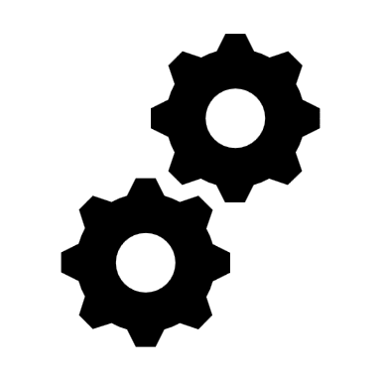
…

Slide 2
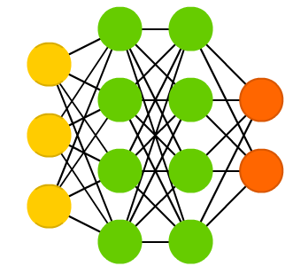

Evaluation
Probing
Prediction
Prediction
Data samples
Model
Probing samples
Model
…
Accuracy: 95%

Slide 3
Probing
Prediction
Probing samples
Model

Slide 4
Evaluation
Prediction
Data samples
Model
…
Accuracy: 95%
Probing
Prediction
Probing samples
Model

