Slide 1






Evading stepping-stone detection with enough chaff
Henry Clausen, David Aspinall, Michael Gibson
Notes:
Hi everyone,
My name is Henry Clausen and
I will talk to you today about our research on stepping stone data and the current state of their detection.
I conducted this research together with David Aspinall from Edinburgh and Michael Gibson from BT research.

Slide 2
Contribution
Large public Stepping-stone dataset:
90,000 connection pairs
Chaff/delay tactics
realistic setup
Re-evaluation of eight SSD-methods
Fair comparison of capabilities
different settings
Detection rates and AUC-scores
Notes:
To start, I just want to highlight the two main contributions of this work:
The first one is a large dataset that contains traffic from realistic stepping-stone connections that we intend to make public.
The second one is an in-depth evaluation of eight state-of-the-art stepping-stone methods that for the first time enables us to compare the results from
different methods and asses their capabilities.

Slide 3
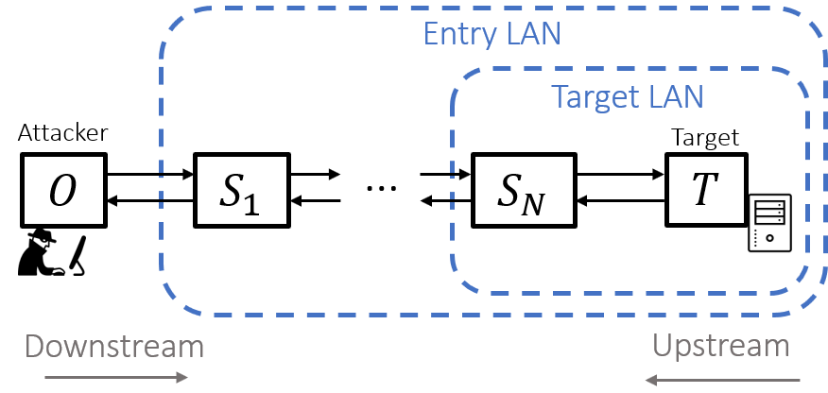
Stepping-stone
1
Relay of attack via “stepping-stone”
Hide attack origin
Access protected resources
Interactive access
Tools
SSH-tunnels
Netcat backpipe
SOCKS proxy
…
Usually encrypted
Notes:
Ok, so a stepping-stone is a node that is used by an attacker to relay their attack.
This is often done to access otherwise protected resources like an enterprise server, with the stepping-stone being a computer inside the target network.
Stepping-stones are also often used to hide the true origin of an attack behind a chain of relay hosts.
Stepping-stones are usually used in an encrypted interactive session, and are often established with tools such as SSH-tunnels, backpipes, or proxies.

Slide 4
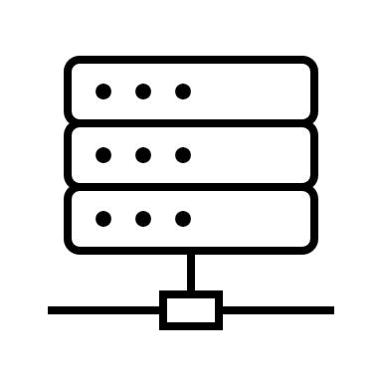




Stepping-stone detection
1
Sensor records incoming and outgoing connections
Measure correlation between pairs
Goal
Identify stepping-stones early before attacker
reaches target
exfiltrates data
Trace attack back to origin
$$H$$
$$H$$
…
Sensor
…
$${ S}_{1}$$
$${ S}_{N}$$
Notes:
The goal of stepping-stone detection is normally to detect indications of an ongoing attack before it reaches its target,
And to help trace the attack back to its origin
For this, a sensor is placed in a network that records the incoming and outgoing connections for each host and, depending on the methods, attempts to measure whether an incoming and an outgoing connection carry the same information

Slide 5
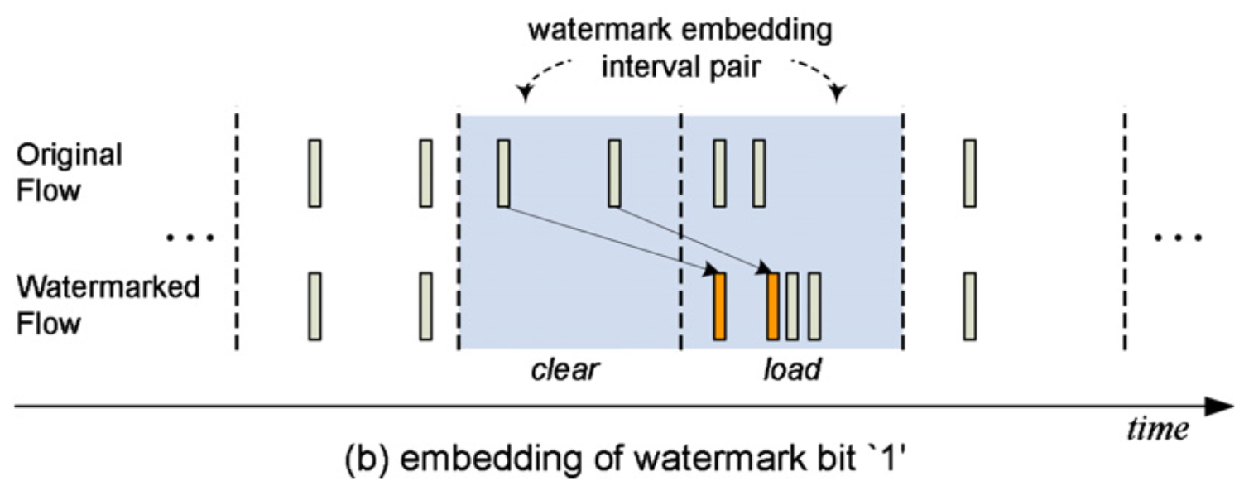
Stepping-stone detection
1
Most common techniques:
Watermarking
Packet correlation
RTT-based
Anomaly-detection
Evasive techniques
Transfer delays
Chaff packets
Repacketisation
Flow splitting
Flow 1
Flow 2
Notes:
A common technique to detect stepping-stones is Watermarking, where a bitstring is actively embedded in the first packet stream by altering packet interarrival times. This watermark is then detected in the forwarded packet stream
Another popular technique is packet correlation, where similar packets that occur in both streams are matched through their size, timing, and other metadata, and accumulated as evidence of a relay.
Furthermore, some methods attempt to measure excessive round-trip-time in a connection, a characteristic of relayed connections.

Slide 6

Stepping-stone detection
1
Most common techniques:
Watermarking
Packet correlation
RTT-based
Anomaly-detection
Evasive techniques
Transfer delays
Chaff packets
Repacketisation
Flow splitting
Flow 1
Flow 2
$$Δt$$
Notes:
Attackers can try to evade detection by adding jittered transfer delays to forwarded packets in order to destroy watermarks or packet matching,
And can insert additional packets in each connections to make the signal more noisy.
Anomaly-based methods attempt to identify these perturbations as another attack indicator.
Repacketisation and flow splitting have also been discussed as evasive tactics.

Slide 7
Evaluation problems
1
No public data!
Widespread use of self-generated data
Simplistic attack scenario
restrictive evasive tactics
Unrealistic background traffic
No standard on number of packets
Setup shielded from other influences
→ Impossible to compare detection rates
Notes:
The motivation for us to undertake this work is that it is currently impossible to compare results of
Different detection methods to each other.
The main reason for this is that there exists no public dataset that contains stepping-stone data, which leads
Researchers to use self-generated data. However, the generation of this data is often not independent and heavily
influenced by the researcher’s perception of stepping-stone behaviour. We have often seen that the conducted attack
communication is overly simplistic and lacking realistic aspects such as waiting times etc., or that unfounded assumptions
about the chaff or jitter perturbations are made such as limits on the amount of chaff.
Another reason is a lack of evaluation standards, such as an agreed number of packets necessary for detection or an maximum tolerable
false-positive rates. It very hard to compare the stated detection rates of two models if they are achieved under different conditions.

Slide 8



Data generation set-up
2
Interactive SSH-session
relayed using SSH-tunnels
SSH-script
commands drawn randomly
randomized inputs
sleep intervals to simulate reaction times
Containers for reproducibility
Virtual network in Docker
SSH-daemon
SSH-daemon
$$O$$
Forwarded ports
$$S_{2}$$
22
22
…
SSH-Tunnel 1
SSH-Tunnel 2
…
22
$$S_{1}$$
22
Server
SSH-daemon
Notes:
The goal in our setup was to provide independent data that can yield different settings
To highlight the strengths and weaknesses of methods in varying conditions.
Our attack scenario consists of interactive SSH-sessions that are forwarded from host to host using SSH-tunnels.
The command-scripts are generated for each session by drawing and concatenating common SSH-commands randomly,
And separating them with sleep intervals of random length to simulate the reaction time of an attacker. The input
Such as passwords, textfile inputs or directorys are also randomised
To ensure that each session is conducted in a reproducible manner, we relied on containerised applications that communicate in
A virtual container network

Slide 9








Data generation set-up
a)
2
$$O$$
Forwarded ports
$$S_{2}$$
rm xy
22
22
…
SSH-Tunnel 1
SSH-Tunnel 2
Ack
22
$$S_{1}$$
22
Interactive SSH-session
relayed using SSH-tunnels
SSH-script
commands drawn randomly
randomized inputs
sleep intervals to simulate reaction times
Containers for reproducibility
b)
$$S_{2}$$
Ack
22
…
SSH-Tunnel 2
…
$$S_{1}$$
22
rm xy
$$S_{2}$$
c)
22
rm xy
…
SSH-Tunnel 2
…
$$S_{1}$$
22
Notes:
A crucial aspect of SSH-tunnels is that they automatically repacketize and encrypt the forwarded contents,
And send independent ack-packets, which makes packet matching harder and is a reason why SSH-tunnels are often used for stepping stones.

Slide 10
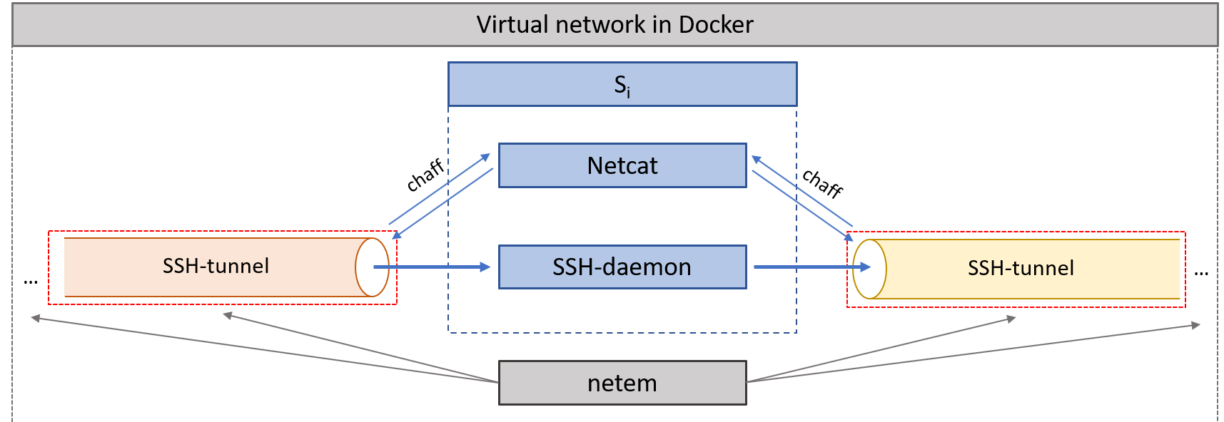
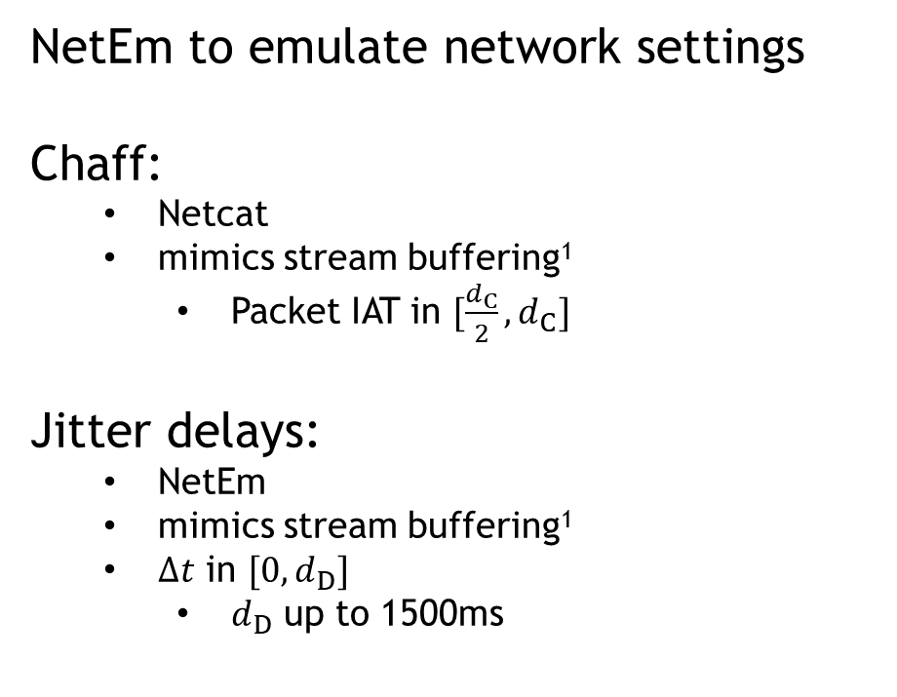
Data generation set-up
2
NetEm to emulate network settings
Chaff:
Netcat
mimics stream buffering¹
Packet IAT in $[\frac{d_{C}}{2},d_{C}]$
Jitter delays:
NetEm
mimics stream buffering¹
$Δt$ in $[0,d_{D}]$
$d_{D}$ up to 1500ms
¹ Padhye et al. (2010)
Notes:
To simulate different types of network environments and congestion, we apply
Randomised levels of packet loss, RTTs, or bandwidth usage with TC netem to the container interfaces.
We also use netem to apply jittered transfer delays to forwarded packets on the examined node, which are
drawn from a uniform distribution to mimic streaming services
Similarly, we insert random chaff packets to connections using netcat, with their interarrivals also mimicking streaming services, which
Has been proposed by Padhye et al. as an efficient way to add noise.

Slide 11

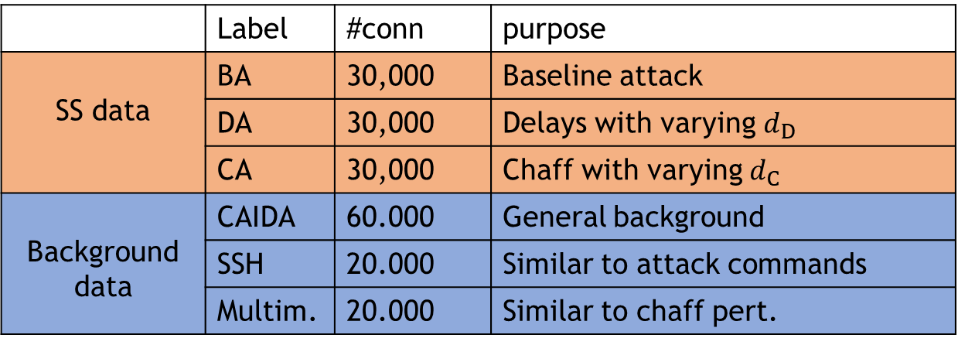
Evaluation data
2
Connection pairs from $S_{N}$
1,400 packets
 | Label | #conn | purpose
SS data | BA | 30,000 | Baseline attack
 | DA | 30,000 | Delays with varying $d_{D}$
 | CA | 30,000 | Chaff with varying $d_{C}$
Background data | CAIDA | 60.000 | General background
 | SSH | 20.000 | Similar to attack commands
 | Multim. | 20.000 | Similar to chaff pert.
Notes:
We created three different stepping-stone datasets,
With the first one containing baseline relayed connection pairs without any evasive behaviour,
And the second and third containing varying levels of chaff or delays.
As a control, we used the CAIDA traffic traces as general background, and also generating traffic from regular SSH
and streaming services to examine how well detection methods can distinguish between the attack data and traffic with similar characteristics

Slide 12
Selected methods
3
Label | TP | FP | Robustness | Category
PContext (2011) | 100% | 0% | jitter/chaff | Packet correlation
DeepCorr (2018) | 90% | 0.0002% | small jitter | Neural networks
WuNeur (2010) | 100% | 0% | -
Rwalk (2015) | - | - | chaff | RTT-based
Crossover (2016) | 85% | 5% | -
Ano1 (2011) | 99% | 1% | jitter/chaff | Anomaly-based
Ano2 (2011) | 95% | 0% | jitter/chaff
WM (2011) | 100% | 0.5% | jitter | Watermarking
Notes:
For the evaluation, we tried to include methods that cover different detection techniques and evasion robustness claims.
We included traditional packet correlation method, as well two deep learning-based correlation method, one of which is very recent and the other a bit older.
We then include two successful RTT-based methods, as well as two anomaly-based methods and a watermarking method that promises robustness to jitter delays.

Slide 13
3
Notes:
The first thing we did was analyse overall detection rates on the baseline-dataset, which does not contain any evasive techniques.
Here you see ROC-curve where the achieved true-positives of a method are plotted against the false-positives, here on a logarithmic scale, while varying the detection threshold.
Unsurprisingly, the watermarking method already achieves quite high detection-results at a false-positive rate of around 0.01%, which is an order of magnitude lower than the next best methods, the packet correlation and the first deep learning model.
The RTT-based methods and the older deep learning do not perform very well and only really start to reliably detect stepping-stones at a false-positive rate approaching 10%.
We excluded the anomaly-based methods here since this dataset includes no evasive behaviour.

Slide 14
3
FP-rate: 0.4%
Notes:
So now take a look at the second dataset to examine how
transfer delays imposed by the attacker affect detection rate. For this,
We fixed the false-positive rate at 0.4% for all methods and then measured
the detection rate in dependence of the imposed maximum delay.
While the traditional packet-correlation is affected immediately, the watermarking method performs reasonably well for delays up to 300ms.
Even more remarkable is that detection rates for the newer deep-learning method seem to be relatively unaffected by the transfer delays.
The two anomaly-based methods only detect transfer delays relatively late at around 500ms or more, which is far higher than claimed by the authors.

Slide 15
3
FP-rate: 0.4%
Disproves chaff robustness claims by PCorr, RTT1, and both anomaly methods!
Notes:
Lastly, we look at the performance of the selected methods under chaff perturbations.
Again, we fixed the false-positive rate at 0.4% and plotted the detection rate against the ratio of chaff packets in the connections.
The main takeaway here is that detection rates for all methods decline if enough chaff is inserted. Surprisingly, the anomaly-based
methods were not able to reliably identify even excessively high amounts of chaff without raising false-positives in the benign streaming data,
Which leads us to conclude that an attacker can successfully disguise a stepping-stone connection as streaming-data to evade detection.
The methods which perform best in the presence of smaller amounts of chaff are the watermarking and the newer and larger deep-learning model.

Slide 16
Limitations
4
No behavioural/graph-based models
No store-forward-stepping stones
No flow-splitting
Data might need updates for future methods
Notes:
The main limitations of our analysis are that we focused exclusively on the effect of connection
relays to the packet stream. This is appropriate for the methods we focused on, but is unsuitable for
Behavioural or graph-based methods which focus more on features such as the number of contacted IP-addresses
Or potential chains in the network.
Furthermore, we did not look at another class, called store-and-forward stepping stones,
Which do not operate in an interactive manner, as the name suggests.
Finally, since none of the currently published methods are described as being robust against flow-splitting,
We did not include this technique in the data generation.

Slide 17
Conclusion
4
Large public dataset
Realistic interactions
Evasive tactics
github.com/detlearsom/detgen/stepping-stone-data
Evaluation of current state-of-the-art
Lower overall detection rates
Lack of robustness against chaff
Watermarking and deep-learning performs best
Notes:
To conclude, we are realising a large independent dataset for other reaserchers to use,
Which features realistic SSH-interactions and different levels of evasive tactics
We are currently in the process of creating a suitable repository for it, you will be able to find it under the following address.
Our evaluation demonstrates that the detection rates on our dataset for many methods are actually lower than stated,
And that there is a severe lack of robustness against chaff instertion.
Currently, it looks like watermarking and large deep-learning-models are the way to go.
That‘s it, and thank you for your attention

Slide 18
Additional results
3
WAN-influence
 | Value | Deviation from average
 |  | DeepCorr | WuNeur | RWalk | COver | WM
RTT | 5ms | -0.2% | +41.3% | -42.3% | -36% | +0.03%
 | 70ms | -5.6% | -5.8% | +35.1% | +51% | -2.2%
Packet loss | 0% | +1.2% | +1.3% | +2.1% | +4.3% | +0.02%
 | 7% | -9.1% | -1.1% | -3.1% | -7.3% | -9.7%
Notes:
Execution script contains
Selected subscenario
Number of repeats
Randomised input
WAN emulation

Slide 19
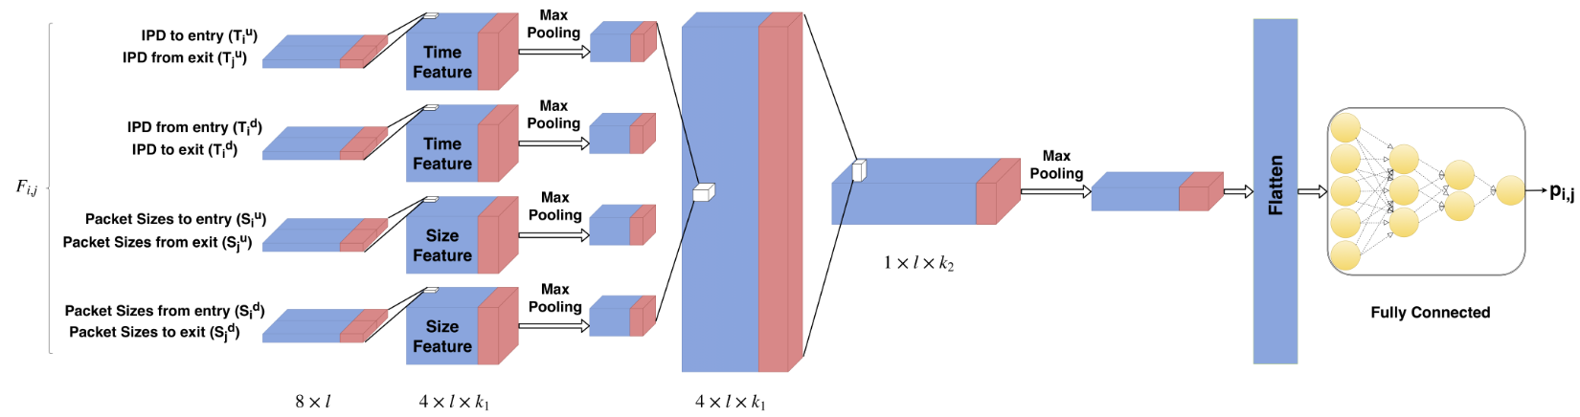
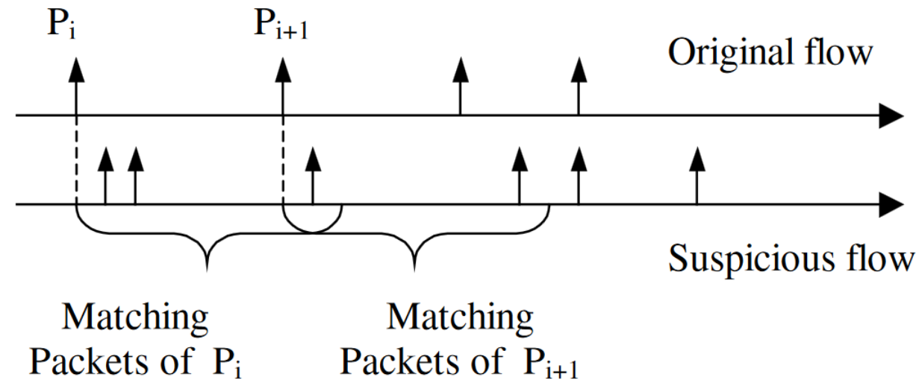
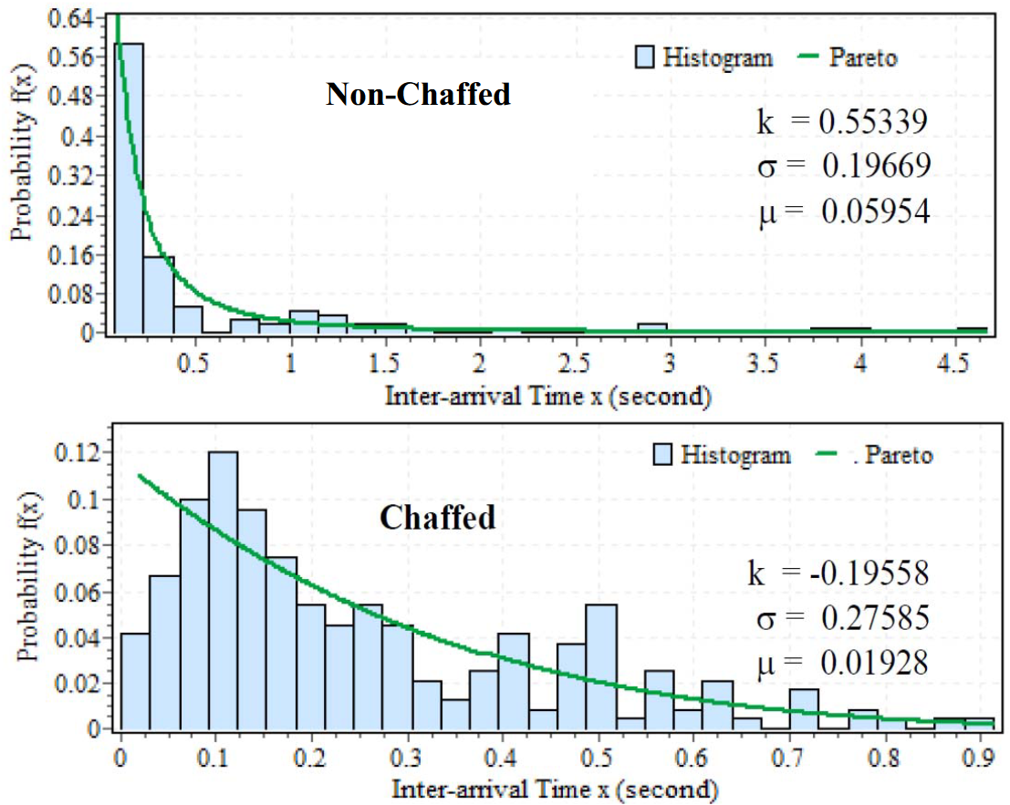
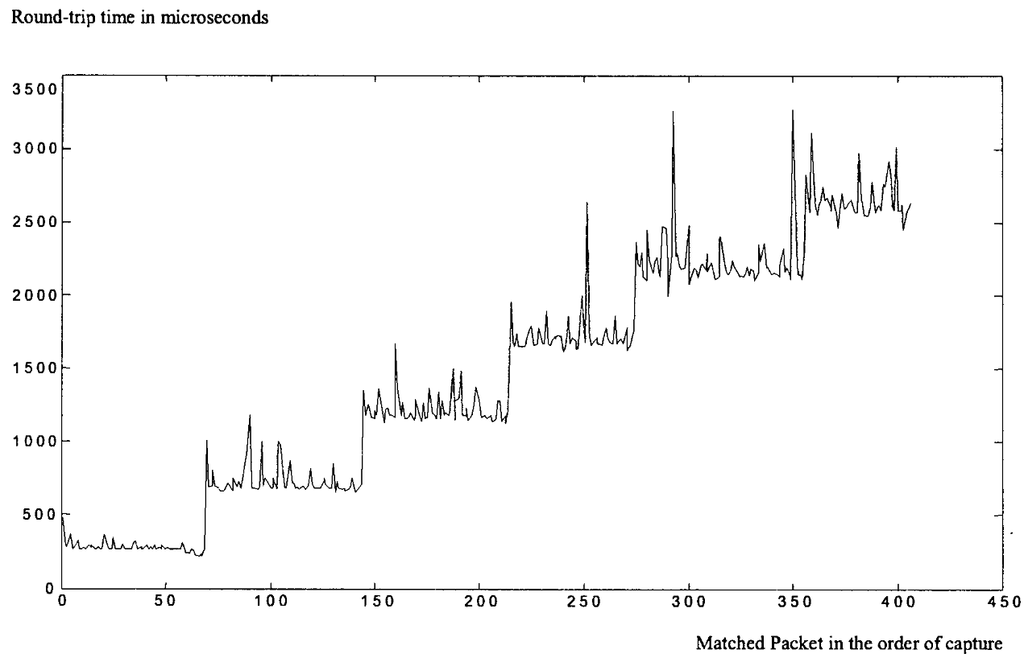
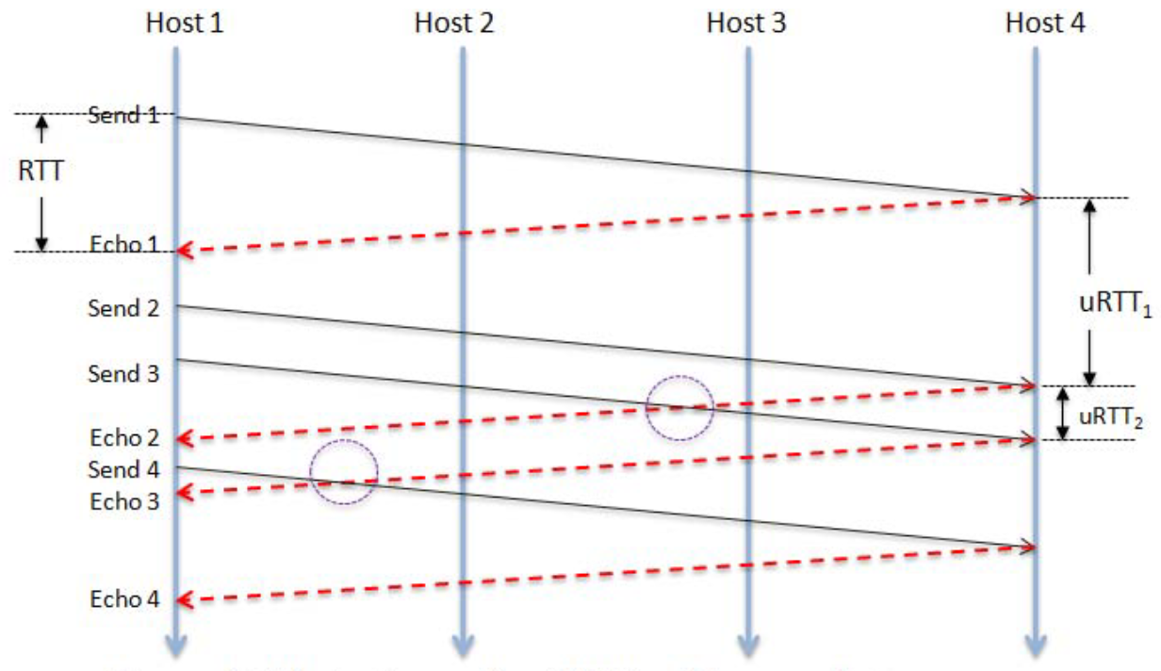
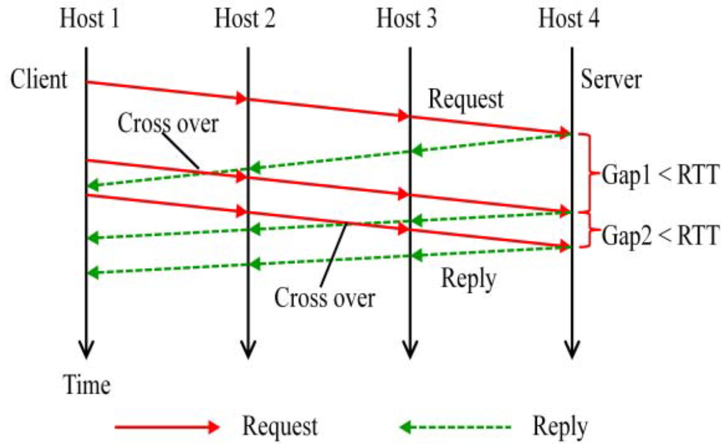
Models
2
DeepCorr 2018, Nasr et al.
Notes:
Since traffic is generated from scripted activities, traffic variation is dependent on the range of these activities
Attention is usually paid to cover a wide range of popular protocols
We found that within ind. Protocols, these tasks conduct little exploration of the available options
Example are ftp connections within cic-ids 17,
Deleting files, fetching multiple files at once, printing path, etc.
Same file over again, this will limit the observed numbers of packets , their direction, and the connection size
Another source of variation that is neglected are of more technical nature and include
Can alter observed packet/flow signatures

Slide 20
Agenda
ML and network data
Problems in current datasets
Containerization
Traffic generation suite
Example use-case
Limitation & conclusion
Notes:
ML and application to net security and net data
Problems we found in current datasets

Slide 21
Agenda
ML and network data
Problems in current datasets
Containerization
Traffic generation suite
Example use-case
Limitation & conclusion
Notes:
ML and application to net security and net data
Problems we found in current datasets

Slide 22
Agenda
Stepping-stones and detection
Data generation process
Evaluation
Limitation & conclusion

Slide 23
Agenda
Stepping-stones and detection
Data generation process
Evaluation
Limitation & conclusion
Notes:
To outline this presentation, I will first give a brief overview over stepping-stones and methods to detect them
I will then explain the process we followed to generated realistic stepping-stone data,
and then go through the results of our evaluation, before giving our conclusion and limitations.

Slide 24
Agenda
Stepping-stones and detection
Data generation process
Evaluation
Limitation & conclusion
Notes:
To outline this presentation, I will first give a brief overview over stepping-stones and methods to detect them
I will then explain the process we followed to generated realistic stepping-stone data,
and then go through the results of our evaluation, before giving our conclusion and limitations.

Slide 25
Agenda
Stepping-stones and detection
Data generation process
Evaluation
Limitation & conclusion
Notes:
ML and application to net security and net data
Problems we found in current datasets

Slide 26
Agenda
Stepping-stones and detection
Data generation process
Evaluation
Limitation & conclusion
Notes:
ML and application to net security and net data
Problems we found in current datasets

Slide 27
Limitations
6
Not replicated well:
Network-wide distribution
long-term temporal structures
Data volume huge
preprocessing required
Manual implementation
Notes:
While this provides great insight into small-scale traffic structures, framework will not replicate realistic network-wide structures, such as port usage distributions or long-term temporal activity.
These quantities would have to be statistically estimated from other real-world traffic beforehand and included in coalescing process
to allow our framework to emulate such behavior reliably.
Other datasetssuch as UGR-16 use this approach to fuse real-world and synthetic traffic and are currently better suited to build models of large-scaletraffic structures.

Slide 28
Conclusion
6
Our traffic generation suite fuels ML through:
High degree of traffic variability
Ground truth labels through activity isolation
Scalability
Modularity
github.com/detlearsom/detgen/
Future work:
capture of syslogs
streamlined data coalescence
Notes:
expand explanation on how to address limitations

Slide 29

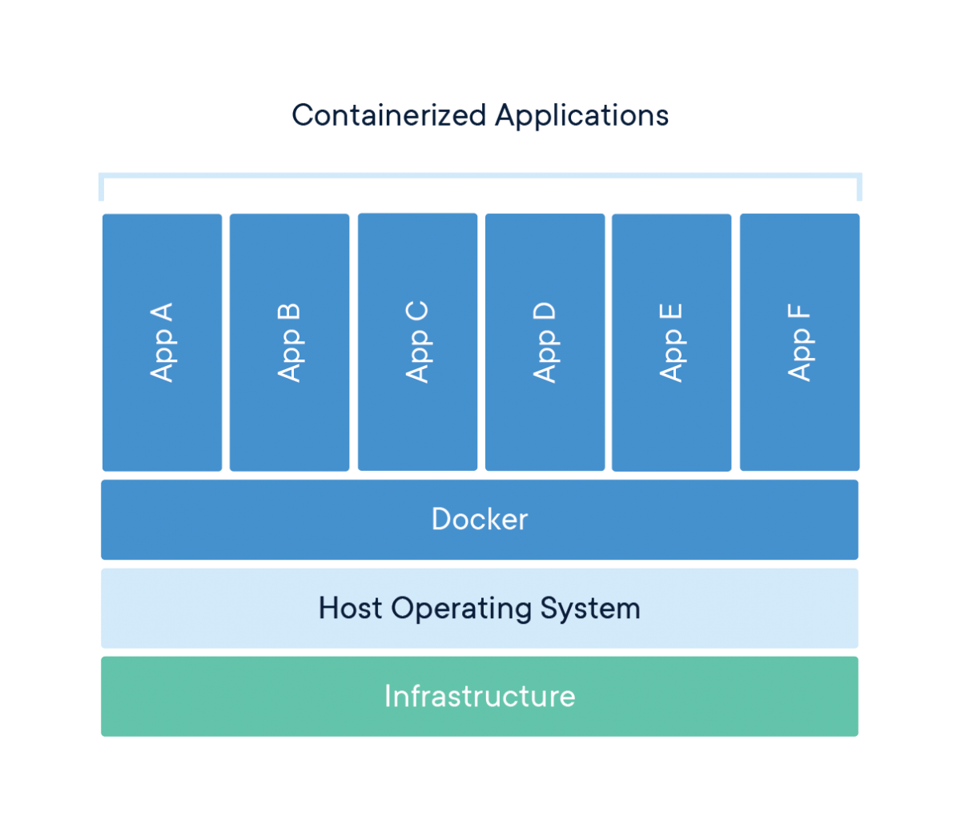
Containerization
3
Programs/process as standalone virtualised standard units
Advantages:
lightweight
runs uniformly
safe through isolation
Containers can be arranged in virtual networks
Notes:
New programming paradigm
Isolated and independent of host OS
including IP addresses
This arrangement of isolated programs into a network rather than full-fledged operating systems will enable us to make more accurate ground truth statements about collected traffic

Slide 30
Stepping-stone detection
1
Most common techniques:
Watermarking
Packet correlation
ML-based flow correlation
RTT-based
Anomaly-detection
Evasive techniques
Chaff packets
Transfer delays
Repacketisation
Flow splitting
Notes:
Applications of ML in … that are already in place or are seen as promising in the future are multifold
I have included some graphical examples of this,
give more details on bullet points

Slide 31
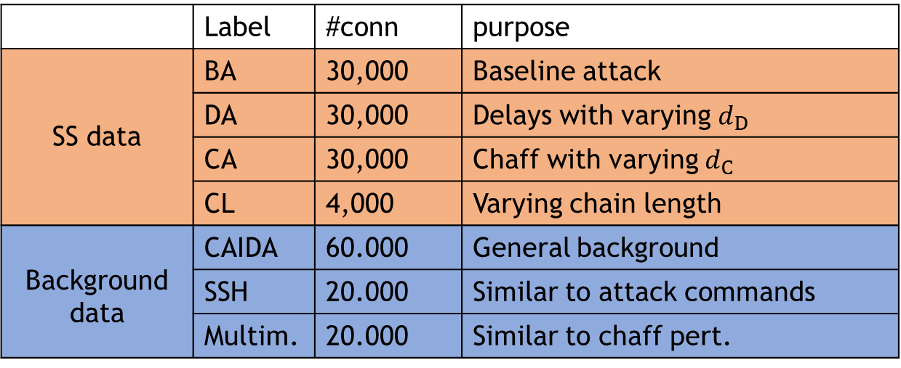
Evaluation data
2
Connection pairs from $S_{N}$
1,400 packets
 | Label | #conn | purpose
SS data | BA | 30,000 | Baseline attack
 | DA | 30,000 | Delays with varying $d_{D}$
 | CA | 30,000 | Chaff with varying $d_{C}$
 | CL | 4,000 | Varying chain length
Background data | CAIDA | 60.000 | General background
 | SSH | 20.000 | Similar to attack commands
 | Multim. | 20.000 | Similar to chaff pert.
Notes:
We created four different stepping-stone datasets,
With the first one containing relayed connection pairs without any evasive behaviour,
And the second and third containing varying levels of chaff or delays. The fourth dataset explores the effect
Of the stepping-stone chain length
As background data, we

