Slide 1


Slide 2

Notes:
note: Keep it punchy.

Slide 3


Slide 4
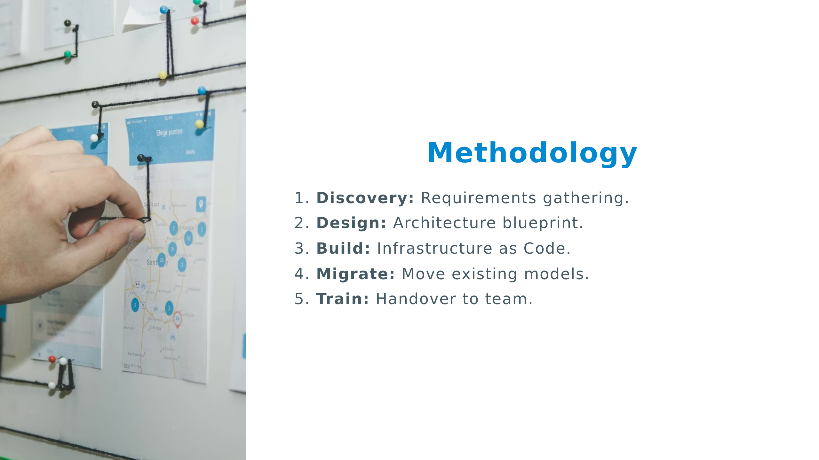

Slide 5
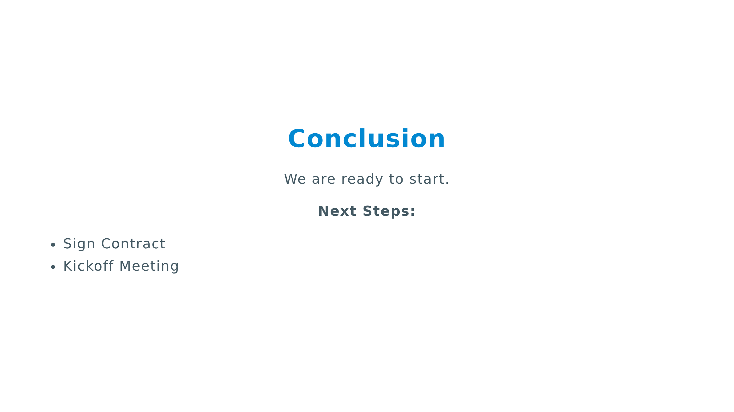

Slide 6


Slide 7
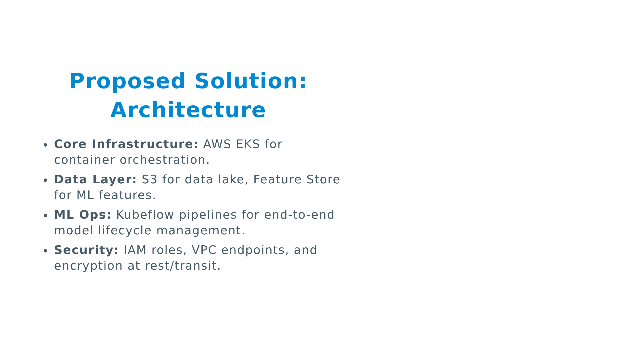

Slide 8
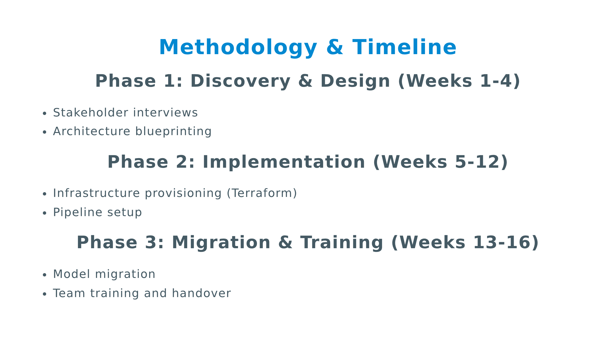

Slide 9


Slide 10
