Slide 1

Medical insurance cost prediction ANALYSIS
TEAM 6:
Himanshu Chhabra
Kamaleshwar Ravichandran
Somil Saxena
Vidhi Bansal

Slide 2
Project purpose
Background
Understanding Insurance costs is important to governments, insurance providers, hospitals, and many other entities. As students pursuing analytics, understanding how to model similar data is of great interest
Problem
For insurance companies, an important task is to determine an ideal premium for every insured individual given a few independent variables
Solution/Approach
Construct a statistical model to compute the expected charges

Slide 3
BRIEF INTRODUCTION
Medical insurance companies, are often looking for analysis to determine an ideal premium for every insured individual given a few independent variables like Body Mass Index, dependents, smoking habits etc.
Early identification of those with a higher risk of hospitalization could help in making efficient analysis to determine the charges
Using historical data, the project will try to construct a statistical model to compute the expected charges for everyone. Before that, exploratory graphs and quick modelling will give us basic insights

Slide 4
Data dictionary
age: Age of the primary beneficiary
sex: Insurance contractor gender; female, male
bmi: Body mass index, providing an understanding of body, weights that are relatively high or low relative to height, objective index of body weight (kg / m ^ 2) using the ratio of height to weight, ideally 18.5 to 24.9
children: Number of children covered by health insurance / Number of dependents
smoker: Whether smoker or not
region: The beneficiary's residential area in the US, northeast, southeast, southwest, northwest
charges: Individual medical costs billed by health insurance

Slide 5
Descriptive – exploratory data analysis
Dataset has 1429 observations of 7 variables:
age | sex | bmi | children | smoker | region | charges
Int | Factor | Num | Int | Factor | Factor | Num
A brief look at the dataset summary tells us few noteworthy points:
 | vars | n | mean | sd | median | trimmed | mad | min | max | range | skew | kurtosis | se
age | 1 | 1429 | 39.44 | 13.71 | 40 | 39.3 | 17.79 | 18 | 64 | 46 | 0.02 | -1.18 | 0.36
sex* | 2 | 1429 | 1.5 | 0.5 | 2 | 1.5 | 0 | 1 | 2 | 1 | 0 | -2 | 0.01
bmi | 3 | 1429 | 30.79 | 6.09 | 30.5 | 30.62 | 6.2 | 15.96 | 53.13 | 37.17 | 0.29 | -0.03 | 0.16
children | 4 | 1429 | 1.12 | 1.21 | 1 | 0.97 | 1.48 | 0 | 5 | 5 | 0.93 | 0.22 | 0.03
smoker* | 5 | 1429 | 1.19 | 0.39 | 1 | 1.12 | 0 | 1 | 2 | 1 | 1.56 | 0.45 | 0.01
region* | 6 | 1429 | 2.45 | 1.1 | 2 | 2.44 | 1.48 | 1 | 4 | 3 | 0.05 | -1.33 | 0.03
charges | 7 | 1429 | 17444 | 12819 | 14244 | 15749 | 10515 | 1122 | 70021 | 68900 | 1.17 | 1.03 | 339.1
Charges, our target variable has high variance
All the variables are normally distributed, with notable kurtosis in age, sex , region and charges columns

Slide 6
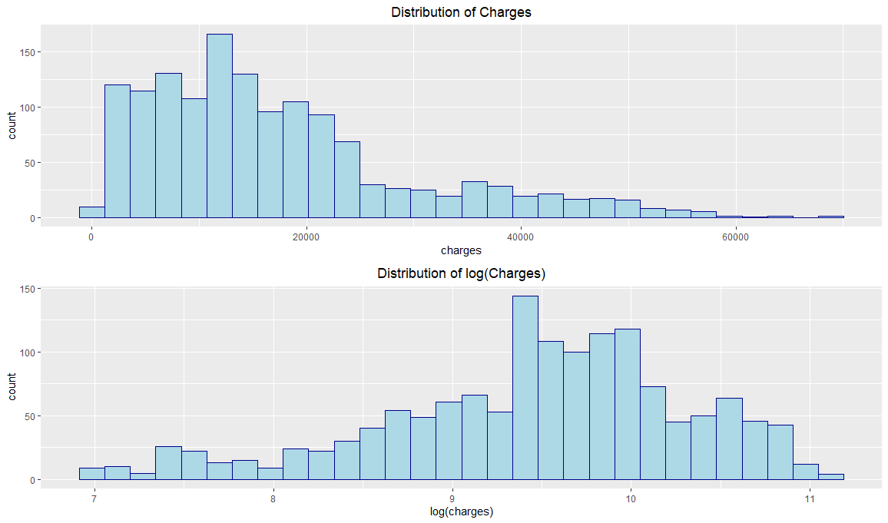
exploratory data analysis
A histogram of Charges (target variable) shows a skewed distribution. After log transformation, the distribution is much more symmetric

Slide 7
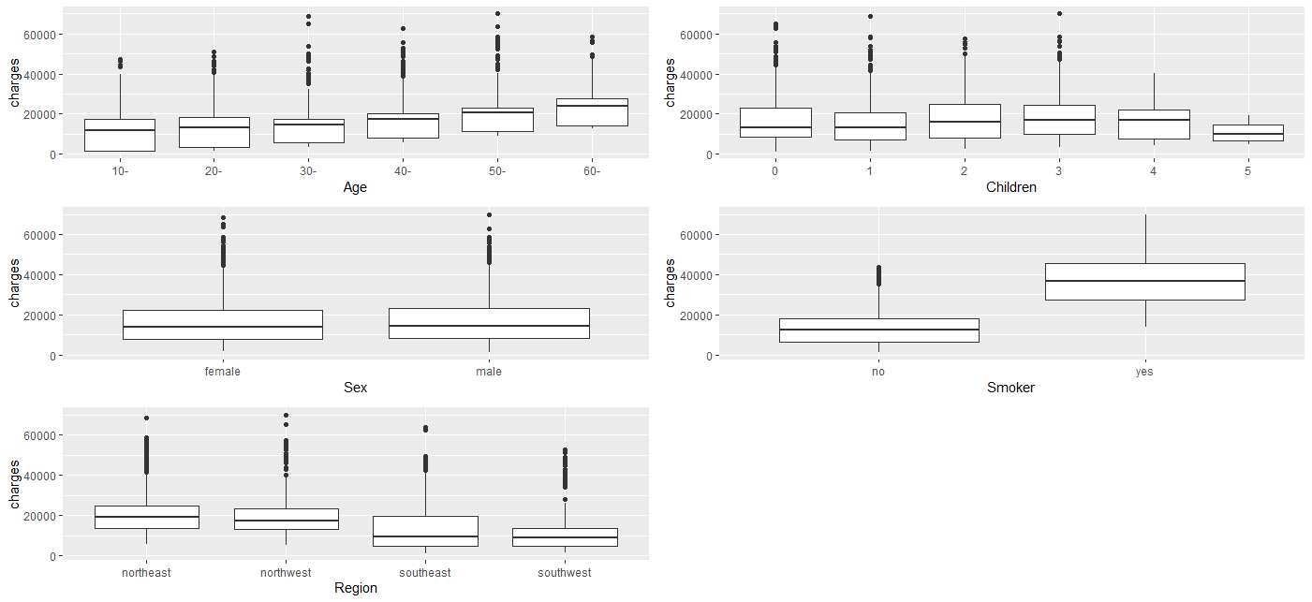
exploratory data analysis - OUTLIER PLOT
A quick look at the outlier plots tells us-
Insurance payers at age 30 and 40 have outliers
Insurance payers at 1 and 3 children/dependents have outliers
Insurance payers in NE and NW regions

Slide 8
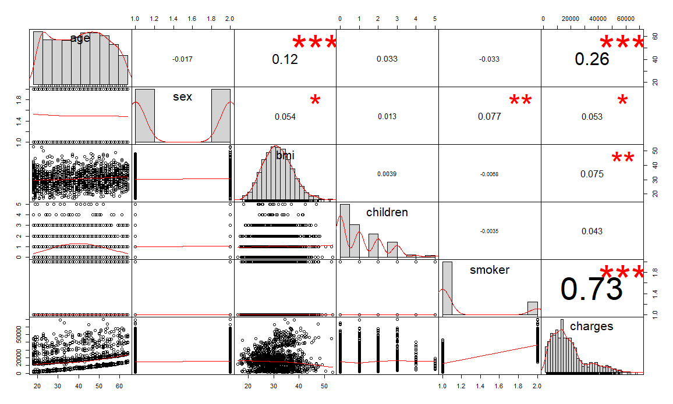
exploratory data analysis
Variables overall have very low levels of correlation with one another, with the only particularly strong interaction being between charges and smoker
Some other notable significance, even if less with target variable are - Age with charges and bmi with age
Our data set contains relatively even distribution of age, bmi and sex
Many respondents have 0 children or 0 dependents

Slide 9
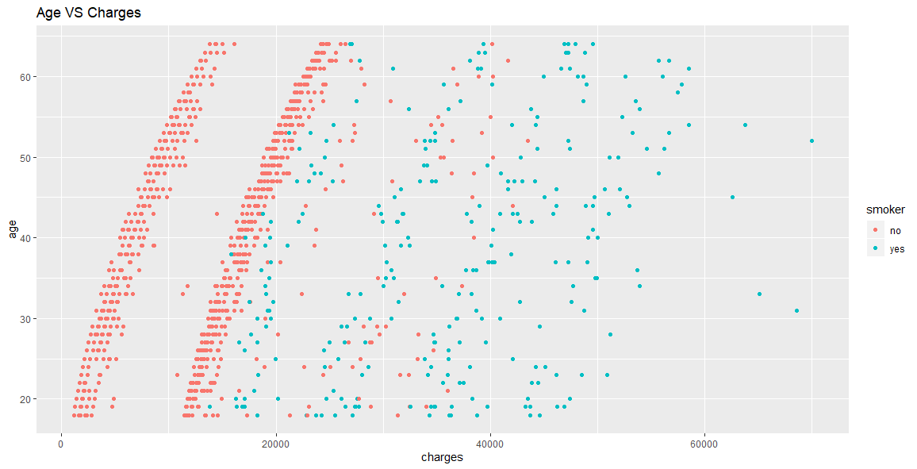
exploratory data analysis
Age is positively correlated with charges
Separating age by smoking status is important as non smokers- irrespective of age tend to pay less insurance charges

Slide 10
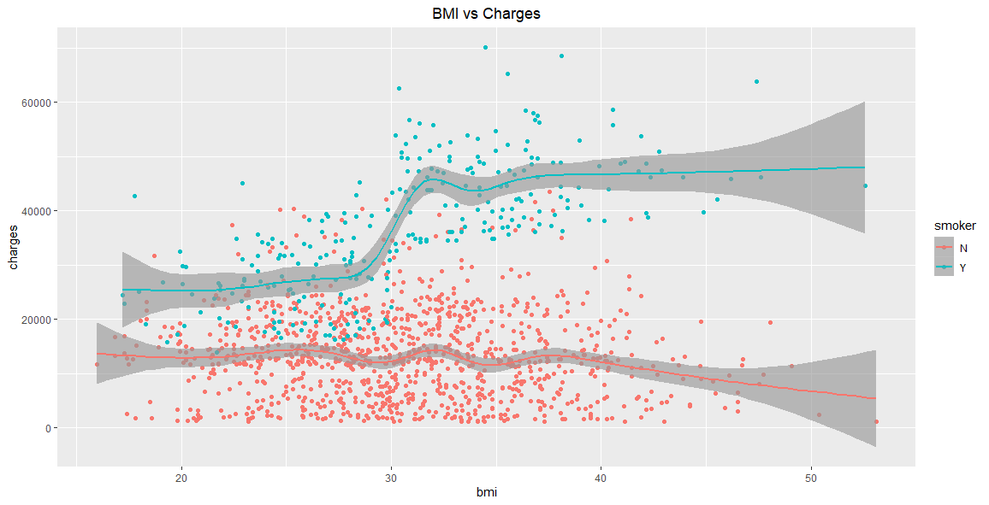
exploratory data analysis
There is a big jump in charges for people smoking and over 30 bmi
It looks like BMI and Charges has almost no relationship for people who do not smoke. However there is certainly a trend for those who do

Slide 11
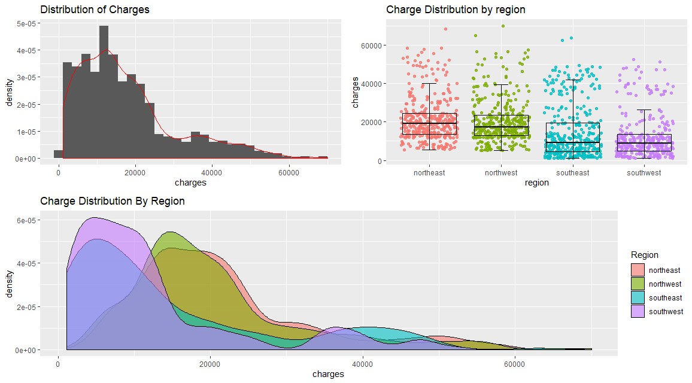
exploratory data analysis
Overall the price distribution is skewed to the right
It is due to some specific regions
NE and NW regions have high mean which is pulling the overall distribution towards the right, indicating higher income group or expensive premium

Slide 12
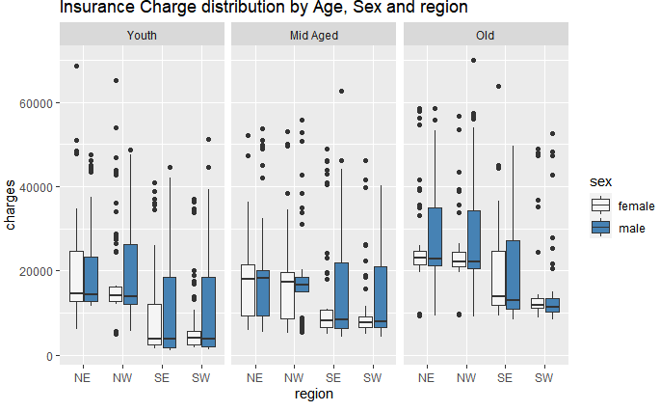
exploratory data analysis
Male Female population is analyzed for price for each region and age group
Age is broken down into 3 groups
Youth - 18 – 35 years
Mid Aged - 36 – 50 years
Old – 51 – 80 years
It is observed that-
For NW region and NE region Males have higher charges in the old category whereas
Females have higher charge for NE in the Youth and Mid Age category

Slide 13
FEASABILITY TEST – LINEAR REGRESSION MODEL
To check feasibility of model linear regression using all the features was performed
Based on EDA, interaction effect between BMI (>30) and smoker (Yes) was also introduced. Summary:
Interaction Effect​ | Linear Model | Adj. R Squared​ | Significant Predictors
NO​ | Log(charges) ~ age + smoker + bmi30 + sex + children + region​ | 0.701 | age, children, smokeryes, bmi30obese​
YES​ | Log(charges) ~ age + smoker + bmi30 + sex + children + region + bmi30*smoker​ | 0.736 | age, children, smokeryes, bmi30obese, regionsouthwest​ ​
It can be safely concluded that data has enough predictability power to estimate the variance in charges

Slide 14

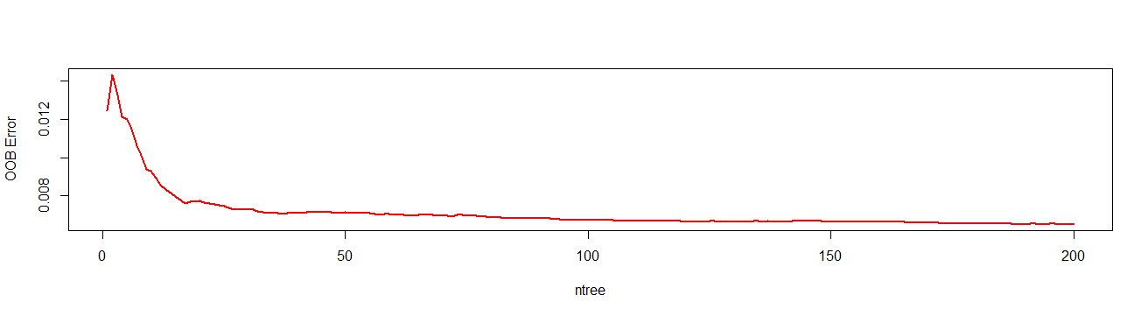
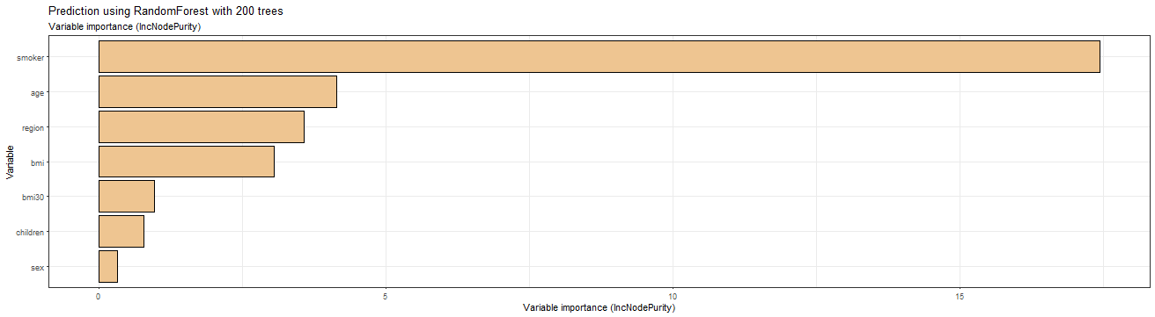
RANDOM FOREST - REGRESSION
Data is split as 80-20(train-test). For mtry 2 and ntree 200, Random Forest is modelled on the training data with model formula inclusive of interaction effect -
As per Variable Importance Plot, smoker status has the highest importance, followed by age, region and BMI in predicting the insurance charges
Out of sample prediction accuracy has significantly increased compared to linear regression model
Evaluation metrics:
 | R-Squared | RMSE
Training Set | 0.9318 | 0.0522
Test Set | 0.7818 | 0.1014
Notes:
Number of variables available for splitting at each tree node. In the random forest literature, this is referred to as the mtry parameter.

Slide 15
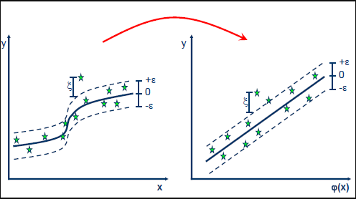
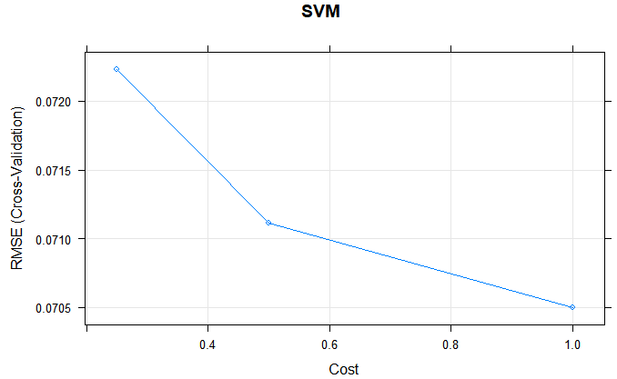
SUPPORT VECTOR MACHINE-REGRESSION (SVR)
To give flexibility to our model to define how much error is acceptable, we used SVR model on our data
To measure the accuracy of the SVM model, the target variable was predicted for the in-sample data. The predicted ‘charges’ had a RMSE of 0.0681
Then for the out of sample data the predicted ‘charges’ had a RMSE of 0.0997
Thus, the out of sample RMSE has slightly decreased compared to Random Forest
Evaluation metrics:
 | R-Squared | RMSE
Training Set | 0.8688 | 0.0681
Test Set | 0.7828 | 0.0997

Slide 16

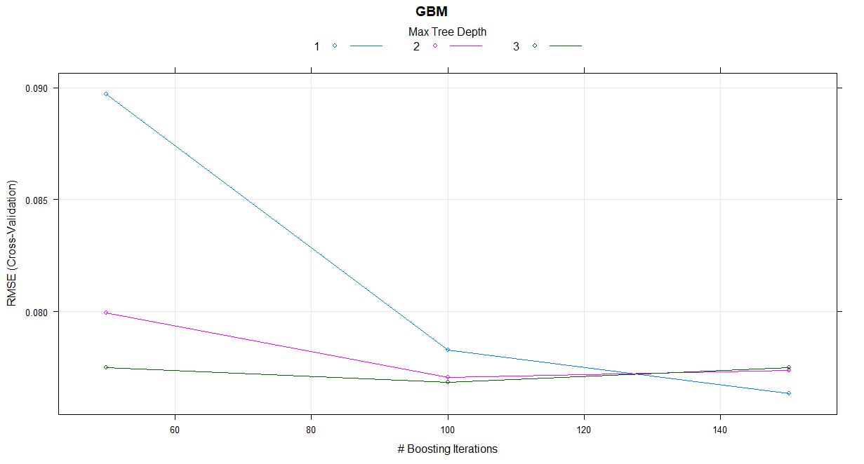
Gradient BOOSTING
To further increase the prediction accuracy, we trained Gradient Boosting model on training data, with normalized target variable. Gradient Boosting trains many models in a gradual, additive and sequential manner
From the cross-validation plot, it can be observed that with interaction depth 3 and 100 iterations, the RMSE (Root Mean Square Error) can be significantly lowered
Out of sample RMSE has been further decreased using Gradient Boosting
Evaluation metrics:
 | R-Squared | RMSE
Training Set | 0.8748 | 0.0663
Test Set | 0.7786 | 0.0990

Slide 17
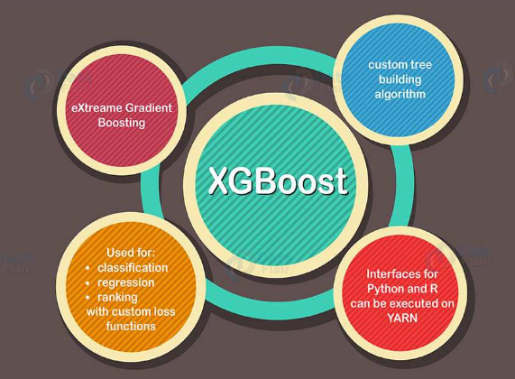
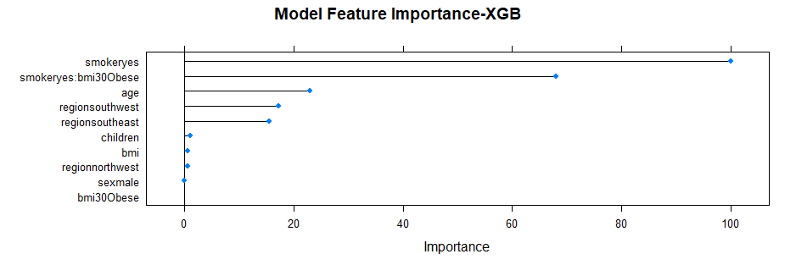
XG BOOSTING
The XG Boost model was developed trained on the train dataset with “Cross Validation” as resampling method and ‘RMSE’ as the metric to select the optimal model
As per Model Feature Importance Plot, smoker status followed by smoker with high bmi, age and region are important features in predicting the insurance charges
Out of sample RMSE is the lowest for XG Boosting and accuracy is highest at 78.52%
Evaluation metrics:
 | R-Squared | RMSE
Training Set | 0.8749 | 0.0663
Test Set | 0.7852 | 0.0985

Slide 18
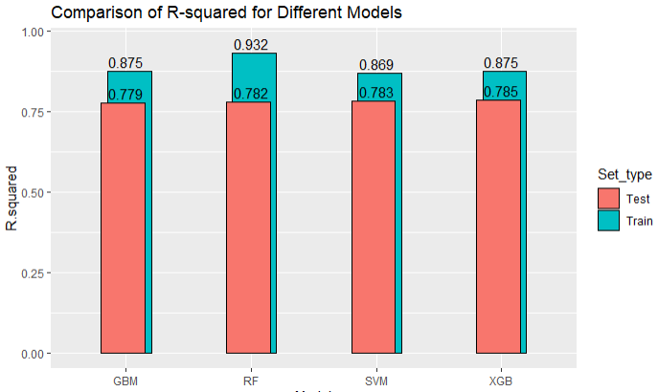
MODEL COMPARISON – A BRIEF LOOK
In pursuit of using new techniques to increase the prediction power of the model; Random Forest, XG Boosting, Gradient Boosting and SVM- Regression were used, here’s a visual comparison of all the models:
Every successive stage of modeling from Gradient Boosting, Random Forest, SVR and XG Boosting has increased R squared in testing data, though slightly yet marking improvement in predicting target variable
XG Boosting gives the highest accuracy on testing data – 78.52%
Model | RMSE | R Squared | MAE
RF_Train | 0.0522 | 0.9318 | 0.0335
RF_Test | 0.1014 | 0.7818 | 0.0636
XGB_Train | 0.0663 | 0.8749 | 0.0374
XGB_Test | 0.0985 | 0.7852 | 0.0578
GBM_Train | 0.0663 | 0.8748 | 0.0378
GBM_Test | 0.0990 | 0.7786 | 0.0581
SVM_Train | 0.0681 | 0.8688 | 0.0334
SVM_Test | 0.0997 | 0.7828 | 0.0562

Slide 19

learnings
Different seeds and splits were tried on various models to evaluate model performance to predict the target variable, ‘charges’ with high accuracy
Random Forest was chosen due to ease of deployment and reducing the likelihood of overfitting
Our data included categorical variables with different number of levels, random forests are biased in favor of those attributes with more levels. Therefore, the variable importance scores from random forest were not reliable
Next, Gradient Boosting was employed to create a strong learner from an ensemble of weak learner. Unlike RF, models are added iteratively to increase the performance
XGBoost has additional advantages: training is very fast, can be distributed across clusters. It uses a more regularized model formalization to control over-fitting, which gives it better performance. Additionally, it has extra randomization parameter that can be used to reduce the correlation between trees

Slide 20
Thank you

