Slide 1
DS-UA 112 Introduction to Data Science
Lecture 12
Text II – Text from Websites
Notes:
Remember
Wireless mic
pointer
Cord for power
Marker erasure
NYU classes (cell phone)
3 x 25 minutes
1 5 announcement /overview /takeaways
2 5 questions check NYU Classes ask for questions
10 10 lesson demo
%%%%%%%%%%
Post demo before class
Overviews discussing the problem
Review snippets connecting to lesson
%%%%%%%
Review before agenda…or continue with first segment
Reference rather than review – previous lecture, section, assignment
Review Data sets
Hints on Homework Projects
%%%%%%%%%%%%%%%
Take aways concepts and methods
Box anything accountable for exam

Slide 2
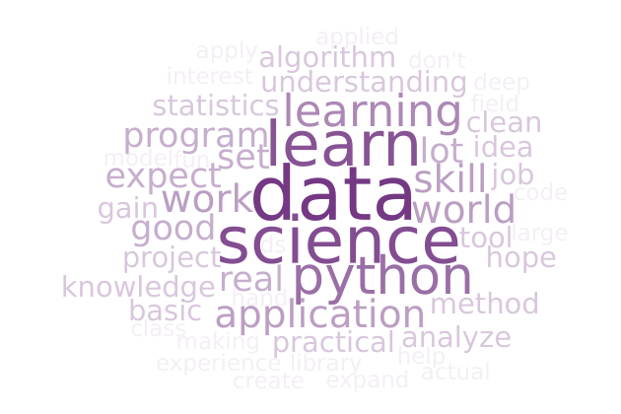
Announcements
Homework 3
Due Friday October 18
Project 1
Extended to Sunday October 27
Midterm
Wednesday October 23 4:55-6:10
Pencil and Paper with Cheat-Sheets
Section and Office Hours
Practice Exam
Notes:
Please post to FORUM
Tuesday 10/22 3:30-5:30
Practice exam for format: true/false, multiple, fill in the blank, textual short answer

Slide 3
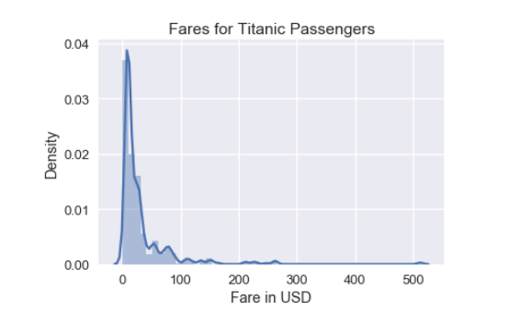
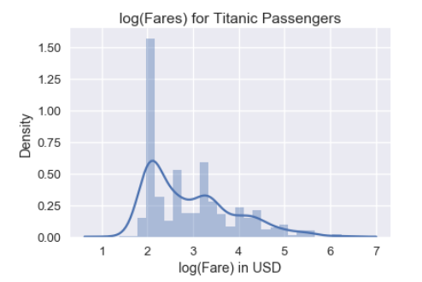
Review
Logarithm
Transformations
Logarithms and Powers
Notes:
Transformations:
logarithm and power transformations – make more symmetric
ratio of distance between quartiles
argument in plotting (logx, logy)
Question: What is flipped left skewed…would work…what could you try
Invert x, then log transform!

Slide 4
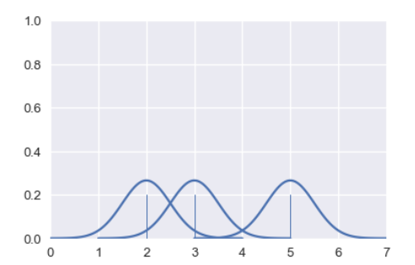
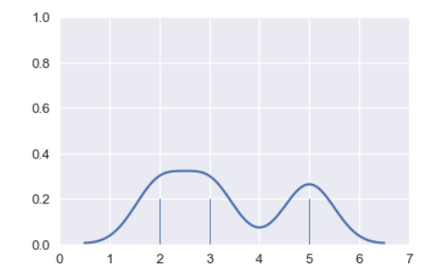
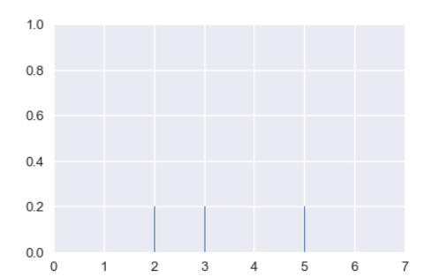
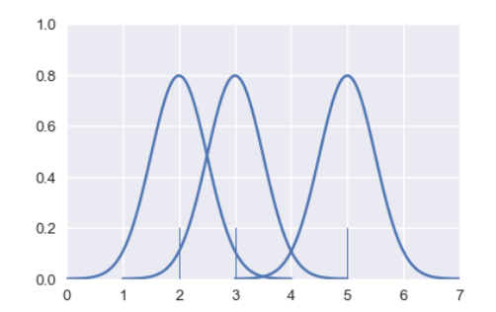
Review
Transformations
Smoothing
Notes:
Transformations:
smoothing with density to capture trend

Slide 5
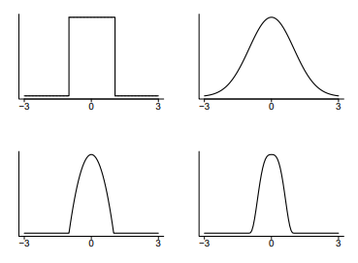
Review
Transformations
Smoothing
Notes:
could have used step function instead of bell curve
Question: which resembles histogram more closely
The Gaussian Kernel is widely used because it is simple to understand and results in very smooth curves. Conversely the boxcar kernel (square function) results in very jagged curves that more closely approximate a histogram. The Epanechnikov kernel enjoys some additional statistical guarantees and is a reasonable compromise between Guassian and Boxcar kernels.

Slide 6
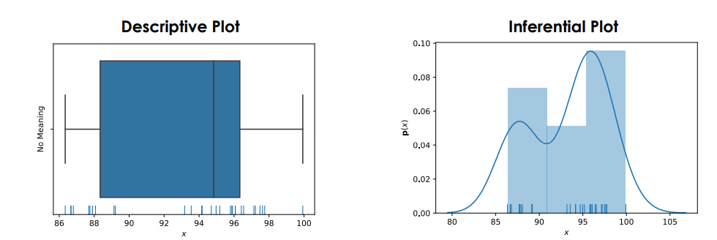
Review
Transformations
Smoothing
Notes:
could have used step function instead of bell curve
Question: which resembles histogram more closely
The Gaussian Kernel is widely used because it is simple to understand and results in very smooth curves. Conversely the boxcar kernel (square function) results in very jagged curves that more closely approximate a histogram. The Epanechnikov kernel enjoys some additional statistical guarantees and is a reasonable compromise between Guassian and Boxcar kernels.

Slide 7
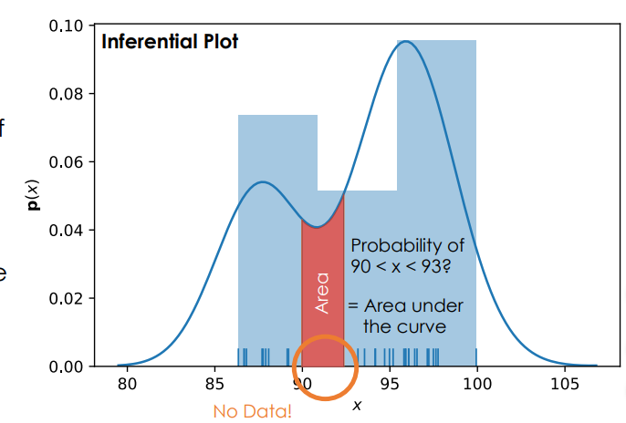
Review
Transformations
Smoothing
Notes:
could have used step function instead of bell curve
Question: which resembles histogram more closely
The Gaussian Kernel is widely used because it is simple to understand and results in very smooth curves. Conversely the boxcar kernel (square function) results in very jagged curves that more closely approximate a histogram. The Epanechnikov kernel enjoys some additional statistical guarantees and is a reasonable compromise between Guassian and Boxcar kernels.

Slide 8
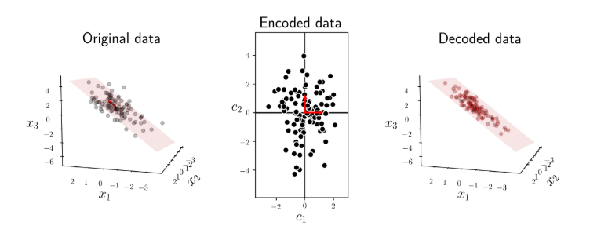
Review
Transformations
Reducing Dimension
Notes:
Transformations:
reducing dimension – finding directions where data spread out neglecting other directions
encode with combination of features
brings out patterns explaining the distribution of the data

Slide 9
Review
Transformations
Reducing Dimension
Many rows
Many columns
Notes:
Large scale problem
lots of data
Group (panel data time range windows of days) – make more coarse
Set transparency (alpha) low in dense regions and high in dense regions
Otherwise overplotting
Lots of features
combine to summarize (mean median mode)
use shape color size to capture additional

Slide 10
Agenda
Objectives
Properties of Data
What are Scope, Temporality, Granularity, Faithfulness?
Application Programming Interfaces
What file formats do we need for Websites?
Readings:
Nolan 5.3-5.7, 7.1, 8
Grus 9
Lessons
Working with dates
and times
Data from Websites
Demos
Police Reports
Restaurant Inspections
Questions
Notes:
Text is everywhere…but how to work with it like numbers?
Small collection of tools will allow

Slide 11
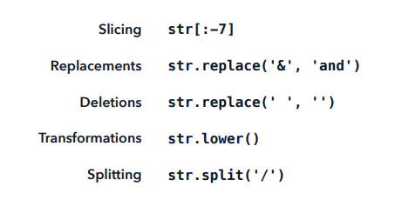
String Methods
Sometimes strings contain special characters like ‘\n’ for newline.
We can escape these special characters with an extra backslash ‘\\n’ or indicate raw string r’\n’
Notes:
upper lower
strip
replace
manipulating strings

Slide 12
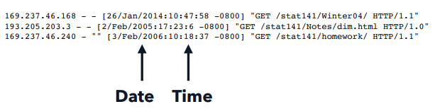
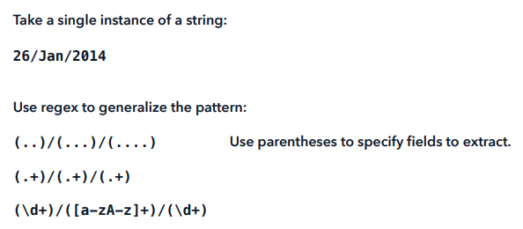
Regular Expressions
Rules for matching portions of string. Useful for extracting fields like date and time…

Slide 13
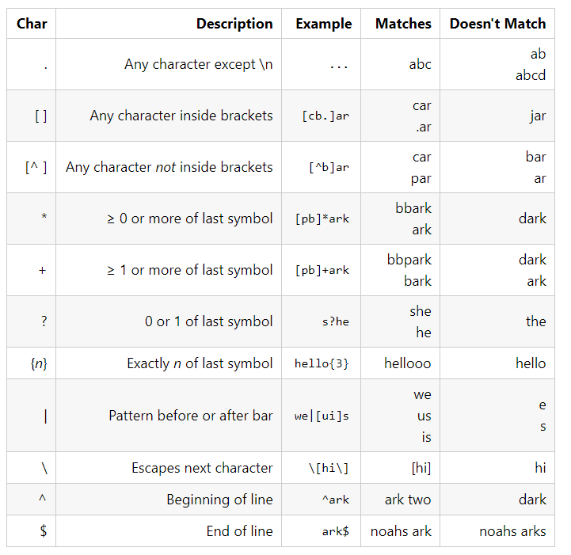
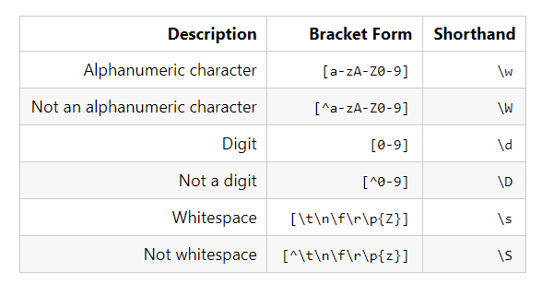
Regular Expressions
Set of Characters
Number of Characters
Position in String
Short hands for letters, numbers and space
Notes:
Precedence (parenthesis)
Character literals (as opposed to special characters)
Closure (the number of times)
Disjunction (either or)

Slide 14
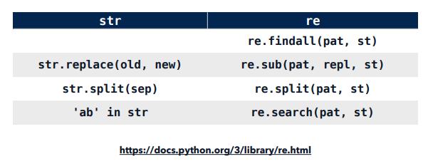
String Methods vs Regex

Slide 15
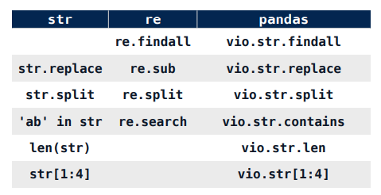
String Methods vs Regex vs pandas (DEMO)
Notes:
Example:
compare all three
date and time to process time stamp (project 1)
Case Study (Lab05)
Calls data set

Slide 16
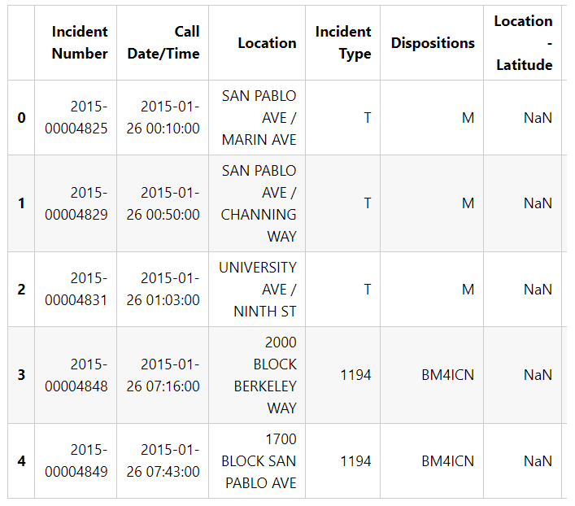
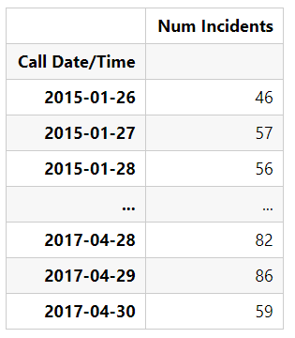
Properties of Data
The granularity of your data is what each record in your data represents. We have coarse and fine granularity
Notes:
What does a record represent?
In the Calls dataset, each record represents a single case of a police call
In the Stops dataset, each record represents a single incident of a police stop.
Do all records capture granularity at the same level? (Sometimes a table will contain summary rows.)
Yes, for both Calls and Stops datasets.
If the data were aggregated, how was the aggregation performed? Sampling and averaging are are common aggregations.
No aggregations were performed as far as we can tell for the datasets. We do keep in mind that in both datasets, the location is entered as a block location instead of a specific address.
What kinds of aggregations can we perform on the data?
For example, it's often useful to aggregate individual people to demographic groups or individual events to totals across time.
In this case, we can aggregate across various granularities of date or time. For example, we can find the most common hour of day for incidents with aggregation. We might also be able to aggregate across event locations to find the regions of Berkeley with the most incidents.

Slide 17
Properties of Data
Data Types What kinds of data do we have?
Granularity How fine/coarse is each datum?
Scope How (in)complete are the data?
Temporality How are the data situated in time?
Faithfulness How accurately do the data describe the world?

Slide 18
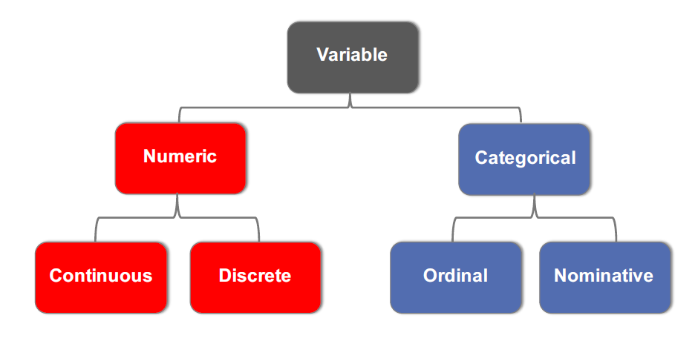
Data Types: Statistical vs Computational
Notes:
computational does not imply statistical!

Slide 19
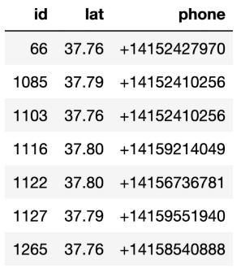
Data Types: Statistical vs Computational
Notes:
Qualtitative variables
Quantitative variables
Int64
float64
object (usually means string)
ordinal for phone not important
lat

Slide 20
Properties of Data
The granularity of your data is what each record in your data represents. We have coarse and fine granularity
What does a record represent?
Do all records capture granularity at the same level? (Sometimes a table will contain summary rows.)
If the data were aggregated, how was the aggregation performed? Sampling and averaging are common aggregations.
What kinds of aggregations can we perform on the data?
In general, how do we change the granularity?
Notes:
1. In the Calls dataset, each record represents a single case of a police call
In the Stops dataset, each record represents a single incident of a police stop.
2. Yes, for both Calls and Stops datasets.
3. No aggregations were performed as far as we can tell for the datasets. We do keep in mind that in both datasets, the location is entered as a block location instead of a specific address.
4. For example, it's often useful to aggregate individual people to demographic groups or individual events to totals across time.
In this case, we can aggregate across various granularities of date or time.
For example, we can find the most common hour of day for incidents with aggregation.
We might also be able to aggregate across event locations to find the regions of Berkeley with the most incidents.

Slide 21

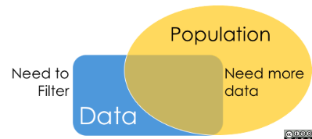
Properties of Data
The scope of the dataset refers to the coverage of the dataset in relation to what we are interested in analyzing.
Geographic Scope?
Notes:
Geographic Scope –
Bike Share data in HW03
VA MA DC
census or sample

Slide 22
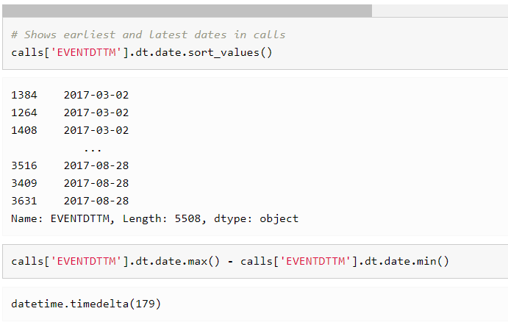
Properties of Data
The temporality refers to the date and time fields in the dataset.
What is the meaning of the date
and time fields in the dataset?
What representation do the date
and time fields have in the data?
Are there strange timestamps
that might represent null values?
Notes:
1. In the Calls and Stops dataset, the datetime fields represent when the call or stop was made by the police. However, the Stops dataset also originally had a datetime field recording when the case was entered into the database which we took out during data cleaning since we didn't think it would be useful for analysis.
REMEMBER NOT TO DROP. EXLUSION BIAS – EITHER LOSSING FEATURES OR TAKING RANDOM TO NONRANDOM.
however for meta-data
2.
timezone
Daylight Savings for datetime fields especially when dealing with data that comes from multiple locations.
Although the US uses the MM/DD/YYYY format, many other countries use the DD/MM/YYYY format. There are still more formats in use around the world and it's important to recognize these differences when analyzing data.
3. Default dates instead of null values 1900, 1970

Slide 23
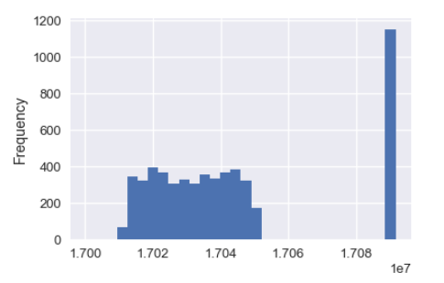
Properties of Data
We describe a dataset as faithful if we believe it accurately captures reality.
Unrealistic or incorrect values
Violations of obvious dependencies
Hand-entered data
Clear signs of data falsification
Notes:
Unrealistic or incorrect values
For example, dates in the future, locations that don't exist, negative counts, or large outliers.
Violations of obvious dependencies
For example, age and birthday for individuals don't match.
99 year old mother in baby weight data set
Hand-entered data
As we have seen, these are typically filled with spelling errors and inconsistencies. Spelling of
Chihuahua
Clear signs of data falsification
For example, repeated names, fake looking email addresses, or repeated use of uncommon names or fields.
Notice the many similarities to data cleaning. As we have mentioned, we often go back and forth between data cleaning and EDA, especially when determining data faithfulness. For example, visualizations often help us identify strange entries in the data.
Think IRS using Benford’s law to detect fraud – looking at occurrence of digits much like Zipf’s rule looked at occurrence of words

Slide 24
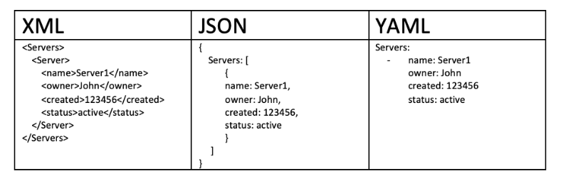
Data Formats for Websites
Descriptive
Extensible
Human and Machine Readable
Notes:
Why? Ø Descriptive
Can maintain meta-data :
think Trump device : our clue to who is posting the information …. though seems like meta-data!
Extensible
Organization can change and maintain compatibility
Human readable
Useful for debugging and provides a common interface
Machine readable
A wide range of technologies for parsing

Slide 25
JavaScript Object Notation
Key: Value
Value is Array of
string, number, Boolean, null
Key:Value
Notes:
Why? Ø Descriptive
Can maintain meta-data :
think Trump device : our clue to who is posting the information …. though seems like meta-data!
Extensible
Organization can change and maintain compatibility
Human readable
Useful for debugging and provides a common interface
Machine readable
A wide range of technologies for parsing

Slide 26
eXtensible Markup Language
Start Tag
End Tag
Content along with other nodes
Start Tag
End Tag
Content
Notes:
1. Hierarchical Data
Basic unit called element (or node more common in the language of graphs)
2. Node can contain another along with text
3. Whitespace not necessary (unlike YAML)
4. Can be empty

Slide 27
Take-Aways
Regular Expressions
Properties of Data
Data Types
Scope, Temporality, Faithfulness, Granularity
File Formats for Websites
JSON, YAML
XML, HTML
Notes:
Check file size
Keep zipped

