Slide 1
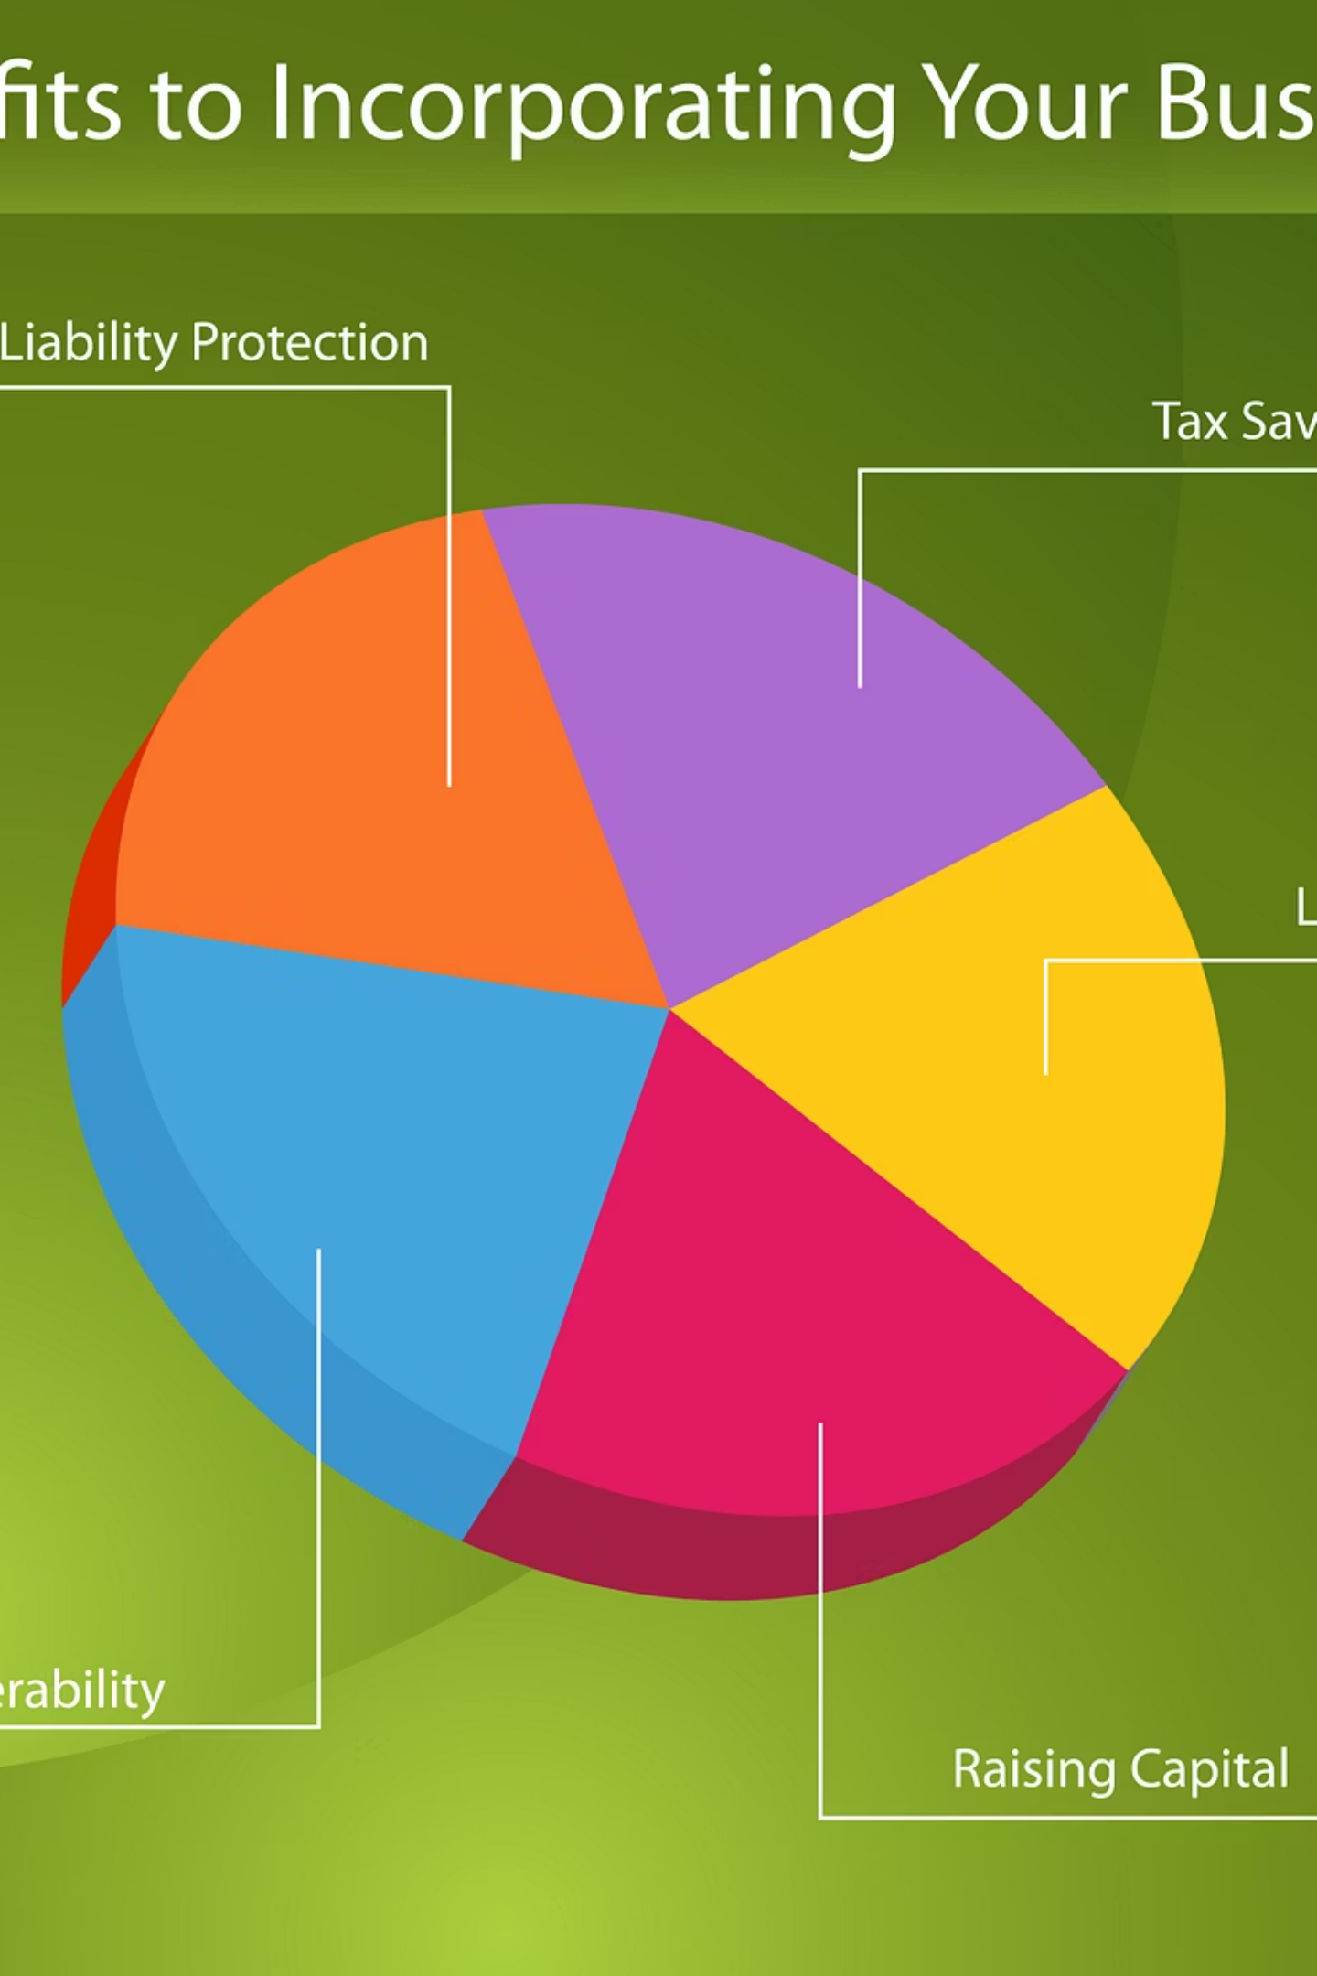
ContractGuard AI
Transforming Contract Review with Production-Grade Agentic Intelligence

Slide 2

The "Word-by-Word" Bottleneck
In today's fast-paced business environment, executives and legal teams are trapped in an exhausting cycle of manual contract review. Every agreement demands meticulous, line-by-line scrutiny that consumes countless hours of valuable time.
The stakes couldn't be higher. A single overlooked clause, an ambiguous term, or a missed liability can trigger catastrophic financial consequences—lawsuits, regulatory penalties, and damaged partnerships that cost millions.
This antiquated process is fundamentally broken. Human fatigue introduces errors. Manual workflows don't scale with business growth. Legal teams become bottlenecks rather than enablers. Organizations desperately need a transformative solution.

Slide 3

ContractGuard AI: Intelligent, Automated, Secure
Beyond Reading
Production-Ready
AI That Reasons
Our platform doesn't just scan text—it comprehends context, identifies risks, and provides actionable insights with human-level understanding.
Built with enterprise-grade security and scalability from day one, ready to handle your most critical contracts immediately.
Advanced large language models combined with specialized legal tools create an intelligent agent that thinks, analyzes, and protects your interests.

Slide 4

The Product Is the Presentation
Hackathon Innovation
Show, Don't Tell
Intuitive by Design
We rejected the traditional pitch deck approach. Instead, we built a fully functional, self-demonstrating user interface that proves our concept through live interaction.
The jury can experience our agentic workflow firsthand, watching real-time contract analysis unfold with complete transparency and explainability.
Our interface needs no manual or training. Its intuitive design demonstrates that enterprise AI can be both powerful and accessible to every user.

Slide 5





True Agentic Architecture
Beyond Simple Chatbots
ContractGuard AI represents a fundamental leap forward in artificial intelligence application. Unlike basic question-answer systems, our platform employs a sophisticated agentic framework that mirrors human cognitive processes.
Input Analysis
Receives and interprets complex contract documents and user queries
Reasoning Engine
Evaluates context, identifies risks, and formulates strategic approach
Tool Selection
Chooses appropriate analytical instruments from specialized toolkit
Execution
Performs deep analysis using selected tools and methods
Refined Output
Delivers comprehensive, actionable insights with full explanation
This autonomous decision-making capability enables ContractGuard AI to tackle unprecedented complexity with remarkable accuracy and speed.

Slide 6

Seeing the "Brain" at Work
Explainable AI (XAI)
Transparency builds trust. That's why ContractGuard AI provides unprecedented visibility into its decision-making process. Our revolutionary XAI interface reveals every step of the agent's cognitive journey.
Users witness the complete analytical workflow: initial thinking, logical reasoning, tool activation, and LLM processing. This transparency isn't just impressive—it's essential for enterprise adoption.
Legal teams can validate the AI's conclusions, audit its methodology, and confidently present findings to stakeholders knowing exactly how every insight was derived.
01
02
Thinking Phase
Reasoning Process
Agent assesses the query and contract context
Logic chains form to identify relevant clauses and risks
03
04
Action Execution
LLM Synthesis
Specialized tools perform targeted analysis
Language model generates clear, actionable insights

Slide 7
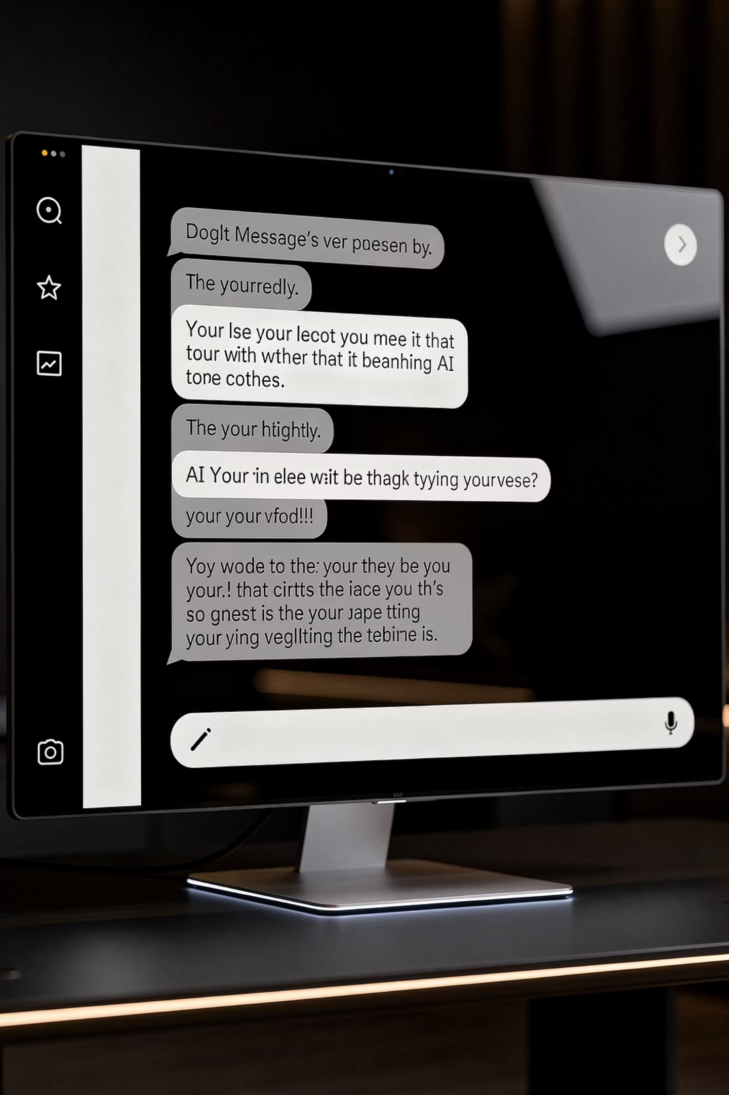
Seamless Conversational Interface
ContractGuard AI delivers a conversational user interface (CUI) that feels remarkably natural—like consulting with your most knowledgeable legal advisor. The system maintains context across complex, multi-turn conversations, understanding nuanced follow-up questions without requiring repetition.
Real-Time Streaming
Contextual Intelligence
Watch responses materialize word-by-word, providing immediate feedback and creating an engaging, human-like interaction pattern. No more waiting for processing to complete.
The AI remembers previous questions, understands references to earlier discussion points, and builds comprehensive understanding throughout your session.

Slide 8
Production-Grade Security
Built for Enterprise from Day One
Security isn't a feature we added later—it's the foundation of ContractGuard AI's architecture. We've implemented comprehensive security measures that meet the stringent requirements of Fortune 500 legal departments and regulated industries.
Role-Based Access Control (RBAC)
Comprehensive Auditing
Industrial-Strength Authentication
Every agent action is logged with timestamp, user identity, and reasoning chain. Full audit trails enable compliance verification and forensic investigation when needed.
Granular permissions ensure complete data isolation between departments, projects, and user groups. Every document, query, and result respects organizational boundaries.
Multi-factor authentication, single sign-on integration, and session management protocols that align with enterprise identity systems and security policies.

Slide 9

Privacy & Compliance: Safety First
ContractGuard AI treats sensitive information with the highest level of protection. Our multi-layered privacy framework ensures that confidential data remains secure throughout the entire analytical process.
Automatic PII Masking
Advanced detection algorithms identify and redact personally identifiable information—names, dates, financial amounts, addresses—before any processing occurs. Your sensitive data never reaches the language model in its raw form.
Strict Guardrails
Sophisticated validation layers prevent AI hallucinations and ensure responses remain grounded in actual contract content. Output boundaries enforce legal compliance and prevent unauthorized disclosure of protected information.

Slide 10
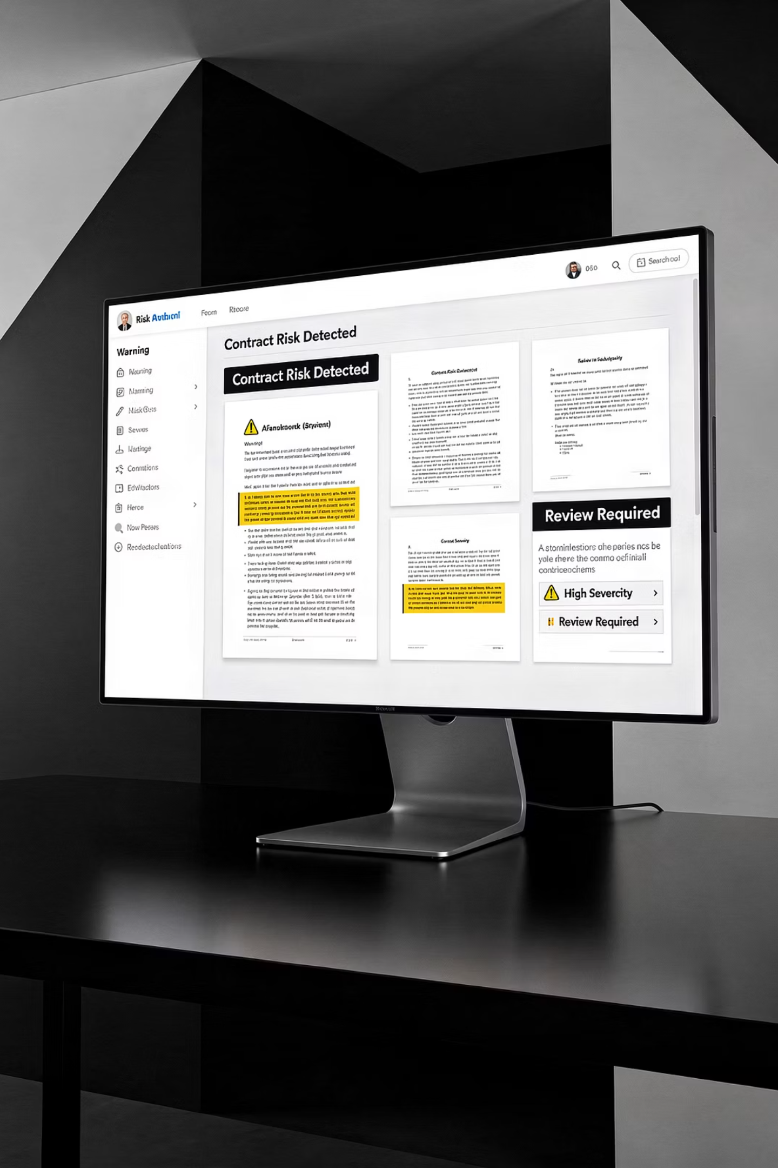
Proactive Risk Detection
Identifying Flawed Contracts Automatically
ContractGuard AI doesn't wait for you to ask the right questions—it proactively hunts for problems. The moment you upload a document, sophisticated analysis engines spring into action, scanning for vulnerabilities that human reviewers often miss.
Missing Clauses
Ambiguous Terms
Identifies absent but essential provisions like indemnification, termination rights, or dispute resolution mechanisms that could leave you exposed.
Flags vague language, undefined terms, and unclear obligations that create dangerous interpretation gaps and litigation risk.
High-Risk Liabilities
Surfaces unfavorable liability caps, one-sided obligations, and dangerous warranty provisions that could cost millions.

Slide 11
Action-Oriented AI with Tool-Use Capabilities
ContractGuard AI doesn't just generate text—it solves problems through intelligent tool utilization. Our agents access a sophisticated toolkit of specialized instruments, each designed for specific legal and analytical tasks.
Legal Cross-Reference
Financial Analysis
Automatically compares contract provisions against relevant statutes, regulations, and case law to ensure legal compliance.
Calculates penalties, payment schedules, termination costs, and financial exposure with precision.
Clause Comparison
Obligation Tracking
Identifies discrepancies between multiple contract versions or compares terms against your standard templates.
Extracts deadlines, milestones, and deliverables to create comprehensive obligation timelines.
This tool-first architecture means ContractGuard AI takes action and delivers results, not just conversational responses.

Slide 12

The "Contract Tutor" Agent
Mastering Legal Jargon
Legal language shouldn't be a barrier to understanding your own contracts. ContractGuard AI includes a dedicated "User Guide" agent that functions as your personal AI tutor, transforming impenetrable legalese into crystal-clear explanations.
This specialized agent breaks down complex terminology, explains the practical implications of specific clauses, and provides real-world examples that make abstract legal concepts concrete and actionable.
Non-legal professionals gain confidence to review contracts independently, ask informed questions, and participate meaningfully in negotiations—democratizing legal knowledge across your entire organization.

Slide 13



Adaptive Persona-Based Experience
The Right Information for the Right Person
ContractGuard AI recognizes that different stakeholders need different insights from the same contract. Our intelligent persona system automatically adapts its analysis, language, and focus based on who's asking.
Chief Executive
Legal Counsel
Procurement Officer
High-level strategic summary focusing on financial risk, business impact, and critical decision points. Bottom-line oriented insights without unnecessary legal detail.
Deep clause-by-clause analysis with statutory citations, precedent references, and technical legal reasoning. Comprehensive risk assessment with litigation considerations.
Payment terms, delivery schedules, service level agreements, and vendor obligations. Operational focus on performance metrics and contract execution requirements.

Slide 14
Measurable Business Value
85%
94%
$2.3M
Time Reduction
Error Prevention
Average Risk Avoided
Contract review cycles compressed from days to minutes, accelerating deal velocity and time-to-revenue
Dramatic reduction in missed clauses and oversight errors that lead to costly disputes and renegotiations
Per enterprise client annually through proactive identification of unfavorable terms and hidden liabilities
Empowering Non-Experts
Scaling Legal Operations
Business stakeholders gain confidence to understand complex agreements without constant legal consultation, improving autonomy and decision-making speed.
Legal teams handle 10x contract volume without proportional headcount increase, focusing expertise on strategy rather than routine review.

Slide 15

Ready for the Real World
Not Just a Concept
The Future of Contract Intelligence
ContractGuard AI isn't vaporware or a proof-of-concept demo. It's a production-grade, enterprise-ready platform that handles the full complexity of modern business contracts today.
We've built the solution that legal and business teams have been waiting for—AI that truly understands contracts, protects your interests, and scales with your business.
Our secure agentic architecture, explainable AI transparency, and comprehensive security framework make it ready for immediate deployment in the most demanding legal environments.
Thank you for your time and consideration.

