Slide 1

Used Car Price Prediction Analysis
Machine Learning 1: Classification Methods
Dr. Maciej Wilamowski
Huseyin Can Minareci
Noam Shmuel

Slide 2
Introduction
In this project, we aim to find the best regression model for dataset in order to be able to predict used cars prices.
We have used public dataset from Kaggle which was scraped with Scrapy by Orges Leka from Ebay-Kleinanzeigen. It contains more than 370000 cars and 20 features of each of them like price, power, model etc...
Original dataset had plenty missing values, outliers and mistakes, to be able to work on it we had to clean, impute and change their format.
We select the features carefully and extract new features from raw data.
In order to achieve this goal we used Linear Model, K Nearest Neighbor and Random Forest, processed and analyzed the results which will be further presented in the upcoming slides.

Slide 3
Data Preparation
Some important variables:
price : the price on the advert to sell the car, This is the dependent variable in all of the upcoming models.
name : headline, which the owner of the car gave to the advert
vehicleType : one of eight vehicle-categories
yearOfRegistration : at which year the car was first registered
gearbox : manual or automatic
powerPS : the power of the car in PS
model : the car's model
kilometer : how many kilometres the car has driven
fuelType : one of seven fuel-categories
brand : the car's brand
notRepairedDamage : if the car has a damage which is not repaired yet

Slide 4
Duplicates and outliers
The amount of data after removing duplicates left: 97.6 %
Outliers
Cars more expensive than 40000: 2692
Cars cheaper than 250: 19530
Cars which has less than 10PS: 39579
Cars which has more than 400PS: 1864
Cars newer than 2017: 14483
Cars older than 1990: 10495
The amount of data left after removing outliers(mistakes): 79.9%

Slide 5
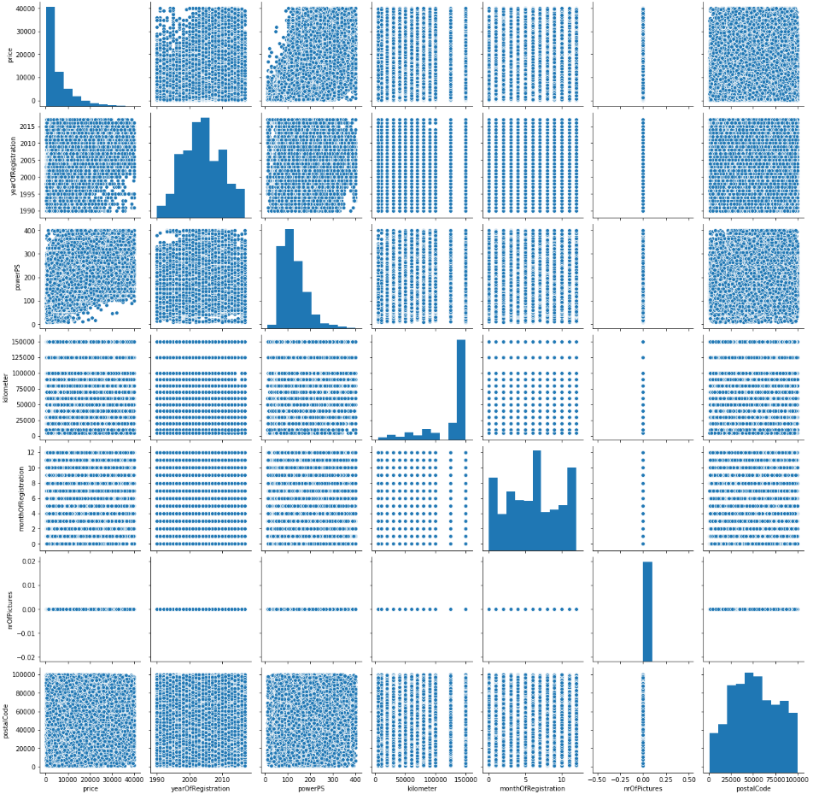
Exploratory Data Analysis
price and powerPS is right skewed in order to make them normally distributed we applied log transformation
There is only zeros(mistake of scrapper) in nrOfPictures so we dropped it from data.
There are almost no cars with high power and low price.

Slide 6
Feature Engineering & Selection
There were 20 variables in the original dataset and we had to remove "dateCrawled", "postalCode", "abtest", "offerType", "nrOfPictures", "monthOfRegistration" and "seller" because they were not useful for our purpose.
We created new features:
"daysBeforeSold" by using "dateCreated" and "lastSeen“(how long advert was on air)
"namelen" by using "name“ (number of letters used in the advert name)
"age" by using "yearOfRegistration“ (age of the car)
At the end we stayed with 1 dependent and 11 independent variables.

Slide 7
Imputation of Missing Values
21.8% data has missing values(after removing outliers)
vehicleType 17107
gearbox 5248 (removed)
model 10686 (removed)
fuelType 16998
notRepairedDamage 42028
Missing values(dropped): 5.1%
Missing values(imputed): 16.6%
We impute missing values in vehicleType and fuelType according to their group mean
We fill missing values with “No” in notRepairedDamage because Nas highly possible means that, car doesn't have a damage which needs to be repaired.

Slide 8
Converting string into integers
We created ordered numerical labels for notRepairedDamage (0:”no” 1:”yes” )
do one-hot encoding (binarization) for vehicleType gearbox model fuelType and brand (Linear Regression and KNN)
LabelEncoder (Random Forest)

Slide 9
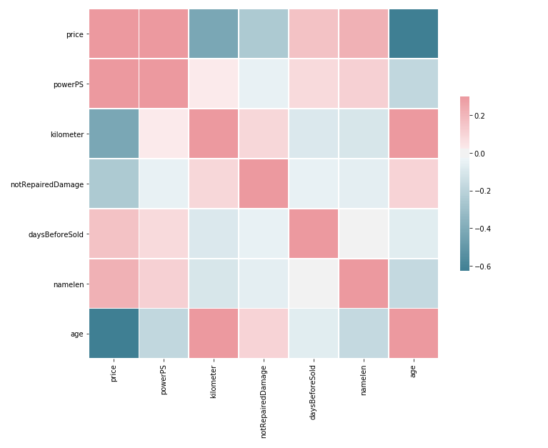
Correlation
We checked correlation between variables to understand how they effect each other.
powerPS, daysBeforeSold and namelen has positive effect on price
kilometer and age has negative effect effect on price
Kilometer and age has positive correlation
Correlations are as expected.

Slide 10
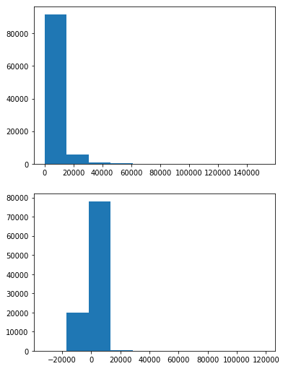
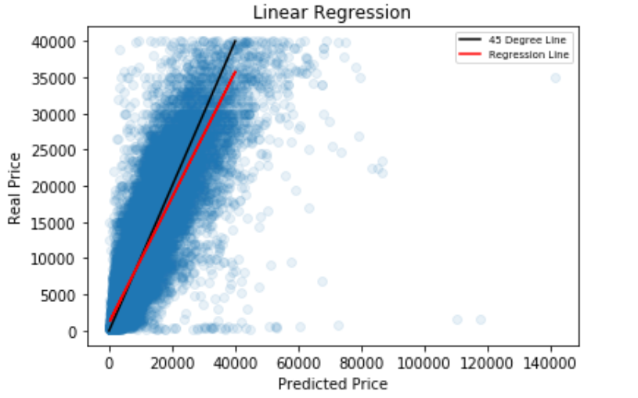
Linear regression
With “model”
Mean squared error: 0.510
R-squared Score: 78.46 %
Without “model”
Mean squared error: 0.543
R-squared Score: 75.92 %

Slide 11
K-Nearest Neighbors
Since KNN is a Distance-Based algorithm we had to scale all variables and we scale them between 0 and 1.
Since KNN runs slow first we tried with 50k rows sample from our data and split them as 0.7 train and 0.3 test
In order to decide how many neighbors we should have take we decided to check one by one and 6 was the best number.
KNN R-squared Score was 78% on the sample, and we decided to go with all data
We tried 50 neighbors to all data but it was too much and R-squared Score dropped
6 fit the best for full data as well with 83% R-squared Score.

Slide 12
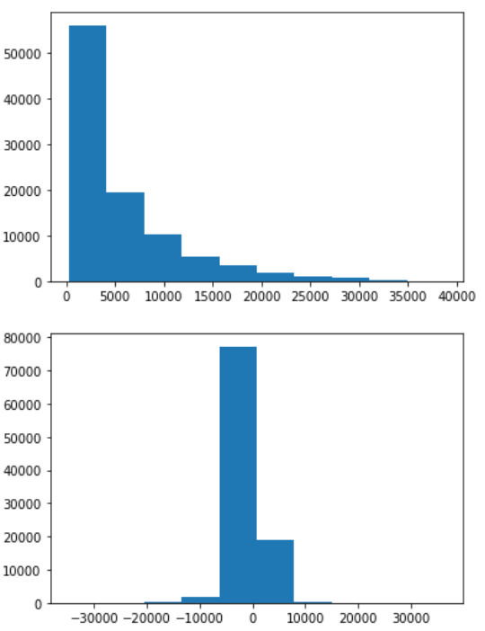
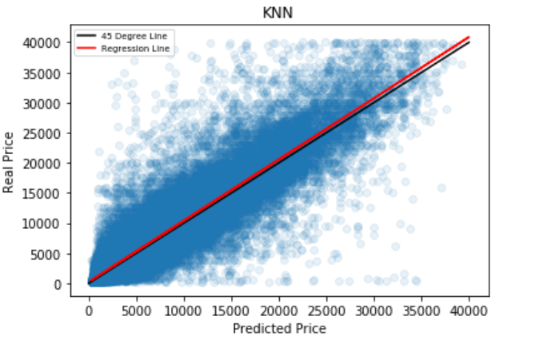
K-Nearest Neighbors
With “model”
Mean squared error: 0.447
R-squared Score: 83.6 %
Without “model”
Mean squared error: 0.446
R-squared Score: 83.7 %

Slide 13
Random Forest
Plenty categories especially under brand and model.
Since random forest is working with tree-based model we wanted to change the way we encode our data and try to make depth and runtime shorter.
We used Cross-Validation with Kfold to be able get more from our data and see if R-squared Score changes depending on the which part of data we are training and testing our model.

Slide 14
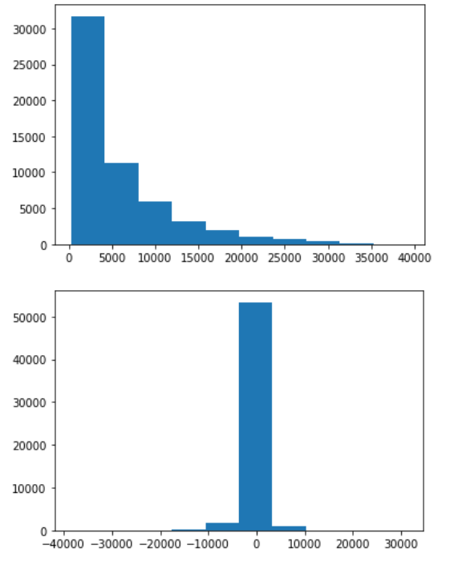
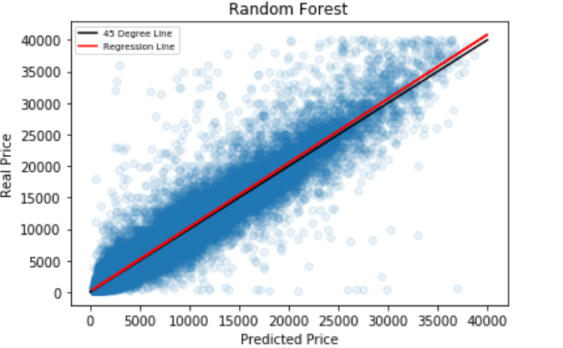
Random Forest
With “model”
Average R-squared Score: 88 %
Average mean squared error: 0.382
Without “model”
Mean squared error: 0.394
R-squared Score: 87.33 %

Slide 15
Comparison of Methods
R-squared Score Mean Squared Error (log)
Random Forest (with “model”) 88.01 % 0.382
Random Forest (without “model”) 87.33 % 0.394
KNN (without “model”) 83.70 % 0.446
KNN (with “model”) 83.61 % 0.447
Linear Regression (with “model”) 78.46 % 0.510
Linear Regression (without “model”) 75.92 % 0.543

Slide 16
Conclusions
Linear regression
R-squared Score was 78% but it overshoot for some cars (100k-140k) and cause outliers, also underpricing was very common.
It gave 3% less R-squared Score on the dataset without “model”.
In general was not successful.
KNN
One-hot encoding.
Independent variables scaled (0,1)
6 n_neighbors.
Same R-squared Score with the data with and without "model“
Better than Linear Regression worst than Random Forest
Random Forest
LabelEncoder (0,1,2,…,n)
Cross-Validation
Results were better than Linear Regression and KNN.
Same R-squared Score with the data with and without "model“(MSE was relatively smaller with “model”)

Slide 17
Random Forest(with model) gave the best result 88%. For this dataset Random Forest perform in a best way in prediction and also computational power and time.
Despite the quality of the dataset we believe that results were pretty outstanding.

Slide 18
Thank you
Huseyin Can Minareci
Noam Shmuel

