Slide 1

Reclaiming Solid Wastes
CASE 6
Parper Plane
Peiyang Chen
Haocheng Zhang
Hanbo Lin

Slide 2
Background
The Save-it company operates a reclamation center that collects four types of solid waste materials and then treats them so that they can be amalgamated into a salable product.
Three different products can be made by mixing four types of wasting materias.

Slide 3
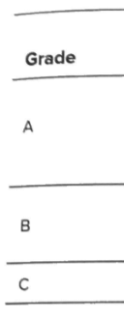
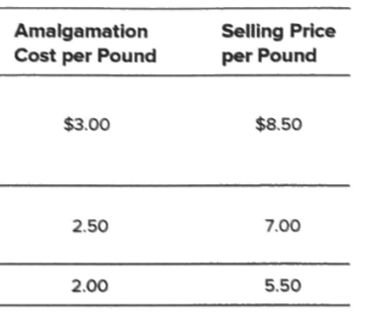
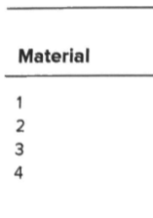
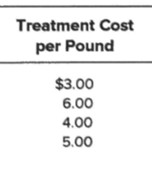
Problem
Decision
Allocate the materials to product grades so as to maximize the total weekly profit
Constraints
17 in toal
(Profit =total revenue - total material cost - total amalgamation cost)
Notes:
The decision that save-it company going to make is allocate the materials to product grades so as to maximize the total weekly profit, because total material treatment cost and total amalgamation cost is seperate, total profit is equal to total revenue minus total material cost and total amalgamation cost. So, in order to get total profit, we need to get total revenue, material cost and amalgamation cost. Total revenue is calculated by the number of product times its selling price, and material cost calculated by each material that used in different grade product times its treatment cost, total amalgamation cost is amalgamation cost of each product times the number produced.

Slide 4
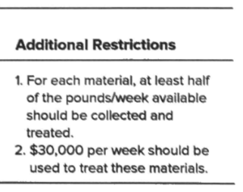
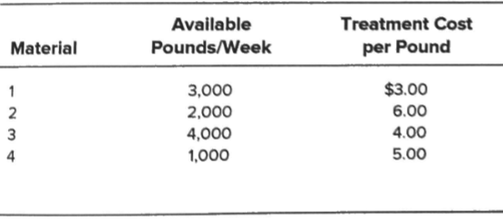
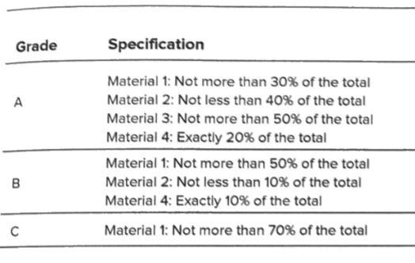
Constraints
Total material cost = 30000
Total material1 ≥ 1500
Total material2 ≥ 1000
Total material3 ≥ 2000
Total material4 ≥ 500
Total material1 ≤ 3000
Total material2 ≤ 2000
Total material3 ≤ 4000
Total material4 ≤ 1000
GradeA-M1 ≤ 30% total material of GradeA
GradeA-M2 ≥ 40% total material of GradeA
GradeA-M3 ≤ 50% total material of GradeA
GradeA-M4 = 20% total material of GradeA
GradeB-M1 ≤ 50% total material of GradeB
GradeB-M2 ≥ 10% total material of GradeB
GradeB-M4 = 10% total material of GradeB
GradeC-M1 ≤ 70% total material of GradeC
Notes:
We can set up object function and constraints. For Grade A product,material 1 is not more than 30% of the total, material 2 is not less than 40% of the total, material 3 is not more than 50% of the total, and material 4 is exactle 20% of the total. For Grade B product material is not more than 50% of the total, material 2 is not less than 10%, material 4 is exactly 10% of the total, For Grade C, material 1 is not more than 70% of the total. and under additional restrictions ,For each material, at least half of the pounds per week available should be collected and treated and 30,000 dollars per week should used to treat these material. So for each material, we have two constraint, material 1 is less than 3000 pounds per week and more than 1500 pounds per week, material 2 is less then 2000 pounds per week and more than 1000 ,material 3 is less than 4000 pounds per week and more than 2000 pounds per week, and material 4 is less than 1000 pounds per week and more than 500 pounds. So, there are 17 constraints in total.

Slide 5
Decision variable
The number of Material 1, 2, 3, 4 that respectively used in Grade A, B, C
Denote as M1A,M1B,M1C,M2A, etc….
Object function
Total Material = 3*(M1A+M1B+M1C)+6*(M2A+M2B+M2C)+4*( M3A+M3B+M3C)+5*(M4A+M4B+M3C)
Total Amalgamation Cost = 3*(M1A+M2A+M3A+M4A)+2.5*(M1B+M2B+M3B+M4B)+2*(M1C+M2C+M3C+M4C)
Total Revenue = 8.5*(M1A+M2A+M3A+M4A)+7*(M1B+M2B+M3B+M4B)+5.5*(M1C+M2C+M3C+M4C)
Toal Profit = Total Revenue - Total Material - Total Amalgamation

Slide 6
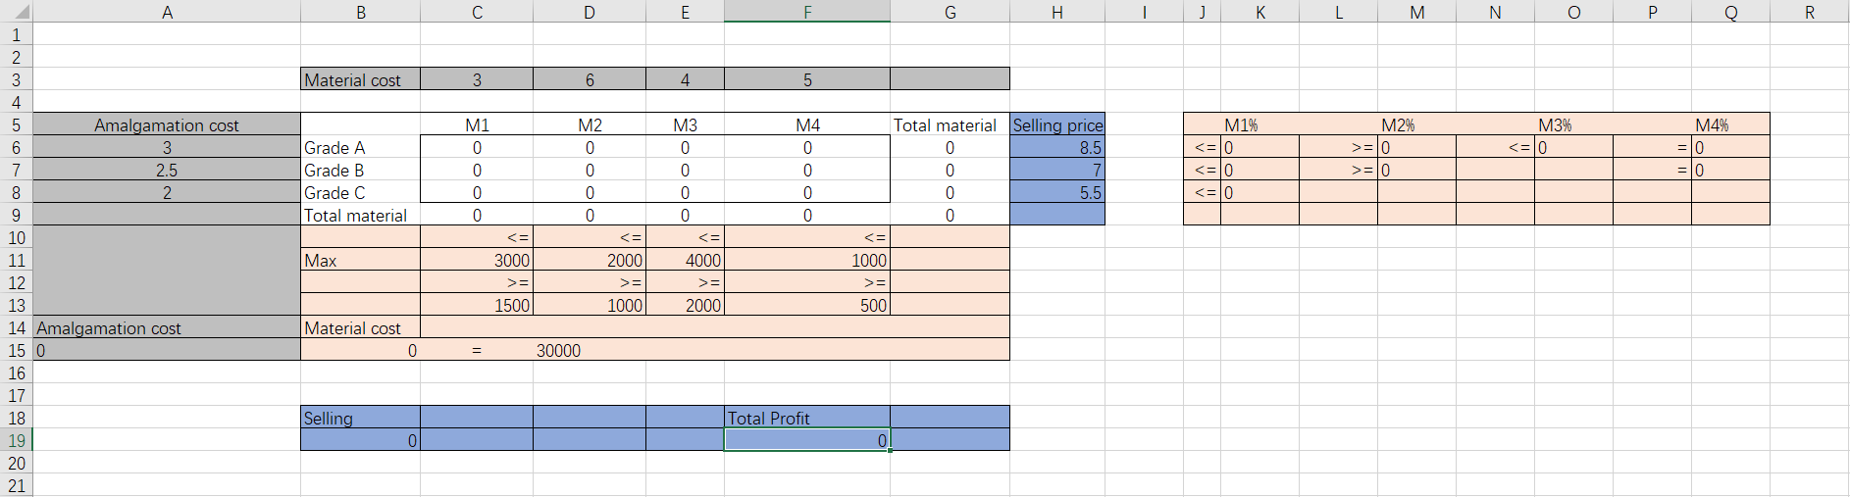
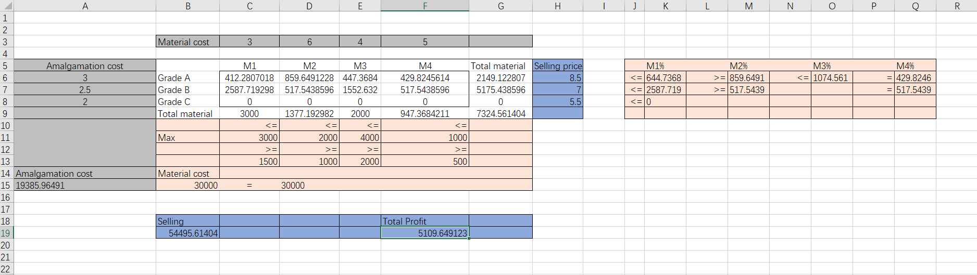
Excel
Notes:
This is our spreadsheet, using solover we get optimized solution. Thank you

