Slide 1
Eclipse – Git 연결

Slide 2
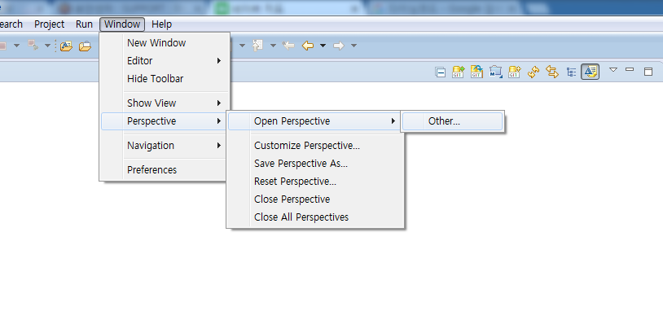
https://jwgye.tistory.com/38

Slide 3
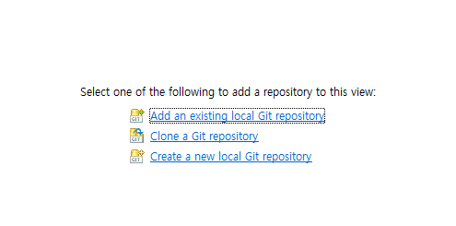
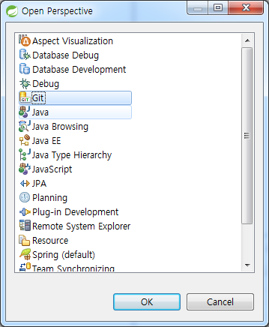
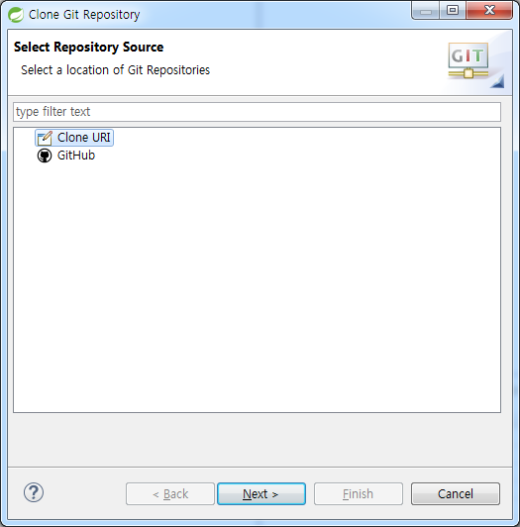

Slide 4
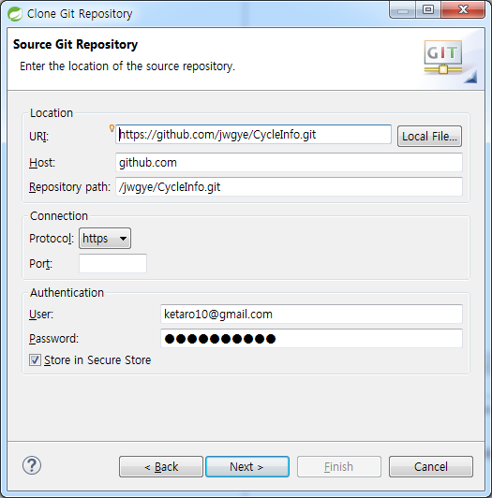

Slide 5
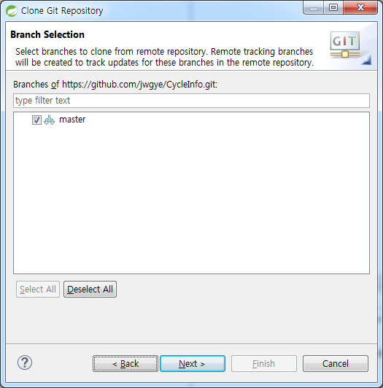

Slide 6
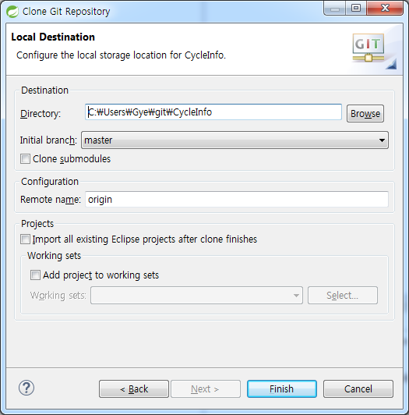

Slide 7
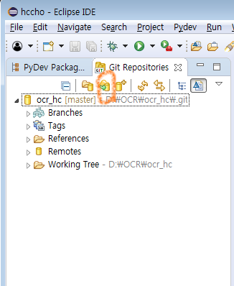
새로운 git 추가

Slide 8
“Undefined variable from import” errors?

Slide 9
step 2) Window - Preferences - PyDev - Interpreters - Python Interpreter Go to the Forced builtins tab Click on New... Type the name of the module (curses in my case) and click OK
step 3) Right click in the project explorer on whichever module is giving errors. Go to PyDev->Code analysis.

