Slide 1
COMPUTER VISION FOR PRIOR-ART SEARCH
Design Patent Similarity with ArcFace Metric Learning
Hui-Ching Chuang · Yueh-Heng Wu
Department of Statistics, National Taipei University · hcchuang@gm.ntpu.edu.tw
Patent identity—not product category—is the right supervision for finding visually similar designs.
15-MINUTE RESEARCH TALK

Slide 2
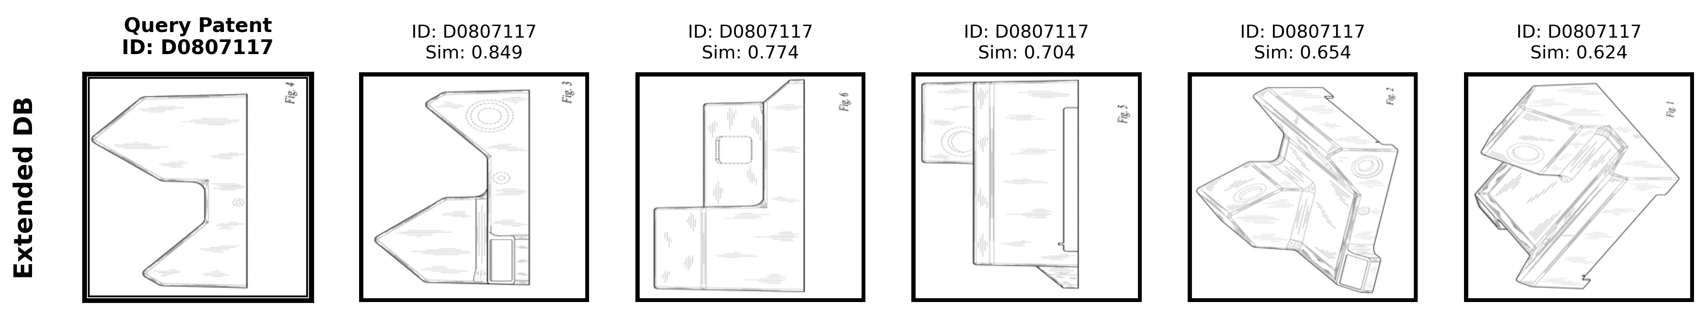
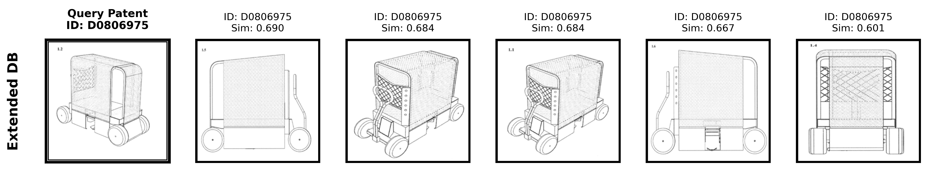
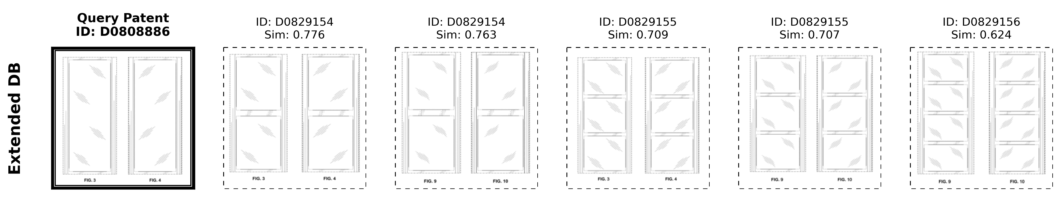
EXPERIMENTAL RESULTS
Three retrieval examples show success and hard negatives
Example 1 · exact recovery
Query D0807117: all five retrieved views share the query patent ID.
Example 2 · exact recovery
Query D0806975: all five retrieved views share the query patent ID.
Example 3 · hard negative
Query D0808886: visually close panels rank highly despite different patent IDs.
DESIGN PATENT SIMILARITY WITH ARCFACE METRIC LEARNING · HUI-CHING CHUANG · YUEH-HENG WU
Extended Gallery qualitative retrieval results

Slide 3
DATA
A national-scale corpus makes the task realistic
834,168
5.20M
1976–2025
338,436
US design patents
drawing images
coverage
extended-gallery images
Train / validation / retrieval split
128,888 training patents
22,746 validation
46,179 extended-gallery patents
The extended gallery is 8.7× larger than the standard gallery—closer to production retrieval.
DESIGN PATENT SIMILARITY WITH ARCFACE METRIC LEARNING · HUI-CHING CHUANG · YUEH-HENG WU
Corpus and split statistics reported in the paper

Slide 4
METHOD
Patent IDs become the metric-learning signal
Patent drawing
ConvNeXtV2
L2 embedding
ArcFace objective
multiple views
visual backbone
64–256 dimensions
pull same-patent views together
push different patents apart
Training
Retrieval
Scale 30 · angular margin 0.50 · 30 epochs · effective batch ≈512
Cosine search, then optional query expansion or graph diffusion
DESIGN PATENT SIMILARITY WITH ARCFACE METRIC LEARNING · HUI-CHING CHUANG · YUEH-HENG WU
Model architecture and training protocol from the paper

Slide 5
MODEL SELECTION
Resolution and backbone capacity both matter
BEST: 0.8193 mAP
0.8193
0.8
0.7254
0.6
0.5447
0.4619
0.4
0.3856
0.3422
0.2
0.0
ConvNeXt-T
64px
ConvNeXt-T
128px
ConvNeXt-T
256px
ResNet-18
256px
ResNet-50
256px
ResNet-152
256px
DESIGN PATENT SIMILARITY WITH ARCFACE METRIC LEARNING · HUI-CHING CHUANG · YUEH-HENG WU
Standard Gallery mean average precision

Slide 6
BENCHMARK
The gain survives a much larger search gallery
Standard Gallery
Extended Gallery
mAP
mAP
0.8193
0.6493
Ours
Ours
0.3760
0.2620
PatentNet
PatentNet
Acc@1 = 0.9312
Acc@20 = 0.9906
Acc@1 = 0.8088
Acc@20 = 0.9711
DESIGN PATENT SIMILARITY WITH ARCFACE METRIC LEARNING · HUI-CHING CHUANG · YUEH-HENG WU
Best 256px ConvNeXtV2-Tiny vs. PatentNet

Slide 7
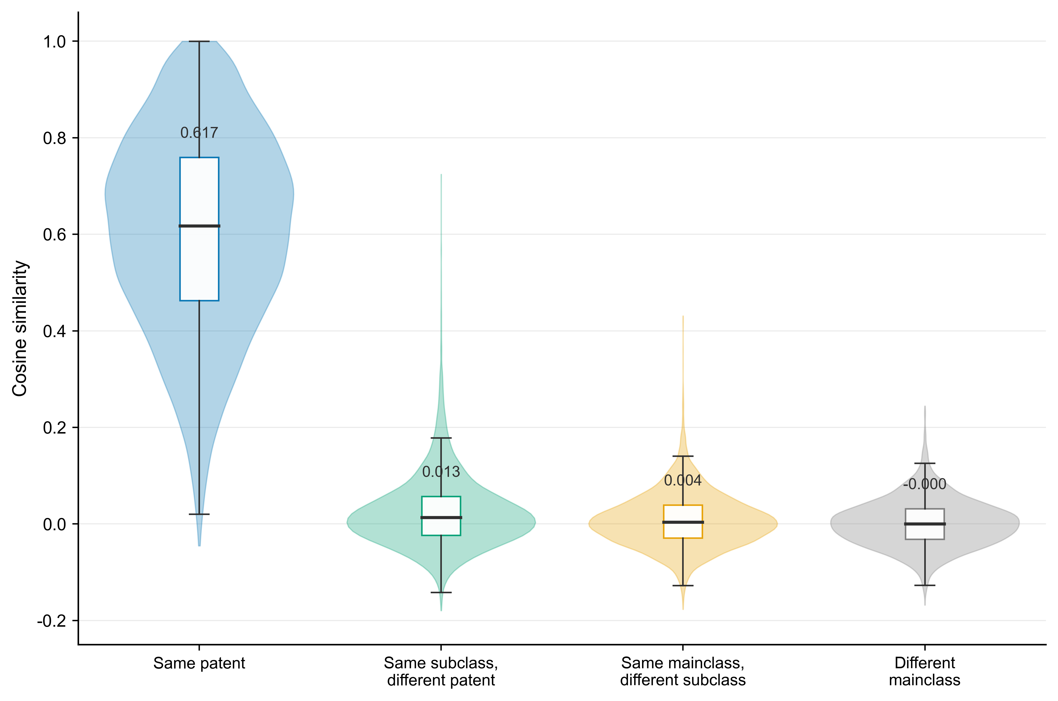
REPRESENTATION
The embedding learns identity—not just taxonomy
0.617
median: same patent
0.013
same subclass, other patent
≈0
different main class
DESIGN PATENT SIMILARITY WITH ARCFACE METRIC LEARNING · HUI-CHING CHUANG · YUEH-HENG WU
Cosine-similarity distribution across the design hierarchy

Slide 8
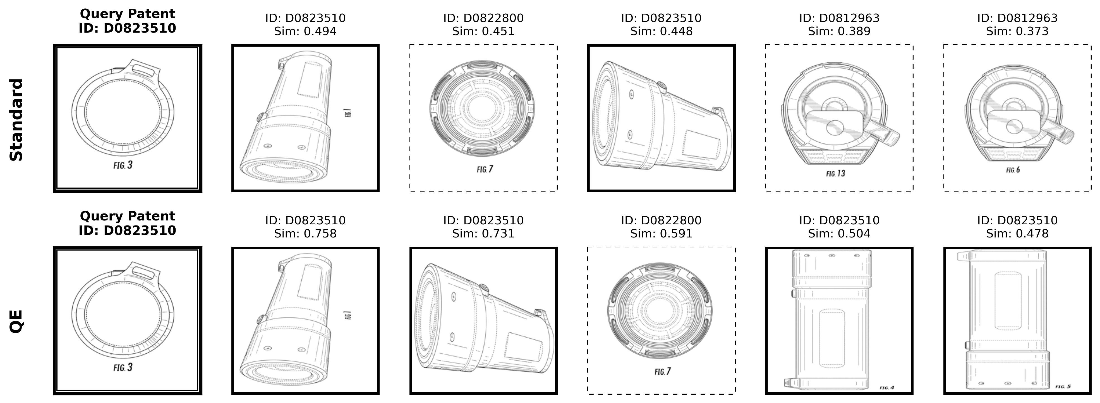
RANKING
Query expansion improves ranking—selectively
0.8193
baseline mAP
0.8417
query expansion mAP
Best setting
k = 3 · α = 1
Diffusion peaks at 0.8332.
DESIGN PATENT SIMILARITY WITH ARCFACE METRIC LEARNING · HUI-CHING CHUANG · YUEH-HENG WU
Standard Gallery; qualitative query-expansion example

Slide 9
TAKEAWAYS
A deployable retrieval layer—with clear limits
1 · Supervision
2 · Scale
3 · Next step
Patent identity turns multi-view drawings into strong positive pairs and avoids category-only shortcuts.
High-resolution ConvNeXt features maintain useful precision in a 338k-image extended gallery.
Hard negatives, domain filtering, and examiner-centered evaluation remain essential.
Bottom line: metric learning can narrow prior art; it does not replace legal judgment.
DESIGN PATENT SIMILARITY WITH ARCFACE METRIC LEARNING · HUI-CHING CHUANG · YUEH-HENG WU
Design Patent Similarity with ArcFace Metric Learning

