Slide 1
Revisiting the Missing R&D-Patent Relation: Challenges and Solutions for Firm Fixed Effects Models
Hui-Ching Chuang | National Taipei University
Po-Hsuan Hsu | National Tsing Hua University
Chung-Ming Kuan | National Taiwan University
Jui-Chung Yang | National Taiwan University

Slide 2
The prevailing use of firm fixed effects
A common practice in economics, finance, and accounting studies: firm fixed effects in regression models.
FE regression absorbs the influences of individual-specific, unobservable, and time-invariant effects.
We argue that, without theoretical modeling or appropriate econometric designs, prevailing use of fixed effects may
failing to identify the effect of the persistent variable of interest.
The R&D-patent relation is perhaps the most intuitive relation in economics.
More R&D input, more patent output
We conduct a comprehensive literature from 200+ papers based on the survey papers of Ederer and Manso (2011), He and Tian (2018), Lerner and Seru (2022) and author’s reading list.
Statistics suggests that 40% to 50% estimates are insignificant or even have negative values on R&D.

Slide 3
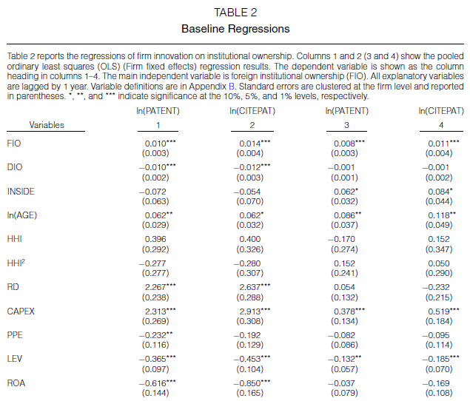

Example: Luong et al. (2017, JFQA)
Dependent variables: innovation output
ln(PATENT): Natural logarithm of the number of patents filed by each firm in a year plus 1.
ln(CITEPAT): Natural logarithm of the number of citations received by each firm’s patents in a year plus 1.
Our focus:
RD: Research and development
expenditures scaled by total assets.
How come R&D does not explain patents?

Slide 4
Our explanations
OLS allows us to understand R&D’s explanatory power for total variations of patents (= cross-sectional/between-firm variations + time-series/within-firm variations)
FE models absorb all cross-sectional/between-firm variations in patents
An analogy: a high (low) tech firm’s R&D and patents are persistently high (low). Thus, cross-sectional variation could be more important than time-series variation (Hausman et al., 1984; Hall et al., 2005).
However, FE models eliminate all cross-sectional variations in firms’ patents – so R&D role is missing
So, the estimation results of FE models only tell us R&D’s explanatory power for a firm’s time-series variations in patents

Slide 5
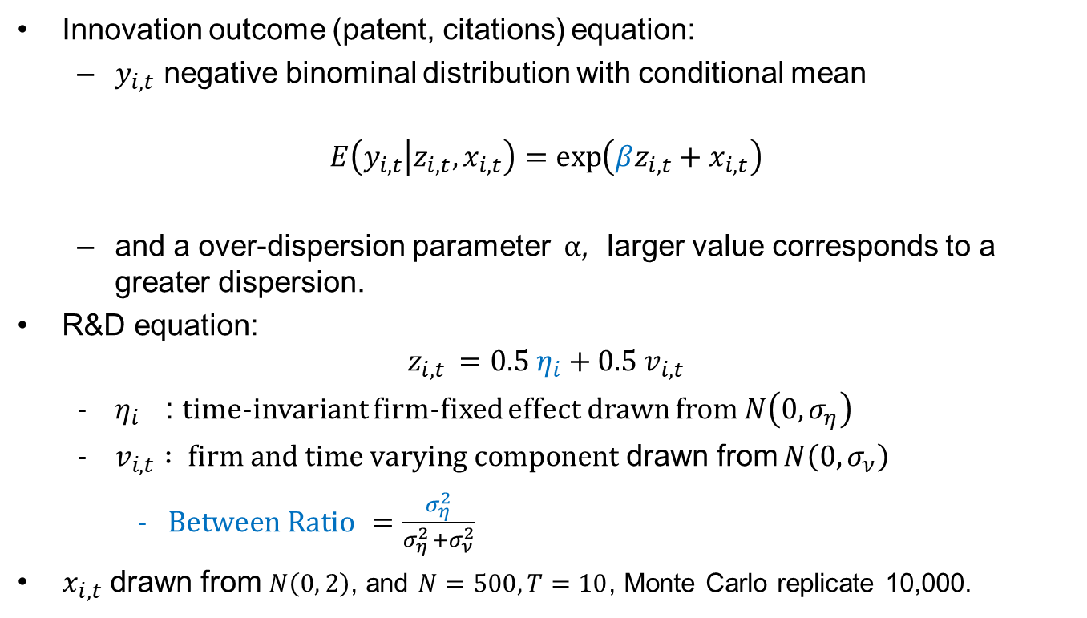
Simulation Study
Innovation outcome (patent, citations) equation:
$y_{i,t}$ negative binominal distribution with conditional mean
$$E\left(y_{i,t} | z_{i,t}, x_{i,t}\right)=\exp\left(βz_{i,t}+x_{i,t}\right)$$
and a over-dispersion parameter $α$, larger value corresponds to a greater dispersion.
R&D equation:
$$z_{i, t }=0.5 η_{i}+0.5 v_{i,t}$$
$η_{i}$ : time-invariant firm-fixed effect drawn from $N\left(0, σ_{η}\right)$
$v_{i,t} : firm and time varying component$ drawn from $N\left(0, σ_{ν}\right)$
$Between Ratio$ $=\frac{σ_{η}^{2}}{σ_{η }^{2}+σ_{ν}^{2}}$
$x_{i,t}$ drawn from $N\left(0, 2\right)$, and $N=500, T=10$, Monte Carlo replicate 10,000.

Slide 6
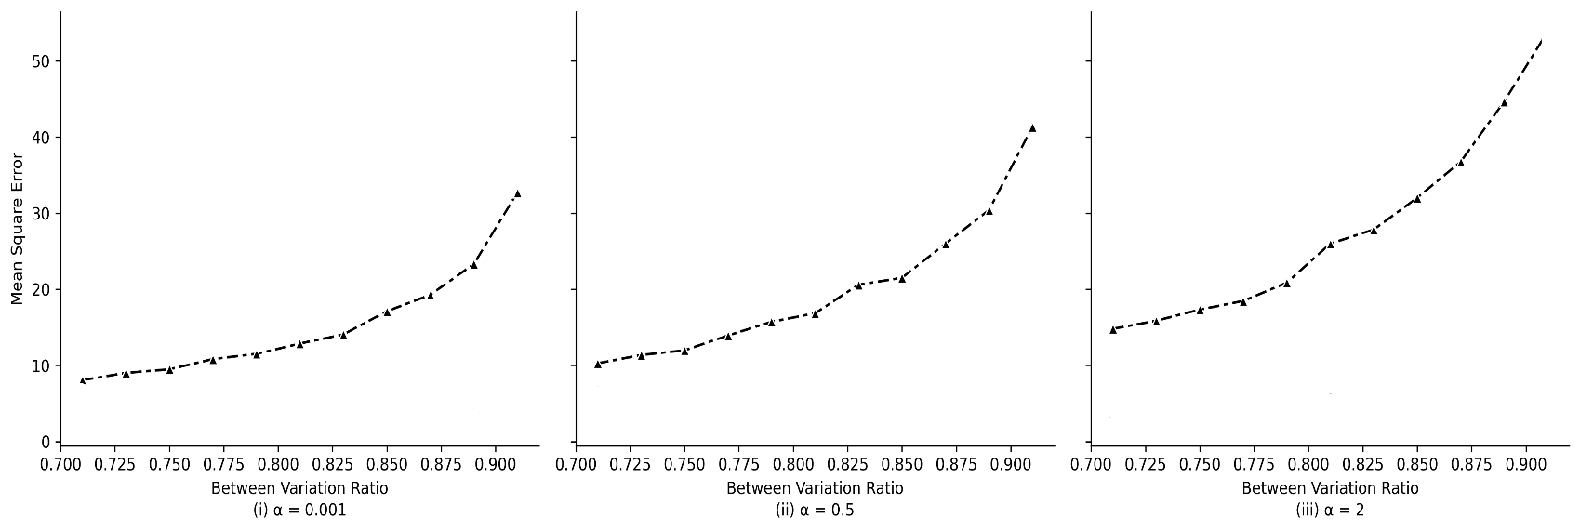
Simulation Study (cont’d)
Mean Square Error (FE)

Slide 7
Econometric Tools
A lack of appropriate econometric tools to address the issue for more reliable statistical inferences.
Not to include firm fixed effects (Baltagi et al., 2000; Hall et al., 2005; Noel and Schankerman, 2013; Pesaran and Zhou, 2018) may introduce alternative biases.
Our propositions and contributions:
1. Adjusted Hausman and Taylor (“adj-HT” 1981) method
2. Machine learning
Post-Regularization LASSO (PRL)
Double-machine learning (DML)

Slide 8
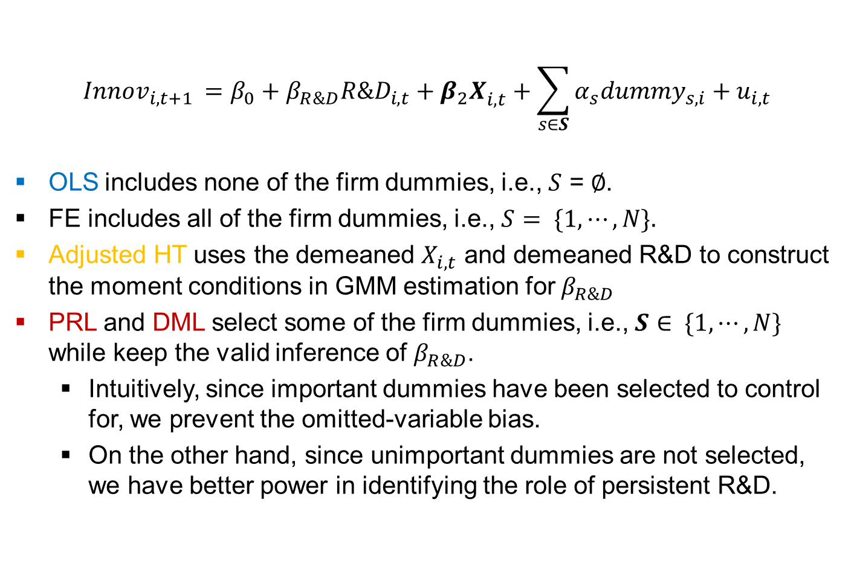
Overview: OLS, FE, adjHT, PRL, and DML
$$Innov_{i,t+1 }=β_{0}+β_{R\&D}R\&D_{i,t}+{β_{2}X}_{i,t}^{}+\sum_{s∈S}{α_{s}dummy_{s,i}+u_{i,t}}$$
OLS includes none of the firm dummies, i.e., $S$ =$∅$.
FE includes all of the firm dummies, i.e., $S= \{1, ⋯, N\}.$
Adjusted HT uses the demeaned $X_{i, t}$ and demeaned R&D to construct the moment conditions in GMM estimation for $β_{R\&D}$
PRL and DML select some of the firm dummies, i.e., $S∈ \{1, ⋯, N\}$ while keep the valid inference of $β_{R\&D}$.
Intuitively, since important dummies have been selected to control for, we prevent the omitted-variable bias.
On the other hand, since unimportant dummies are not selected, we have better power in identifying the role of persistent R&D.

Slide 9
Our recommendations
Instead of only reporting regressions with firm fixed effects, please also present the results without firm fixed effects and discuss why the coefficient estimates vary
We recommend to report R-squared and within R-squared results from regressions
If the results from 1 and 2 are inconsistent. Consider our adjusted Hausman and Taylor, PRL and DML methods as “second opinion”.
easy to implement by STATA (or R/Python). We make our codes available online:
https://github.com/hcchuang/Revisiting-the-Missing-RD-Patent-Relation_Challenges-and-Solutions-for-Firm-Fixed-Effects-Models
handle omitted variable issues without strict assumptions
enable researchers to decide exactly which firm dummies should be added in regressions.

Slide 10
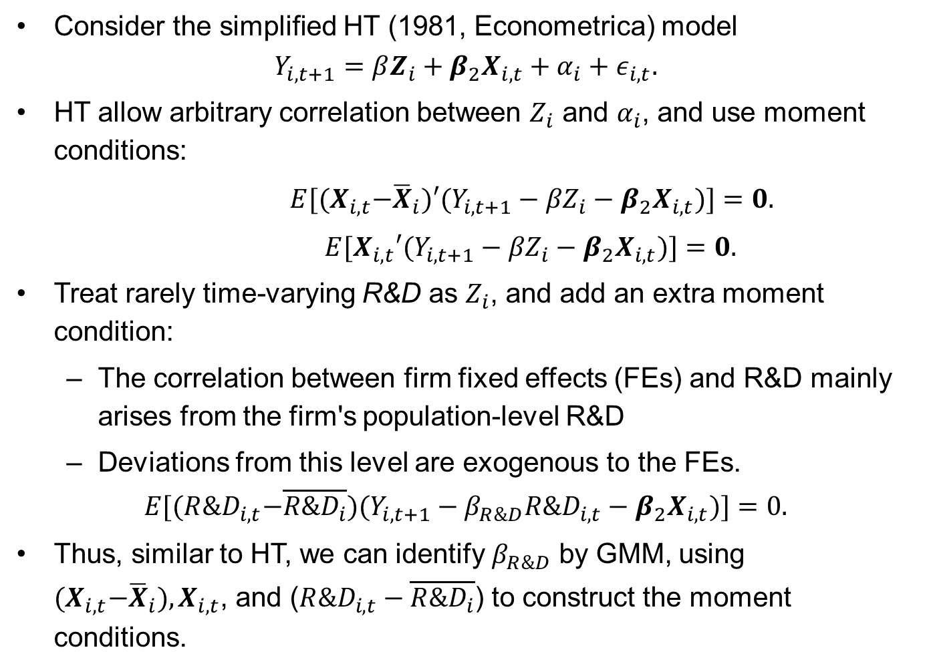
Our proposition-1 Adjusted Hausman-Taylor methods
Consider the simplified HT (1981, Econometrica) model
$$Y_{i,t+1}={βZ_{i}+β_{2}X}_{i,t}+α_{i}+ε_{i,t}.$$
HT allow arbitrary correlation between $Z_{i}$ and $α_{i}$, and use moment conditions:
$E[{(X}_{i,t}−{\overline{X}}_{i})′(Y_{i,t+1}−{βZ}_{i}−{β_{2}X}_{i,t})]=0.$
$E[X_{i,t}′(Y_{i,t+1}−{βZ}_{i}−{β_{2}X}_{i,t})]=0.$
Treat rarely time-varying R&D as $Z_{i}$, and add an extra moment condition:
The correlation between firm fixed effects (FEs) and R&D mainly arises from the firm's population-level R&D
Deviations from this level are exogenous to the FEs.
$$E[{(R\&D}_{i,t}−\overline{R\&D_{i}})(Y_{i,t+1}−{β_{R\&D}R\&D}_{i,t}−{β_{2}X}_{i,t})]=0.$$
Thus, similar to HT, we can identify $β_{R\&D}$ by GMM, using ${(X}_{i,t}−{\overline{X}}_{i}),X_{i,t}$, and (${R\&D}_{i,t}−\overline{R\&D_{i}}$) to construct the moment conditions.

Slide 11
Our proposition-2
Unobserved heterogeneity exists in some firms but not others.
Some managers are aggressive in investing in R&D and pursuing patent output, but others are not.
Some firms have a strong, innovation-oriented culture, while others do not.
A smarter methodology that can select which individual firm dummies to be included is called for.
In this paper, we proposed the second advanced machine learning method:
Post-regularization LASSO (PRL, Chernozhukov et al., 2015)
Double machine learning (DML, Chernozhukov et al., 2018)
to select individual firm dummies (and explanatory variables) in explaining firm-level patent outputs.

Slide 12
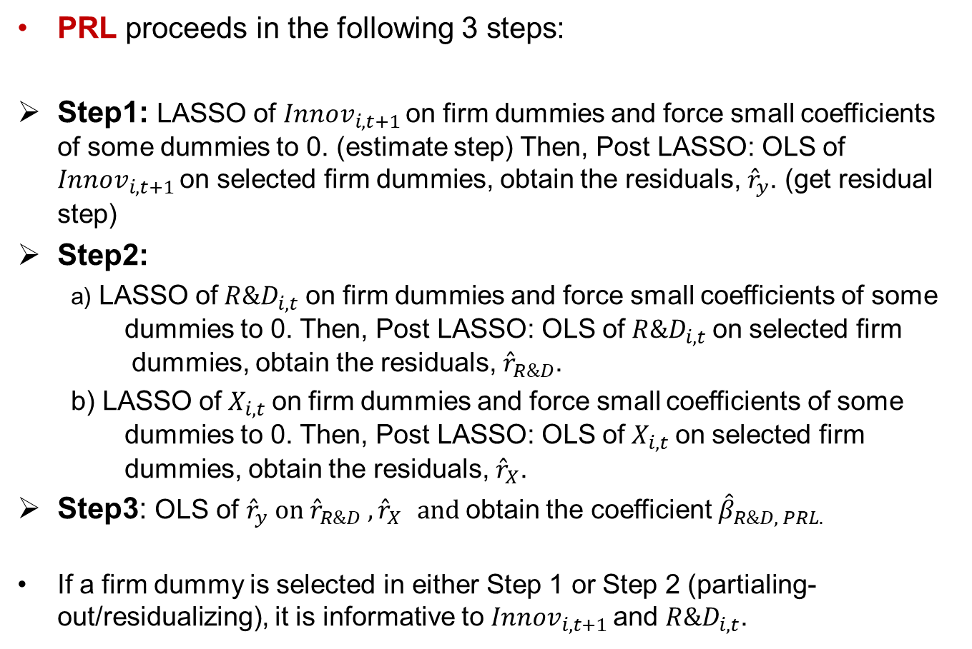
Post-Regularization LASSO (PRL)
PRL proceeds in the following 3 steps:
Step1: LASSO of $Innov_{i,t+1 }$on firm dummies and force small coefficients of some dummies to 0. (estimate step) Then, Post LASSO: OLS of $Innov_{i,t+1 }$on selected firm dummies, obtain the residuals, ${\hat{r}}_{y}$. (get residual step)
Step2:
a) LASSO of$R\&D_{i,t}$on firm dummies and force small coefficients of some dummies to 0. Then, Post LASSO: OLS of$R\&D_{i,t}$on selected firm dummies, obtain the residuals, ${\hat{r}}_{R\&D}$.
b) LASSO of$X_{i,t}$on firm dummies and force small coefficients of some dummies to 0. Then, Post LASSO: OLS of$X_{i,t}$on selected firm dummies, obtain the residuals, ${\hat{r}}_{X}$.
Step3: OLS of ${\hat{r}}_{y} on {\hat{r}}_{R\&D} ,{\hat{r}}_{X} and$obtain the coefficient ${\hat{β}}_{R\&D, PRL.}$
If a firm dummy is selected in either Step 1 or Step 2 (partialing-out/residualizing), it is informative to $Innov_{i,t+1 }$and $R\&D_{i,t}$.

Slide 13
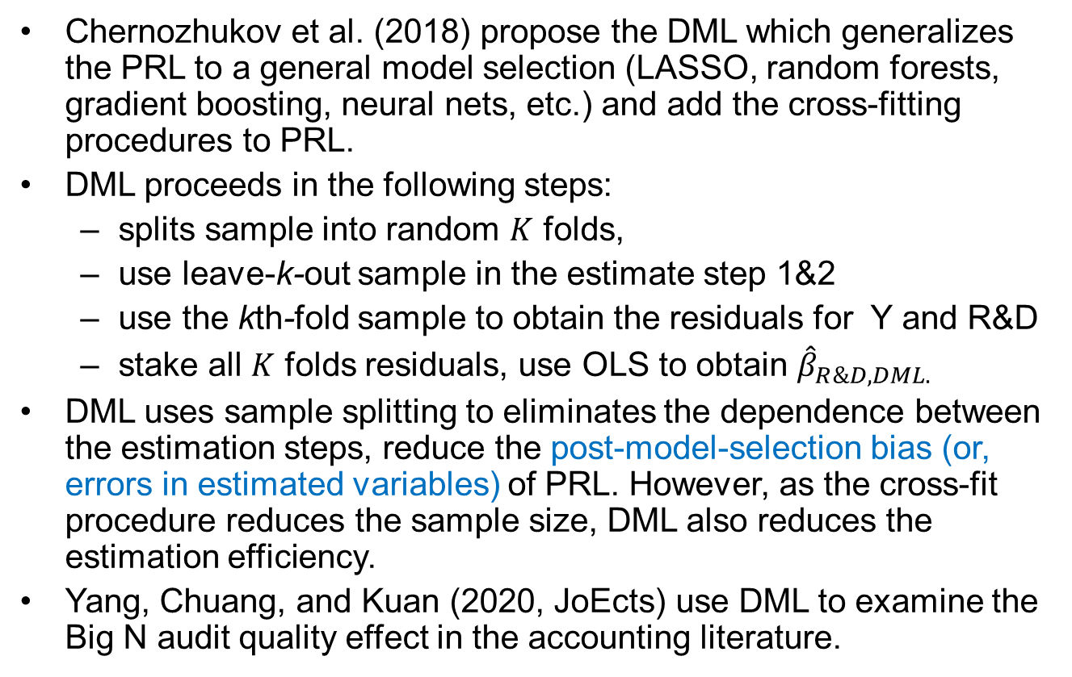
Double Machine Learning (DML)
Chernozhukov et al. (2018) propose the DML which generalizes the PRL to a general model selection (LASSO, random forests, gradient boosting, neural nets, etc.) and add the cross-fitting procedures to PRL.
DML proceeds in the following steps:
splits sample into random $K$ folds,
use leave-k-out sample in the estimate step 1&2
use the kth-fold sample to obtain the residuals for Y and R&D
stake all $K$ folds residuals, use OLS to obtain ${\hat{β}}_{R\&D, DML.}$
DML uses sample splitting to eliminates the dependence between the estimation steps, reduce the post-model-selection bias (or, errors in estimated variables) of PRL. However, as the cross-fit procedure reduces the sample size, DML also reduces the estimation efficiency.
Yang, Chuang, and Kuan (2020, JoEcts) use DML to examine the Big N audit quality effect in the accounting literature.
1 | 2 | 3 | 4 | 5
2 | 3 | 4 | 5
1

Slide 14
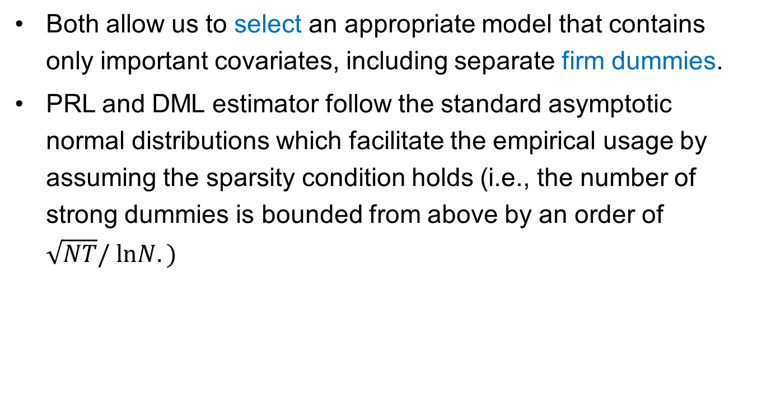
PRL and DML benefits
Both allow us to select an appropriate model that contains only important covariates, including separate firm dummies.
PRL and DML estimator follow the standard asymptotic normal distributions which facilitate the empirical usage by assuming the sparsity condition holds (i.e., the number of strong dummies is bounded from above by an order of $\sqrt{NT}/ lnN.)$

Slide 15
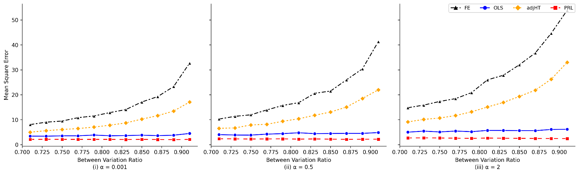
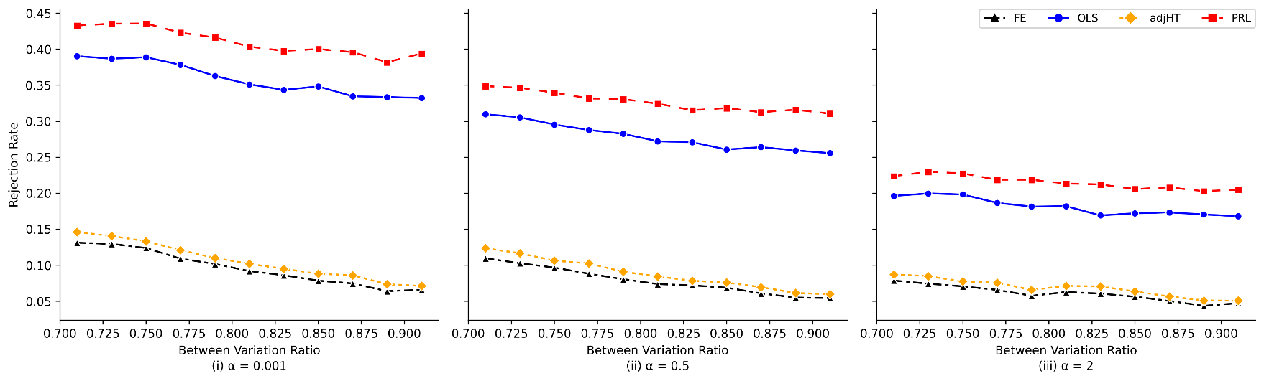
Simulation Study (cont’d)

Slide 16
Sample
We first collect the financial and accounting data of all publicly-listed firms in the U.S. from CRSP and Compustat.
We exclude financial and utility firms (SIC in 6000-6999, and 4900-4999), and firms with negative and missing total asset and sales.
We then collect the patent and citation data of all public firms from the PatentsView patent database that is organized by the USPTO.
As a result, we have 86,341 firm-year observations during 1976-2000. (We also consider sample of firms with at least one patent during the sample period.)

Slide 17
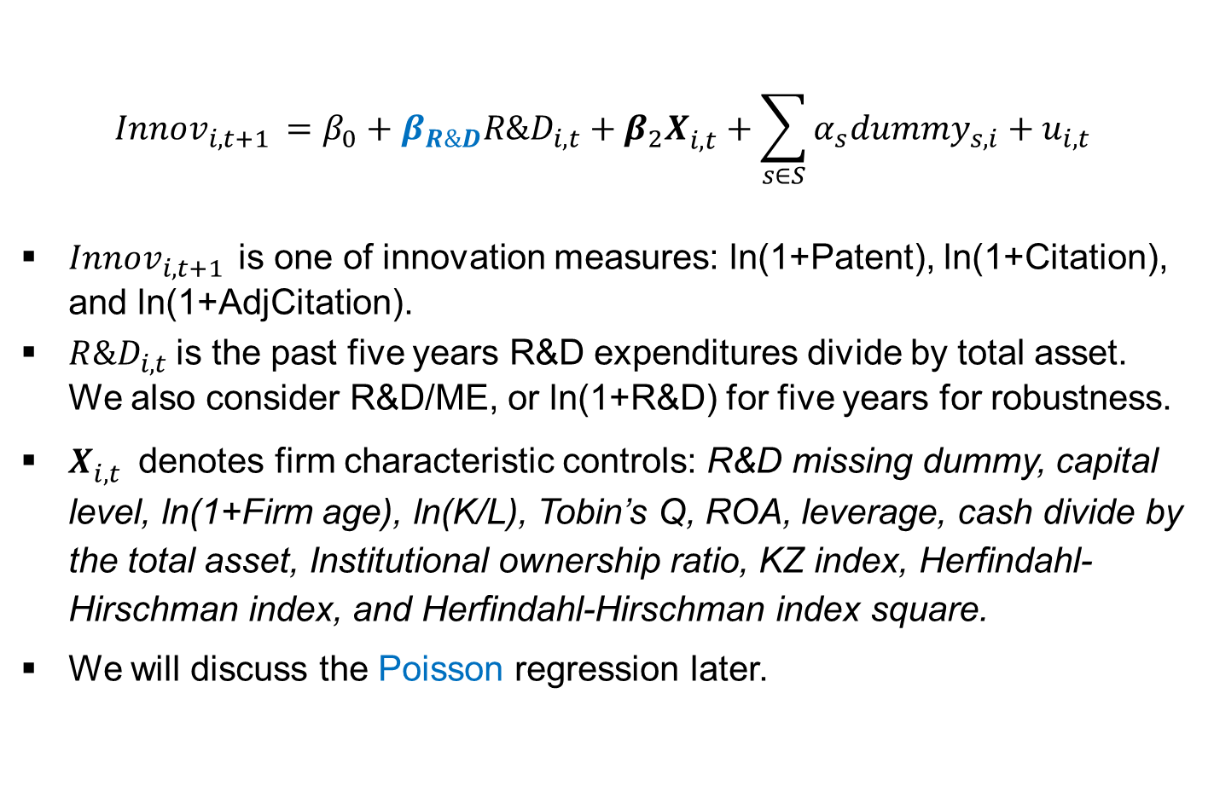
Our baseline regressions
$$Innov_{i,t+1 }=β_{0}+β_{R\&D}R\&D_{i,t}+{β_{2}X}_{i,t}^{}+\sum_{s∈S}{α_{s}dummy_{s,i}+u_{i,t}}$$
$Innov_{i,t+1 }$is one of innovation measures: ln(1+Patent), ln(1+Citation), and ln(1+AdjCitation).
$R\&D_{i,t}$is the past five years R&D expenditures divide by total asset. We also consider R&D/ME, or ln(1+R&D) for five years for robustness.
$X_{i,t}^{}$ denotes firm characteristic controls: R&D missing dummy, capital level, ln(1+Firm age), ln(K/L), Tobin’s Q, ROA, leverage, cash divide by the total asset, Institutional ownership ratio, KZ index, Herfindahl-Hirschman index, and Herfindahl-Hirschman index square.
We will discuss the Poisson regression later.

Slide 18
Diagnostic steps: Within R square and Adj-HT
 | OLS (Year Dummies Only) | Fixed Effects (All Firm and Year Dummies) | Adj HT
R&D/Asset | 0.593*** | 0.041 | 0.220***
 | (0.042) | (0.028) | (0.027)
R square | 0.424 | 0.822
Adj R square | 0.423 | 0.804
Within R square |  | 0.049
Adj Within R square |  | 0.049
FE models, R square reports the regression R square where model include raw y and raw x were x include all explanatory variables and all firm dummies.
FE models : Within R square is the R square from the regression of the de-entity-meaned (i.e, within transformation) of y and
de-meaned x.

Slide 19
Patent regression: PRL and DML results
PRL
 | OLS (Year Dummies Only) | PRL (Firm and Year Dummies) | Fixed Effects (All Firm and Year Dummies)
R&D/Asset | 0.593*** | 0.199*** | 0.041
 | (0.042) | (0.018) | (0.028)
Number of dummies |  | 11,570
Number of selected dummies |  | 1,241 (10.73%)
DML
 | OLS (Year Dummies Only) | DML (Firm and Year Dummies) | Fixed Effects (All Firm and Year Dummies)
R&D/Asset | 0.593*** | 0.213*** | 0.041
 | (0.042) | (0.014) | (0.028)
Number of dummies |  | 1,1570
Number of selected dummies |  | 1,737 (15.01%)

Slide 20
Citation regression: PRL and DML results
PRL
 | OLS (Year Dummies Only) | PRL (Firm and Year Dummies) | Fixed Effects (All Firm and Year Dummies)
R&D/Asset | 1.396*** | 1.397*** | -0.051
 | (0.084) | (0.083) | (0.068)
Number of dummies |  | 11,570
Number of selected dummies |  | 525 (4.54%)
DML
 | OLS (Year Dummies Only) | DML (Firm and Year Dummies) | Fixed Effects (All Firm and Year Dummies)
R&D/Asset | 1.396*** | 1.364*** | -0.051
 | (0.084) | (0.050) | (0.068)
Number of dummies |  | 11,570
Number of selected dummies |  | 947 (8.18%)

Slide 21
Adjusted-Citation regression: PRL and DML results
PRL
 | OLS (Year Dummies Only) | PRL (Firm and Year Dummies) | Fixed Effects (All Firm and Year Dummies)
R&D/Asset | 0.590*** | 0.210*** | 0.033
 | (0.045) | (0.019) | (0.031)
Number of dummies |  | 11,570
Number of selected dummies |  | 1,194 (10.32%)
DML
 | OLS (Year Dummies Only) | DML (Firm and Year Dummies) | Fixed Effects (All Firm and Year Dummies)
R&D/Asset | 0.590*** | 0.198*** | 0.033
 | (0.045) | (0.015) | (0.031)
Number of dummies |  | 11,570
Number of selected dummies |  | 1,882 (16.27%)

Slide 22
PRL and DML results
The coefficients on R&D input are statistically significant and that their economic magnitude is much closer to those from OLS models without firm fixed effects (than those with firm fixed effects).
PRL and DML select about 10% to 20% of firm dummies to be included in regression models -- the bias from adding all firm dummies overpowers the bias from not adding any at all (the consequence is an insignificant R&D coefficient)
These results, together with prior analyses, suggest that most firm dummies do not play a crucial role.
To recap: FE model = 0.041 (insig.)
OLS = 0.593,
adj-HT = 0.220,
PRL = 0.199, DML = 0.213

Slide 23
STATA code
To implement adjusted Hausman and Taylor:
To implement PRL
To implement DML
ivregress gmm y z x (z = demean_z demean_x), wmatrix(cluster firmID)
poregress y z x, controls(i.firmID) vce(cluster firmID)
xporegress y z x, controls(i.firmID) vce(cluster firmID) xfolds(#folds)
Notes:
Circulate purpose

Slide 24
Robustness
Alternative R&D measures
Tested R&D/ME, and Ln(1+R&D) in addition to R&D/AT,
Patenting firms
Excluded firms without any patent for during its sample period.
Handling missing R&D values
Remove firm-year observations with missing R&D
Alternative specifications in HT, PRL, and DML methods
Different fold count from two to five in DML method

Slide 25
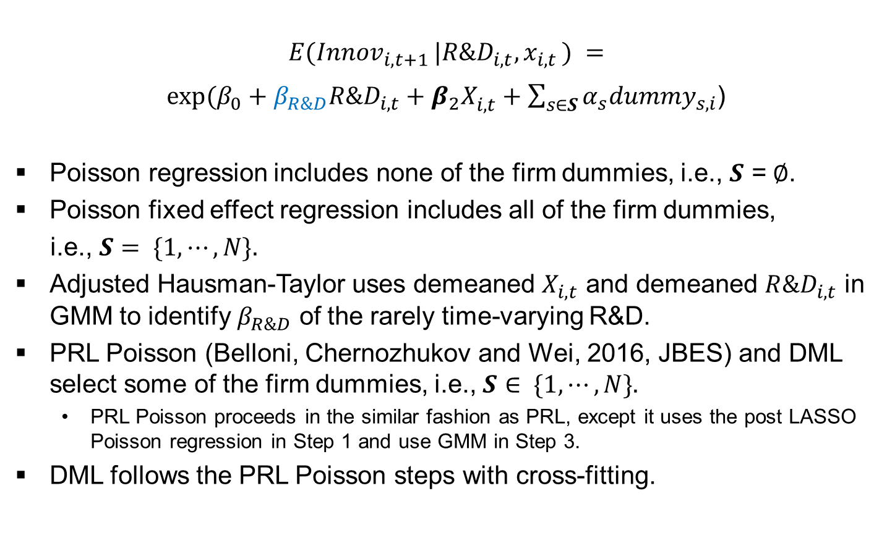
Poisson regression
$$E(Innov_{i,t+1 }|R\&D_{i,t}, x_{i,t }) =$$
$exp⁡(β_{0}+β_{R\&D}R\&D_{i,t}+{β_{2}X}_{i,t}^{}+\sum_{s∈S}{α_{s}dummy_{s,i}}$)
Poisson regression includes none of the firm dummies, i.e., $S$ =$∅$.
Poisson fixed effect regression includes all of the firm dummies,
i.e., $S= \{1, ⋯, N\}.$
Adjusted Hausman-Taylor uses demeaned $X_{i,t}$ and demeaned $R\&D_{i,t}$ in GMM to identify $β_{R\&D}$ of the rarely time-varying R&D.
PRL Poisson (Belloni, Chernozhukov and Wei, 2016, JBES) and DML select some of the firm dummies, i.e., $S∈ \{1, ⋯, N\}.$
PRL Poisson proceeds in the similar fashion as PRL, except it uses the post LASSO Poisson regression in Step 1 and use GMM in Step 3.
DML follows the PRL Poisson steps with cross-fitting.

Slide 26
PRL Poisson and DML
Patent Counts
 | Poisson | FE Poisson | PRL Poisson | DML
 | Year Dummies only | All Firm and Year Dummies | Firm and Year Dummies | Firm and Year Dummies
R&D/Asset | 2.305*** | -0.248 | 2.407*** | 2.312***
 | (0.187) | (0.255) | (0.161) | (0.120)
Number of dummies |  |  | 11,570 | 11,570
Number of selected dummies |  |  | 1,218 (10.53%) | 2,484 (21.47%)
Citation Counts
 | Poisson | FE Poisson | PRL Poisson | DML
 | Year Dummies only | Firm and Year Dummies | Firm and Year Dummies | Firm and Year Dummies
R&D/Asset | 2.094*** | -0.125 | 2.299*** | 2.262***
 | (0.219) | (0.252) | (0.256) | (0.113)
Number of dummies |  |  | 11,570 | 11,570
Number of selected dummies |  |  | 1,226 (10.51%) | 2,426 (20.97%)

Slide 27
Our recommendations
Instead of only reporting regressions with firm fixed effects, please also present the results without firm fixed effects and discuss why the coefficient estimates vary
We recommend to report within R-squared and results from regressions without firm fixed effects
If the results from 1 and 2 are inconsistent. Consider our adjusted Hausman and Taylor, PRL and DML methods as “second opinion”.
easy to implement by STATA (or R/Python). We make our codes available online:
https://github.com/hcchuang/Revisiting-the-Missing-RD-Patent-Relation_Challenges-and-Solutions-for-Firm-Fixed-Effects-Models
handle omitted variable issues without strict assumptions
enable researchers to decide exactly which firm dummies should be added in regressions.

Slide 28
Our contributions
Corporate finance studies tend to solve firm-specific, time-invariant unobservables issues by using fixed effects models (e.g., Angrist and Pischke, 2009; Imbens and Wooldridge, 2009; Roberts and Whited, 2013)
We illustrate the potential biases of such a practice by using the intuitive R&D-patent relation as our lab.
More importantly, we offer two feasible and ready-to-use methodologies to enable corporate finance researchers to analyze the effects of economic variables that are persistent in time, such as ownership structure and managerial capability.
In particular, we provide explanations that they may use to justify their choice of regression specifications without firm fixed effects (or with only a limited set of firm dummies).

Slide 29
Our contributions (Cont.)
We add to modern machine learning techniques in corporate finance research, for the selection of relevant covariates (e.g., Chinco et al., 2019; Feng et al., 2020; Gu et al., 2020; Erel et al., 2021).
This study also adds to the economics literature by supporting and justifying prior studies' choice of not including firm fixed effects to estimate knowledge production functions (Pakes and Griliches, 1984; Blundell et al., 1995; Hall et al., 2007; Noel and Schankerman, 2013).

Slide 30
Thank you! Questions? Comments? hcchuang@gm.ntpu.edu.tw (Hui-Ching Chuang)

Slide 31
Selected Top 30 Firms
1 | INTL BUSINESS MACHINES | 11 | XEROX HOLDINGS CORP | 21 | FORD MOTOR CO
2 | LUCENT TECHNOLOGIES | 12 | AT&T INC | 22 | HONEYWELL INTERNATIONAL INC
3 | GENERAL ELECTRIC | 13 | TEXAS INSTRUMENTS INC | 23 | CBS CORP -OLD
4 | APTIV PLC | 14 | 3M CO | 24 | RAYTHEON TECHNOLOGIES CORP
5 | EASTMAN KODAK | 15 | RCA CORP | 25 | PROCTER & GAMBLE CO
6 | MOTOROLA SOLUTIONS | 16 | BROADCOM CORP | 26 | SUN MICROSYSTEMS INC
7 | GENERAL MOTORS CO | 17 | NORTH AMERICAN PHILIPS CORP | 27 | QUALCOMM INC
8 | DU PONT (E I) DE NEMOURS | 18 | EXXON MOBIL CORP | 28 | MOBIL CORP
9 | AT&T CORP | 19 | HP INC | 29 | CONOCOPHILLIPS
10 | DUPONT DE NEMOURS INC | 20 | MERCK & CO | 30 | MICRON TECHNOLOGY INC

Slide 32
Alternative R&D measures: Patent regression
 | Fixed Effects (Firm and Year Dummies) | OLS (Year Dummies) | adjHT (Year Dummies) | PRL (Firm and Year Dummies) | DML (Firm and Year Dummies)
R&D/ME | 0.026 | 0.502*** | 0.139*** | 0.112*** | 0.123***
 | (0.018) | (0.035) | (0.018) | (0.015) | (0.012)
Ln(R&D) | 0.023*** | 0.140*** | 0.071*** | 0.032*** | 0.035***
 | (0.003) | (0.004) | (0.003) | (0.001) | (0.001)
Firm cluster standard errors in parentheses. *p<0.1, **p<0.05, and ***p<0.01.
We suppress the year and firm characteristics variables to save space.

Slide 33
Alternative R&D measures: Citation regression
 | Fixed Effects (Firm and Year Dummies) | OLS (Year Dummies) | adjHT (Year Dummies) | PRL (Firm and Year Dummies) | DML (Firm and Year Dummies)
R&D/ME | -0.024 | 1.040*** | 0.286*** | 1.015*** | 1.001***
 | (0.040) | (0.064) | (0.040) | (0.064) | (0.038)
Ln(R&D) | 0.036*** | 0.286*** | 0.176*** | 0.285*** | 0.285***
 | (0.007) | (0.006) | (0.006) | (0.006) | (0.003)
Firm cluster standard errors in parentheses. *p<0.1, **p<0.05, and ***p<0.01.
We suppress the year and firm characteristics variables to save space.

Slide 34
Alternative R&D measures: AdjCitation regression
 | Fixed Effects (Firm and Year Dummies) | OLS (Year Dummies) | adjHT (Year Dummies) | PRL (Firm and Year Dummies) | DML (Firm and Year Dummies)
R&D/ME | 0.021 | 0.506*** | 0.135*** | 0.119*** | 0.117***
 | (0.019) | (0.037) | (0.019) | (0.016) | (0.012)
Ln(R&D) | 0.022*** | 0.143*** | 0.071*** | 0.035*** | 0.035***
 | (0.003) | (0.004) | (0.003) | (0.001) | (0.001)
Firm cluster standard errors in parentheses. *p<0.1, **p<0.05, and ***p<0.01.
We suppress the year and firm characteristics variables to save space.

Slide 35
Patenting firms (Observation: 45,913)
 | Fixed Effects (All Firm and Year Dummies) | OLS (Year Dummies) | adjHT (Year Dummies) | PRL (Firm and Year Dummies) | DML (Firm and Year Dummies)
Patent regression
R&D/AT | 0.035 | 0.448*** | 0.161*** | 0.406*** | 0.399***
 | (0.031) | (0.045) | (0.030) | (0.044) | (0.025)
Citation regression
R&D/AT | -0.061 | 0.777*** | 0.317*** | 0.738*** | 0.740***
 | (0.079) | (0.087) | (0.075) | (0.084) | (0.054)
AdjCitation regression
R&D/AT | 0.033 | 0.419*** | 0.175*** | 0.369*** | 0.377***
 | (0.036) | (0.049) | (0.034) | (0.047) | (0.028)
Firm cluster standard errors in parentheses. *p<0.1, **p<0.05, and ***p<0.01.
We suppress the year and firm characteristics variables to save space.

Slide 36
Summary statistics
 | Obs. | Mean | Median | Std. dev. | P25 | P75
ln(1+Patent) | 86,341 | 0.53 | 0.00 | 1.11 | 0.00 | 0.69
ln(1+Citation) | 86,341 | 1.25 | 0.00 | 2.27 | 0.00 | 2.20
ln(1+AdjCitation) | 86,341 | 0.54 | 0.00 | 1.16 | 0.00 | 0.34
R&D/Asset | 86,341 | 0.13 | 0.00 | 0.26 | 0.00 | 0.14
ln(ME) | 86,341 | 11.13 | 10.95 | 2.07 | 9.60 | 12.51
R&D Missing Dummy | 86,341 | 0.43 | 0.00 | 0.50 | 0.00 | 1.00
ln(1+Age) | 86,341 | 2.48 | 2.48 | 0.75 | 1.95 | 3.09
ln(K/L) | 86,341 | 10.00 | 9.85 | 1.29 | 9.18 | 10.64
Tobin Q | 86,341 | 1.76 | 1.22 | 1.66 | 0.94 | 1.85
ROA | 86,341 | 0.10 | 0.13 | 0.18 | 0.06 | 0.19
Leverage | 86,341 | 0.23 | 0.21 | 0.18 | 0.07 | 0.35
Cash/Asset | 86,341 | 0.14 | 0.07 | 0.17 | 0.02 | 0.18
KZ Index | 86,341 | -3.42 | -0.54 | 10.77 | -3.48 | 1.03
Institutional ownership | 86,341 | 0.23 | 0.15 | 0.24 | 0.01 | 0.40
HH Index | 86,341 | 0.25 | 0.20 | 0.20 | 0.11 | 0.30
HH Index Square | 86,341 | 0.10 | 0.04 | 0.18 | 0.01 | 0.09
Notes:
Patent = e^0.53-1 = 0.69
Citation = e^1.25-1 = 2.49
Age = 11.94
Kaplan-Zingales Index: The KZ-Index (Kaplan-Zingales Index) is a relative measurement of reliance on external financing. Companies with a higher KZ-Index scores are more likely to experience difficulties when financial conditions tighten since they may have difficulty financing their ongoing operations.
KZ Index = -1.001909 x Cash Flows / K + 0.2826389 x Q + 3.139193 x Debt / Total Capital + '-39.3678 x Dividends / K + -1.314759 x Cash / K

Slide 37
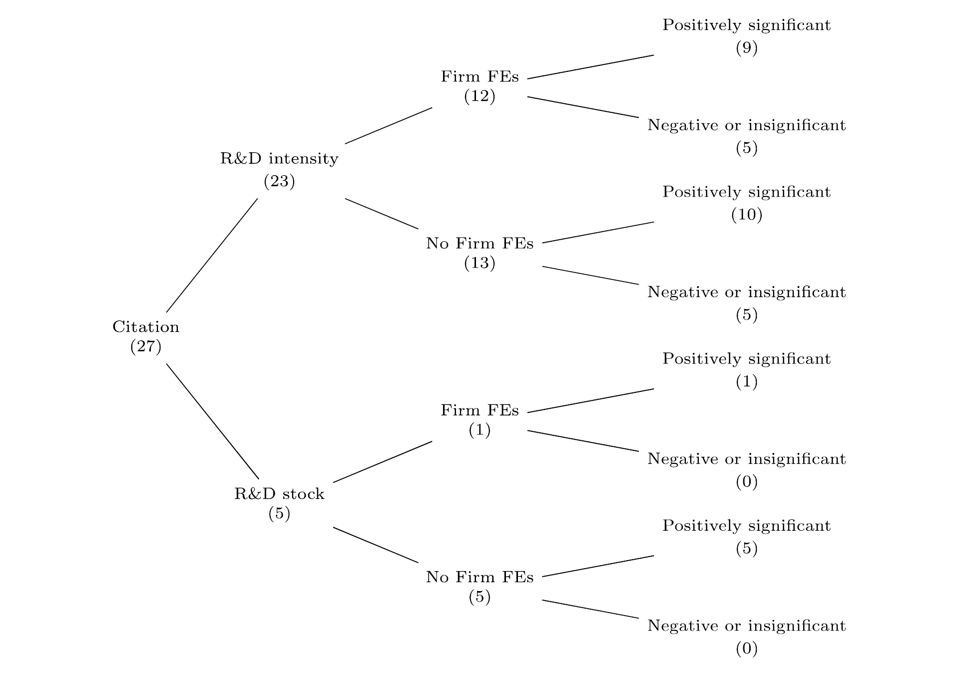
Our survey of the corporate innovation literature Least square approach on Citation (paper #)
Notes:
Among 27 citation-R&D papers,
23(5) has the scaled R&D(unscaled R&D) as an explanatory variable.
Among 23 citation-scaled R&D papers, 12 include firm FE.
Among 12 using firm FE, citation-scaled R&D papers, 5 of them show negative or insignificantly positive coefficients on R&D.

Slide 38
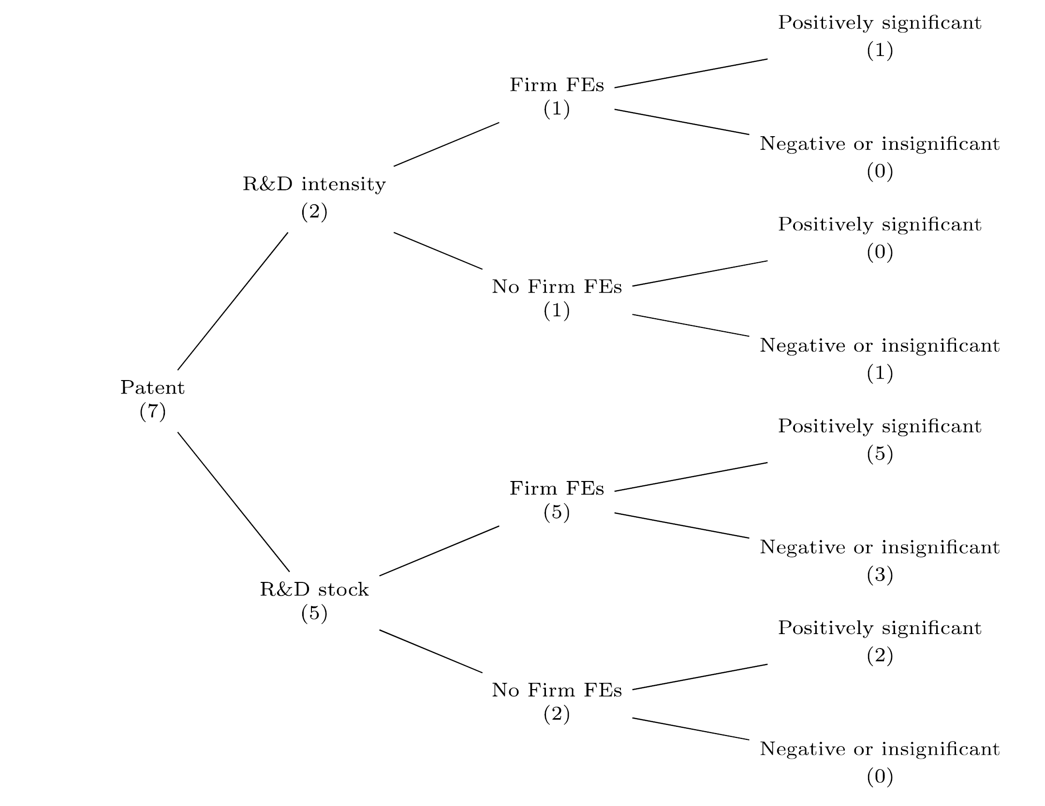
Our survey of the corporate innovation literature Poisson and negative binominal approach on Patent

Slide 39
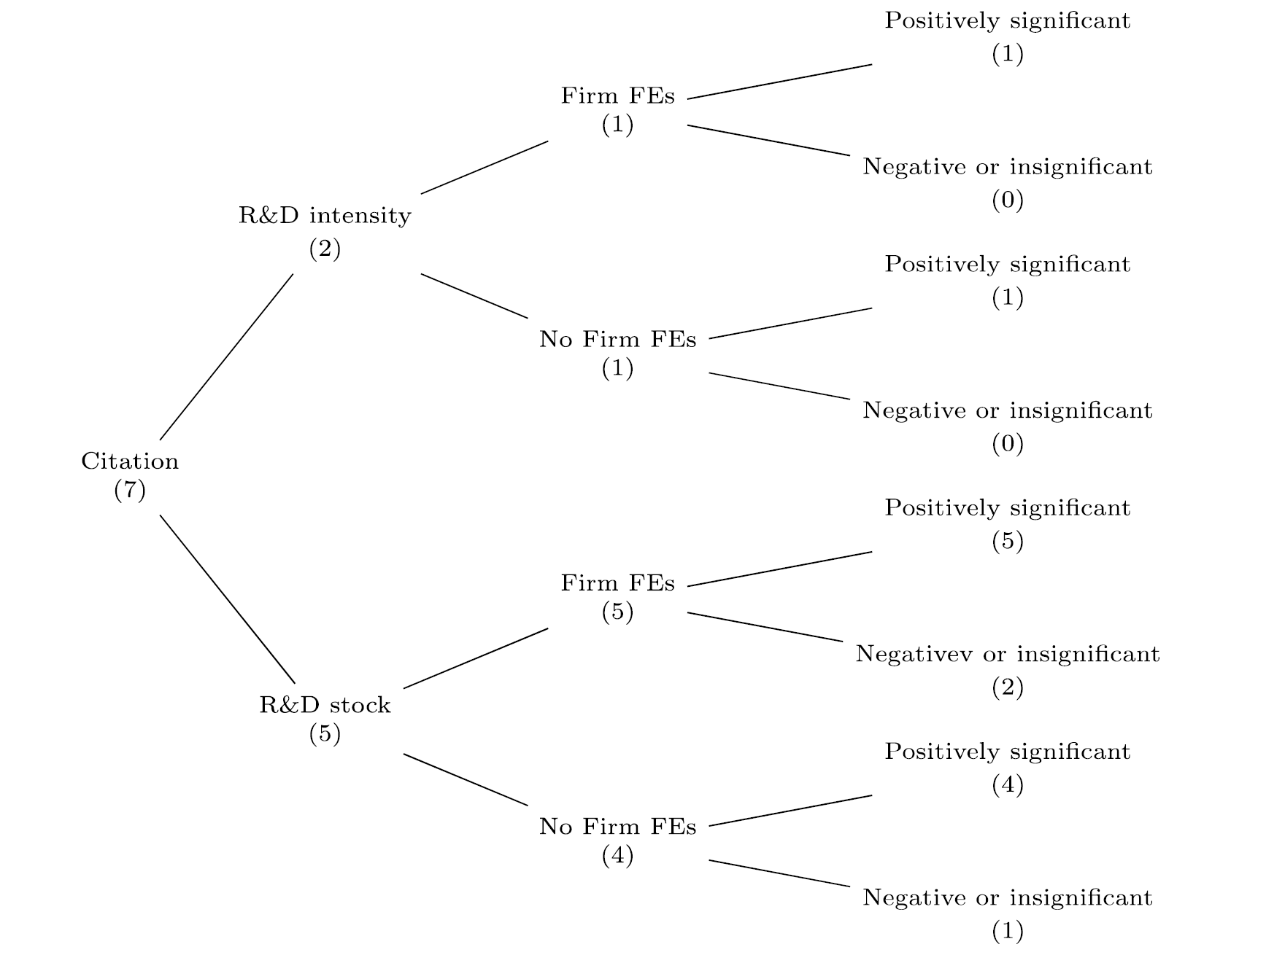
Our survey of the corporate innovation literature Poisson and negative binominal approach on Citation

