Slide 1
FOMC COMMUNICATION AND ASSET PRICES
Hawkish by Voice
Yueh-Heng Wu · Hui-Ching Chuang · Ju-Fang Yen
Department of Statistics, National Taipei University · hcchuang@gm.ntpu.edu.tw
Holding the words fixed, the way Q&A sounds contains market-relevant information.
15-MINUTE RESEARCH TALK

Slide 2
RESEARCH QUESTION
Do markets react to how the FOMC sounds?
Same words
Different delivery
“Inflation remains elevated.”
Human voice − same-text TTS
Text-based tone is held constant
The difference isolates non-textual delivery signals
Voice gap = net hawkishness(human) − net hawkishness(TTS)
HAWKISH BY VOICE: FINANCIAL MARKET REACTIONS TO FOMC COMMUNICATION · HUI-CHING CHUANG
Conceptual identification: exact-text human–TTS comparison

Slide 3
IDENTIFICATION
Each sentence is paired with itself
FOMC audio
ASR alignment
Text labels
WavLM
Same-text TTS
statement + Q&A
sentence timestamps
FOMC-RoBERTa
voice hawkishness
counterfactual voice
What is held fixed
What the gap can include
The words, sentence boundaries, and underlying semantic content.
Delivery plus speaker composition in the interactive Q&A—not only the chair.
HAWKISH BY VOICE: FINANCIAL MARKET REACTIONS TO FOMC COMMUNICATION · HUI-CHING CHUANG
Human–TTS paired-sentence design

Slide 4
SAMPLE AND MODEL
89 press conferences yield 35,619 paired sentences
89
35,619
30,671
2011–25
press conferences
clean sentences
Q&A sentences
sample window
Held-out speech classification
0.9125
0.8362
0.8362
pooled AUC
accuracy
macro F1
HAWKISH BY VOICE: FINANCIAL MARKET REACTIONS TO FOMC COMMUNICATION · HUI-CHING CHUANG
WavLM-Large cross-validation and corpus statistics

Slide 5
VOICE GAP
Human Q&A is modestly more hawkish than TTS
Sentence level
Meeting level
Human
0.4225
Human
0.4589
TTS
0.4125
TTS
0.4469
Gap = 0.0100
t = 9.94***
Gap = 0.0120
t = 2.24**
HAWKISH BY VOICE: FINANCIAL MARKET REACTIONS TO FOMC COMMUNICATION · HUI-CHING CHUANG
Paired Q&A estimates; ** p<0.05, *** p<0.01

Slide 6
MARKET RESPONSE
Treasury sensitivity rises with maturity
CAR[0,1] · HUMAN − TTS
0.040***
0.04
0.03
0.020**
0.02
0.012**
0.01
0.005*
SHY
IEI
IEF
TLT
A 0.01 increase in the voice gap is associated with a larger two-day return at longer maturities.
HAWKISH BY VOICE: FINANCIAL MARKET REACTIONS TO FOMC COMMUNICATION · HUI-CHING CHUANG
Regression coefficients with standard controls; 89 meetings

Slide 7
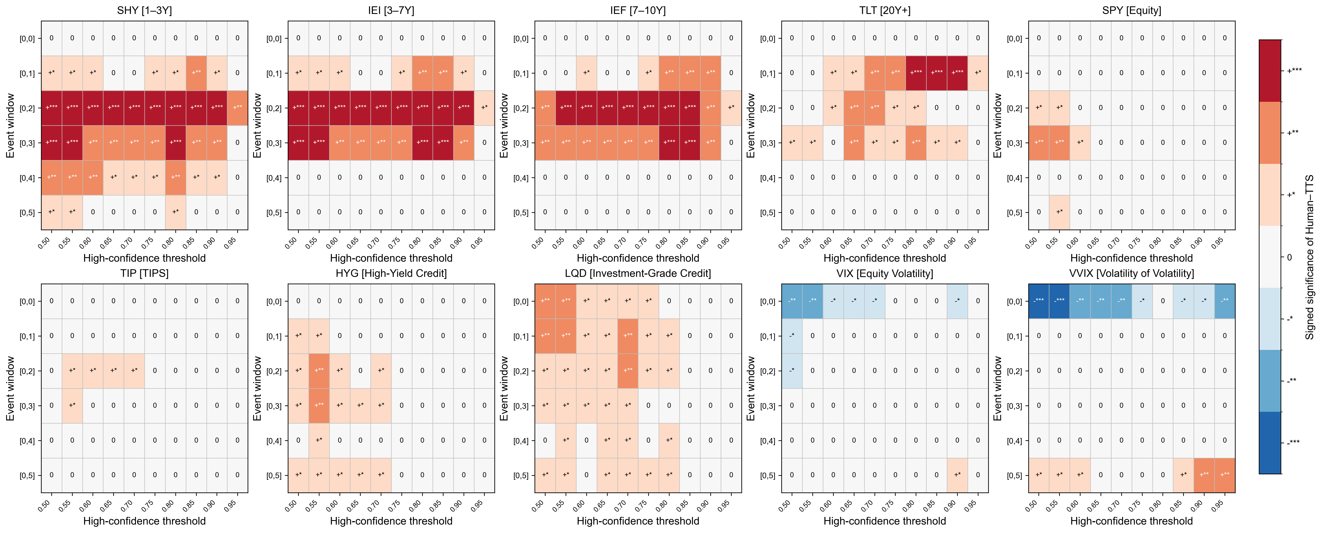
ROBUSTNESS
The main effect is stable across design choices
Across thresholds
Signs persist across alternative high-confidence cutoffs.
Across windows
Results are visible beyond one event-window choice.
Across assets
The strongest unconditional pattern is in Treasuries.
HAWKISH BY VOICE: FINANCIAL MARKET REACTIONS TO FOMC COMMUNICATION · HUI-CHING CHUANG
Human–TTS coefficient heatmap across assets, thresholds, and windows

Slide 8
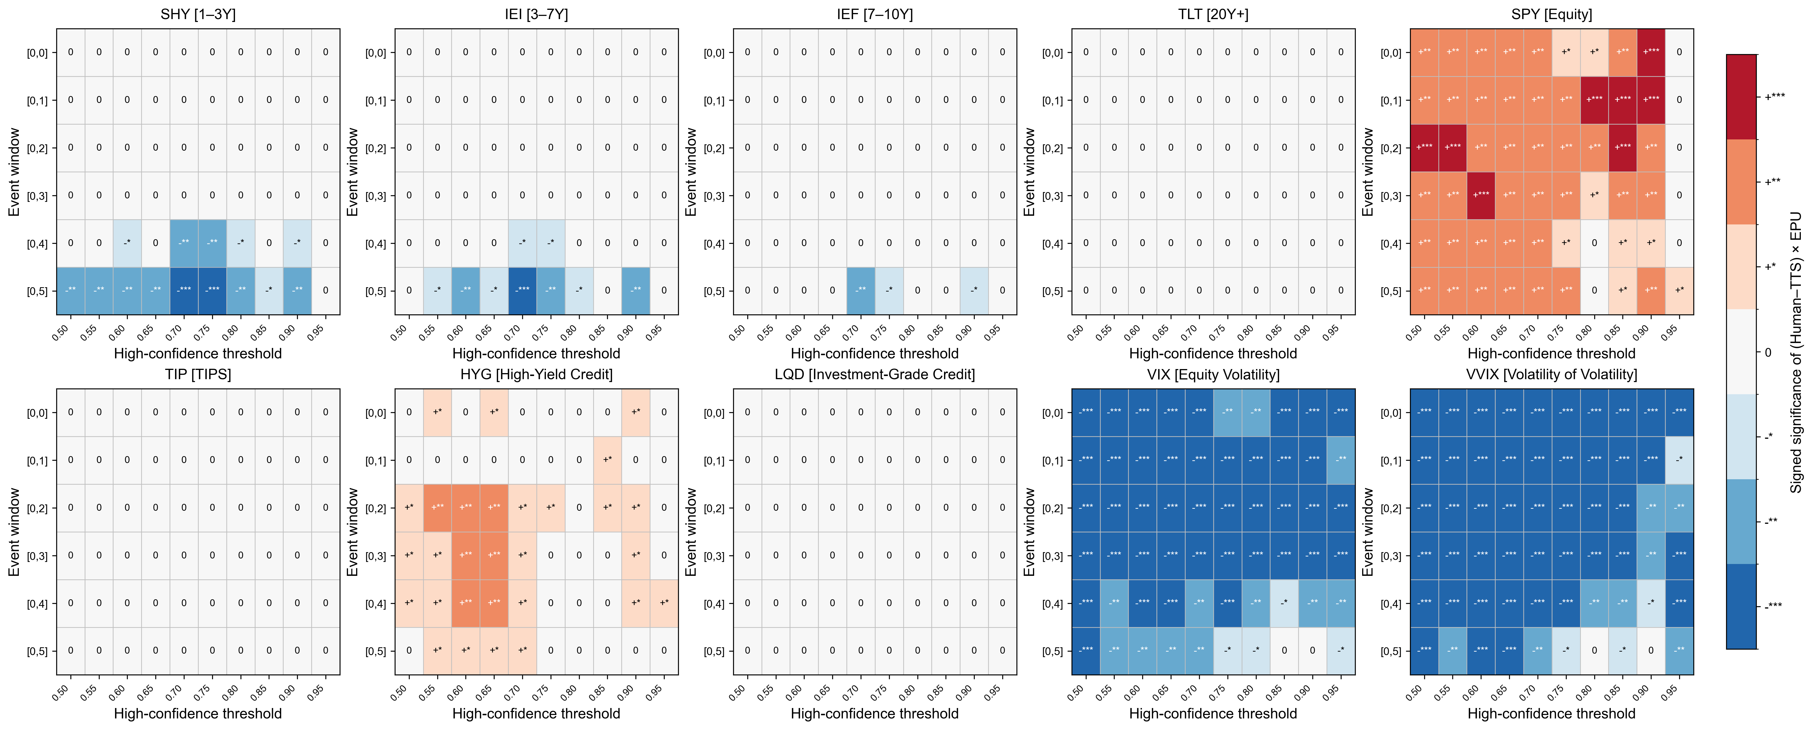
STATE DEPENDENCE
Policy uncertainty redirects the response
+0.0003
SPY × EPU
−0.058
VIX × EPU
−0.163
VVIX × EPU
HAWKISH BY VOICE: FINANCIAL MARKET REACTIONS TO FOMC COMMUNICATION · HUI-CHING CHUANG
Interaction of Human–TTS gap with economic policy uncertainty

Slide 9
INTERPRETATION
Voice matters, but the estimand is broader than the chair
What we learn
What we do not claim
Why it matters
Markets respond to non-textual information embedded in live FOMC Q&A, even after fixing the words.
The coefficient is not a causal chair-only voice effect; reporters, moderator, and interaction matter.
Communication measurement should be multimodal—and evaluated against economic outcomes.
Bottom line: text and delivery are distinct channels of monetary-policy communication.
HAWKISH BY VOICE: FINANCIAL MARKET REACTIONS TO FOMC COMMUNICATION · HUI-CHING CHUANG
Hawkish by Voice: Financial Market Reactions to FOMC Communication

