Slide 1
Limitation of Firm Fixed Effects Models and the Missing R&D-Patent Relation: New Methods and Evidence
Hui-Ching Chuang | National Taipei University
Po-Hsuan Hsu | National Tsing Hua University
Chung-Ming Kuan | National Taiwan University
Jui-Chung Yang | National Taiwan University
Department of Economics
National Taipei University
April 21, 2025

Slide 2
The prevailing use of firm fixed effects
A common practice in economics, finance, and accounting studies: firm fixed effects in regression models.
FE regression absorbs the influences of individual-specific, unobservable, and time-invariant effects.
We argue that, without theoretical modeling or appropriate econometric designs, prevailing use of fixed effects may have disadvantage –failing to identify the effect of the persistent variable of interest.
The R&D-patent relation had been extensively examined by Hausman et al. (1984), Griliches (1990), etc.
It is perhaps the most intuitive relation in economics: more R&D input, more patent output

Slide 3
Findings in the literature
Several studies document the FE model weakens/eliminates the explanatory power of persistent variables (such as R&D):
Aghion, Reenen, and Zingales (2013, AER) “In the specifications where we include fixed effects, the coefficient on the R&D stock falls significantly.”
Balsmeier, Fleming, and Manso (2017, JFE) “Alternative regressions with R&D investments scaled by total assets reveal a significant positive effect only in specifications without firm fixed effects. Inclusion of controls for time-invariant firm heterogeneity leads to statistically insignificant results.”

Slide 4
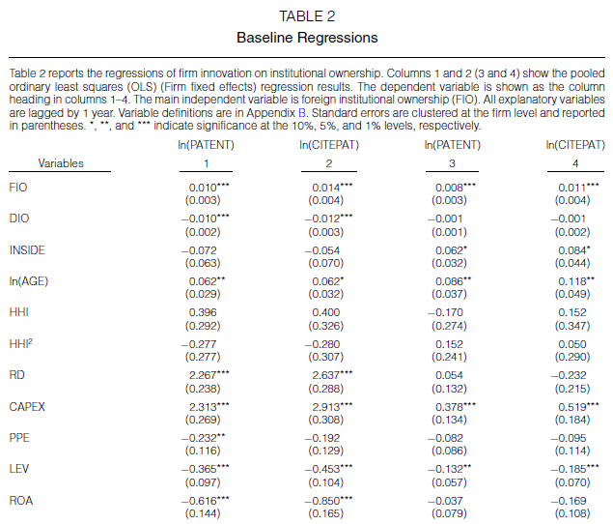

Example: Luong et al. (2017, JFQA)
Dependent variables: innovation output
ln(PATENT): Natural logarithm of the number of patents filed by each firm in a year plus 1.
ln(CITEPAT): Natural logarithm of the number of citations received by each firm’s patents in a year plus 1.
Our focus:
RD: Research and development
expenditures scaled by total assets.
How come R&D does not explain patents?

Slide 5
Our survey of the corporate innovation literature
We start our screening of corporate innovation papers from the 200+ papers based on the survey papers of Ederer and Manso (2011),
He and Tian (2018), Lerner and Seru (2022) and authors' reading list.
36 papers include the patent/citation-R&D equations at least in one column of their tables. They are published on: JFE(10), JFQA(8), MS(7), RFS(4), JF(2), AER, Econometrica, JAE, JLE, and REStat from 2007 to 2021.
28 specify the dependent variable as patent count and use linear regression model to investigate the patent/citation-R&D relationship.
6 use Poisson (negative binominal) model to investigate the patent/citation-R&D relationship.
Others use hierarchical linear model, change to change, Tobit, and Fama-Macbeth approach.
Notes:
1. Patent includes: EFFPATENT INNOV PAT, Ln(1+ firms’ patents weighted by the number of forward citations, Ln(1+Patents), Logarithm of Patent Count , Number of patents, patents weighted by the number of non-self forward citations, , logarithm of the total number of granted patents that are filed within the first five years after a firm's
Cite-weighted patent counts
2. Citation includes: CPATENT, INNOV CITE ln(1 + Citations per patent), Ln(1+ \\bar{Citation}), Ln(1+ 3yrs citation/ 3-yrs patents）, Ln(1+QCITATIONS), Ln(1+TCITATIONS), Ln(1+three year citation), LN(CPP), logarithm of citations per patent for granted patents that are filed within the first five years after a firm's IPO, Number of non-self-citations received by firm i on its patents filed in year t

Slide 6
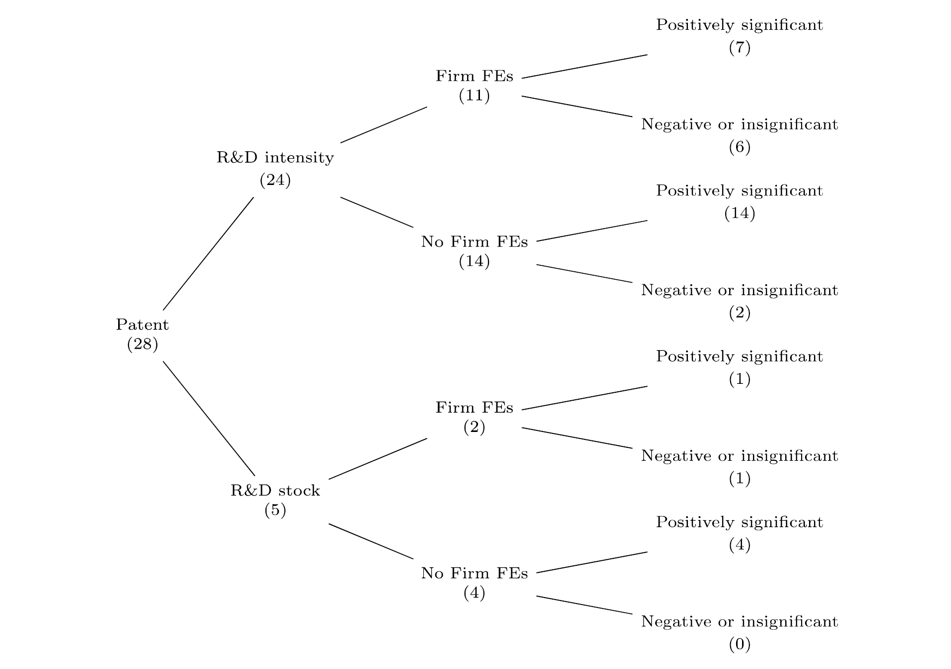
Our survey of the corporate innovation literature: Least square approach on Patent (paper #)
In FE models, the role of R&D is often missing
In OLS (no FEs), the role of R&D more likely holds
Notes:
Among 28 patent-R&D papers,
24(5) use the scaled R&D(unscaled R&D) as an explanatory variable.
- Scaled R&D: R&D/Asset, R&D/Sales, ln(1+R&D/Asset), ln(R&D/Sales)
- Unscaled R&D: ln(R&D), R&D.
Among 24 patent-scaled R&D papers, 11 include firm FE.
Among 11 using firm FE, 6 of them show negative or insignificantly positive coefficients on R&D.
1. Patent includes: EFFPATENT INNOV PAT, Ln(1+ firms’ patents weighted by the number of forward citations, Ln(1+Patents), Logarithm of Patent Count , Number of patents, patents weighted by the number of non-self forward citations, , logarithm of the total number of granted patents that are filed within the first five years after a firm's
Cite-weighted patent counts
2. Citation includes: CPATENT, INNOV CITE ln(1 + Citations per patent), Ln(1+ \\bar{Citation}), Ln(1+ 3yrs citation/ 3-yrs patents）, Ln(1+QCITATIONS), Ln(1+TCITATIONS), Ln(1+three year citation), LN(CPP), logarithm of citations per patent for granted patents that are filed within the first five years after a firm's IPO, Number of non-self-citations received by firm i on its patents filed in year t

Slide 7
Our survey of the corporate innovation literature
Our literature review suggests a surprising and puzzling pattern.
40% to 50% estimates for R&D in the literature show insignificant or even negative coefficients on R&D input.
OLS allows us to understand R&D’s explanatory power for total variations of patents (= cross-sectional/between-firm variations + time-series/within-firm variations)
FE models absorb all cross-sectional/between-firm variations in patents
An analogy: a high (low) tech firm’s R&D and patents are persistently high (low). Thus, cross-sectional variation could be more important than time-series variation (Hausman et al., 1984; Hall et al., 2005).
However, FE models eliminate all cross-sectional variations in firms’ patents – so R&D role is missing
So, the estimation results of FE models only tell us R&D’s explanatory power for a firm’s time-series variations in patents

Slide 8
Issues with FE model results
If R&D input cannot explain patent output in a fixed effect regression model, then to what extent can we trust prior estimation results for the explanatory power of those new factors?
Instead, it may only capture the time-series variation of patent output, which is relatively small when compared with the cross-sectional variation (Hausman et al., 1984; Hall et al., 2005).
In addition, statistical inferences based on firm fixed effects regressions may be dominated by firms that are featured with larger within-firm (time-series) variation (deHaan, 2021).
These issues also apply to many persistent variables in corporate finance, such as ownership structure, culture, executive talents, etc.

Slide 9
Other persistent explanatory variables
A surge of studies on new factors that can explain corporate innovation performance.
Those new factors include managerial style, compensation design, institution ownership, board structure, accounting standard, banking policy and others (Ederer and Manso (2011), He and Tian (2018), and Lerner and Seru (2022))
These models often use firm fixed effects regressions.
However, if these new variables are also persistent, just like R&D, then they likely correlate with firm unobservable heterogeneities.
Coles, Daniel, and Naveen (2006, JFE) “One possible reason for slightly weaker results using firm fixed effects is that the relation between firm investment policy and vega is strong in the cross-section but not very prominent in the time series.”
A critical issue: do those new factors have sufficient explanatory power (both cross-section and time series)? Those factors may only explain (limited) time-series variation but not the full picture
Notes:
X: include:
managerial overconfidence(Galasso and Simcoe (2011), Hirshleifer, Low, and Teoh (2012)),
(Foreign) Institutional ownership (Aghion, Van Reenen, and Zingales (2013), Luong et al (2017)),
corporate governance, board diversity/gender composition (Sapra, Subramanian, and Subramanian (2014)),
analysts following (He and Tian(2013)),
stock liquidity (Fang, Tian, and Tice (2014)),
banking deregulation (Chava, Oettl, Subramanian, and Subramanian (2013)),
accounting conservatism or transparency((Chang, Hilary, Kang, and Zhang (2013), Zhong 2018 JAE),
(Non)executive employee stock options (Chang, Fu, Low, and Zhang (2014)), and so on.

Slide 10
Econometric Tools
A lack of appropriate econometric tools to address the issue for more reliable statistical inferences.
Not to include firm fixed effects (Baltagi et al., 2000; Hall et al., 2005; Noel and Schankerman, 2013; Pesaran and Zhou, 2018) may introduce alternative biases.
Our propositions and contributions:
1. Adjusted Hausman and Taylor (“adj-HT” 1981) method
2. Machine learning
Post-Regularization LASSO (PRL)
Double-machine learning (DML)

Slide 11
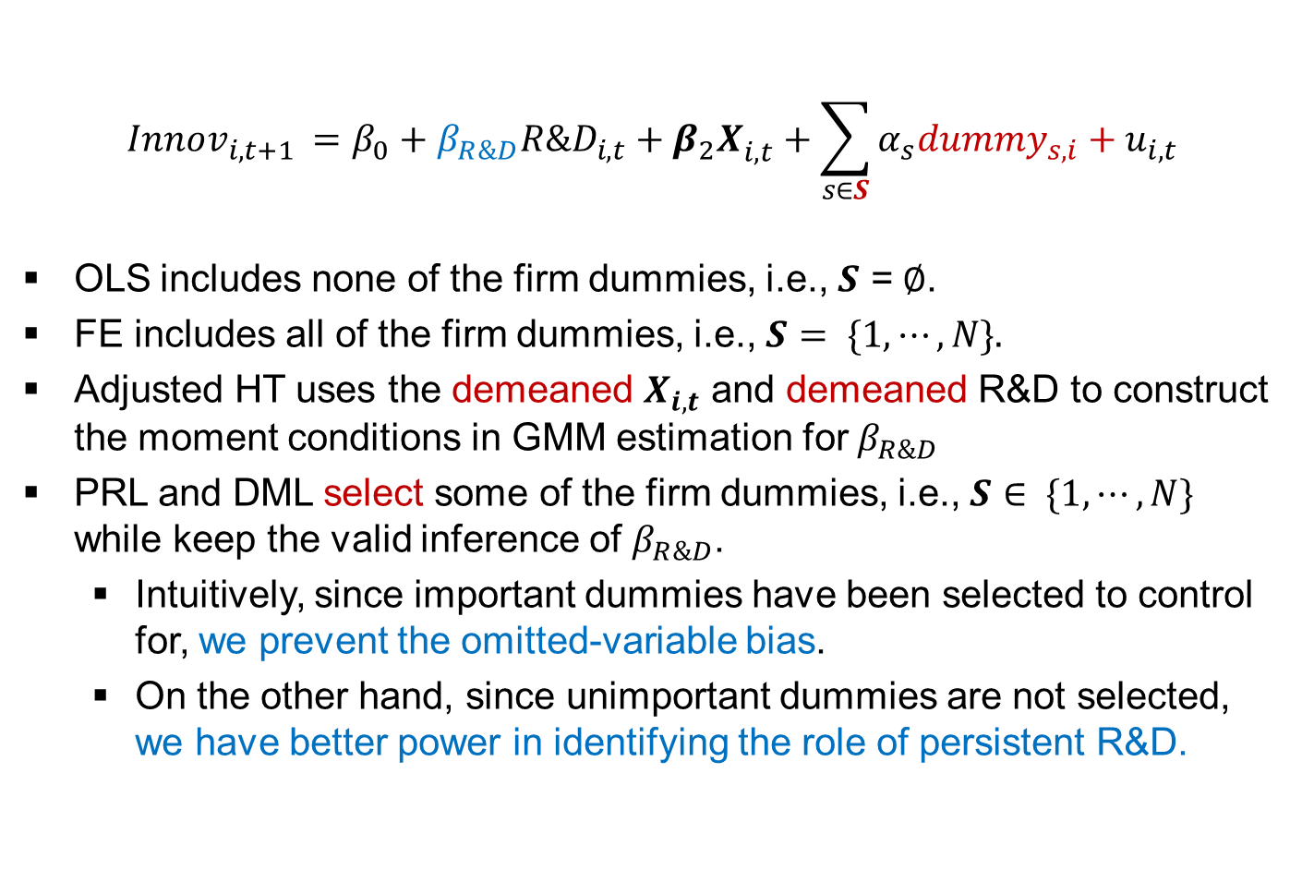
Overview: OLS, FE, HT, PRL, and DML
$$Innov_{i,t+1 }=β_{0}+β_{R\&D}R\&D_{i,t}+{β_{2}X}_{i,t}^{}+\sum_{s∈S}{α_{s}dummy_{s,i}+u_{i,t}}$$
OLS includes none of the firm dummies, i.e., $S$ =$∅$.
FE includes all of the firm dummies, i.e., $S= \{1, ⋯, N\}.$
Adjusted HT uses the demeaned $X_{i, t}$ and demeaned R&D to construct the moment conditions in GMM estimation for $β_{R\&D}$
PRL and DML select some of the firm dummies, i.e., $S∈ \{1, ⋯, N\}$ while keep the valid inference of $β_{R\&D}$.
Intuitively, since important dummies have been selected to control for, we prevent the omitted-variable bias.
On the other hand, since unimportant dummies are not selected, we have better power in identifying the role of persistent R&D.

Slide 12
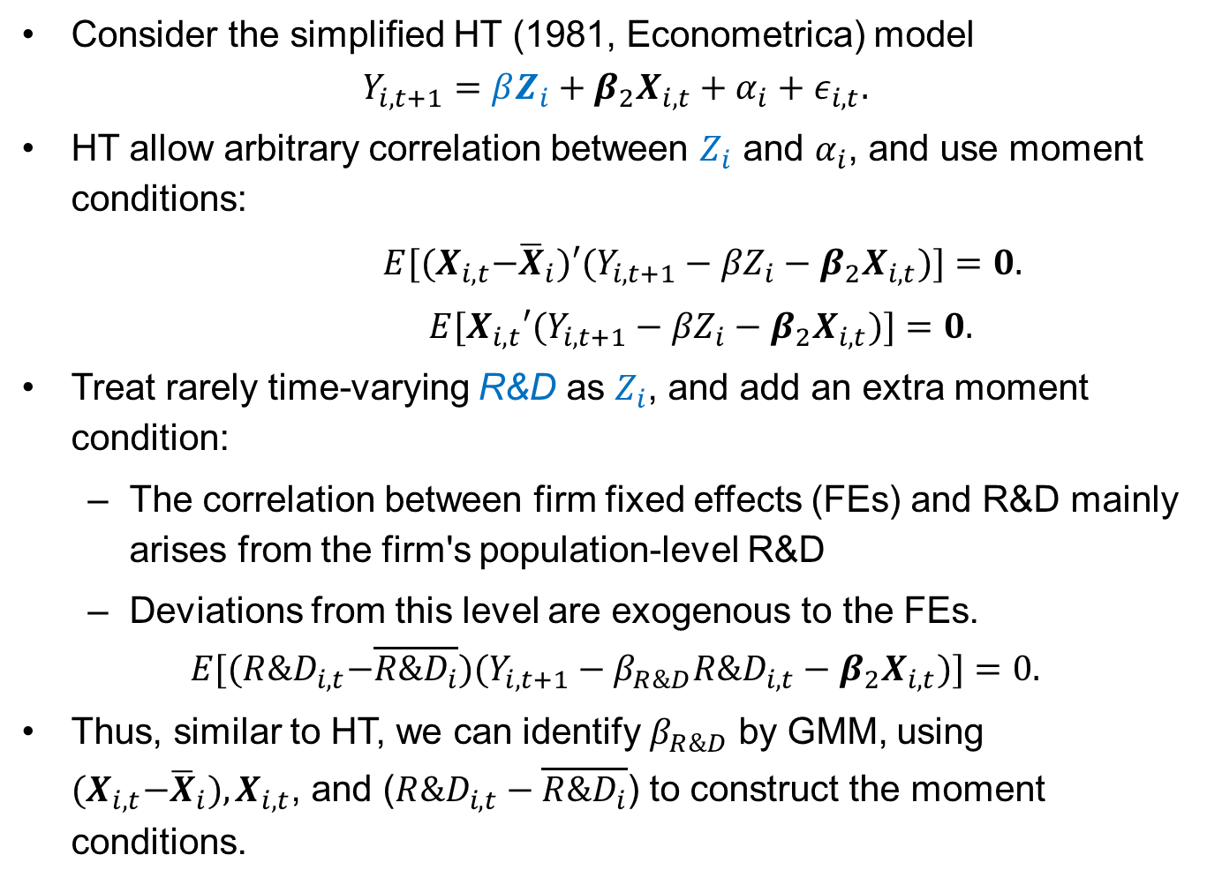
Our proposition-1 Adjusted Hausman-Taylor methods
Consider the simplified HT (1981, Econometrica) model
$$Y_{i,t+1}={βZ_{i}+β_{2}X}_{i,t}+α_{i}+ε_{i,t}.$$
HT allow arbitrary correlation between $Z_{i}$ and $α_{i}$, and use moment conditions:
$E[{(X}_{i,t}−{\overline{X}}_{i})′(Y_{i,t+1}−{βZ}_{i}−{β_{2}X}_{i,t})]=0.$
$E[X_{i,t}′(Y_{i,t+1}−{βZ}_{i}−{β_{2}X}_{i,t})]=0.$
Treat rarely time-varying R&D as $Z_{i}$, and add an extra moment condition:
The correlation between firm fixed effects (FEs) and R&D mainly arises from the firm's population-level R&D
Deviations from this level are exogenous to the FEs.
$$E[{(R\&D}_{i,t}−\overline{R\&D_{i}})(Y_{i,t+1}−{β_{R\&D}R\&D}_{i,t}−{β_{2}X}_{i,t})]=0.$$
Thus, similar to HT, we can identify $β_{R\&D}$ by GMM, using ${(X}_{i,t}−{\overline{X}}_{i}),X_{i,t}$, and (${R\&D}_{i,t}−\overline{R\&D_{i}}$) to construct the moment conditions.

Slide 13
Sample
We first collect the financial and accounting data of all publicly-listed firms in the U.S. from CRSP and Compustat.
We exclude financial and utility firms (SIC in 6000-6999, and 4900-4999), and firms with negative and missing total asset and sales.
We then collect the patent and citation data of all public firms from the PatentsView patent database that is organized by the USPTO.
As a result, we have 86,341 firm-year observations during 1976-2000. (We also consider sample of firms with at least one patent during the sample period.)

Slide 14
Within and between variation
Several authors indicates the issue on the estimation bias of the persistent explanatory variables that likely correlate with important firm unobservables heterogeneities.
Firm FEs model use OLS on the within transformed data. If the within-group variation is small (time persistent in firm), then
amplifies the measurement error issue in FEs model. (Griliches and Hausman,1986; Jennings et. al., 2020)
high variance of the estimates
few large-within-variation group may dominate the estimation results.
R&D/Asset coefficient may be different among the subsample of firms that have no variation c.f. firms with variations on R&D/Asset.
deHaan (2021) and others suggest to examine the within-firm (time-series) and between-firm (cross-sectional) variations.

Slide 15
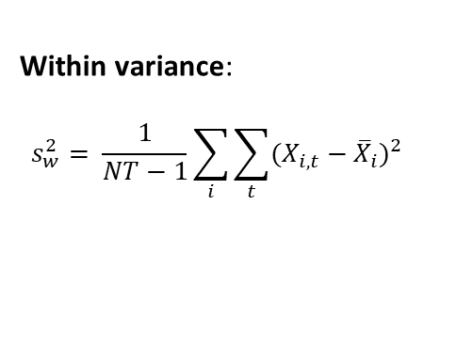

Within and between variation - verification
The un-proportional variations in R&D expenditure of the pooled sample v.s. within-group sample: Between-firm variation > Within-firm variation
Between variance:
$$s_{B}^{2}= \frac{1}{N−1}\sum_{i}{{({\overline{X}}_{i}−\overline{X})}^{2}}$$
 |  | Std. dev. | Btw/Within
R&D/Asset | overall | 0.379
 | between | 0.361
 | within | 0.219 | 1.650
ln(1+Patent) | overall | 1.105
 | between | 0.764
 | within | 0.430 | 1.775
ln(1+Citation) | overall | 2.267
 | between | 1.650
 | within | 1.088 | 1.517
ln(1+Adjcitation) | overall | 1.164
 | between | 0.814
 | within | 0.485 | 1.676
Within variance:
$$s_{w}^{2}= \frac{1}{NT−1}\sum_{i}{\sum_{t}{{(X_{i,t}−{\overline{X}}_{i})}^{2}}}$$
Notes:
We find that these variables' between-firm variation is much larger than their within-firm variation.
It further verifies the influence of firm fixed effects on the missing R&D role.

Slide 16
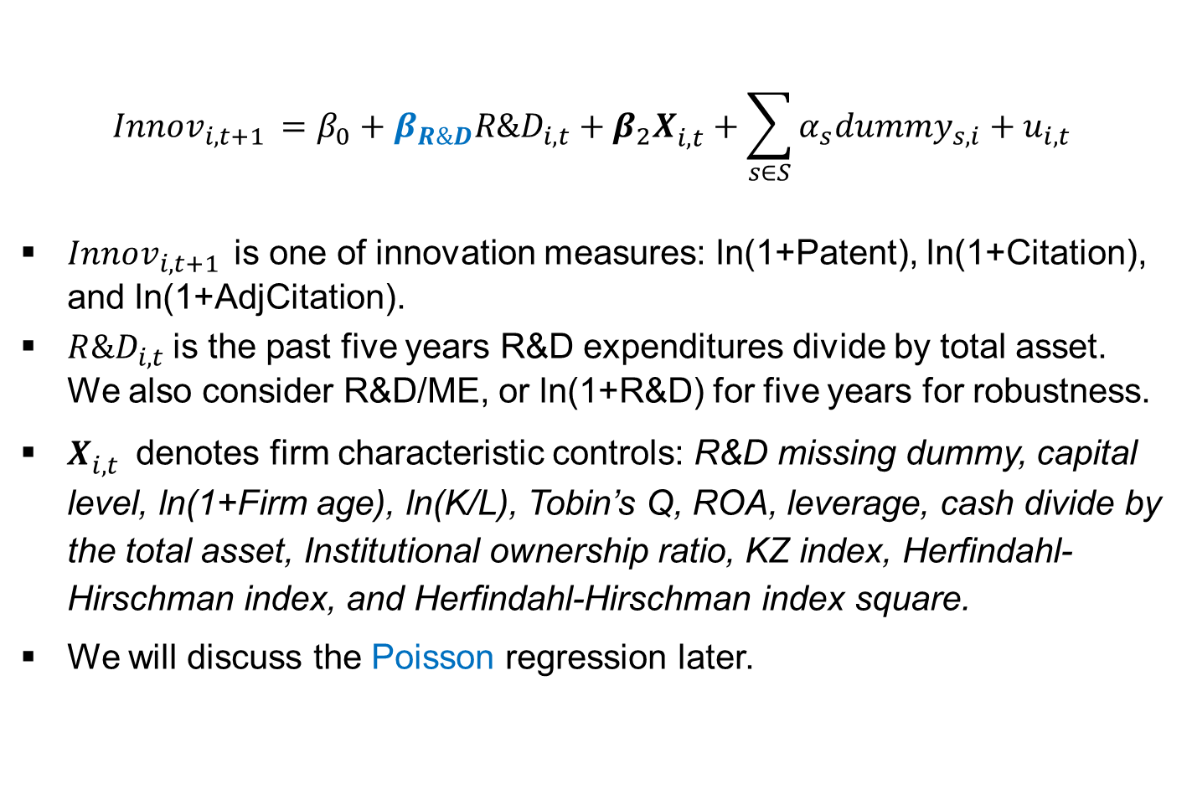
Our baseline regressions
$$Innov_{i,t+1 }=β_{0}+β_{R\&D}R\&D_{i,t}+{β_{2}X}_{i,t}^{}+\sum_{s∈S}{α_{s}dummy_{s,i}+u_{i,t}}$$
$Innov_{i,t+1 }$is one of innovation measures: ln(1+Patent), ln(1+Citation), and ln(1+AdjCitation).
$R\&D_{i,t}$is the past five years R&D expenditures divide by total asset. We also consider R&D/ME, or ln(1+R&D) for five years for robustness.
$X_{i,t}^{}$ denotes firm characteristic controls: R&D missing dummy, capital level, ln(1+Firm age), ln(K/L), Tobin’s Q, ROA, leverage, cash divide by the total asset, Institutional ownership ratio, KZ index, Herfindahl-Hirschman index, and Herfindahl-Hirschman index square.
We will discuss the Poisson regression later.

Slide 17
OLS and Fixed Effects
 | OLS (Year Dummies Only) | Fixed Effects (All Firm and Year Dummies)
Patent regression
R&D/Assets | 0.593*** | 0.041
 | (0.042) | (0.028)
Citation regression
R&D/Assets | 1.396*** | -0.051
 | (0.084) | (0.068)
AdjCitation regression
R&D/Assets | 0.590*** | 0.033
 | (0.045) | (0.031)
Firm cluster standard errors in parentheses. *p<0.1, **p<0.05, and ***p<0.01.
We suppress the year FEs and firm characteristics variables to save space.
Notes:
Our OLS regression results suggest a robust pattern that R&D input positively explains patent output when regression models do not include firm fixed effects.
The magnitude of this positive relation is severely weakened when firm fixed effects are included in regressions.

Slide 18
Adjusted HT, OLS and Fixed Effects
 | OLS (Year Dummies Only) | adjHT (Year Dummies Only) | Fixed Effects (All Firm and Year Dummies)
Patent regression
R&D/Assets | 0.593*** | 0.220*** | 0.041
 | (0.042) | (0.027) | (0.028)
Citation regression
R&D/Assets | 1.396*** | 0.551*** | -0.051
 | (0.084) | (0.065) | (0.068)
AdjCitation regression
R&D/Assets | 0.590*** | 0.231*** | 0.033
 | (0.045) | (0.030) | (0.031)
Firm cluster standard errors in parentheses. *p<0.1, **p<0.05, and ***p<0.01.
We suppress the year FEs and firm characteristics variables to save space.

Slide 19
OLS, Adjusted HT, and Fixed Effects
Our OLS regression results suggest a robust pattern that R&D input positively explains patent output when regression models do not include firm fixed effects.
The magnitude of this positive relation is severely weakened when firm fixed effects are included in regressions.
Our adjusted HT GMM results suggest a robust pattern that R&D input positively explains patent output.
The magnitude of this positive relation is slightly weakened when compared to the OLS results while still significant positive (such as 0.593 => 0.220)

Slide 20
Our proposition-2
Unobserved heterogeneity exists in some firms but not others.
Some managers are aggressive in investing in R&D and pursuing patent output, but others are not.
Some firms have a strong, innovation-oriented culture, while others do not.
A smarter methodology that can select which individual firm dummies to be included is called for.
In this paper, we proposed the second advanced machine learning method:
Post-regularization LASSO (PRL, Chernozhukov et al., 2015)
Double machine learning (DML, Chernozhukov et al., 2018)
to select individual firm dummies (and explanatory variables) in explaining firm-level patent outputs.

Slide 21
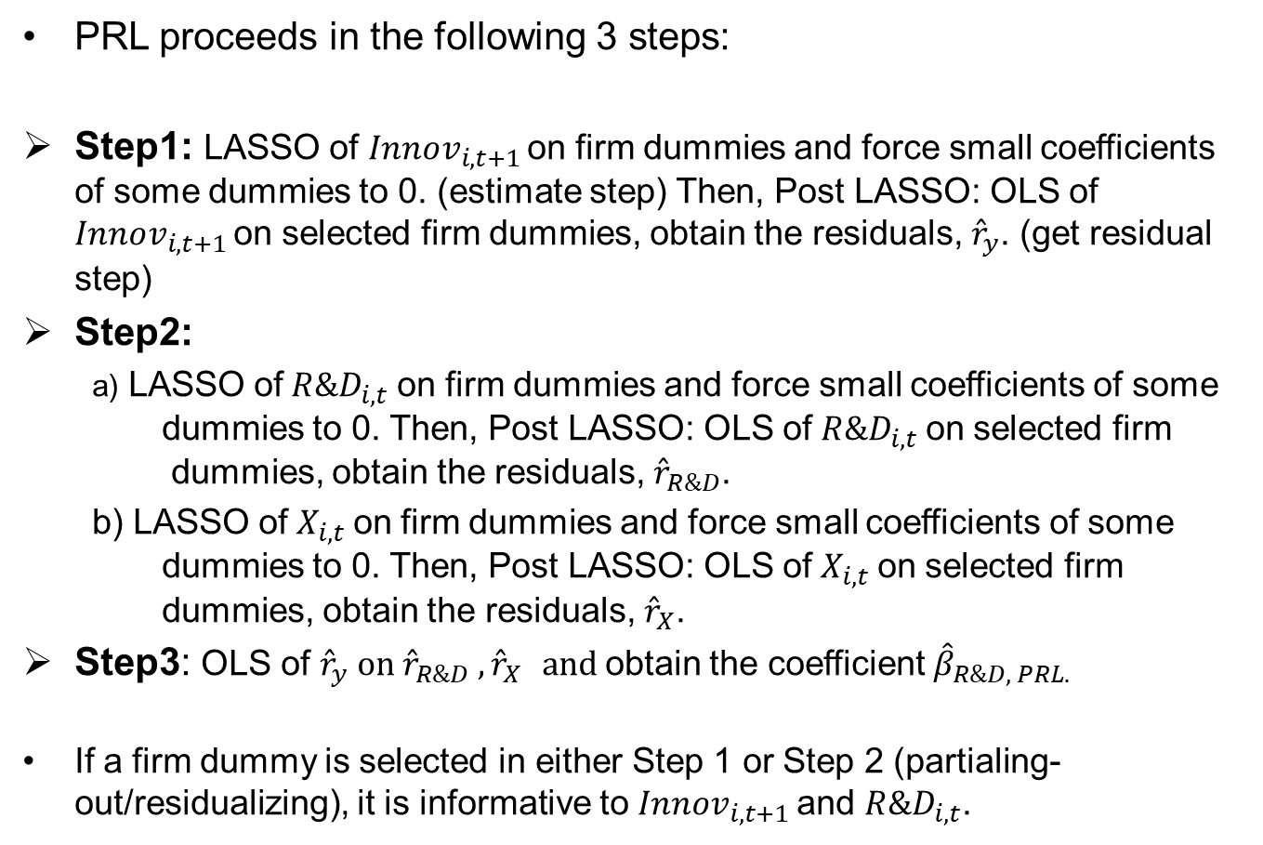
Post-Regularization LASSO (PRL)
PRL proceeds in the following 3 steps:
Step1: LASSO of $Innov_{i,t+1 }$on firm dummies and force small coefficients of some dummies to 0. (estimate step) Then, Post LASSO: OLS of $Innov_{i,t+1 }$on selected firm dummies, obtain the residuals, ${\hat{r}}_{y}$. (get residual step)
Step2:
a) LASSO of$R\&D_{i,t}$on firm dummies and force small coefficients of some dummies to 0. Then, Post LASSO: OLS of$R\&D_{i,t}$on selected firm dummies, obtain the residuals, ${\hat{r}}_{R\&D}$.
b) LASSO of$X_{i,t}$on firm dummies and force small coefficients of some dummies to 0. Then, Post LASSO: OLS of$X_{i,t}$on selected firm dummies, obtain the residuals, ${\hat{r}}_{X}$.
Step3: OLS of ${\hat{r}}_{y} on {\hat{r}}_{R\&D} ,{\hat{r}}_{X} and$obtain the coefficient ${\hat{β}}_{R\&D, PRL.}$
If a firm dummy is selected in either Step 1 or Step 2 (partialing-out/residualizing), it is informative to $Innov_{i,t+1 }$and $R\&D_{i,t}$.

Slide 22
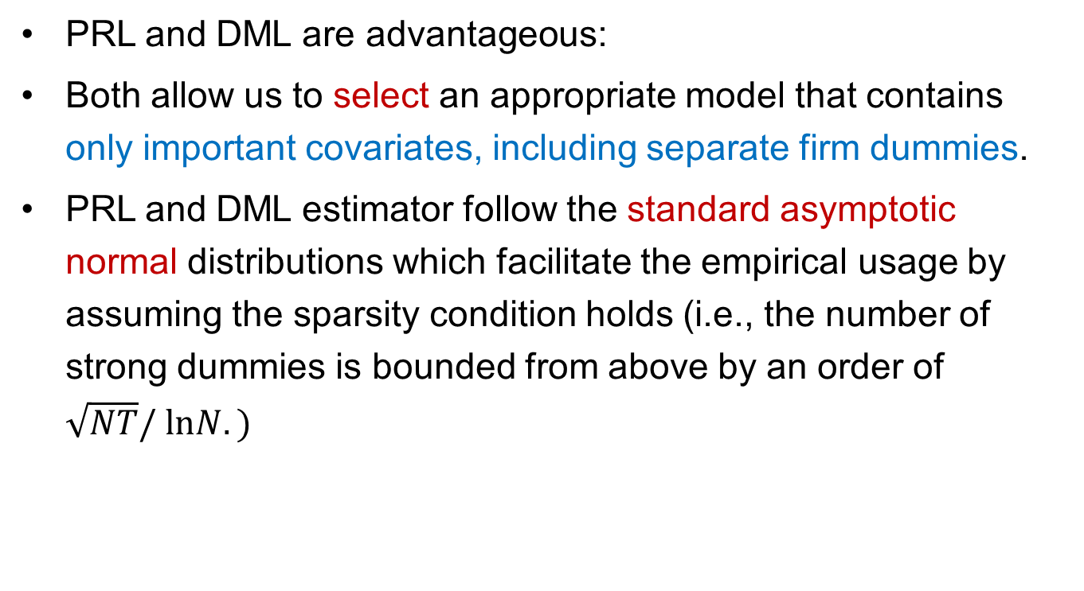
PRL - Post-Regularization LASSO (Chernozhukov et al., 2015, AER PP)
PRL and DML are advantageous:
Both allow us to select an appropriate model that contains only important covariates, including separate firm dummies.
PRL and DML estimator follow the standard asymptotic normal distributions which facilitate the empirical usage by assuming the sparsity condition holds (i.e., the number of strong dummies is bounded from above by an order of $\sqrt{NT}/ lnN.)$

Slide 23
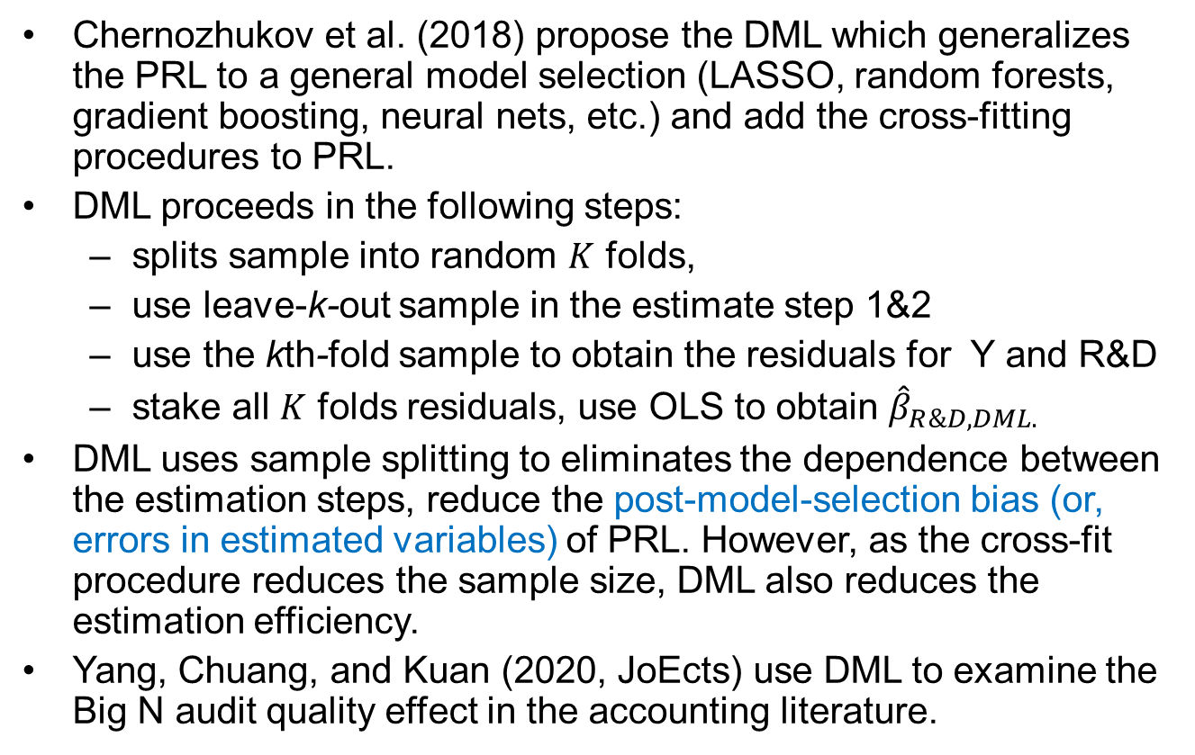
Double Machine Learning (DML)
Chernozhukov et al. (2018) propose the DML which generalizes the PRL to a general model selection (LASSO, random forests, gradient boosting, neural nets, etc.) and add the cross-fitting procedures to PRL.
DML proceeds in the following steps:
splits sample into random $K$ folds,
use leave-k-out sample in the estimate step 1&2
use the kth-fold sample to obtain the residuals for Y and R&D
stake all $K$ folds residuals, use OLS to obtain ${\hat{β}}_{R\&D, DML.}$
DML uses sample splitting to eliminates the dependence between the estimation steps, reduce the post-model-selection bias (or, errors in estimated variables) of PRL. However, as the cross-fit procedure reduces the sample size, DML also reduces the estimation efficiency.
Yang, Chuang, and Kuan (2020, JoEcts) use DML to examine the Big N audit quality effect in the accounting literature.
1 | 2 | 3 | 4 | 5
2 | 3 | 4 | 5
1

Slide 24
Patent regression: PRL and DML results
PRL
 | OLS (Year Dummies Only) | PRL (Firm and Year Dummies) | Fixed Effects (All Firm and Year Dummies)
R&D/Asset | 0.593*** | 0.199*** | 0.041
 | (0.042) | (0.018) | (0.028)
Number of dummies |  | 11,570
Number of selected dummies |  | 1,241 (10.73%)
DML
 | OLS (Year Dummies Only) | DML (Firm and Year Dummies) | Fixed Effects (All Firm and Year Dummies)
R&D/Asset | 0.593*** | 0.213*** | 0.041
 | (0.042) | (0.014) | (0.028)
Number of dummies |  | 1,1570
Number of selected dummies |  | 1,737 (15.01%)

Slide 25
Citation regression: PRL and DML results
PRL
 | OLS (Year Dummies Only) | PRL (Firm and Year Dummies) | Fixed Effects (All Firm and Year Dummies)
R&D/Asset | 1.396*** | 1.397*** | -0.051
 | (0.084) | (0.083) | (0.068)
Number of dummies |  | 11,570
Number of selected dummies |  | 525 (4.54%)
DML
 | OLS (Year Dummies Only) | DML (Firm and Year Dummies) | Fixed Effects (All Firm and Year Dummies)
R&D/Asset | 1.396*** | 1.364*** | -0.051
 | (0.084) | (0.050) | (0.068)
Number of dummies |  | 11,570
Number of selected dummies |  | 947 (8.18%)

Slide 26
Adjusted-Citation regression: PRL and DML results
PRL
 | OLS (Year Dummies Only) | PRL (Firm and Year Dummies) | Fixed Effects (All Firm and Year Dummies)
R&D/Asset | 0.590*** | 0.210*** | 0.033
 | (0.045) | (0.019) | (0.031)
Number of dummies |  | 11,570
Number of selected dummies |  | 1,194 (10.32%)
DML
 | OLS (Year Dummies Only) | DML (Firm and Year Dummies) | Fixed Effects (All Firm and Year Dummies)
R&D/Asset | 0.590*** | 0.198*** | 0.033
 | (0.045) | (0.015) | (0.031)
Number of dummies |  | 11,570
Number of selected dummies |  | 1,882 (16.27%)

Slide 27
PRL and DML results
The coefficients on R&D input are statistically significant and that their economic magnitude is much closer to those from OLS models without firm fixed effects (than those with firm fixed effects).
PRL and DML select about 10% to 20% of firm dummies to be included in regression models -- the bias from adding all firm dummies overpowers the bias from not adding any at all (the consequence is an insignificant R&D coefficient)
These results, together with prior analyses, suggest that most firm dummies do not play a crucial role.
To recap: FE model = 0.041 (insig.)
OLS = 0.593,
adj-HT = 0.220,
PRL = 0.199, DML = 0.213

Slide 28
STATA code
To implement adjusted Hausman and Taylor:
To implement PRL
To implement DML
ivregress gmm y z x (z = demean_z demean_x), wmatrix(cluster firmID)
poregress y z x, controls(i.firmID) vce(cluster firmID)
xporegress y z x, controls(i.firmID) vce(cluster firmID) xfolds(#folds)
Notes:
Circulate purpose

Slide 29
Robustness
Alternative R&D measures
Tested R&D/ME, and Ln(1+R&D) in addition to R&D/AT,
Patenting firms
Excluded firms without any patent for during its sample period.
Handling missing R&D values
Remove firm-year observations with missing R&D
Alternative specifications in HT, PRL, and DML methods
Different fold count from two to five in DML method

Slide 30
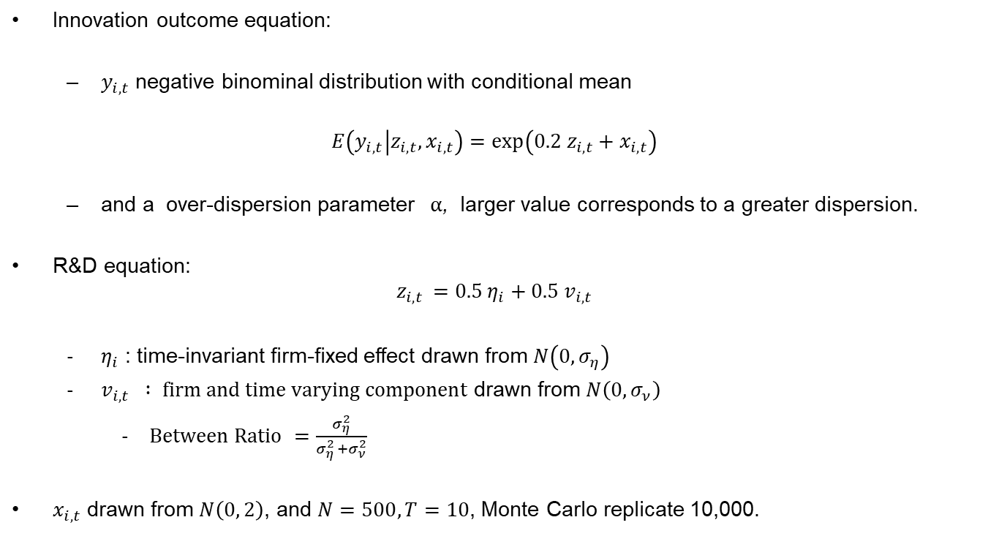
Simulation Study
Innovation outcome equation:
$y_{i,t}$ negative binominal distribution with conditional mean
$$E\left(y_{i,t} | z_{i,t}, x_{i,t}\right)=\exp\left(0.2 z_{i,t}+x_{i,t}\right)$$
and a over-dispersion parameter $α$, larger value corresponds to a greater dispersion.
R&D equation:
$$z_{i, t }=0.5 η_{i}+0.5 v_{i,t}$$
$η_{i}$ : time-invariant firm-fixed effect drawn from $N\left(0, σ_{η}\right)$
$v_{i,t} : firm and time varying component$ drawn from $N\left(0, σ_{ν}\right)$
$Between Ratio$ $=\frac{σ_{η}^{2}}{σ_{η }^{2}+σ_{ν}^{2}}$
$x_{i,t}$ drawn from $N\left(0, 2\right)$, and $N=500, T=10$, Monte Carlo replicate 10,000.

Slide 31
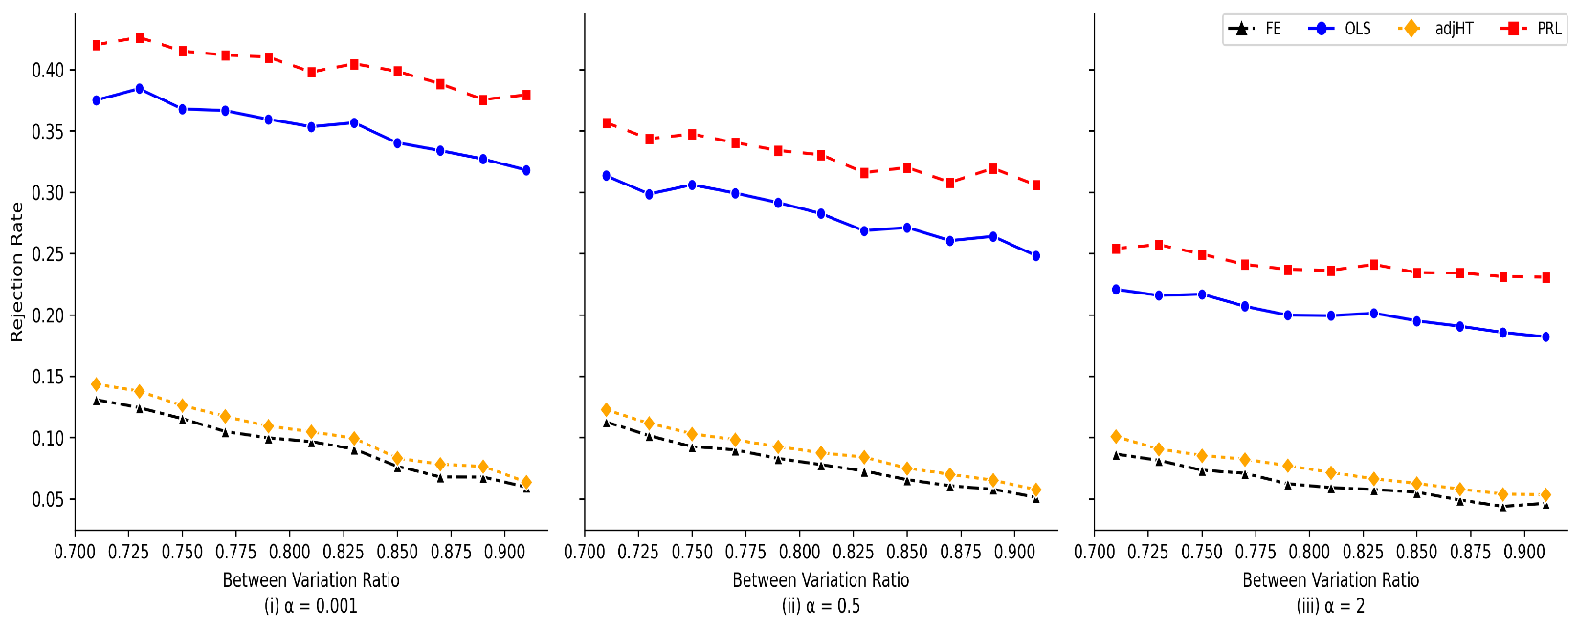
Simulation Study (cont’d)
Rejection Rate

Slide 32
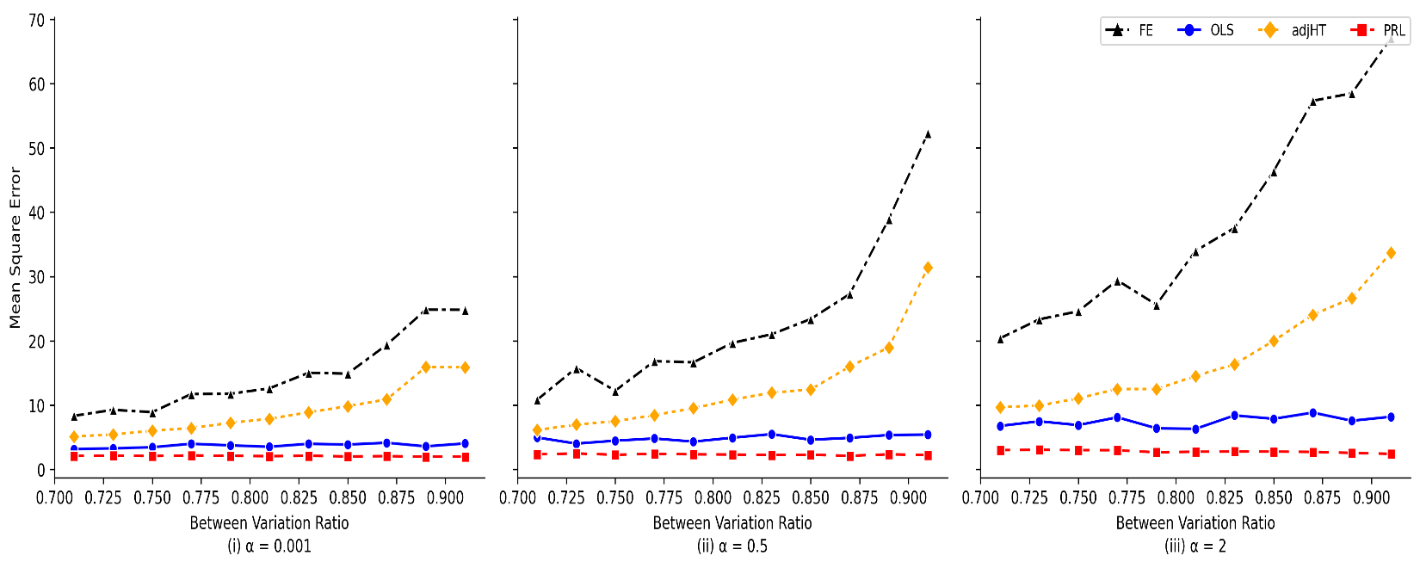
Simulation Study (cont’d)
Mean Square Error

Slide 33
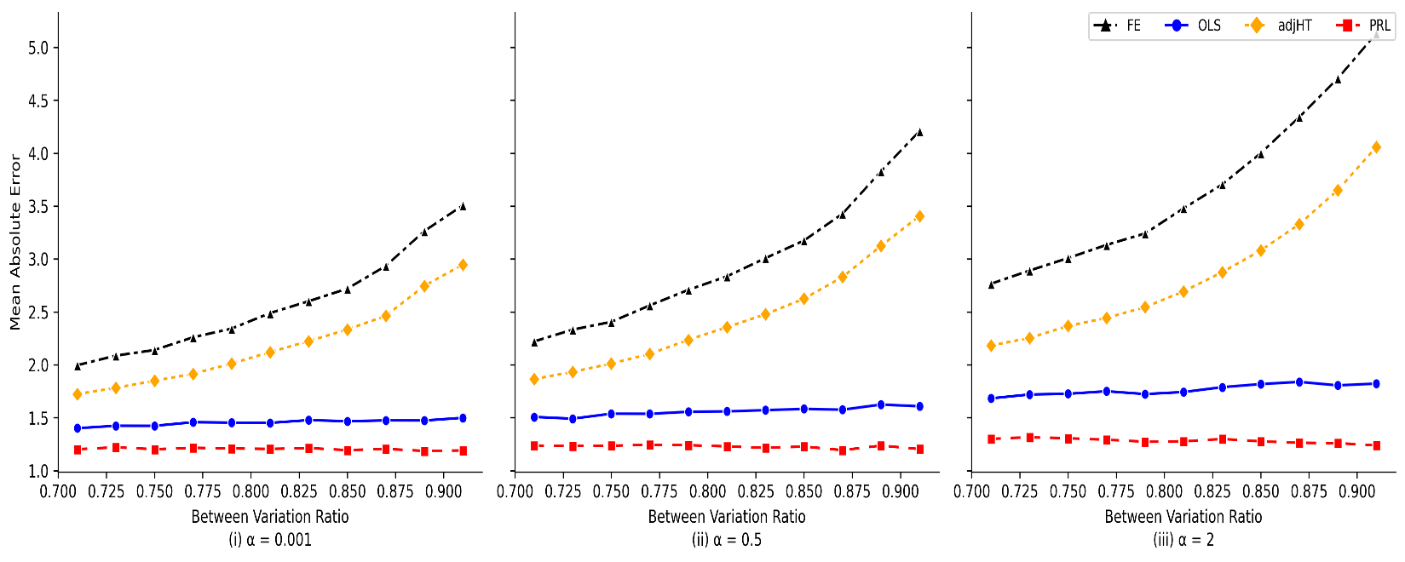
Simulation Study (cont’d)
Mean Absolute Error

Slide 34
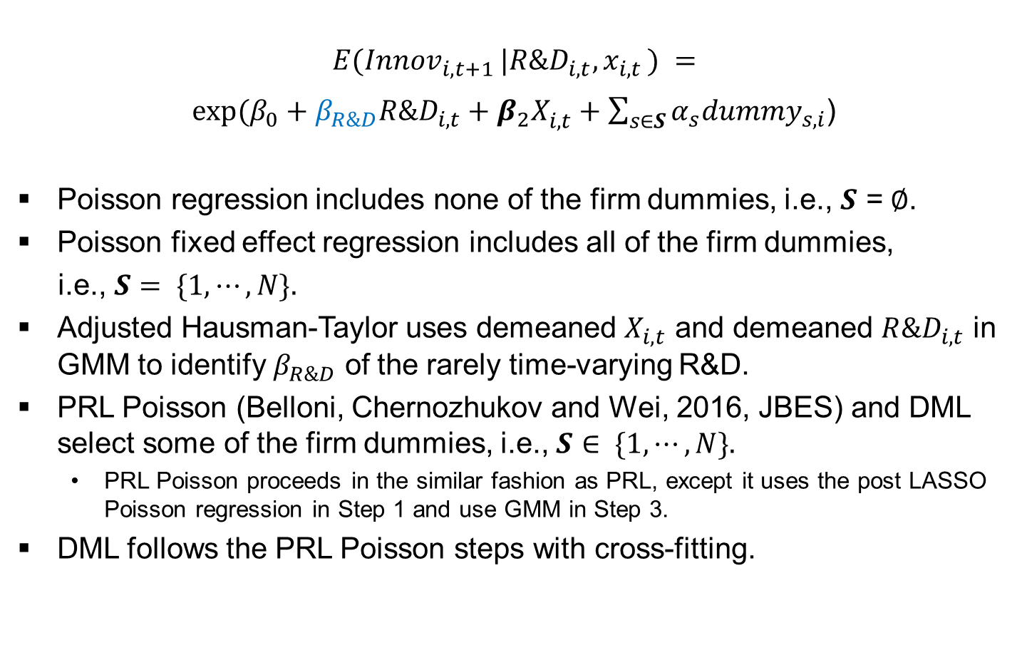
Poisson regression
$$E(Innov_{i,t+1 }|R\&D_{i,t}, x_{i,t }) =$$
$exp⁡(β_{0}+β_{R\&D}R\&D_{i,t}+{β_{2}X}_{i,t}^{}+\sum_{s∈S}{α_{s}dummy_{s,i}}$)
Poisson regression includes none of the firm dummies, i.e., $S$ =$∅$.
Poisson fixed effect regression includes all of the firm dummies,
i.e., $S= \{1, ⋯, N\}.$
Adjusted Hausman-Taylor uses demeaned $X_{i,t}$ and demeaned $R\&D_{i,t}$ in GMM to identify $β_{R\&D}$ of the rarely time-varying R&D.
PRL Poisson (Belloni, Chernozhukov and Wei, 2016, JBES) and DML select some of the firm dummies, i.e., $S∈ \{1, ⋯, N\}.$
PRL Poisson proceeds in the similar fashion as PRL, except it uses the post LASSO Poisson regression in Step 1 and use GMM in Step 3.
DML follows the PRL Poisson steps with cross-fitting.

Slide 35
Adjusted Hausman-Taylor and Poisson regression
Patent Counts
 | Poisson (Year Dummies only) | FE Poisson (All Firm and Year Dummies) | adjHT (Year Dummies only)
R&D/Asset | 2.305*** | -0.248 | 1.679***
 | (0.187) | (0.255) | (0.215)
Citation Counts
 | Poisson (Year Dummies) | FE Poisson (Firm and Year Dummies) | adjHT (Year Dummies)
R&D/Asset | 2.094*** | -0.125 | 1.400***
 | (0.219) | (0.252) | (0.229)
Firm cluster standard errors in parentheses. *p<0.1, **p<0.05, and ***p<0.01. We suppress the year FEs and firm characteristics variables to save space.

Slide 36
PRL Poisson and DML
Patent Counts
 | Poisson | PRL Poisson | DML
 | Year Dummies only | Firm and Year Dummies | Firm and Year Dummies
R&D/Asset | 2.305*** | 2.407*** | 2.312***
 | (0.187) | (0.161) | (0.120)
Number of dummies |  | 11,570 | 11,570
Number of selected dummies |  | 1,218 (10.53%) | 2,484 (21.47%)
Citation Counts
 | Poisson | PRL Poisson | DML
 | Year Dummies only | Firm and Year Dummies | Firm and Year Dummies
R&D/Asset | 2.094*** | 2.299*** | 2.262***
 | (0.219) | (0.256) | (0.113)
Number of dummies |  | 11,570 | 11,570
Number of selected dummies |  | 1,226 (10.51%) | 2,426 (20.97%)

Slide 37
Poisson regression results
Poisson regressions are common for count-based dependent variables in econ / finance literature (Cohn et al., 2022).
When we implement adjusted HT, PRL Poisson, and DML, we again find that the estimated coefficients on R&D input are significantly positive and closer to those from Poisson regressions without firm fixed effects (than those with firm fixed effects).
Like our results in OLS regressions, the existence of firm fixed effects also prevents Poisson models from delivering a positive R&D-patent relation. The bias that we attempt to highlight and solve in this paper is a general issue across different econometric models.

Slide 38
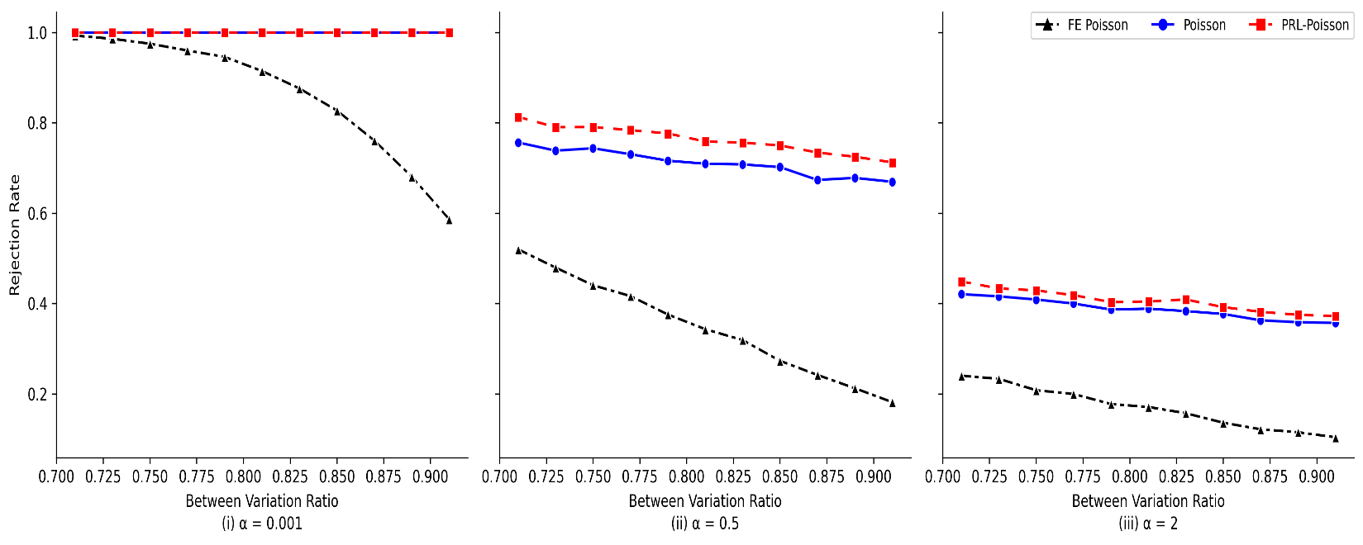
Simulation Study (cont’d)
Rejection Rate

Slide 39
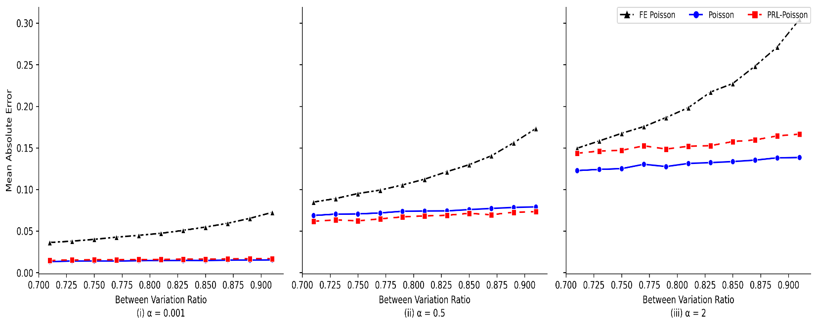
Simulation Study (cont’d)
Mean Absolute Error

Slide 40
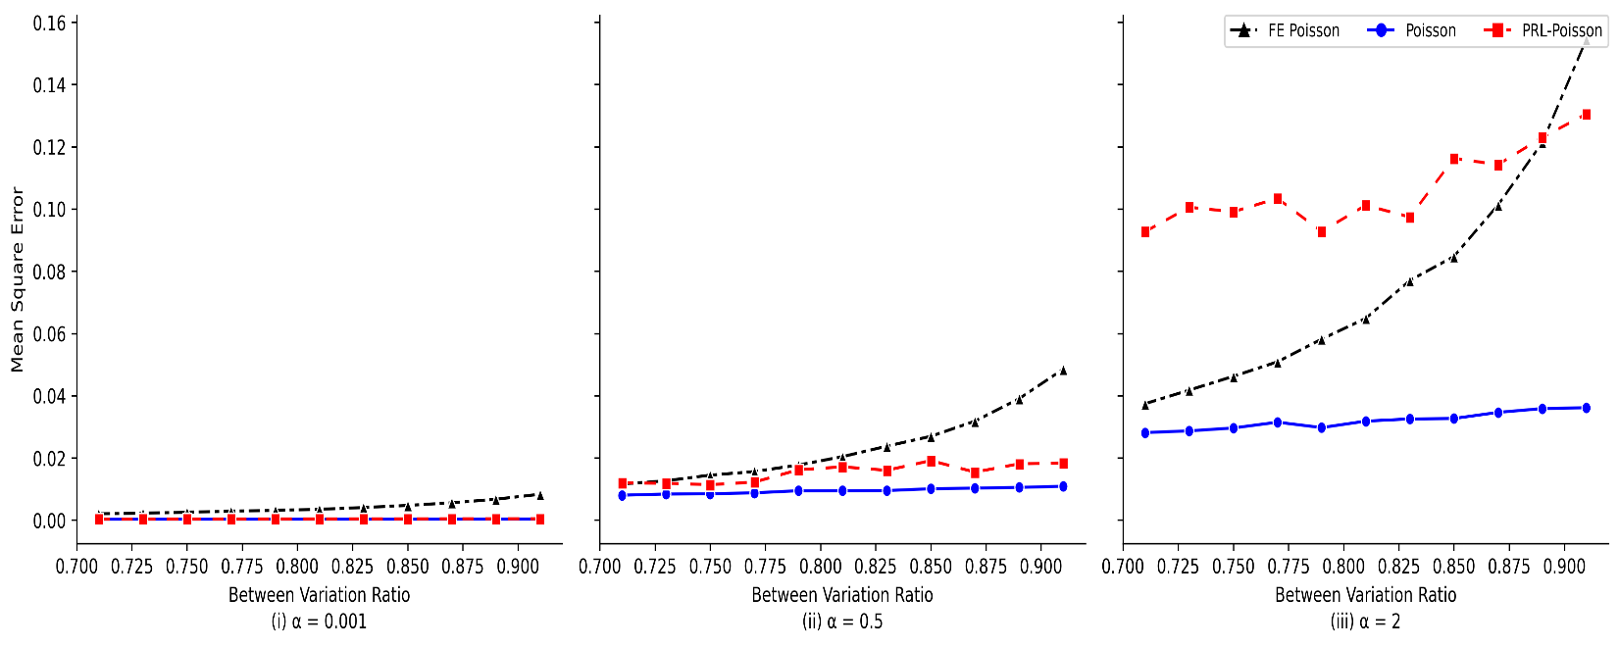
Simulation Study (cont’d)
Mean Square Error

Slide 41
Our recommendations
Instead of only reporting regressions with firm fixed effects, please also present the results without firm fixed effects and discuss why the coefficient estimates vary
The results from no firm FEs can serve as a “second opinion” for the effect you would like to examine
If the results from 1 and 2 go the opposite directions. Consider our adjusted Hausman and Taylor, PRL and DML methods as “third opinion”.
easy to implement by STATA (or R/Python). We make our codes available online:
https://github.com/hcchuang/Limitation-of-Firm-Fixed-Effects-Models-and-the-Missing-R-D-Patent-Relation
handle omitted variable issues without strict assumptions
enable researchers to decide exactly which firm dummies should be added in regressions.

Slide 42
Our contributions
Corporate finance studies tend to solve firm-specific, time-invariant unobservables issues by using fixed effects models (e.g., Angrist and Pischke, 2009; Imbens and Wooldridge, 2009; Roberts and Whited, 2013)
We illustrate the potential biases of such a practice by using the intuitive R&D-patent relation as our lab.
More importantly, we offer two feasible and ready-to-use methodologies to enable corporate finance researchers to analyze the effects of economic variables that are persistent in time, such as ownership structure and managerial capability.
In particular, we provide explanations that they may use to justify their choice of regression specifications without firm fixed effects (or with only a limited set of firm dummies).

Slide 43
Our contributions (Cont.)
We add to modern machine learning techniques in corporate finance research, for the selection of relevant covariates (e.g., Chinco et al., 2019; Feng et al., 2020; Gu et al., 2020; Erel et al., 2021).
This study also adds to the economics literature by supporting and justifying prior studies' choice of not including firm fixed effects to estimate knowledge production functions (Pakes and Griliches, 1984; Blundell et al., 1995; Hall et al., 2007; Noel and Schankerman, 2013).

Slide 44
Thank you! Questions? Comments? hcchuang@gm.ntpu.edu.tw (Hui-Ching Chuang)

Slide 45
Selected Top 30 Firms
1 | INTL BUSINESS MACHINES | 11 | XEROX HOLDINGS CORP | 21 | FORD MOTOR CO
2 | LUCENT TECHNOLOGIES | 12 | AT&T INC | 22 | HONEYWELL INTERNATIONAL INC
3 | GENERAL ELECTRIC | 13 | TEXAS INSTRUMENTS INC | 23 | CBS CORP -OLD
4 | APTIV PLC | 14 | 3M CO | 24 | RAYTHEON TECHNOLOGIES CORP
5 | EASTMAN KODAK | 15 | RCA CORP | 25 | PROCTER & GAMBLE CO
6 | MOTOROLA SOLUTIONS | 16 | BROADCOM CORP | 26 | SUN MICROSYSTEMS INC
7 | GENERAL MOTORS CO | 17 | NORTH AMERICAN PHILIPS CORP | 27 | QUALCOMM INC
8 | DU PONT (E I) DE NEMOURS | 18 | EXXON MOBIL CORP | 28 | MOBIL CORP
9 | AT&T CORP | 19 | HP INC | 29 | CONOCOPHILLIPS
10 | DUPONT DE NEMOURS INC | 20 | MERCK & CO | 30 | MICRON TECHNOLOGY INC

Slide 46
Alternative R&D measures: Patent regression
 | Fixed Effects (Firm and Year Dummies) | OLS (Year Dummies) | adjHT (Year Dummies) | PRL (Firm and Year Dummies) | DML (Firm and Year Dummies)
R&D/ME | 0.026 | 0.502*** | 0.139*** | 0.112*** | 0.123***
 | (0.018) | (0.035) | (0.018) | (0.015) | (0.012)
Ln(R&D) | 0.023*** | 0.140*** | 0.071*** | 0.032*** | 0.035***
 | (0.003) | (0.004) | (0.003) | (0.001) | (0.001)
Firm cluster standard errors in parentheses. *p<0.1, **p<0.05, and ***p<0.01.
We suppress the year and firm characteristics variables to save space.

Slide 47
Alternative R&D measures: Citation regression
 | Fixed Effects (Firm and Year Dummies) | OLS (Year Dummies) | adjHT (Year Dummies) | PRL (Firm and Year Dummies) | DML (Firm and Year Dummies)
R&D/ME | -0.024 | 1.040*** | 0.286*** | 1.015*** | 1.001***
 | (0.040) | (0.064) | (0.040) | (0.064) | (0.038)
Ln(R&D) | 0.036*** | 0.286*** | 0.176*** | 0.285*** | 0.285***
 | (0.007) | (0.006) | (0.006) | (0.006) | (0.003)
Firm cluster standard errors in parentheses. *p<0.1, **p<0.05, and ***p<0.01.
We suppress the year and firm characteristics variables to save space.

Slide 48
Alternative R&D measures: AdjCitation regression
 | Fixed Effects (Firm and Year Dummies) | OLS (Year Dummies) | adjHT (Year Dummies) | PRL (Firm and Year Dummies) | DML (Firm and Year Dummies)
R&D/ME | 0.021 | 0.506*** | 0.135*** | 0.119*** | 0.117***
 | (0.019) | (0.037) | (0.019) | (0.016) | (0.012)
Ln(R&D) | 0.022*** | 0.143*** | 0.071*** | 0.035*** | 0.035***
 | (0.003) | (0.004) | (0.003) | (0.001) | (0.001)
Firm cluster standard errors in parentheses. *p<0.1, **p<0.05, and ***p<0.01.
We suppress the year and firm characteristics variables to save space.

Slide 49
Patenting firms (Observation: 45,913)
 | Fixed Effects (All Firm and Year Dummies) | OLS (Year Dummies) | adjHT (Year Dummies) | PRL (Firm and Year Dummies) | DML (Firm and Year Dummies)
Patent regression
R&D/AT | 0.035 | 0.448*** | 0.161*** | 0.406*** | 0.399***
 | (0.031) | (0.045) | (0.030) | (0.044) | (0.025)
Citation regression
R&D/AT | -0.061 | 0.777*** | 0.317*** | 0.738*** | 0.740***
 | (0.079) | (0.087) | (0.075) | (0.084) | (0.054)
AdjCitation regression
R&D/AT | 0.033 | 0.419*** | 0.175*** | 0.369*** | 0.377***
 | (0.036) | (0.049) | (0.034) | (0.047) | (0.028)
Firm cluster standard errors in parentheses. *p<0.1, **p<0.05, and ***p<0.01.
We suppress the year and firm characteristics variables to save space.

Slide 50
Summary statistics
 | Obs. | Mean | Median | Std. dev. | P25 | P75
ln(1+Patent) | 86,341 | 0.53 | 0.00 | 1.11 | 0.00 | 0.69
ln(1+Citation) | 86,341 | 1.25 | 0.00 | 2.27 | 0.00 | 2.20
ln(1+AdjCitation) | 86,341 | 0.54 | 0.00 | 1.16 | 0.00 | 0.34
R&D/Asset | 86,341 | 0.13 | 0.00 | 0.26 | 0.00 | 0.14
ln(ME) | 86,341 | 11.13 | 10.95 | 2.07 | 9.60 | 12.51
R&D Missing Dummy | 86,341 | 0.43 | 0.00 | 0.50 | 0.00 | 1.00
ln(1+Age) | 86,341 | 2.48 | 2.48 | 0.75 | 1.95 | 3.09
ln(K/L) | 86,341 | 10.00 | 9.85 | 1.29 | 9.18 | 10.64
Tobin Q | 86,341 | 1.76 | 1.22 | 1.66 | 0.94 | 1.85
ROA | 86,341 | 0.10 | 0.13 | 0.18 | 0.06 | 0.19
Leverage | 86,341 | 0.23 | 0.21 | 0.18 | 0.07 | 0.35
Cash/Asset | 86,341 | 0.14 | 0.07 | 0.17 | 0.02 | 0.18
KZ Index | 86,341 | -3.42 | -0.54 | 10.77 | -3.48 | 1.03
Institutional ownership | 86,341 | 0.23 | 0.15 | 0.24 | 0.01 | 0.40
HH Index | 86,341 | 0.25 | 0.20 | 0.20 | 0.11 | 0.30
HH Index Square | 86,341 | 0.10 | 0.04 | 0.18 | 0.01 | 0.09
Notes:
Patent = e^0.53-1 = 0.69
Citation = e^1.25-1 = 2.49
Age = 11.94
Kaplan-Zingales Index: The KZ-Index (Kaplan-Zingales Index) is a relative measurement of reliance on external financing. Companies with a higher KZ-Index scores are more likely to experience difficulties when financial conditions tighten since they may have difficulty financing their ongoing operations.
KZ Index = -1.001909 x Cash Flows / K + 0.2826389 x Q + 3.139193 x Debt / Total Capital + '-39.3678 x Dividends / K + -1.314759 x Cash / K

Slide 51
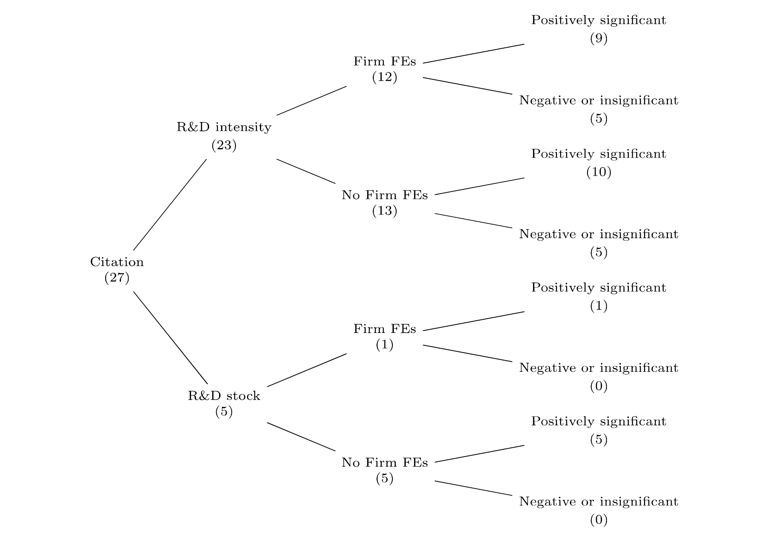
Our survey of the corporate innovation literature Least square approach on Citation (paper #)
Notes:
Among 27 citation-R&D papers,
23(5) has the scaled R&D(unscaled R&D) as an explanatory variable.
Among 23 citation-scaled R&D papers, 12 include firm FE.
Among 12 using firm FE, citation-scaled R&D papers, 5 of them show negative or insignificantly positive coefficients on R&D.

Slide 52
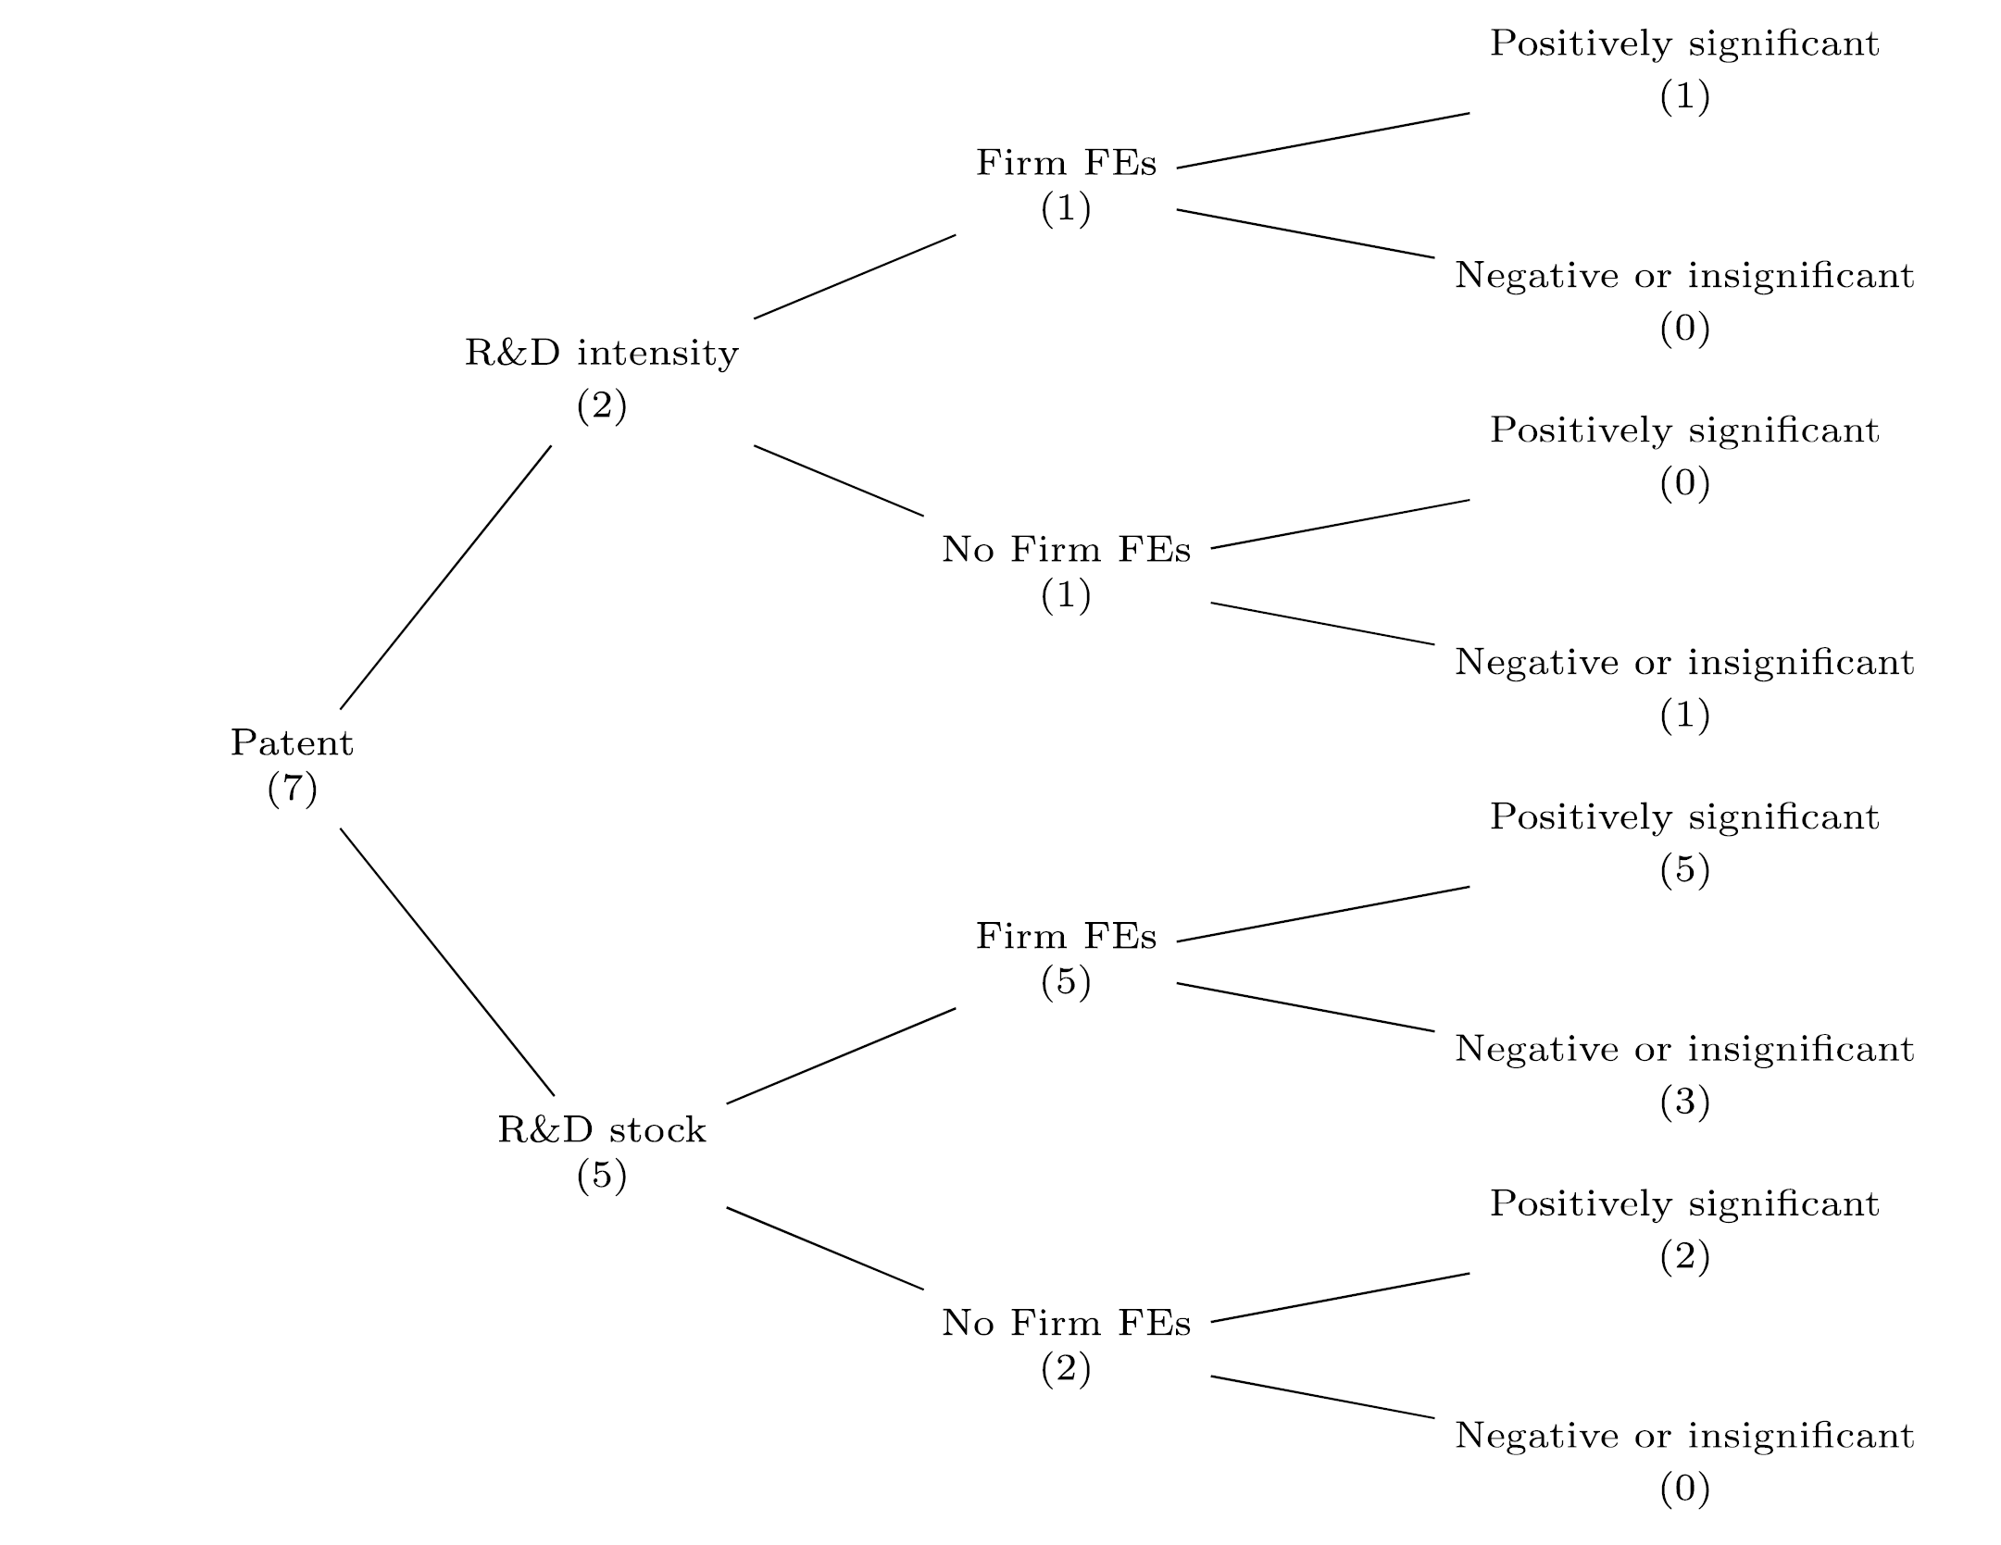
Our survey of the corporate innovation literature Poisson and negative binominal approach on Patent

Slide 53
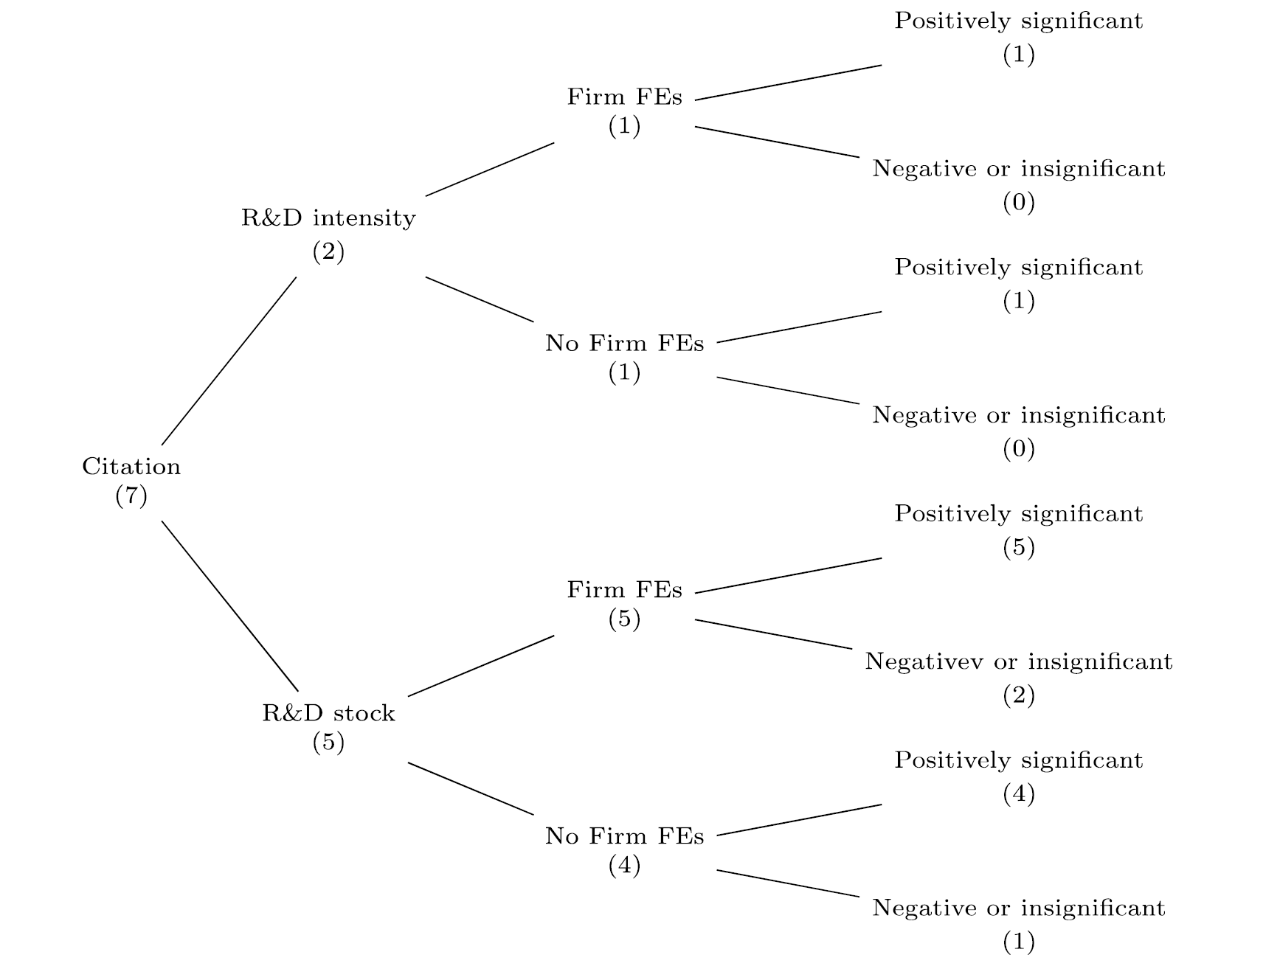
Our survey of the corporate innovation literature Poisson and negative binominal approach on Citation

