Slide 1
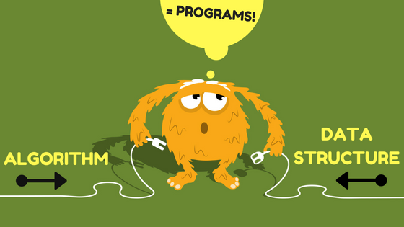

Slide 2

Algorithms

Slide 3
Algorithm Performance Example: Linear Search
Example : Simply search sorted list for number 4
How many operations are necessary ?
1 | 2 | 3 | 4 | 5 | 6 | 7 | 8 | 9 | 10
1 | 2 | 3 | 4 | 5 | 6 | 7 | 8 | 9 | 10
4

Slide 4
Algorithm Performance Example: Linear Search (2)
What is the worst possible number of search operations for this list ?
10
If the list was n numbers long, the worst possible number of search operations would be n.
In the “algorithm performance language”we say, it has a big O notation of O(n)

Slide 5
Algorithm Performance Example: Binary Search
Example : Binary search sorted list for number 4
How many operations are necessary ?
1 | 2 | 3 | 4 | 5 | 6 | 7 | 8 | 9 | 10
4 > 3
4 < 5
1 | 2 | 3 | 4 | 5 | 6 | 7 | 8 | 9 | 10
3

Slide 6
Algorithm Performance Example: BinarySearch (2)
What is the worst possible number of search operations for this list ?
3
If the list was n numbers long, the worst possible number of search operations would be log₂n.
In the “algorithm performance language”we say, it has a big O notation of O(log n)

Slide 7
Logarithms
if y = b^{x,} then x = log_{b}y
exponential logarithmic
y = 2^{x} x = log₂y
2^{x} = 16 log₂16 = x
2⁶ = 64 log₂64 = 6
A logarithmic function is the opposite of an exponential function. When you say
something grows exponentially, it’s being multiplied. When something grows logarithmically,
it is being divided

Slide 8
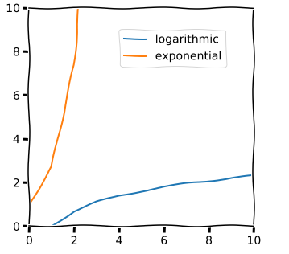
Logarithm

Slide 9
Algorithm Performance Linear vs Binary Search Performance
(where each operation takes 1 ms)
 | Linear Search | Binary Search
100 elements | 100 ms | 7 ms
10 0000 elemsnts | 10 s | 14 ms
1 000 000 000 elements | 11 days | 32 ms

Slide 10
Algorithm Performance Some Common Big O’s
Big O Notation | Example of Algorithms
O(1) | Accessing an array element
O(n) | Simple (linear) search, sum of an array
O(n²) | Summing of 2D array of size n*n
O(log n) | Binary search
O(2^{n}) | Fibonacci numbers with recursive function
Fibonacci: https://www.mathsisfun.com/numbers/fibonacci-sequence.html

Slide 11
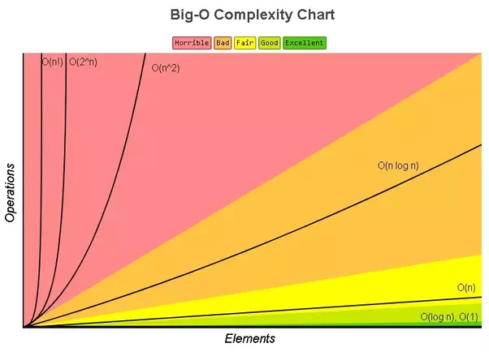
Big-O Complexity

Slide 12
Algorithm Performance
Algorithm speed isn’t measured in seconds, but in growth of the number of operations.
We talk about how quickly the run time of an algorithm increases as the size of the input increases.
Run time of algorithms is expressed in Big O notation.
O(log n) is faster than O(n), but it gets a lot faster as the list of items you’re searching grows.

