Slide 1
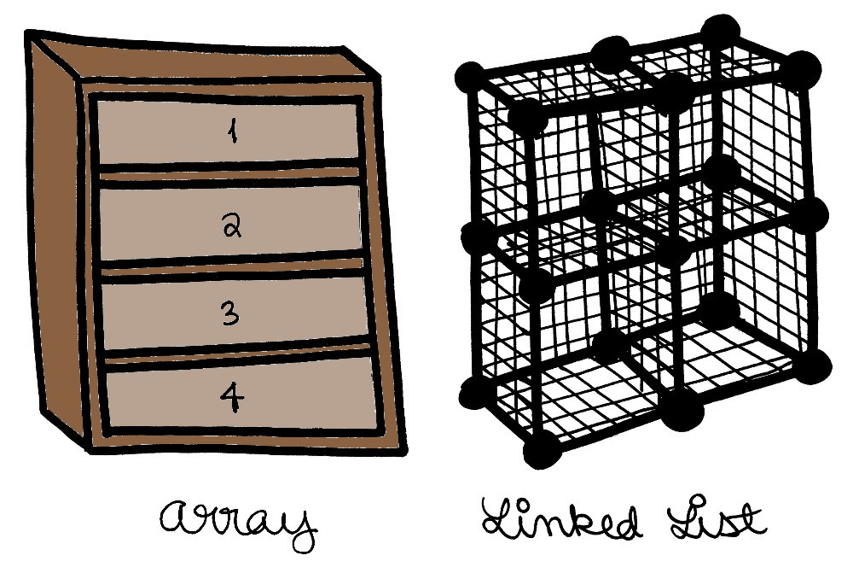
Lists (sequences)
Abstract Data Type that represents a countable number of
ordered values, where the same value may occur more
than once[wiki] .

Slide 2
Arrays vs Linked Lists
Array
List
2 | 23 | 3 | 32 | 5 | 7
0
1
2
3
4
5
Array items are defined by their indices
2
23
3
32
5
7
null
null
Items in Linked Lists have pointers to successor and/or predecessor

Slide 3
Arrays vs Linked Lists (Insert)
Example: insert 10 at position 2
Array
List
2 | 23 | 3 | 32 | 5 | 7
0
1
2
3
4
5
2 | 23 | 10 | 3 | 32 | 5 | 7
0
1
2
3
4
5
6
Memory has to be reallocated to insert an element
2
23
3
32
5
7
null
null
2
23
3
32
5
7
null
10
Easy to insert or delete an element
null

Slide 4
Array Properties
Easy random access (through indices)
Contiguos memory
Multidimensional
Typically allocated in static memory
No extra memory necessary for pointers
Insert and Delete of an element is complex

Slide 5
Linked List Properties
Sequential access (a lot of operations necessary to access an element which is far from the begin)
Allocated from heap
Extra memory necessary for pointers
Insert and Delete of an element are easy by reassigning of the pointers

