Slide 1
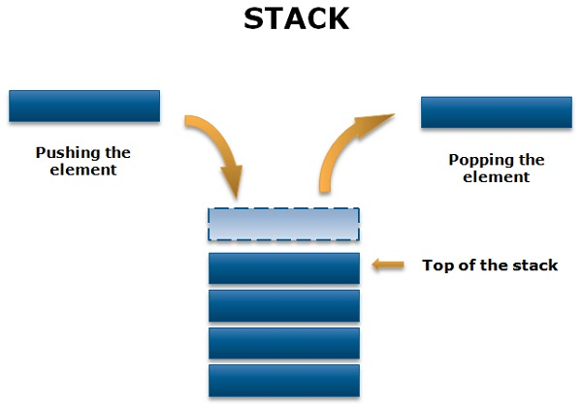
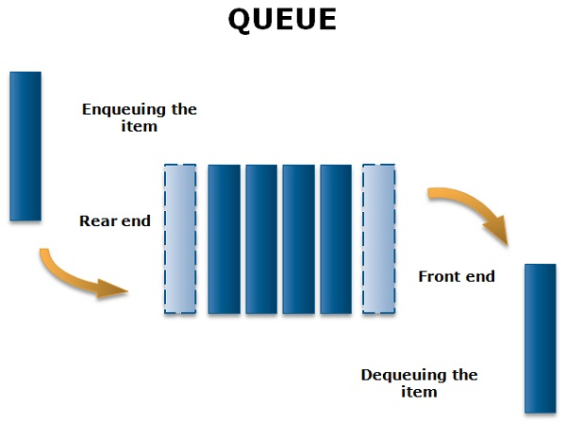
Stacks and Queues
https://techdifferences.com/difference-between-stack-and-queue.html

Slide 2
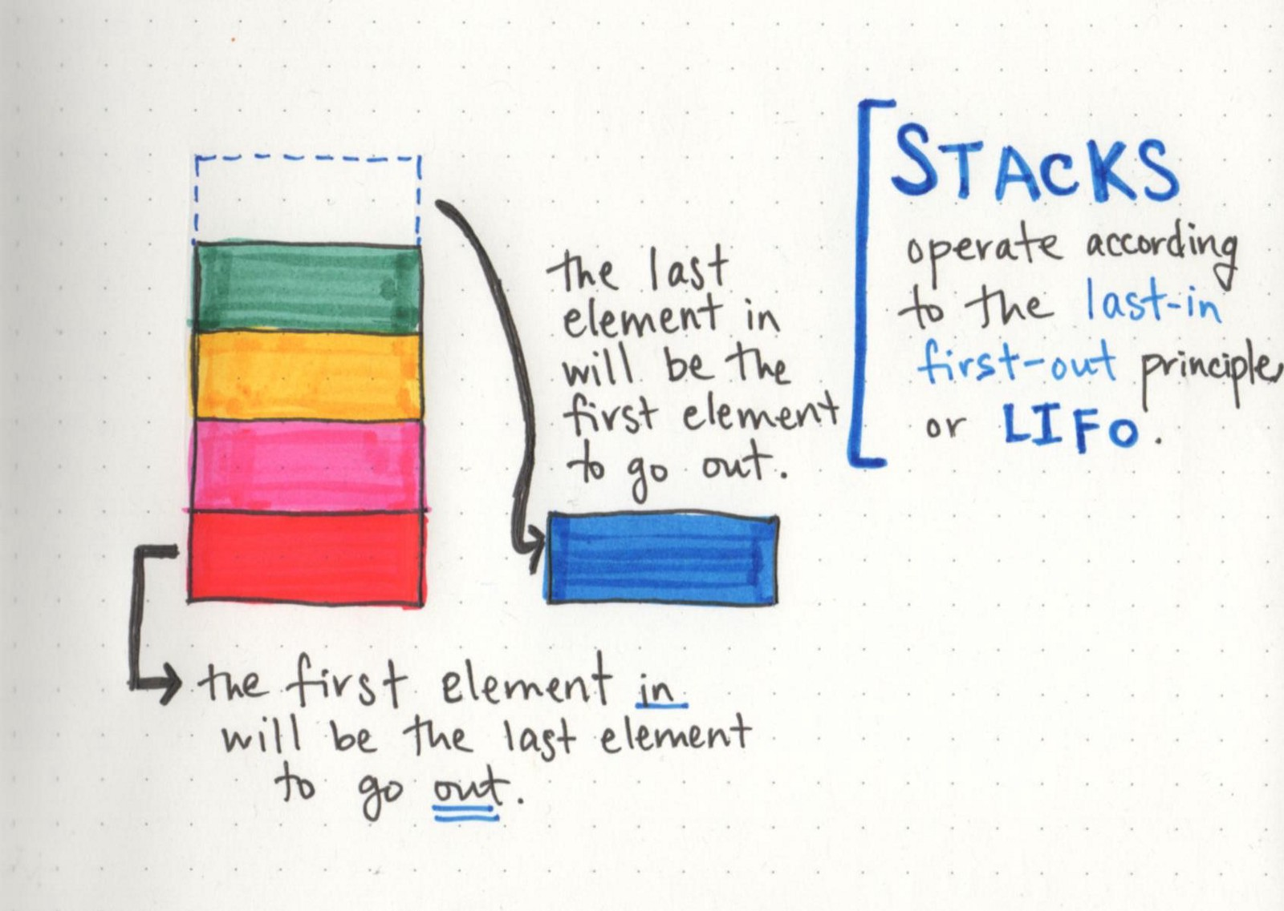
Stacks (Last In First Out)
https://medium.com/basecs/stacks-and-overflows-dbcf7854dc67

Slide 3
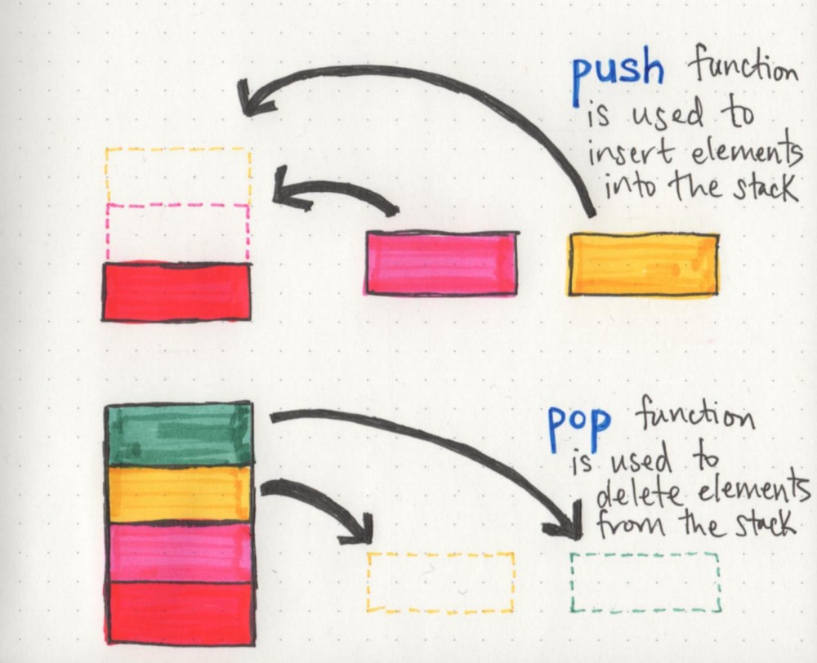
Basic Stack Operations
https://medium.com/basecs/stacks-and-overflows-dbcf7854dc67

Slide 4
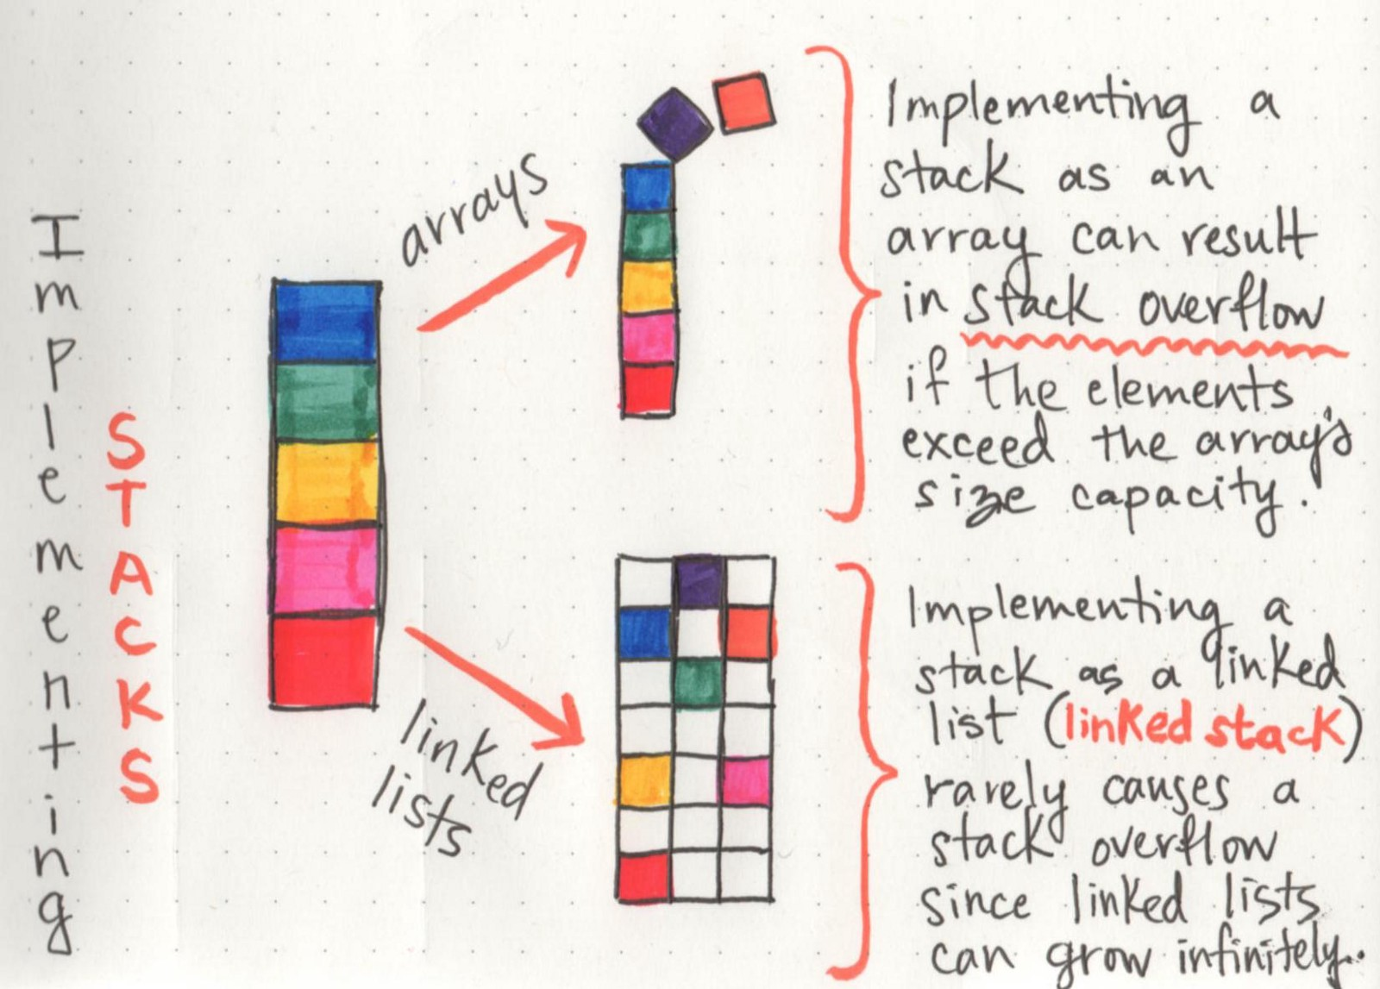
Stack Implementations
https://medium.com/basecs/stacks-and-overflows-dbcf7854dc67

Slide 5
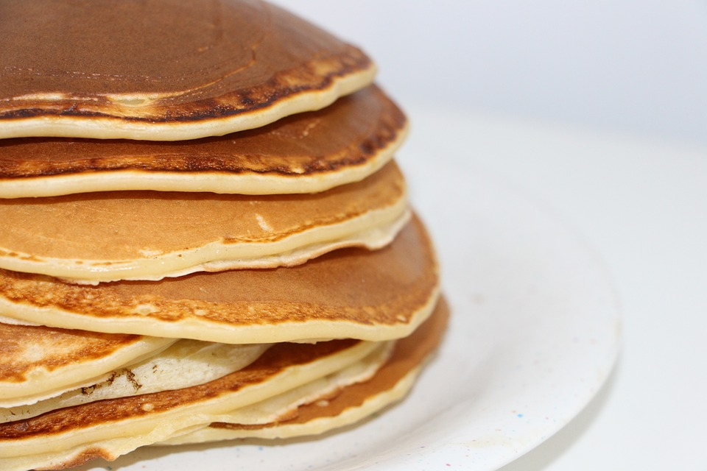
Stack Applications
Expression evaluation
Undo/Redo operations (e.g. “Back” in browsers)
Syntax check of compilers
Memory Management
And many others…

Slide 6
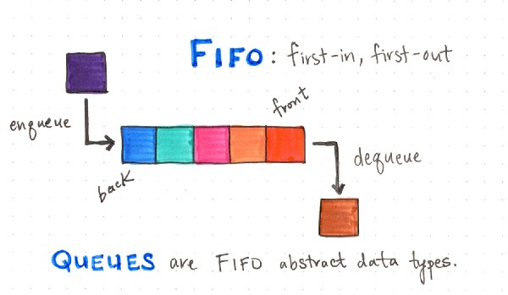
Queues (First In First Out)
https://medium.com/basecs/to-queue-or-not-to-queue-2653bcde5b04

Slide 7
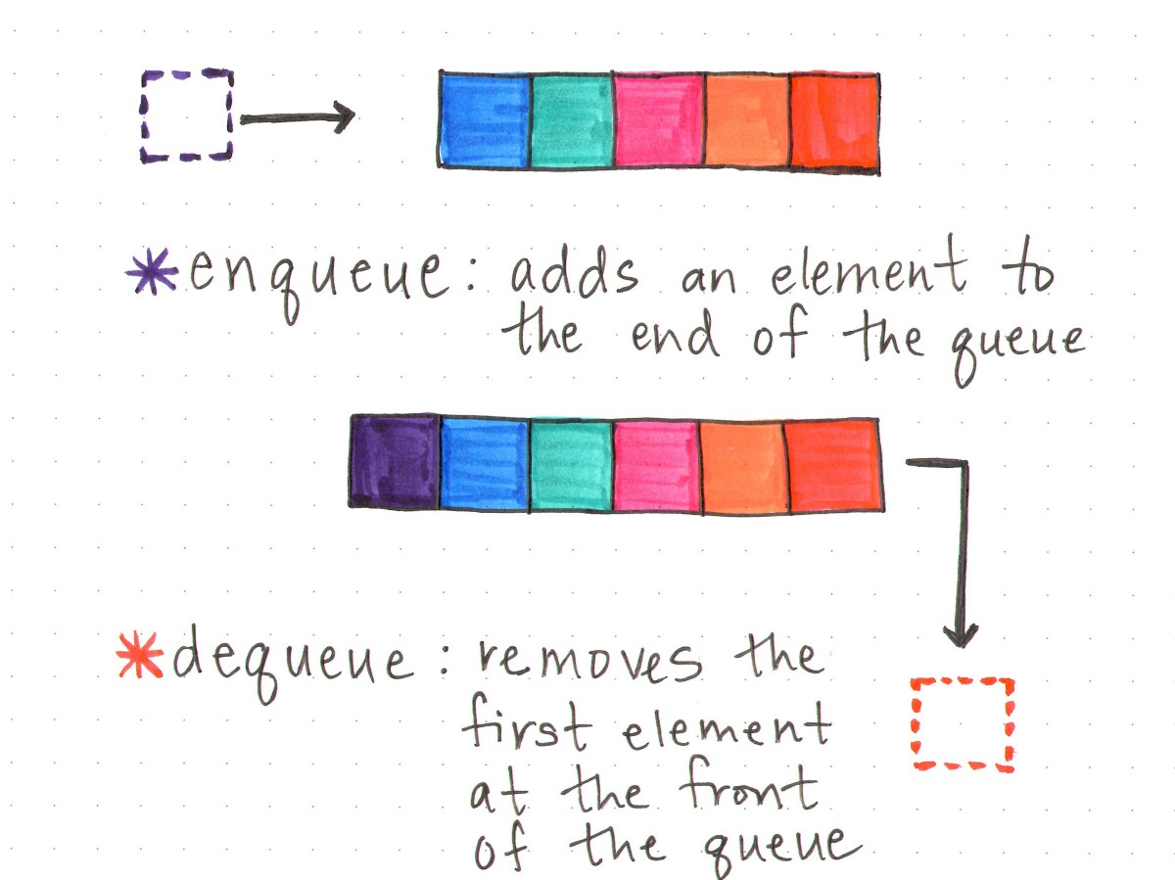
Queue Operations
https://medium.com/basecs/to-queue-or-not-to-queue-2653bcde5b04

Slide 8
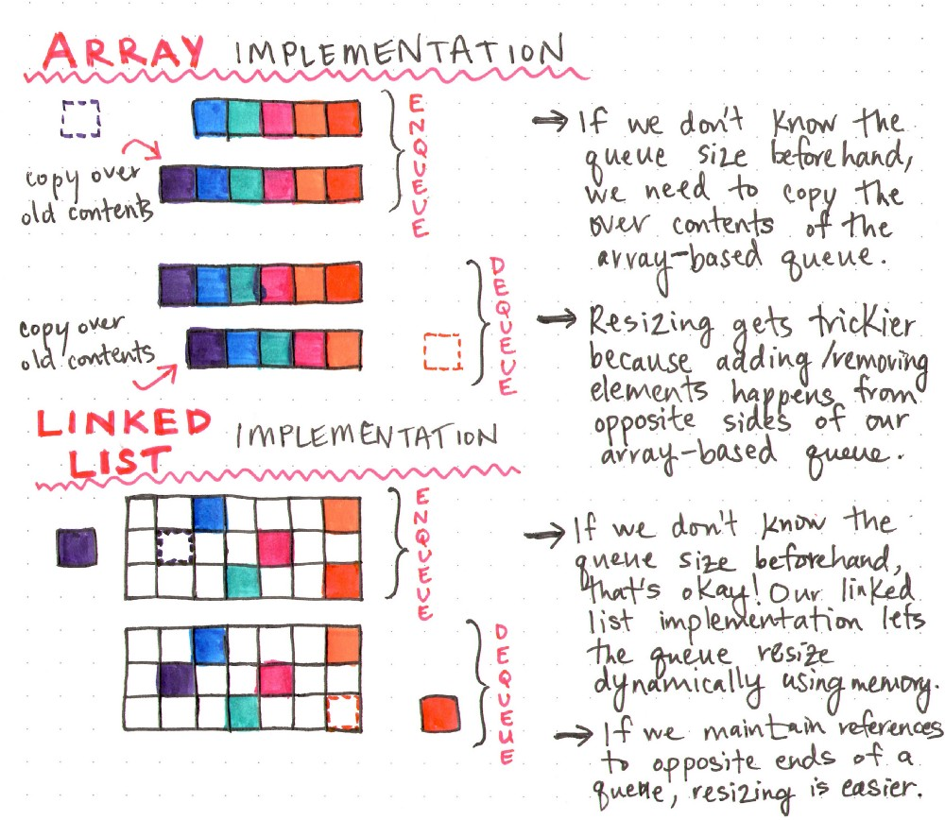
Queue Implementations

Slide 9
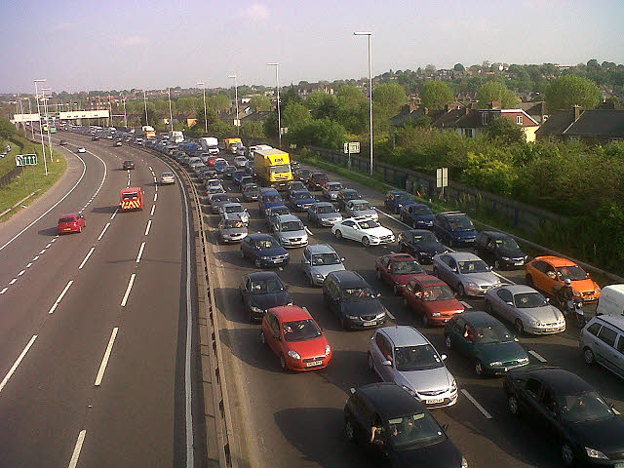
Queue Applications
Message Queues
Job Queues
Priority Queues
Buffering
And many many other applications…

Slide 10
void * pointers
The void pointer in C is a pointer not associated with any data type
Also called general purpose pointer
In C, a malloc() or calloc() function returns void * pointer
Handy for a generic API where we do not know in advance what type of data will be used
Often used for data buffers (of unknown type)

Slide 11
memcpy
Copies n bytes from destination to source.
It’s not allocating the memory to the destination, the caller is responsible for allocating the necessary memory!
void *memcpy(void *dest, const void *src, size_t n)

Slide 12
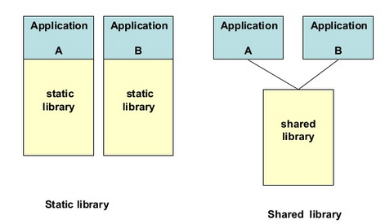
Dynamic vs Static Libraries
.c files -> .o files -> .a file
use of ar (archiver) to make it
.c files -> .o files -> .so file
special make rules, dynamically loaded
For more info: see https://medium.com/@eitanmayer/libraries-dynamic-vs-static-4f8235907c7b

