Slide 1



C++ - Introduction

Slide 2
C++ Introduction
C++ Compared to C and C#

Slide 3
C++
C++ is general purpose language based on C
C++ retains C’s ability to deal efficiently with bits and bytes
C++ is particularly useful for embedded systems programming
C++ extends C with features that support large-scale programming by organizing programs into smaller, simpler units
C++ offers rich features for building libraries of components
Notes:
You can produce better SW in less time by:
-using components that others have written and tested

Slide 4
Useful Features of C++
object-oriented programming
classes (encapsulation)
class derivation (inheritance)
virtual functions (polymorphism)
generic programming
templates
global name management
namespaces

Slide 5
What we already know from C#
Object orientation
Encapsulation
Inheritance
abstract methods / abstract classes / interfaces
static or dynamic binding (virtual)
Exceptions
Unit tests
Class diagrams

Slide 6
C# vs C++
variables: int, char, double
variables: string, list
variables: bool
test: if
loops: for, while, do..while
loops: foreach
methods
classes
exceptions
value types and reference types
variables: int, char, double
variables: string, vector
no ‘real’ bool type
test: if
loops: for, while, do..while
no foreach
methods
classes
exceptions
everything is value type by default
less stuff that works automatically
no garbage collector!
Notes:
Important note: in C++ we have references, they are however NOT similar to reference types in C#! Pointers are similar to reference types in C#!

Slide 7
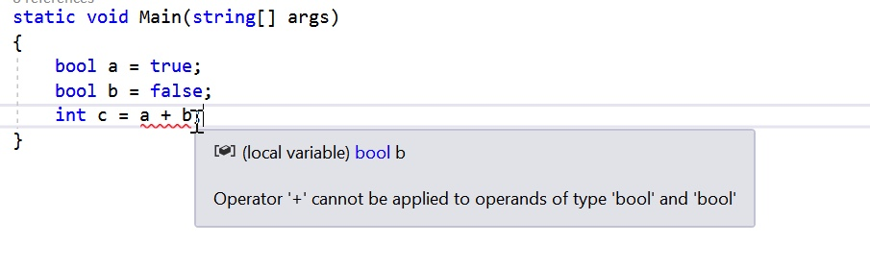
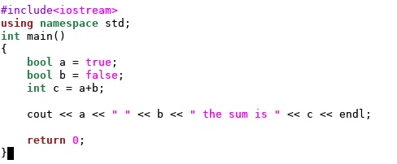
C# vs C++ booleans

Slide 8
What we already know from C
Program layout (headers and source files)
Pointers, arrays, memory management (heap)
Everything is ‘value’ type, reference type is explicit
Unit testing
You have to be careful with what you do
Working in a Linux environment, building your program on the command line
C (and C++) doesn’t have a garbage collector
you’ll have to manage your memory yourself
do test for memory leaks! (e.g. valgrind)

Slide 9
Similarities with C
Simply put: C++ is object oriented C (not entirely true)
Layout of code:
header file (.h) contains class definition (and multiple include protection!)
source file (.cpp) contains code
Everything is value type by default

Slide 10
What’s new for us in C++
Copying objects
sometimes leads to unexpected results
correct behaviour can be made explicitly
copying of objects can be prevented
Copy Constructor/ Deep and Shallow Copy
C++ Shallow vs Deep Copy Animated

Slide 11
C++ Introduction
Hello World

Slide 12
Hello World!
& makes sure geany runs in the background, which means that you can continue to use your command line!
Open a new text file
from command line: geany hello.cpp &
Type the following:
#include <iostream>
using namespace std;
int main()
{
cout << "Hello World!\n”;
return 0;
}
Save and type on command line: make hello
Then: ./hello
no .cpp extension!
You build ‘hello’ using make, which is clever enough to find hello.cpp
./ because your current directory is not in your path
Notes:
./: in contrary to Windows: Linux does not put your current directory in the PATH environment variable. This is done to make your system more secure. More information: http://superuser.com/questions/350844/how-to-permanently-add-current-directory-to-path-in-linux/350847#350847 (especially the last 2 comments)

Slide 13
A first C++ class
Add the following class definition above the main function:
class Hello
{
public:
Hello()
{
cout << "Hello class is constructed!\n";
}
void Print()
{
cout << "Hello World!\n";
}
};
And change the main function to:
int main()
{
Hello h;
h.Print();
return 0;
}
Please compile and run again

Slide 14
C vs C++ : Structures
C
C++
Cannot have member functions
Variables in structure can’t be initialised
For declarations necessary to use “struct” word
No static members
No access modifiers
Can have member functions with variables
Direct initialisation of variables in structures
Not Necessary to use struct word for declarations
Static members possible
Access modifiers and data hiding possible
Notes:
Important note: in C++ we have references, they are however NOT similar to reference types in C#! Pointers are similar to reference types in C#!

Slide 15
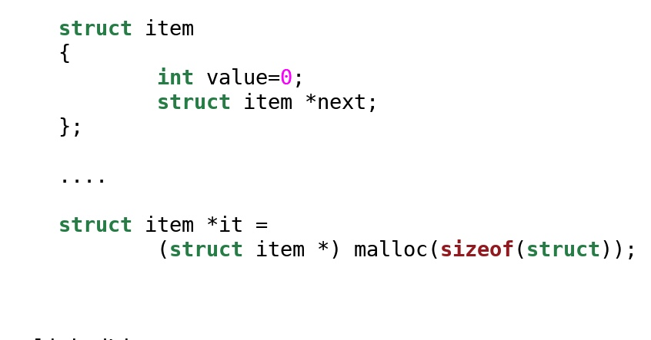
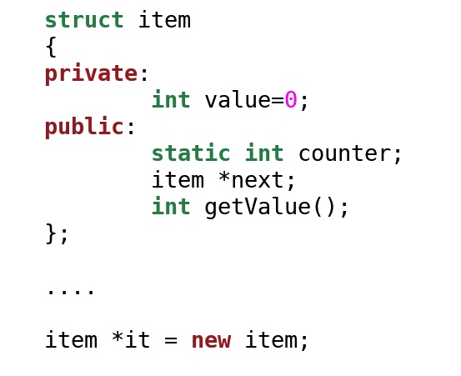
Data Structures C C++
access identifiers
initialisation
no struct declaration C++
static delcaration
member function
memory alloc with new

Slide 16
The real strength of C++ : Classes
More powerful than data structures
Encapsulation with function
Support for Object-Oriented Paradigm
C++ classes are very similar to C# classes
When to use data structures and when classes?Structures vs Classes according to Bjarne Stroustrup

Slide 17
Some more C/C++ differences useful for assignment
C
C++
NULL macro for pointers
No namespaces
malloc()/free() for the heap allocations
Pointers are assigned 0
Namespaces
new and delete to allocate heap for structures and objects
malloc()/free() still possible (when do we use it?)
malloc()/free() of raw data can be replaced by operator new()
Notes:
This is just a very small selection of the differences. There are many more features of C++ not mentioned yet.

Slide 18
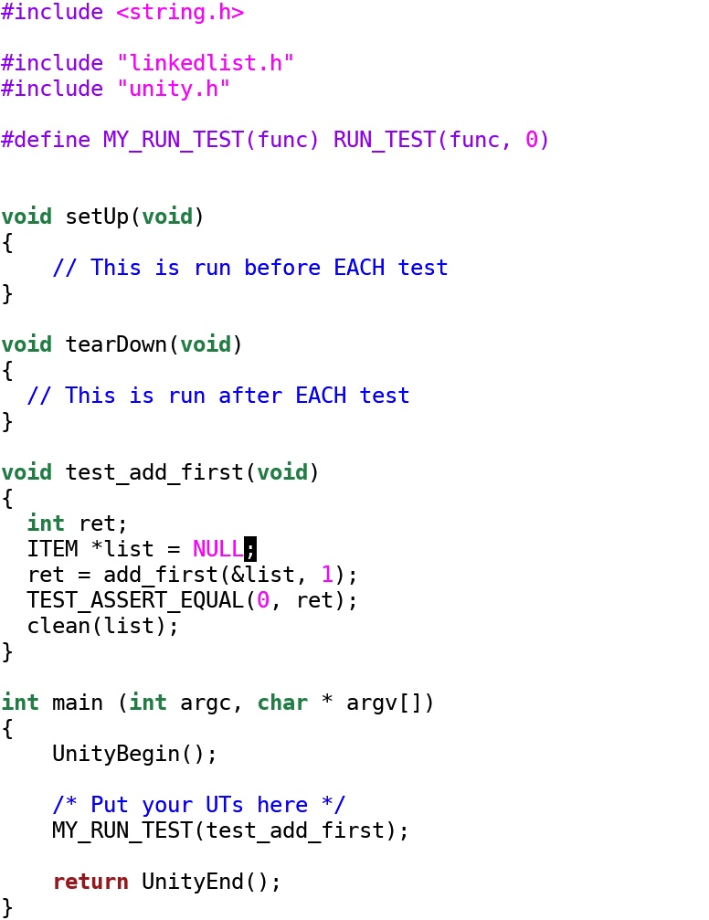
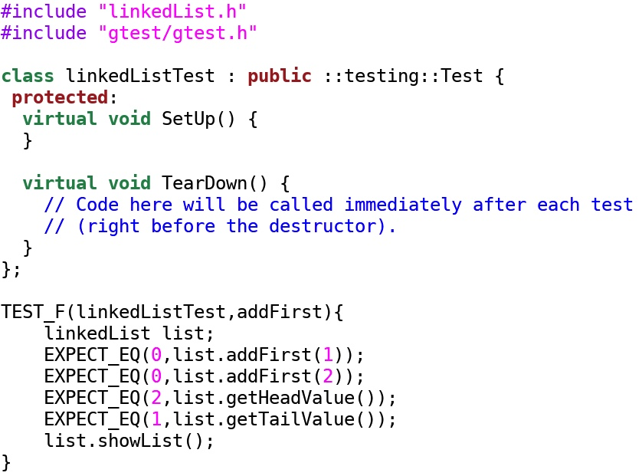
Unity (C) vs Google Test (C++)

