Slide 1



C++ Memory Management

Slide 2
Memory Management
Pointers
References
Call-by-reference
Stack vs Heap
Scope
new & delete

Slide 3
Pointers vs C pointers
Use is identical in C and C++
Pointer contains the address of another variable/object
int main()
{
// A normal integer variable
int a = 10;
// A pointer variable that holds address of var.
int *p = &a;
cout << "Value of a = "<< *p << endl;
cout << "Address of a = " << p << endl;
*p = 20; // Value at the address is now 20
return 0;
}
a=10
p= 0x0100
0x0100
0x0101
0x0102
0x0103

Slide 4
Pointers vs C pointers
Use is identical in C and C++
Pointer contains the address of another variable/object:
int *p = new int(0xE023F5B4);
When do we use pointers?
p
0x0100
E0
0x0100
23
0x0101
F5
0x0102
B4
0x0103
Notes:
To reserve new memory during program execution
To refer and share large data structures without making a copy of it (to reduce memory used)
Working with specific data structures such as linked lists, graphs, trees, etc.

Slide 5
Pointers vs C# references
C++ pointers are conceptually equal to C# references
both can be NULL
both can point to a piece of memory

Slide 6
Memory Management
Pointers
References
Stack vs Heap
Scope
new & delete
Destructor

Slide 7
C++ references
C++ references are very similar to pointers but with small differences
When a variable is declared as a reference, it becomes an alternative name – an alias - for an existing variable
int main()
{
int x = 10;
int& ref = x; // ref is a reference to x.
ref = 20; // Value of x is now changed to 20
cout << "x = " << x << endl ;
return 0;
}

Slide 8
Example
#include<iostream>
using namespace std;
void Increment(int a)
{
a=a+1;
}
int main()
{
int a = 10;
Increment(a);
cout << “a = " << a << endl ;
return 0;
}
Output ?

Slide 9
Example
#include<iostream>
using namespace std;
void Increment(int a)
{
a=a+1;
}
int main()
{
int a = 10;
Increment(a);
cout << “a = " << a << endl ;
return 0;
}
#include<iostream>
using namespace std;
void Increment(int* a)
{
*a=(*a)+1;
}
int main()
{
int a = 10;
Increment(&a);
cout << “a = " << a << endl ;
return 0;
}
#include<iostream>
using namespace std;
void Increment(int& a)
{
a=a+1;
}
int main()
{
int a = 10;
Increment(a);
cout << “a = " << a << endl ;
return 0;
}
Output ?
Output ?
Output ?

Slide 10
References vs Pointers
You cannot have NULL references. You must always be able to assume that a reference is connected to a legitimate piece of storage. It must be initialized.
int& p; // compile error
Once a reference is initialized to an object, it cannot be changed to refer to another object. Pointers can be (re-)pointed to another object at any time.
int x = 5;
int y = 9;
int& p = x;
p = y; // this doesn’t re-reference to y, it copies the value of y to x

Slide 11
Why references?
In case of large data structures you don’t need to make a copy but you manipulate the existing copy.
Safer and cleaner programming, but indeed you can use pointers instead.

Slide 12
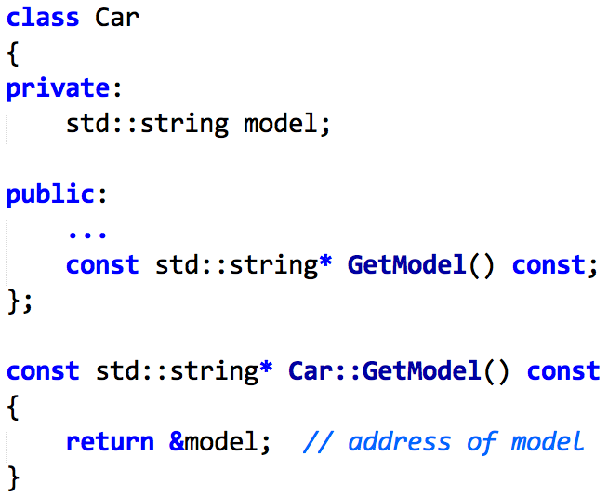
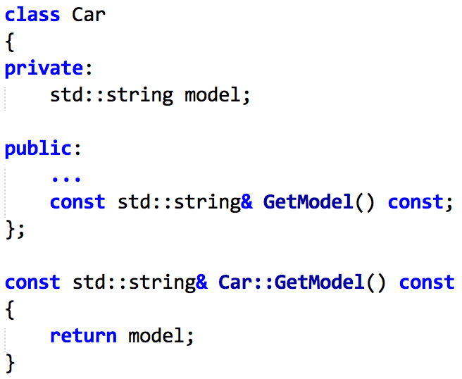
C++ references
C++ references in normal situations they cannot be NULL!
And this can be an big advantage
vs:
Notes:
A BIG advantage of the right version (reference) is that you cannot return a NULL pointer, you *must* return a valid string reference.

Slide 13
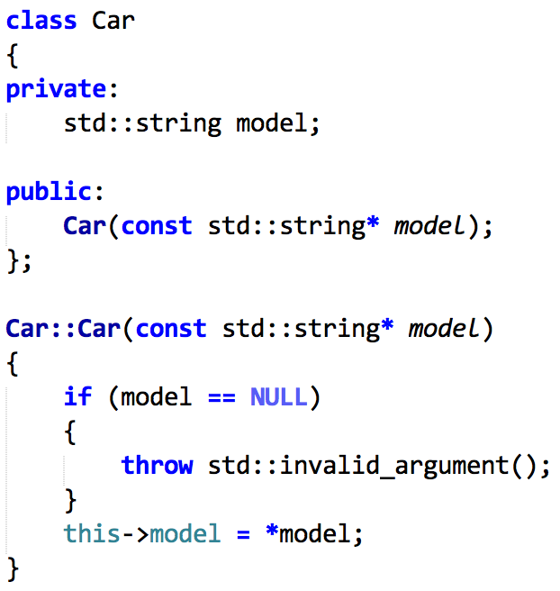
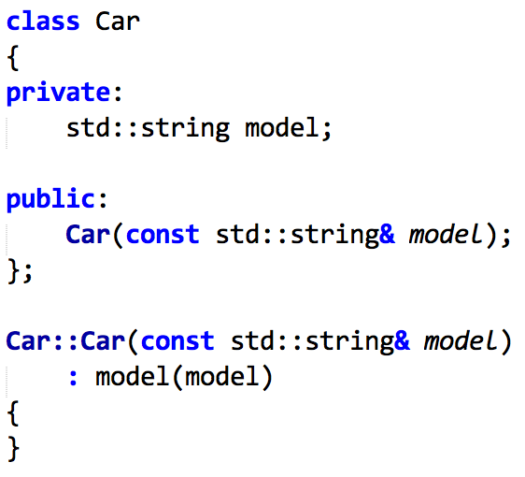
C++ references
vs:

Slide 14
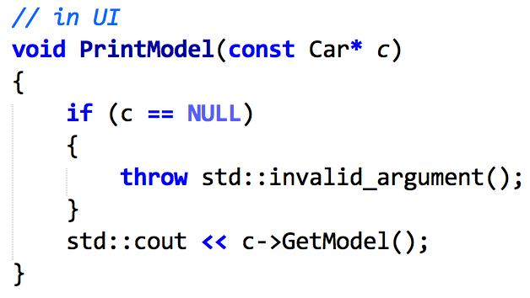
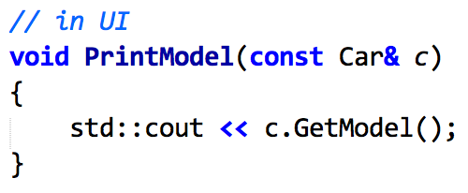
C++ references
vs:
Notes:
In other words: you mostly use references, unless pointers make more sense: mostly when NULL is a valid value (e.g. when you instantiate an array of ”things” and wish to indicate that some fields are not yet valid)

Slide 15
Memory Management
Pointers
References
Stack vs Heap
Scope
new & delete
Destructor

Slide 16
C++ variables and the stack
void DoSomething(int n) { int m = 2; m = 3; n++; } . . . int p = 5; DoSomething(p); . . .
3
m
2
6
n
5
p
5
stack
Notes:
Why if there is no sufficient memory on the Stack? -> Stackoverflow! (eg nonterminating recursion)

Slide 17
C++ the stack and the heap
int main() { int* p; //allocate memory in the heap p = new int; //new is type safe *p= 5; …. return 0; }
p = 500
5
5
500
stack
heap
Notes:
With New and Delete you do not need to do typecasting (like with malloc) because they return type pointer.

Slide 18
C++ the stack and the heap
int main() { int* p; p = new int; *p= 5; p = new int(10); …. return 0; }
p = 200
5
10
500
200
stack
heap

Slide 19
C++ the stack and the heap
int main() { int* p; p = new int; *p= 5; delete p; p = new int(10); …. return 0; }
p = 200
5
10
Memory leak
500
200
stack
heap

Slide 20
C++ the stack and the heap
int main() { int* p; p = new int; *p= 5; delete p; p = new int[20]; …. delete[] p; return 0; }
p = 200
500
200
stack
heap

Slide 21
C++ the stack and the heap
Is anything wrong with this code?
void x() { int* p = new int; … } int main() { int* p; p = new int; *p= 5; delete p; return 0; }
500
200
stack
heap
Notes:
Very often error that leads to memory leak -> deallocation must be done in the function x()

Slide 22
Stack and Heap C# ⬄ C++ C++
Student object
Student object
Heap
st
Stack
pst
st
Student st; st = new Student("p"); st.SetStudentNr(10); | Student st("p"); Student *pst; pst = new Student("p"); st.SetStudentNr(10); pst->SetStudentNr(10); (*pst).SetStudentNr(10);
 | delete pst;
Notes:
Memory Leak!

Slide 23
Instance Variable
Student student(“Hermione”);
Automatic Clean-Up by system
destructor is called automatically: Student::~Student()
example use destructor: Free up resources (e.g. a file or allocated memory)

Slide 24
Dynamic Memory Allocation
Student *student = new Student(“Ronald”);
No Clean-Up by system, thus by programmer!
destructor needs to be called manually: delete student;
classic mistake forgetting to delete: “memory leak” (check with valgrind and fix the leak!)
Notes:
read more about destructor here: https://docs.microsoft.com/en-us/cpp/cpp/destructors-cpp

Slide 25

Memory Management
for each new “knot in your trunk”: remember to delete
C has a similar mechanism: malloc/free
example: Memory Management
Notes:
IMPORTANT: first run example and show what happens, then show example with valgrind to show what happens, then fix bug!

Slide 26
Destructor
Opposite of constructor
cleans up resources
Only implement one if one of the following applies:
you use system resources (i.e. memory, file, network, etc.)
you are a base class (or have a big chance that you’ll become one)
in this case your destructor, even if empty, must be virtual!
Notes:
Note on the last line: see next slide!
General note: C# also has destructors, but are not used when it comes to memory (due to the garbage collector). In C# you use a destructor when a class opens ”something” upon construction and needs to release that resource when it’s destroyed. This principle is called RAII (https://en.wikipedia.org/wiki/Resource_acquisition_is_initialization)
E.g.: a class that handles a database connection will open a connection to the database when it’s created and free the connection when it’s destructed.

Slide 27
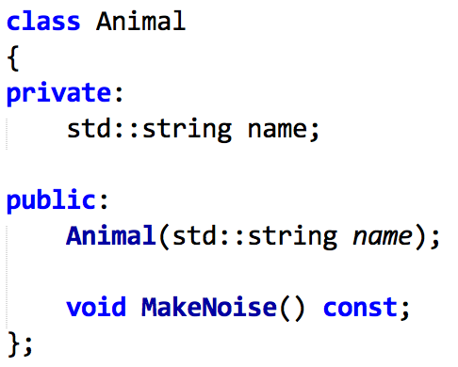
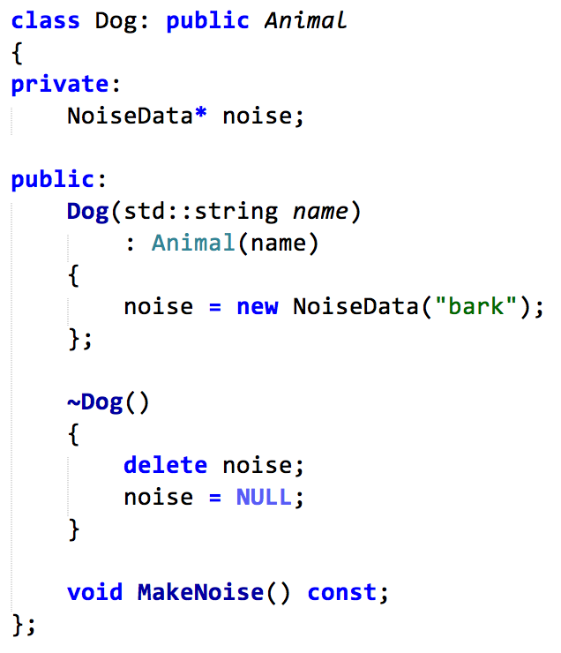
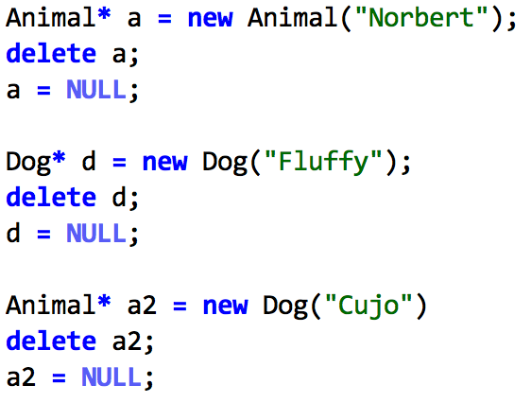
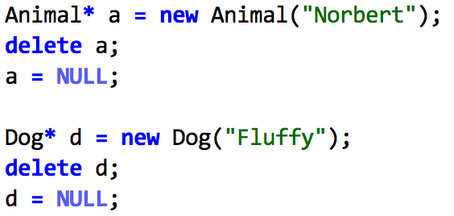
Destructor
What happens here:

