Slide 1
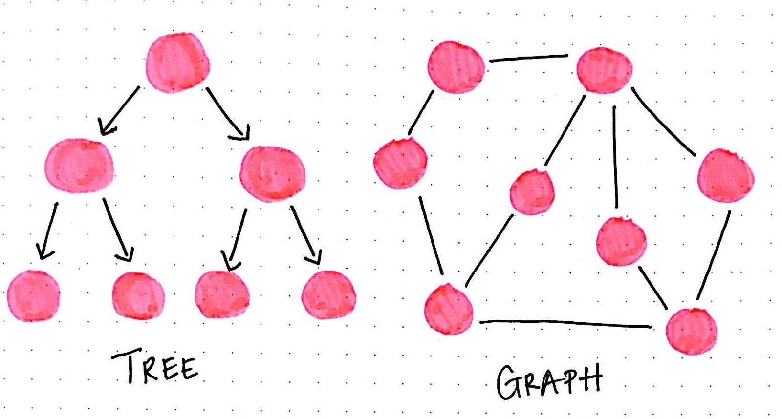
Non-Linear Structures, Recursion
https://medium.com/basecs/a-gentle-introduction-to-graph-theory-77969829ead8

Slide 2
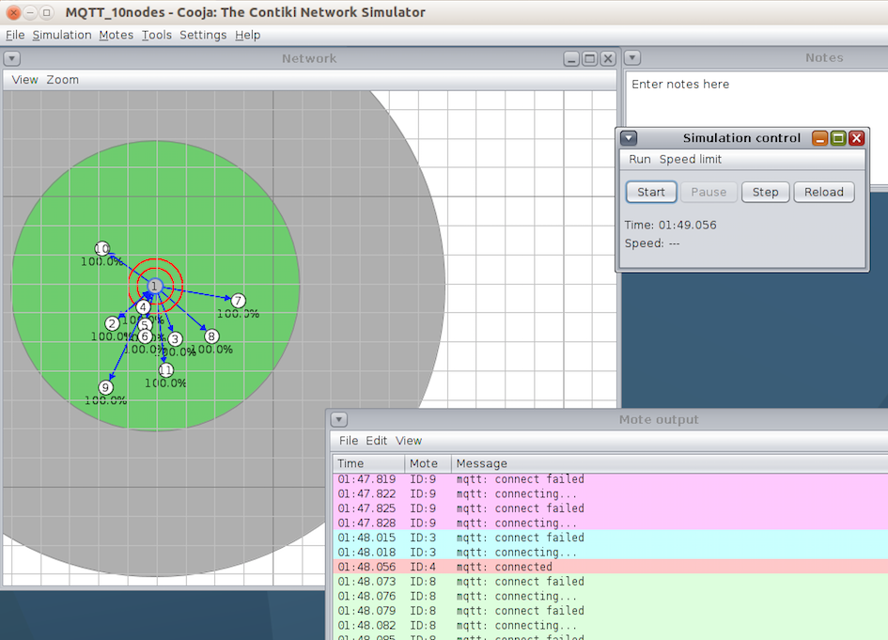
Graph/Tree Applications
Domain Name Systems (URL’s)
(Sensor) Networks
Social Media, e.g. Facebook/LinkedIn/Twitter
Solving Puzzles
Machine Learning
File System
And many others…

Slide 3
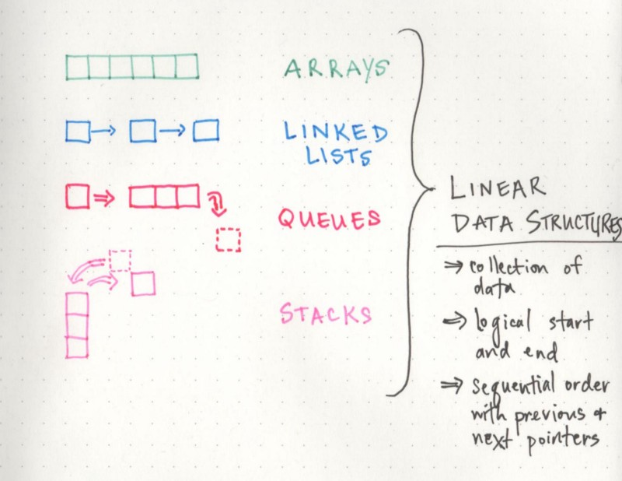
Linear vs Non-Linear Data Structures
https://medium.com/basecs/how-to-not-be-stumped-by-trees-5f36208f68a7

Slide 4
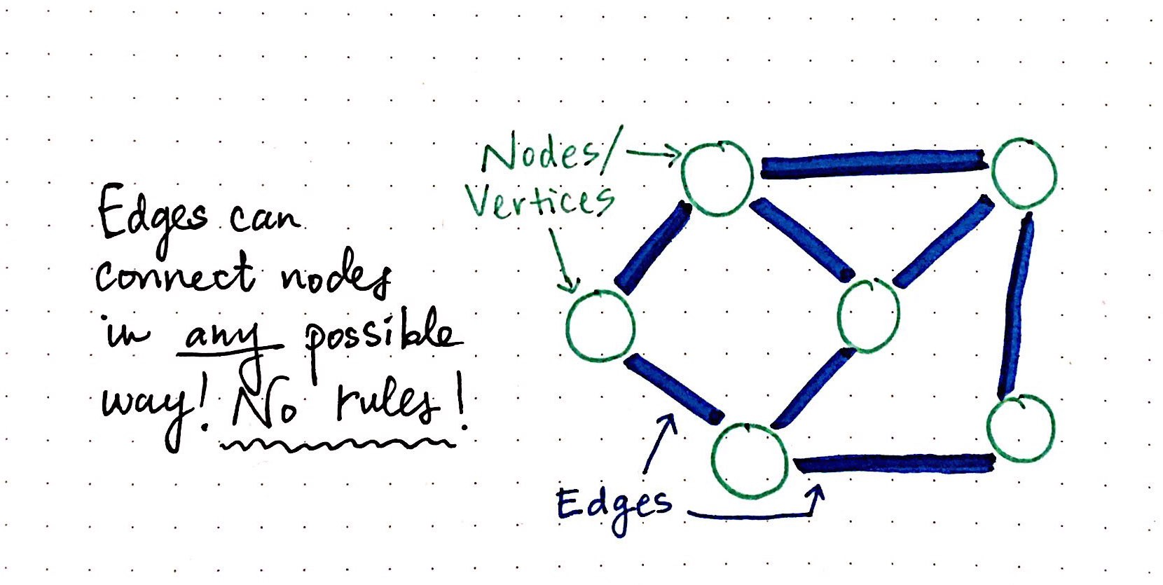
Graphs/Edges/Vertices
https://medium.com/basecs/a-gentle-introduction-to-graph-theory-77969829ead8

Slide 5
Edges and Vertices
https://www.mathsisfun.com/geometry/vertices-faces-edges.html

Slide 6
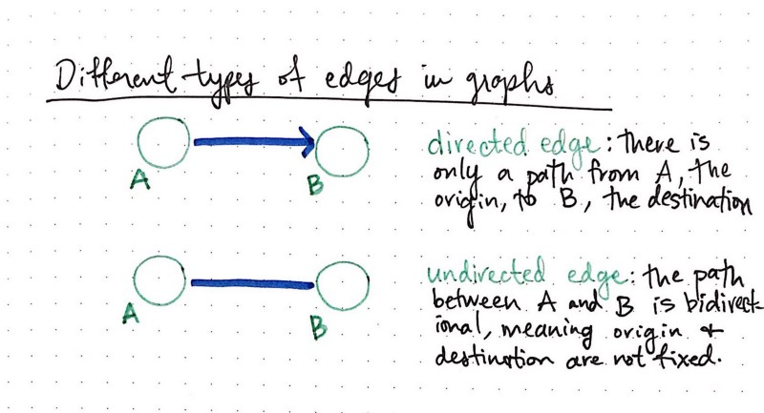
Directed vs Undirected Edges
https://medium.com/basecs/a-gentle-introduction-to-graph-theory-77969829ead8

Slide 7
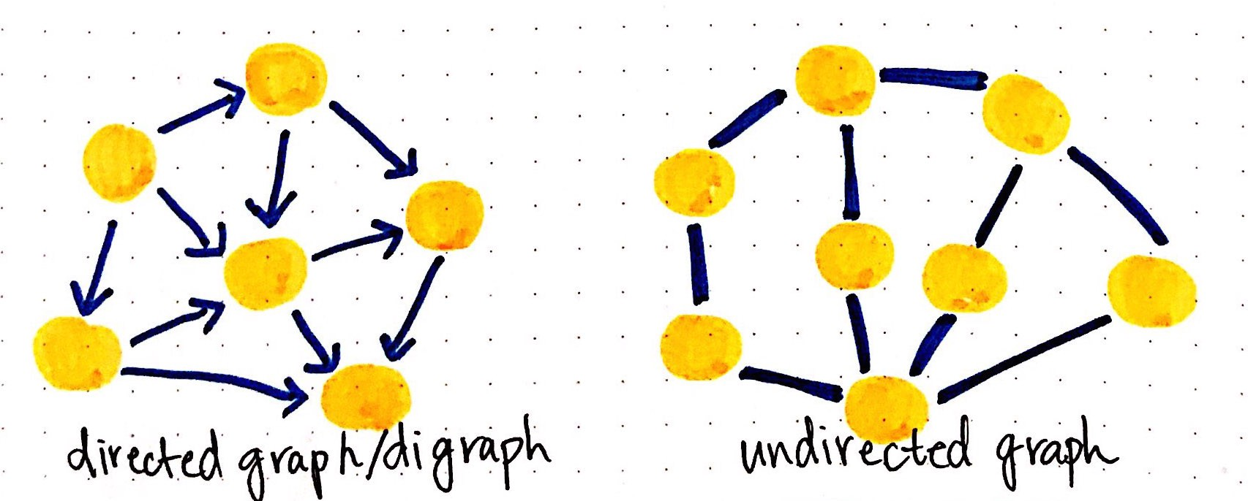
Directed vs Undirected Graph
https://medium.com/basecs/a-gentle-introduction-to-graph-theory-77969829ead8

Slide 8
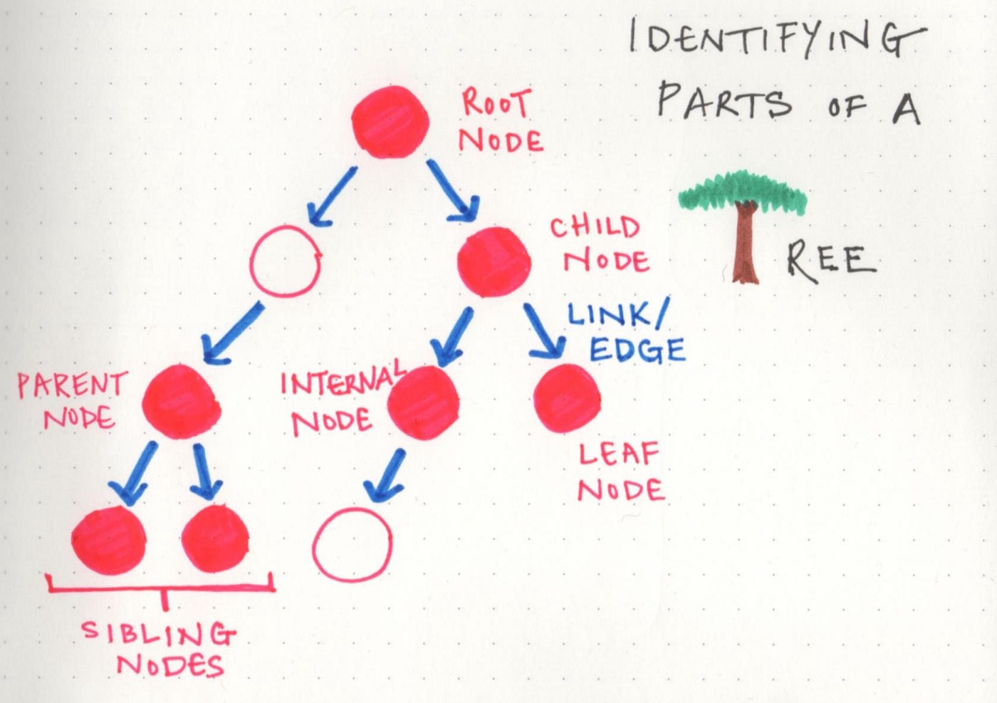
Trees
https://medium.com/basecs/how-to-not-be-stumped-by-trees-5f36208f68a7

Slide 9
Graphs Vs Trees
Comparison | Tree | Graph
Path | Only one between vertices | More than one path
Root Node | Exactly one | No root node
Loops | No loops | Possible loops
Number of Links | N-1 (N is the number of nodes) | Undefined
Model Type | Hierarchical | Network
Complexity | Lower | Higher
https://techdifferences.com/difference-between-tree-and-graph.html

Slide 10
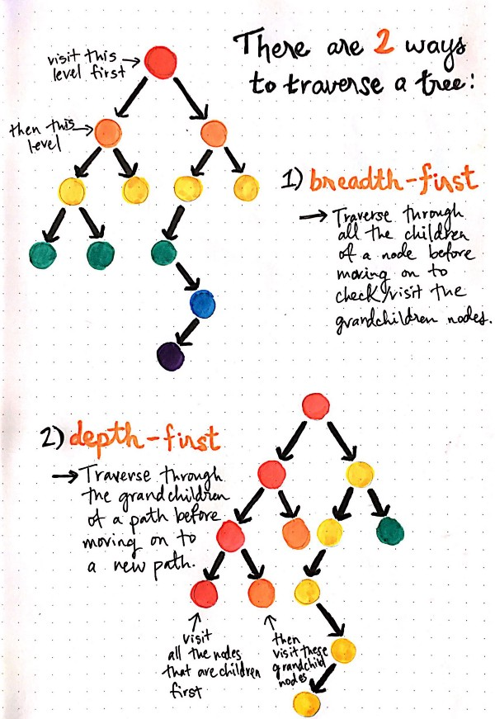
Tree/Graph Traversal
https://medium.com/basecs/demystifying-depth-first-search-a7c14cccf056

Slide 11
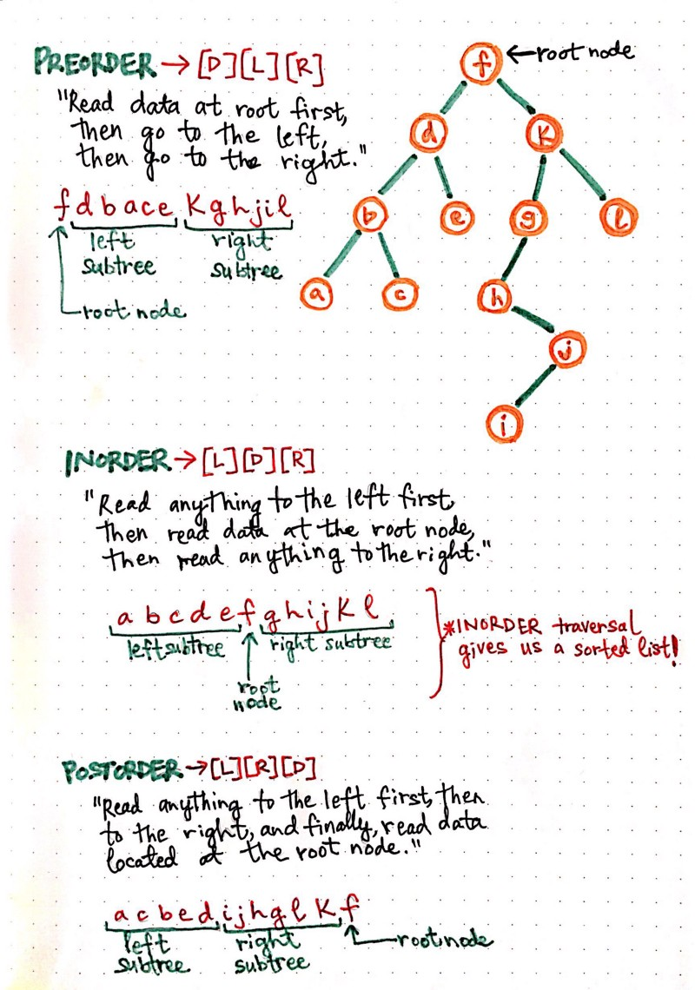
Depth-First Search Alternatives
https://medium.com/basecs/demystifying-depth-first-search-a7c14cccf056

Slide 12
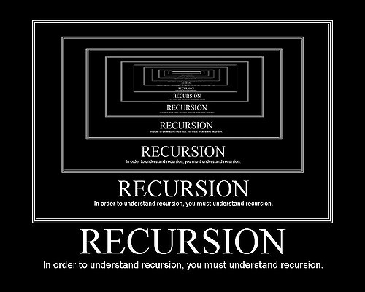
Recursion
The process in which a function calls itself is called recursion.

Slide 13
Recursive Fuction
Base Case + Recursive Case = Recursive Function
int factorial(int n)
{
// base case stops recursion
if (n <= 1)
return 1;
// recursive case
return(n*factorial(n-1));
}

Slide 14
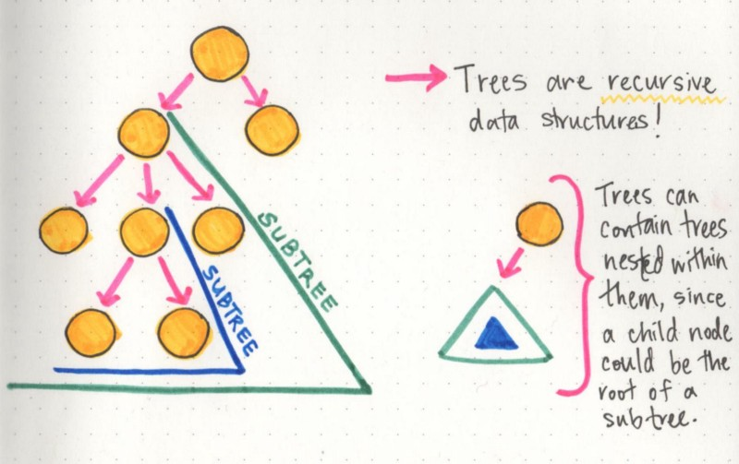
Recursion Example

Slide 15
C++ Templates
Support for Generic Programming, when types are used as parameters
Templates can be used for classes and functions
Templates enhance reusability
Templates are used for standard C++ Template library (STL)

Slide 16

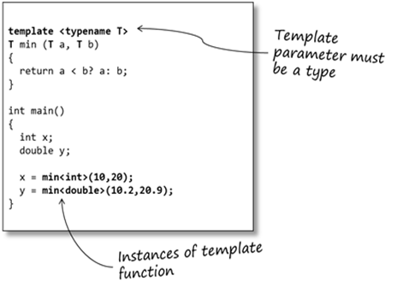
C++ Templates
https://blog.feabhas.com/2014/05/an-introduction-to-c-templates/
Notes:
Different types, different functions. Templates solve this.

Slide 17
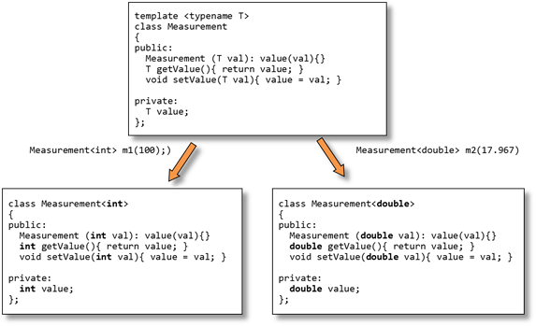
Class Templates
https://blog.feabhas.com/2014/06/template-classes/

Slide 18
C++ Containers (C++ Standard Template Library)
Containers
Utility
pair
vector
deque
list
Sequence
Associative
Derived
set
multiset
map
multimap
stack
queue
priority_queue
https://www.geeksforgeeks.org/the-c-standard-template-library-stl/
Notes:
Which containters are related to the data structures we have already talked about?
Extra reading material and videos:
“Learning C++: Storing Class Objects in Containers” https://levelup.gitconnected.com/learning-c-storing-class-objects-in-containers-ca12546f1a89
“C++ Tutorial 17 : Sequence Containers” https://www.youtube.com/watch?v=KJWOm1bXUxM&list=PLGLfVvz_LVvQ9S8YSV0iDsuEU8v11yP9M&index=20
“C++ Tutorial 18 :Associative Containers & Container Adapters” https://youtu.be/IaTzi_bsuJU?list=PLGLfVvz_LVvQ9S8YSV0iDsuEU8v11yP9M

Slide 19
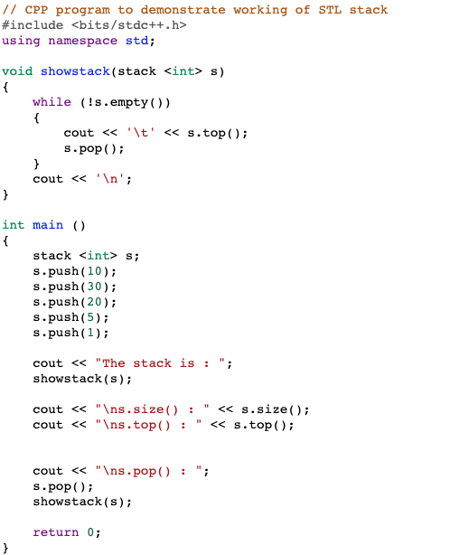
Example Code for Stack Container
https://www.geeksforgeeks.org/stack-in-cpp-stl/

Slide 20
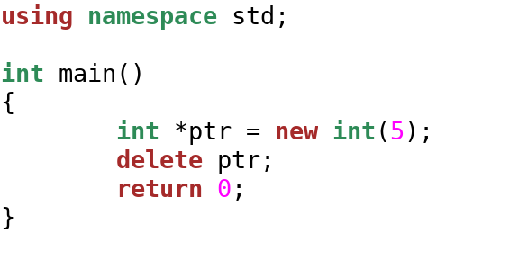
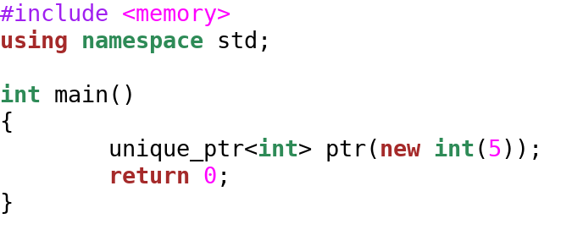
Smart Pointers from C++11
Classical Pointer (always portable)
You have to do your own garbage collection!
Smart Pointer (dependent on –std=c11++ build flag)
Notes:
Smart Pointers provide automatic garbage collection, so you don’t have to free the heap pointers. They are dependent on C++ version. Some of the companies use only Smart Pointers.

