Slide 1



Design Workshop SOLID design principles

Slide 2
Goal 1:
Loud bells are ringing in your head when you violate the following principes:
Single Resposibility Principle (SRP)
Open Closed Principle (OCP)
Liskov Substitution Principle (LSP)
Interface Segration Principle (ISP)
Dependency Inversion Principle (DIP)

Slide 3
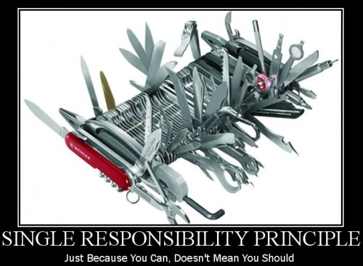
Single Responsibility Principle
SOLID

Slide 4
One responsibility - one reason to change
A class should have one responsibility
Therefore only one reason to change
Think about an LED class: it can have both timing and LED related functions
if the LED changes: you need to modify this class
if the timing changes: you need to modify this class 😳
It’s better to have 2 smaller classes

Slide 5
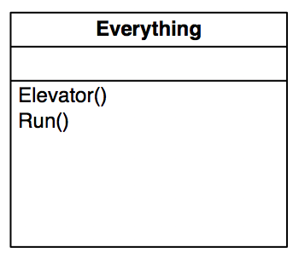
Very bad example: elevator system

Slide 6
Good example
All those small programs on the Linux console
Most do only 1 thing
They can be combined into something bigger:
find . -name ‘*.h’ –exec grep -Hin Foo {} \;
(2 simple tools working together to search all header files in a directory that contain the word Foo)

Slide 7
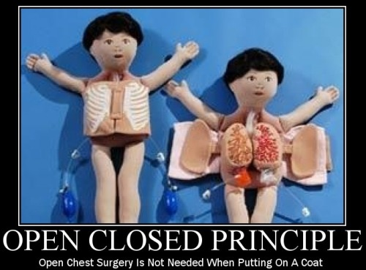
Open Closed Principle
SOLID

Slide 8
Open for extension, closed for modification
If Foo depends on Bar, Bar should not modify its behaviour (that would break Foo)
Bar however should be able to add features

Slide 9
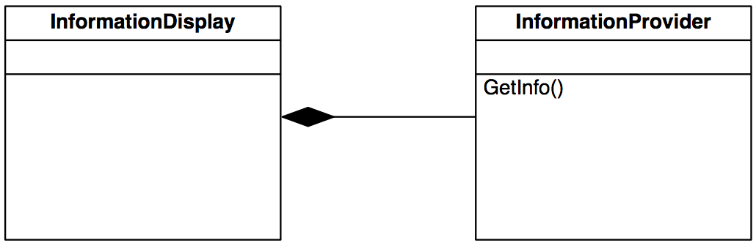
Bad example
InformationDisplay is tightly coupled with InformationProvider
Notes:
If InformationProvider changes, InformationDisplay must at the very least be recompiled.

Slide 10
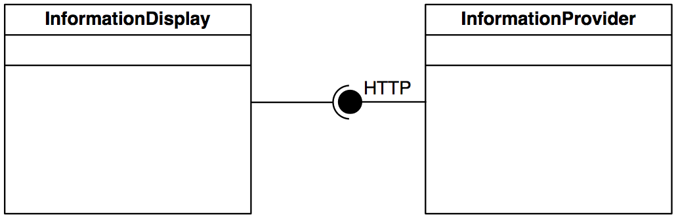
Better example
No hard link. InformationProvider is free to ”grow” as long as
existing functions do not change.
Notes:
HTTP is just an example. It is by no means meant as an example of ”the best interface” for this situation.

Slide 11
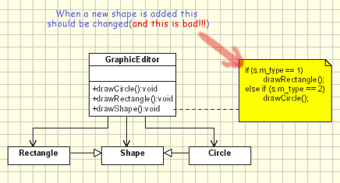
Bad example
Shape is tightly coupled with GraphicalEditor

Slide 12
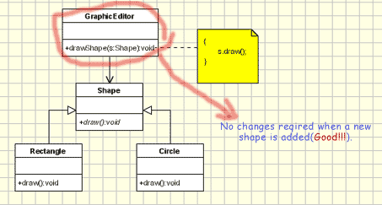
Better example
Shape is tightly coupled with GraphicalEditor

Slide 13
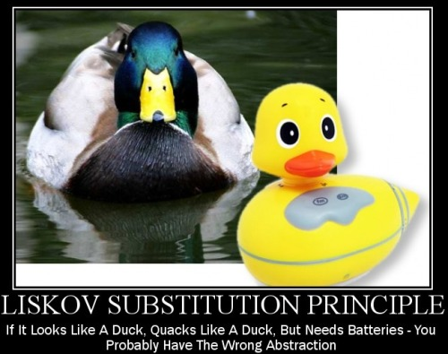
Liskov Substitution Principle
SOLID

Slide 14
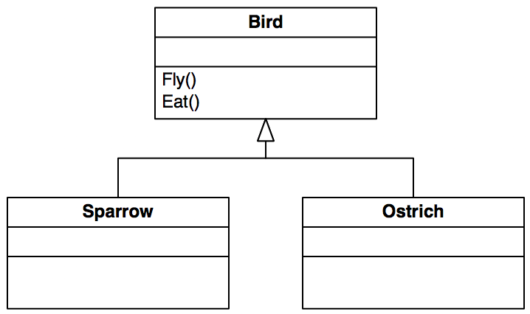
If it behaves like a duck, it probably is a duck
When you use a reference to a base class, you should be able to use a derived class as well
Bad example:
Notes:
When calling Fly on a Bird, it shouldn’t matter what kind of bird it is. This is a bad example, because an ostrich (struisvogel) cannot fly…
Even when this is a logical abstraction in the real world, you should choose your abstraction based on what is logical in your software system.

Slide 15
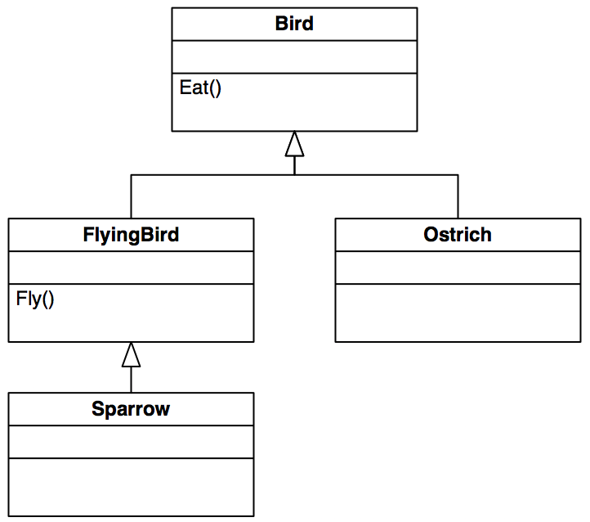
Better example

Slide 16
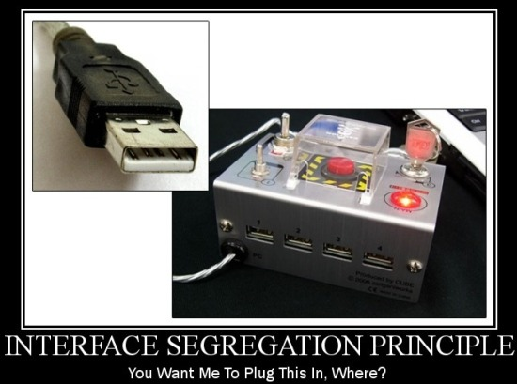
Interface Segregation Principle
SOLID

Slide 17
Don’t enforce an interface I don’t care about
If your module exports some methods:
Make interfaces (plural!), each of which is a logical group of methods
Another way to explain:
Don’t make one big interface that contains everything
Make simple, small interfaces that each have 1 responsibility
Think of it as SRP for interfaces!

Slide 18
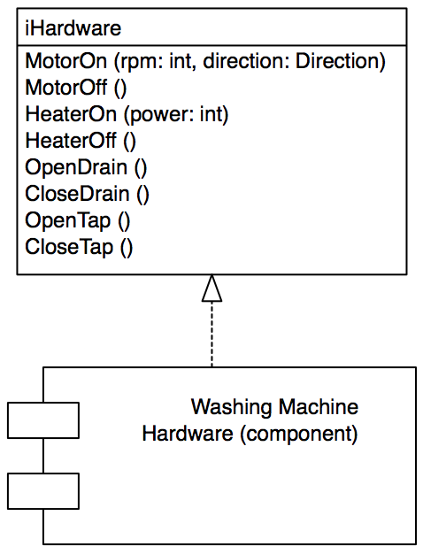
Bad example
Notes:
Washing Machine Hardware is a component, think of it as a library or a set of classes that together implement all hardware functions.
Bad example, because:
- Each class that uses this interface, can accidentally use methods it doesn’t need (WaterHandler only uses the tap functions, not the motor or heater functions)
- Each class that implements a part of this interface must have an empty implementation of the other methods as well

Slide 19
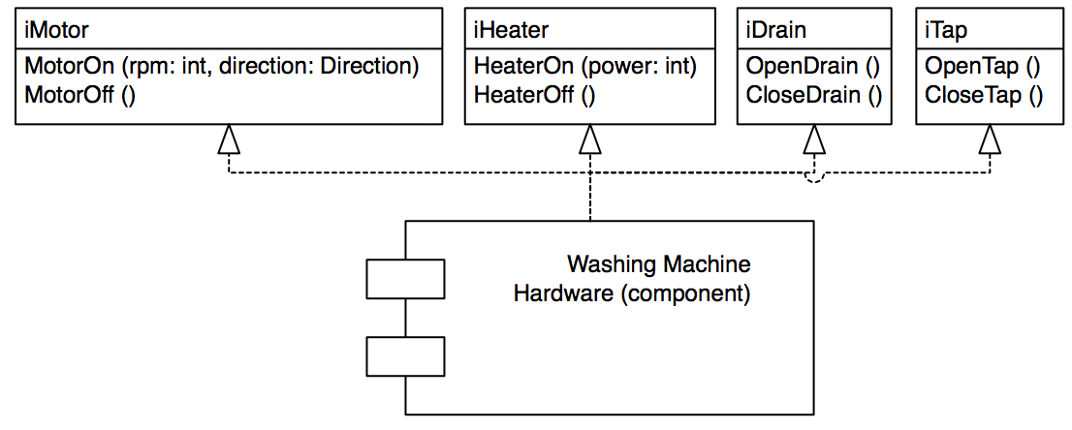
Better example
Notes:
Small interfaces that only provide one function

Slide 20
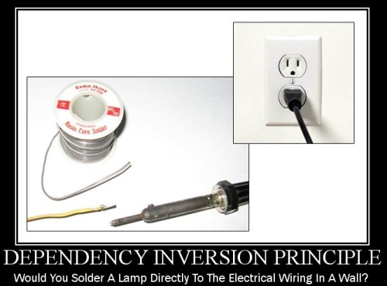
Dependency inversion principle
SOLID

Slide 21
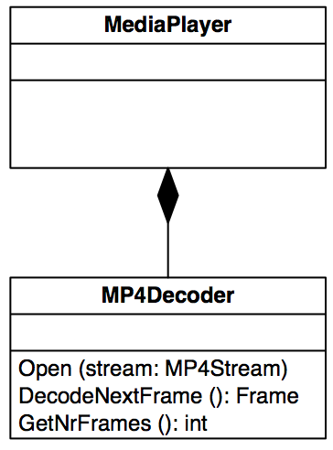
Work with interchangeable modules
Do not create hard dependencies between swappable items
Bad example:
Good example: HAL!
Notes:
Bad example because you might want to use other decoders beside MP4.

Slide 22
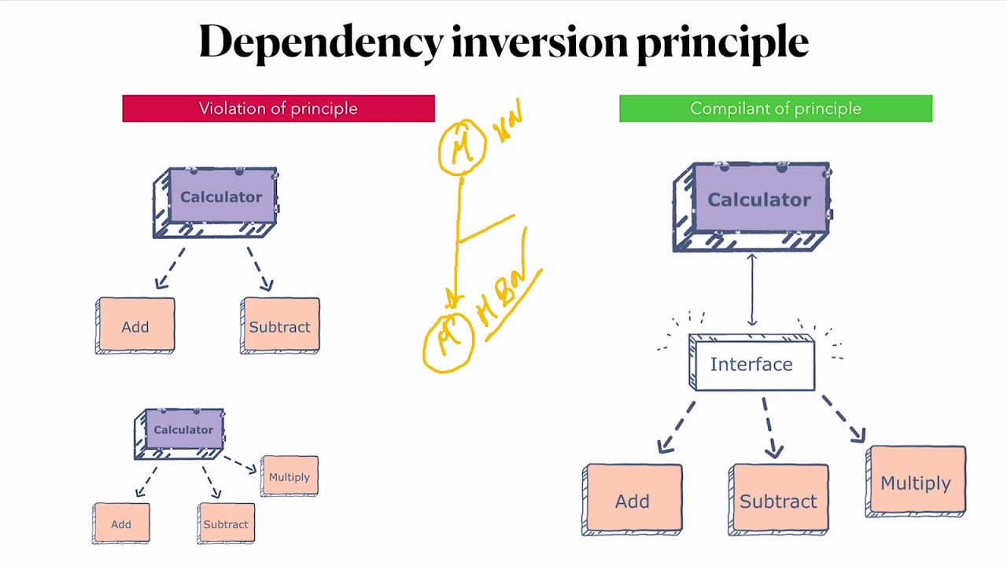

Slide 24
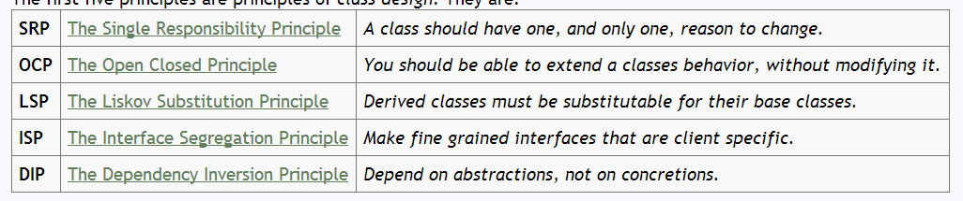
Reading:
Interface Segregation Principle
Robert C. Martin,The Interface Segregation Principle
How-I-explained-OOD-to-my-wife

