Slide 1



Design Workshop Hardware Abstraction

Slide 2
Hardware abstraction
Hardware independent design

Slide 3
Hardware Abstraction
Imagine a simple Arduino program

Slide 4
HIGH level and LOW level stuff in a program
Up until now: loop() does everything:
high level algorithm, and
low level details
Advantages?
Disadvantages?

Slide 5
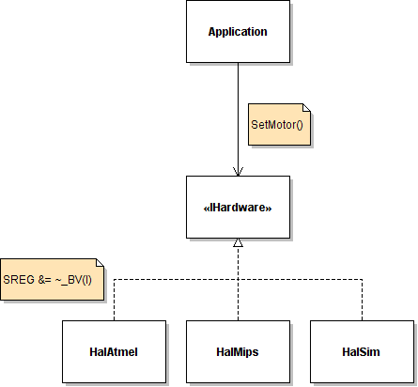
Better approach: split in layers
-abilities ?
portability
readability
testability
separation of concern
Notes:
separation of concern: use specialists for the various tasks
IHardware implemented in various classes; when running a system you take one of the implementations
calling SetMotor results in an operation when we take the microcontroller “HAL” application (HalAtmel)

Slide 6
Interface
An interface is a collection of operations that have no corresponding method implementations
Think of an interface as a very simple contract that declares, “These are the operations that must be implemented by classes that intend to meet this contract.”

Slide 7
Introducing HAL
HAL: Hardware Abstraction Layer
Rules / design principles:
higher layer doesn't know how lowel level is implemented (but knows how to USE it)
lower layer (HAL) doesn't know what it's used for
Notes:
The word Abstraction is important: if you simply define an interface based on what your hardware *can* do you have a hardware layer.
Abstraction means that you define the interface(s) from what the higher layer needs.

Slide 8
Advantages? Disadvantages?
Small disadvantage: you need to create interfaces
Advantages:
those interfaces make higher classes easier to (unit)test (explained in next part)
you program against functionality rather than specific implementation
easier to replace hardware

Slide 9
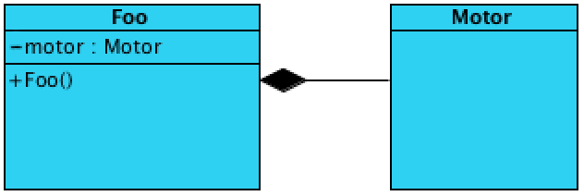
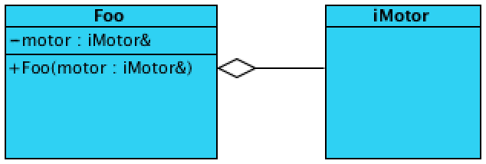
Dependency injection
Foo depends on Motor
Disadvantage for testing?
How about this?

Slide 10
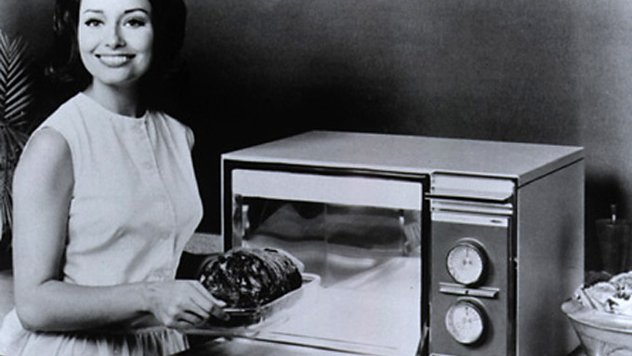
Case study: microwave

Slide 11
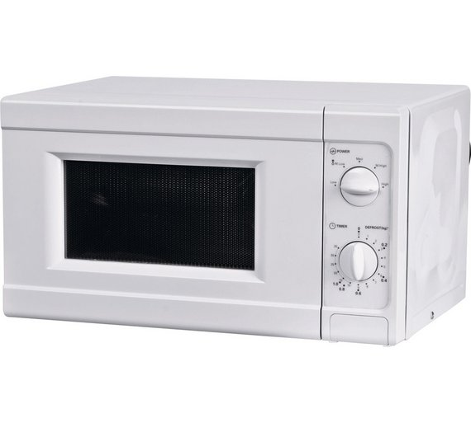
External interface
Power dial
Mechanical clock dial
Door open button
What events do we have?
assume you get a ‘start’ and ‘time up’ event from the mechanical clock
what else?

Slide 12
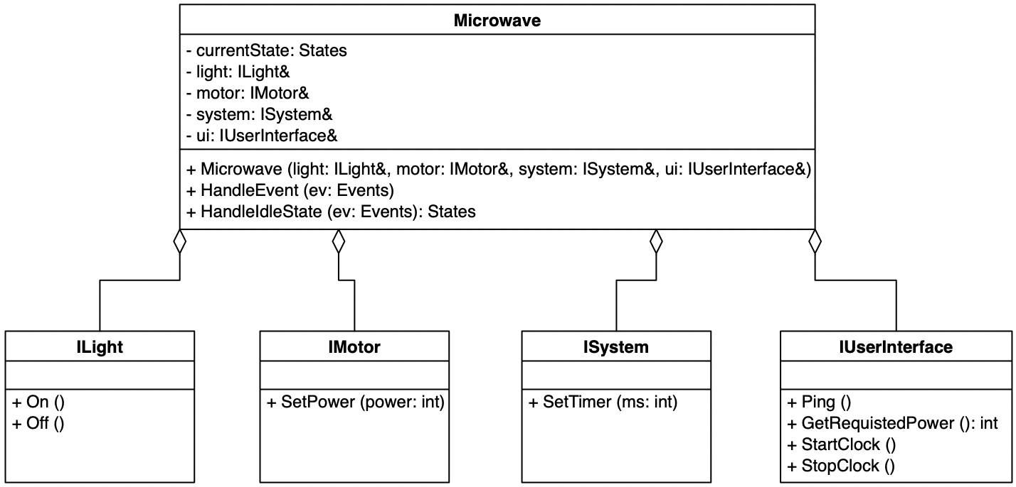
HAL + State class

Slide 13
Responsibilities
Microwave class: implements state behaviour
Constructor: remembers implementations for required interfaces and sets initial state
HandleEvent: runs the state machine, is called each time an event occurs
HandleIdleState: is ran by HandleEvent when IdleState is acive, it returns the next state (or IdleState if no state change occurs) Note: after making the state diagram, other Handle…State methods are added
ILight interface
On: switches the light in the microwave on
Off: switches the light in the microwave off
IMotor interface
SetPower(power: int): sets the microwave engine to the required power, 0 switches the engine off
ISystem interface*
SetTimer(ms: int): enables a timer for ms miliseconds, when the timer fires the TIME_UP event is given
IUserInterface interface
Ping(): gives a subtle beeping sound
GetRequestedPower(): int: returns the power dialed in by the user
StartClock: enables the time dial to slowly turn back to 0
StopClock: stops the time dial
*) ISystem is not necessarily needed. It’s there if you want to do things like:
when leaving the door opened for 2 minutes, the light switches off

Slide 14
Construction of Microwave object (more about this later in SD )
Normal situation:
Light light(...);
Motor motor(...);
System system(...);
UserInterface ui(...);
Microwave mw(light, motor, system, ui)
Test situation:
MLight light(...);
MMotor motor(...);
MSystem system(...);
MUserInterface ui(...);
Microwave mw(light, motor, system, ui)
A mock is an automated, fake implementation of an interface
(the ’M’ prefix indicates it’s a mock: MLight implements ILight, etc.)

