Slide 1

Multithreading in C++
Short Intro

Slide 2
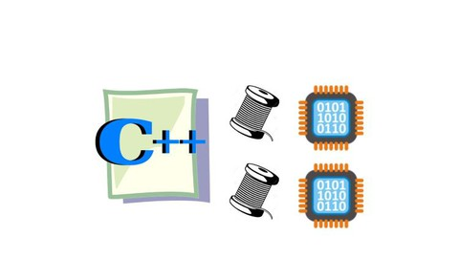
Multithreading and Concurrency
Programs are getting more complex, computers being designed with more CPUs -> need to run (part of) programs at the same time

Slide 3
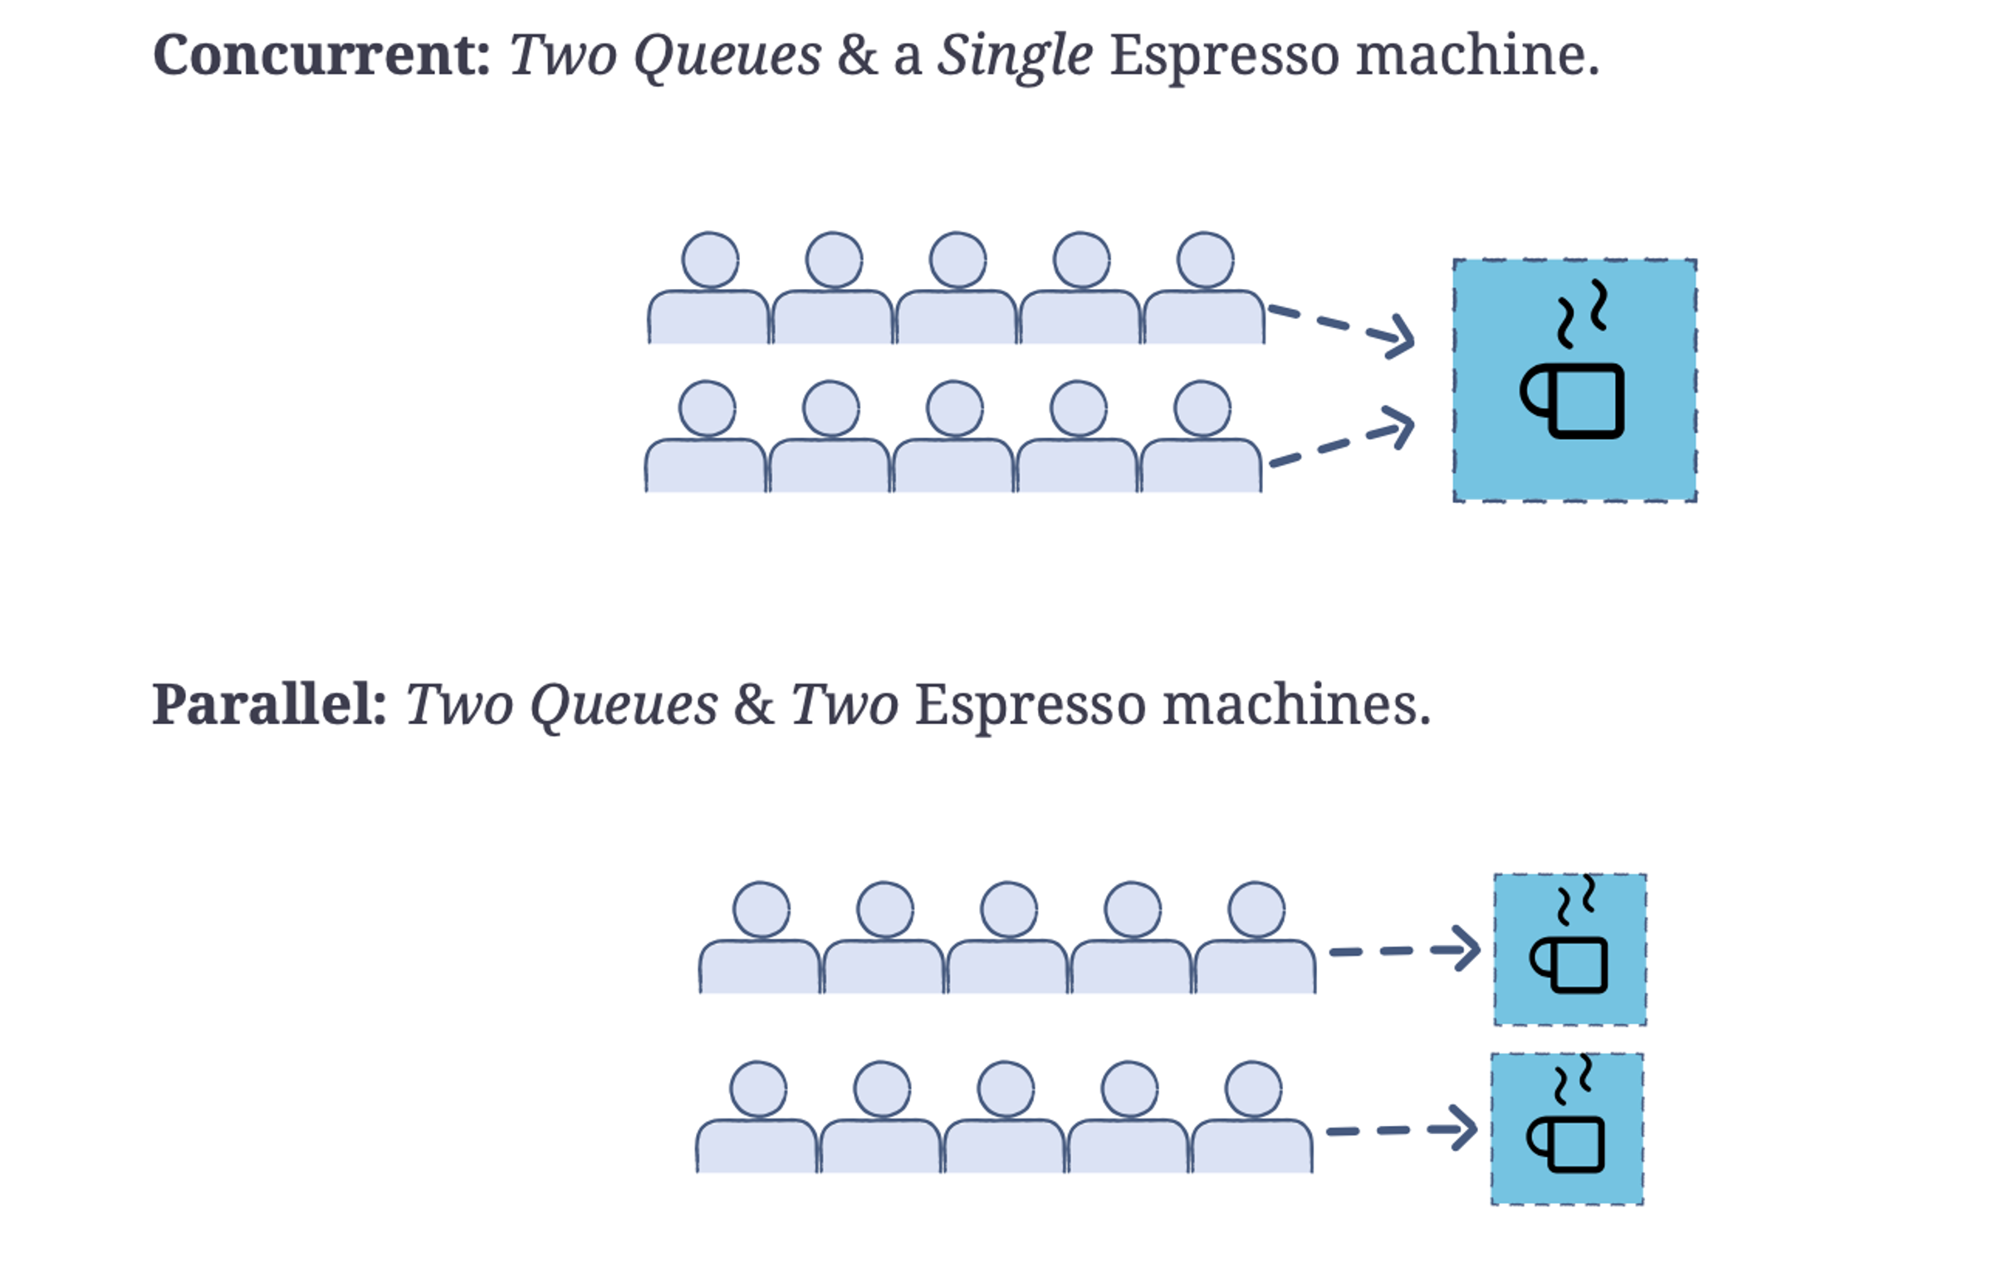
Concurrency vs Parallelism
Concurrency: multiple programs running at the same time on shared data
Parallelism: multiple programs running at the same time with different data
Image from EdPresso shot, "What is concurrent programming?"

Slide 4
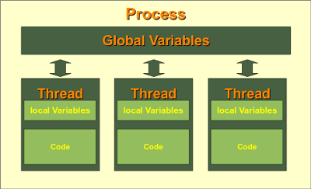
Process vs Thread
Process is any program in execution. It is collection of code, data, memory and other resources.
Thread is an execution unit that is a part of process. A process can have multiple threads, all executing at the same time

Slide 5
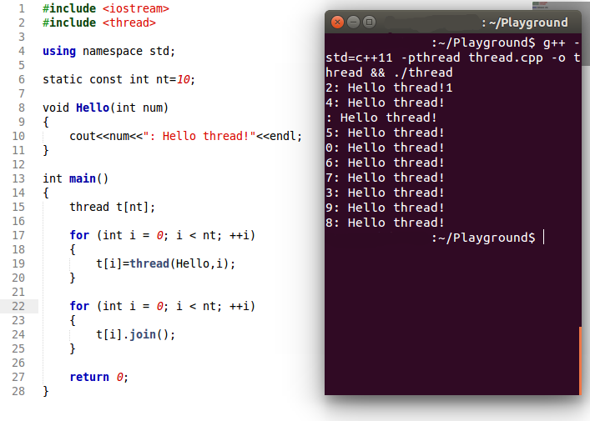
C++ Multithreading
C++ multithreading involves creating and using thread objects, seen as std::thread in code, to carry out delegated sub-tasks independently.
Upon creation, threads are passed a function to complete, and optionally some parameters for that function.
https://www.educative.io/blog/modern-multithreading-and-concurrency-in-cpp

Slide 6
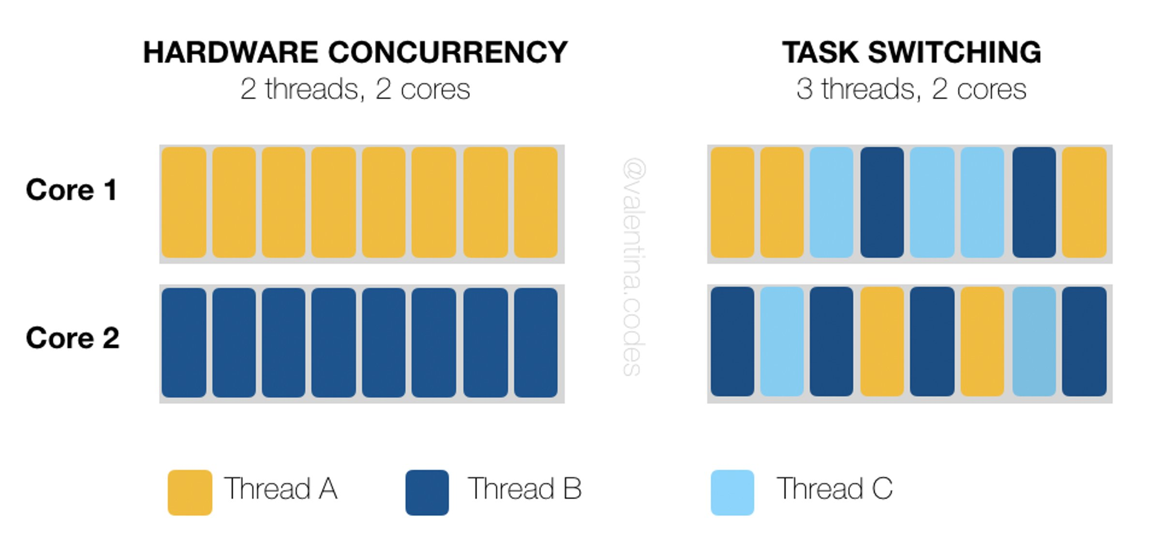
C++ Multithreading
While each individual thread can complete only one function at a time, thread pools allow us to recycle and reuse thread objects to give programs the illusion of unlimited multitasking.

Slide 7
C++ Multithreading : Shared Data
More threads can read and write to the same shared memory, synchronization is necessary to avoid “data-race”, so undefined behavior

Slide 8
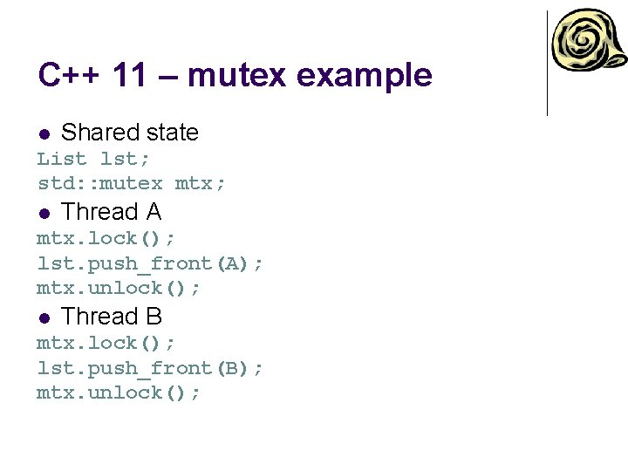
Thread Synchronisation: mutex
Mutex is one of the most common mechanisms for solving data race
You’ll learn more about it in freeRTOS lessons

Slide 9
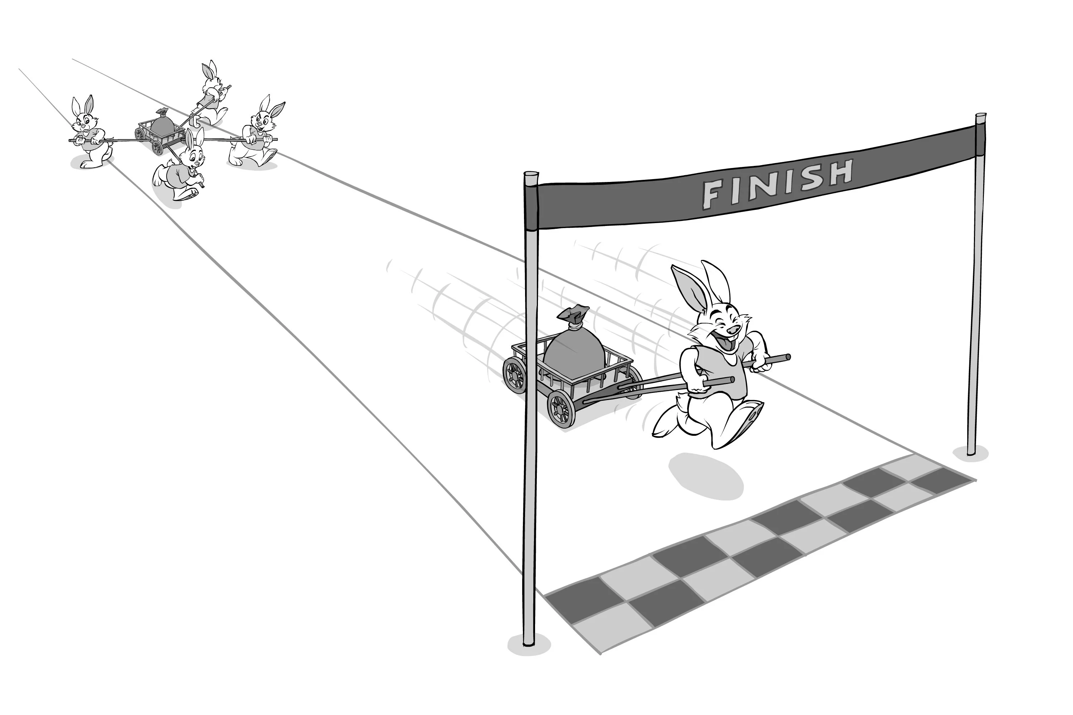
Multithreading: not always the best way to go
Be critical when using multithreading
Which situations can you think of when multithreading could be useful?

