Slide 1
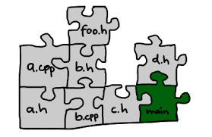
C/C++ Build, Makefiles
Part 1 : Build Process
t-sem3-cb/sd/workshops/buildAndMake

Slide 2
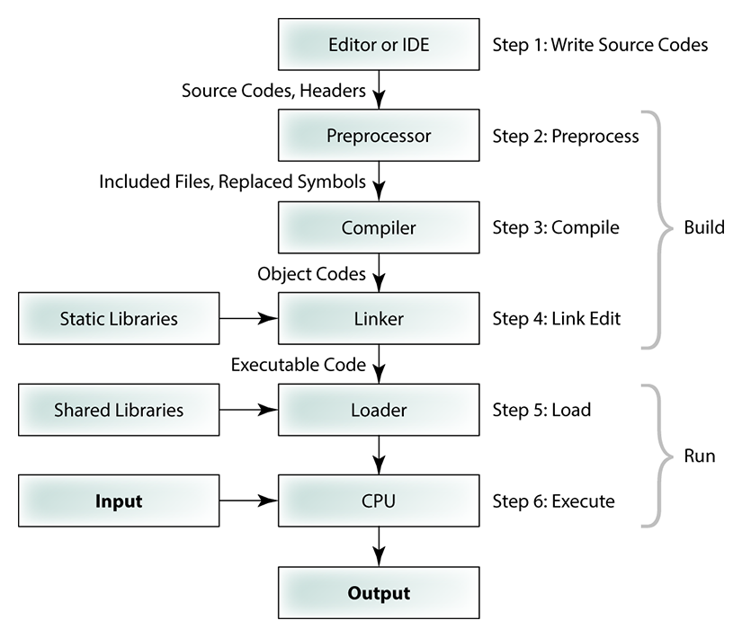
https://tibbo.com/linux/native-c.html

Slide 4
Preprocessor
Processes preprocessor commands that begin with #
Usually substitutes the text from # directive

Slide 5
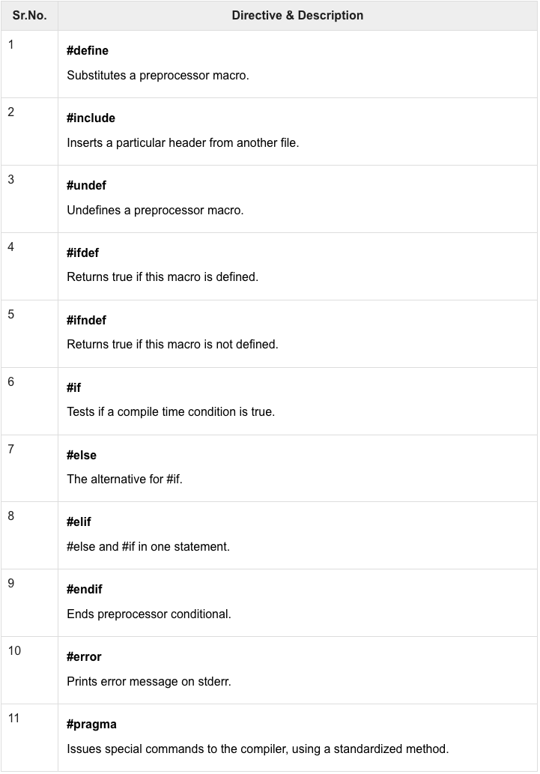
Preprocessor
https://www.tutorialspoint.com/cprogramming/c_preprocessors.htm

Slide 6
Preprocessor: Try it Out!
Go to preprocessor directory and study the example main.c file
Run preprocessor by issuing:
gcc –E main.c or just cpp main.c
You can catch and study the output by using >:
gcc –E main.c > out
Now pass the value of variable DEBUG by issuing:
gcc –E –DDEBUG main.c > out
What’s the difference?
How to get the last printf to be taken in the build too?

Slide 8
Compiler
Takes preprocessed input
Checks the syntax of your program
Creates machine code : .o files

Slide 9
Compiler: Try it Out!
Go to compiler directory
Run compiler by issuing:
gcc main.c
and look at what happens.
Fix the code and rebuild
Remove #pragma once from header.h:
What happened? Why?
Run compiler by issuing:
gcc file.c
and look at what happens. Is there a problem? What problem?

Slide 10
Compiler: Try it Out!
Rerun compiler by issuing:
gcc –c file.c
and look what happens.
What’s the difference with gcc file.c command?

Slide 12
Linker
Creates final executable by assembling static libraries and .o files
Static library – collection of .o files, normally in Linux in a .a file.
compile
file1.c
file1.o
link
file2.c
file2.o
a.out
file3.c
file3.o
lib1.a
file4.c
file4.o
archive

Slide 13
Linker: Try it Out!
Go to linker directory and study the files.
Run compiler by issuing:
gcc main.c
and look at what happens.
Rerun compiler by issuing:
gcc –c main.c file1.c file2.c file3.c
to get .o files
Let’s link all together to a new executable:
gcc –o my_exe file1.o file2.o file3.o main.o
You can also just specify .c files and gcc will build it for you 😉

Slide 14
Linker: Try it Out!
Let’s have a look at static library, issue:
ar r libfiles.a file1.o file2.o file3.o
to use archiver to create a static library.
Tip: run nm command to see what’s inside your library
nm libfiles.a
Rerun linker by issuing:
gcc –o my_exe2 main.o libfiles.a
and run your executable.
Now, change something in printf in the file1.c, file2.c and file3.c files and rebuild executable with libfiles.a again.
Can you see your printf changes?

Slide 15
Linker and prototypes/declarations
Run compiler again by issuing:
gcc –c main.c
and look at what happens.
How to get rid of the warnings?

