Slide 1
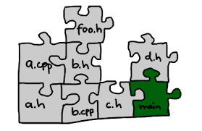
C/C++ Build, Makefiles
Part 2 : Makefiles
t-sem3-cb/sd/workshops/buildAndMake

Slide 2
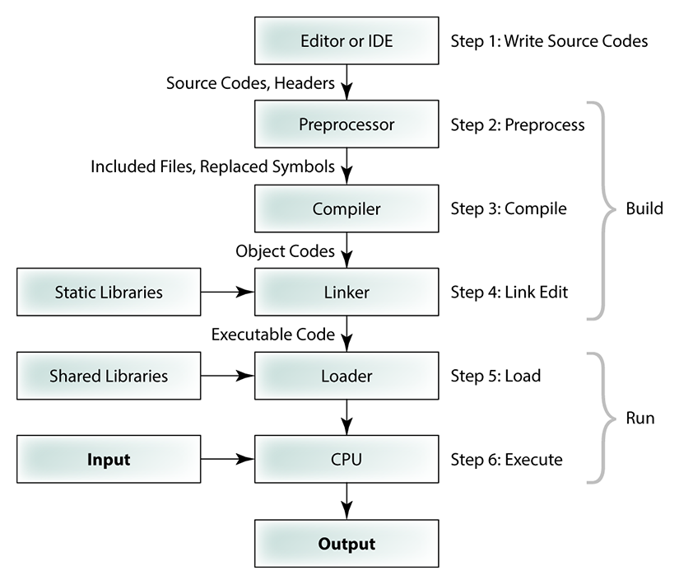
https://tibbo.com/linux/native-c.html

Slide 3
Make/Makefile
Is there to make your life easier, you create a recipe how to cook and make cooks it for you
Another very important feature: make keeps track of the changes in your files and only builds what’s necessary (if your Makefile is correct of course)
You can share the make environment with other people

Slide 4
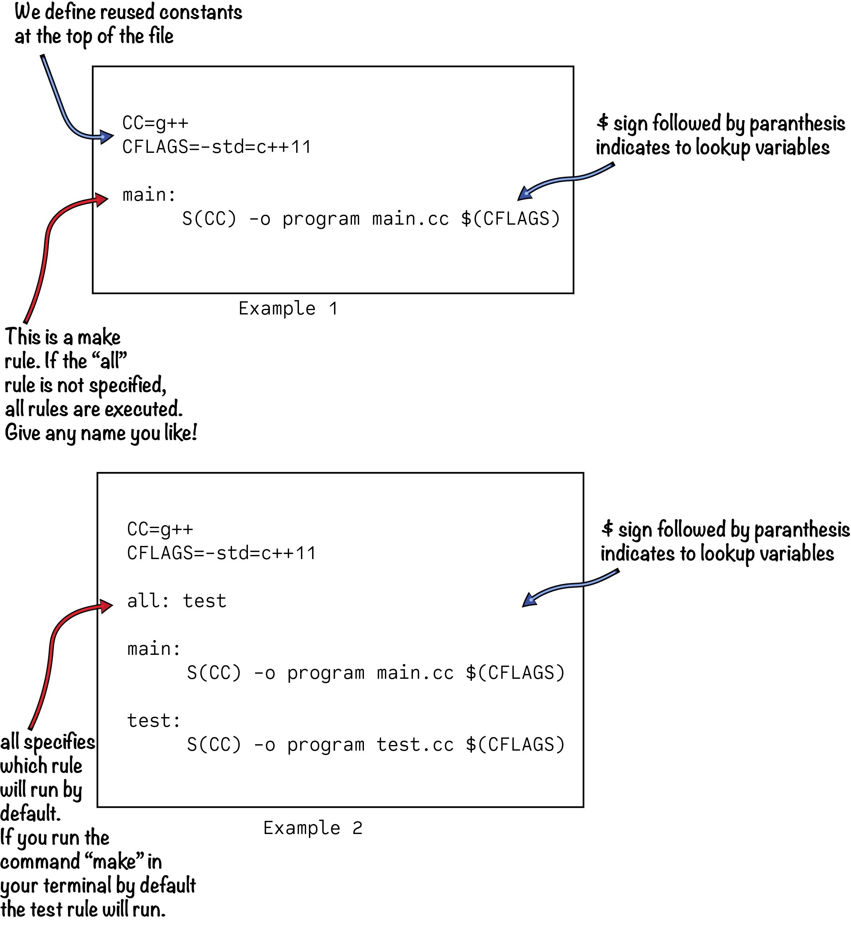
Makefile
tabs
https://malithjayaweera.com/2020/05/create-makefile/

Slide 5
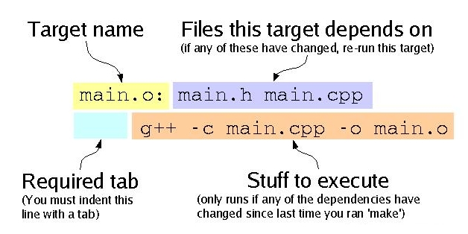
Makefile Rule

Slide 6
Makefile
Go to makefiles directory
Create a Makefile to create a program executable very similarly to the first Makefile from the previous example (it should use gcc compiler and compile C main.c file instead of C++ main.cc). For the CC_FLAGS choose –g to be able to debug it later on. Run it:
make
and run your executable.

Slide 7
Makefile
Extend your makefile so that you create program by compiling main_extended.c file1.c file2.c file3.c.
make
and run your executable.

Slide 8
Variables
Define SOURCES variables and use it in the rules
SOURCES will contain all C files necessary for the build

Slide 9
Makefile: Automatic variables
$@ : target of the rule
$< : the first dependency
$ˆ : all dependencies
$? : all of the dependencies that are newer than the target
And many more: https://www.gnu.org/software/make/manual/html_node/Automatic-Variables.html

Slide 10
Makefile:Example automatic variables
program: file1.o file2.o file3.o
$(CC) $(CCFLAGS) –o $@ $ˆ
Or
SOURCES = file1.c file2.c file3.c
program : $(SOURCES:.c=.o)
$(CC) $(CCFLAGS) –o $@ $ˆ
Or just
SOURCES = file1.c file2.c file3.c
program : $(SOURCES)
$(CC) $(CCFLAGS) –o $@ $ˆ

Slide 11
Makefile exercises
Extend your makefile so that you create target library libfiles.a
Use your knowledge from the previous examples and maybe even automatic variables.
Try to effect/change several .c files by using Linux touch command and rebuild. Is everything being rebuilt? Are your dependencies correct?

Slide 12
Makefile exercise
Use your previously created target library to create program executable, similarly to the linker exercise
And now, last but not least: create clean target that will remove all .o, .a and executable files

