Slide 1

Debugging
GDB
t-sem3-cb/-/tree/master/sd/workshops/gdb
R. Frenken
13-2-2023

Slide 2
Debugger/GDB
Very popular for embedded/C/C++
Let you inspect what happens during execution of the program
Very useful for problems with dynamic memory allocation/pointers
Very useful to better understand coding
Another tool next to unit tests that helps you detect erros

Slide 3
How to prepare your code
Use -g compilation flag to include symbols (you can also use makefile, it will create demo executable)
E.g.
gcc -g a.c

Slide 4
How to run gdb
Just run it with your binary executable file (not shell script!)
E.g.
gdb ./a.out
gdb ./demo

Slide 5
The most important commands
start
run (r)
break (b)
print (p)
next (n)
step (s)
quit (q)
help

Slide 6
Let’s try the commands on your own!
Go to example1 and try to run gdb and above mentioned commands
Inspect the program
Now try to replace the above range of the second “for” loop from m to n. What happens? Is your program still correct? If not, can you debug it and see what happens?

Slide 7
Debugging run-time problems
Help! My program “hangs”. Run it in gdb, use CTRL C to stop it and look where it is.
If you don’t see any useful info, use “up” and “down” commands to walk through the stack of your commands
Go to example2, this should have infinite loop
Try to stop it, debug it and use commands:
up, down, bt (backtrace)

Slide 8
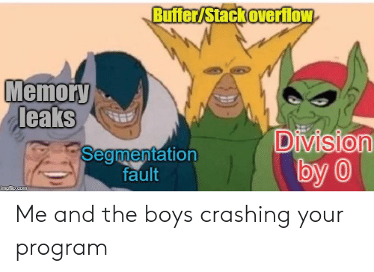
Debugging run-time problems (2)
If your program crashes, load it in the debugger, it’s most probably going to halt in the place the crash occurs. Use up/down commands and try to find an error

Slide 9

Let’s try some “crash” debugging
Go to example3 and try to use gdb to find programming errors
Good luck!

