Slide 1
Social-Listening
Tổng Công ty Truyền thông
Công ty Phát triển Phần mềm VNPT-Media
TÌM HIỂU VỀ Elasticsearch Framework
Trình bày: Dương Văn Ba
Chức vụ, Đơn vị công tác: Phòng Phần mềm DV CNTT
Hà Nội, ngày 15 tháng 3 năm 2020

Slide 2
NỘI DUNG
1
Elasticsearch LÀ GÌ?
2
CÀI ĐẶT Elasticsearch
3
So sánh Elasticsearch với các cơ sở dữ liệu quan hệ
4
CÁC KHÁI NIỆM TRONG Elasticsearch
5
Demo thao tác với Elasticsearch

Slide 3

1
Elasticsearch là gì?
Elasticsearch is a real-time distributed and open source full-text search and analytics engine.
It is used in Single Page Application (SPA) projects.
Elasticsearch is an Apache Lucene-based search server.
Its latest version is 7.6.1.

Slide 4

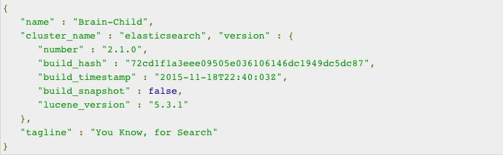
2
Cài đặt Elasticsearch
Check the version of java installed on your computer. It should be java 7 or higher.
Link download: https://www.elastic.co/downloads/elasticsearch
Go to the Elasticsearch home directory and inside the bin folder.
You can check if the server is up and running by browsing http://localhost:9200.

Slide 5
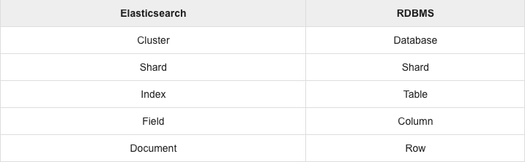
3
So sánh Elasticsearch với RDBMS
In Elasticsearch, index is similar to tables in RDBMS (Relation Database Management System). Every table is a collection of rows just as every index is a collection of documents in Elasticsearch.
The following table gives a direct comparison between these terms

Slide 6
3
So sánh Elasticsearch với RDBMS
Advantages
Disadvantages

Slide 7
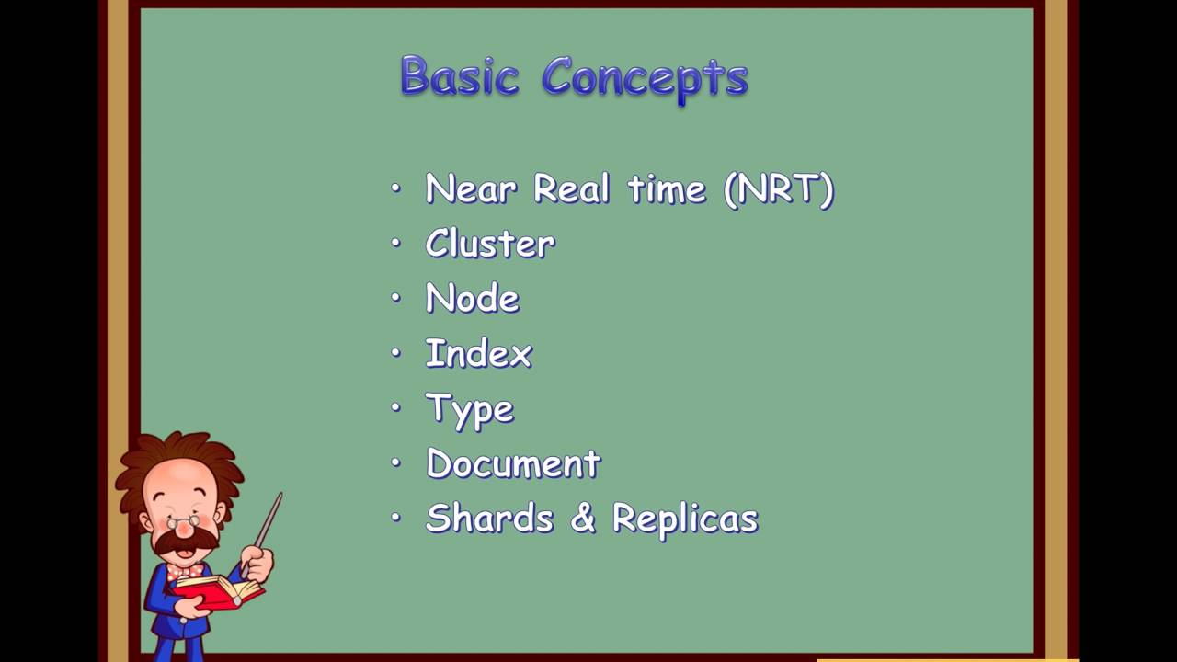
4
Elasticsearch - Basic Concepts
Document
Index
Node
Cluster
Shards
Inverted index

Slide 8
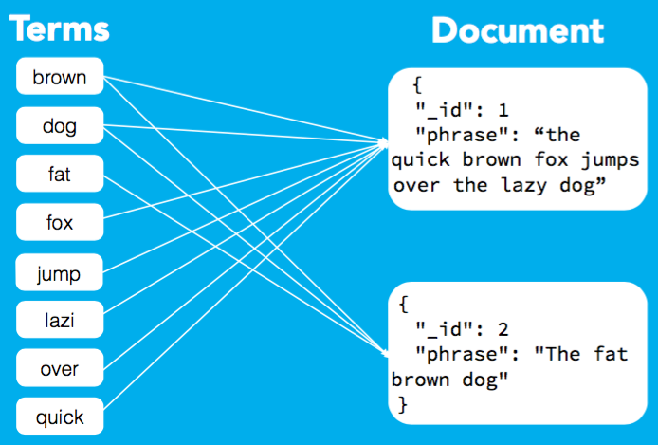
4.1
Document in Elasticsearch
A document is a basic unit of information that can be indexed.
It is a collection of fields in a specific manner defined in JSON format. Every document belongs to a type and resides inside an index. Every document is associated with a unique identifier called the UID.
Within an index, you can store as many documents as you want.

Slide 9
4.2
Index in Elasticsearch
An index is a collection ofdocuments that have somewhat similar characteristics.
For example, you can have an index for customer data, another index for a product catalog, and yet another index for order data.

Slide 10
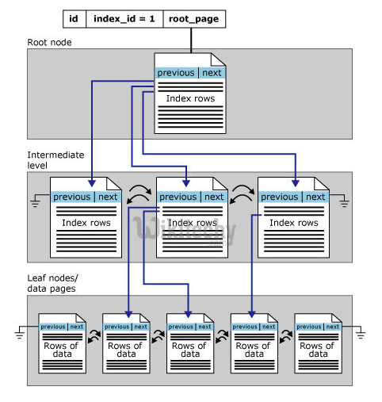
4.3
Node in Elasticsearch
A node is a single server that is part of your cluster, stores your data, and participates in the cluster’s indexing and search capabilities..

Slide 11
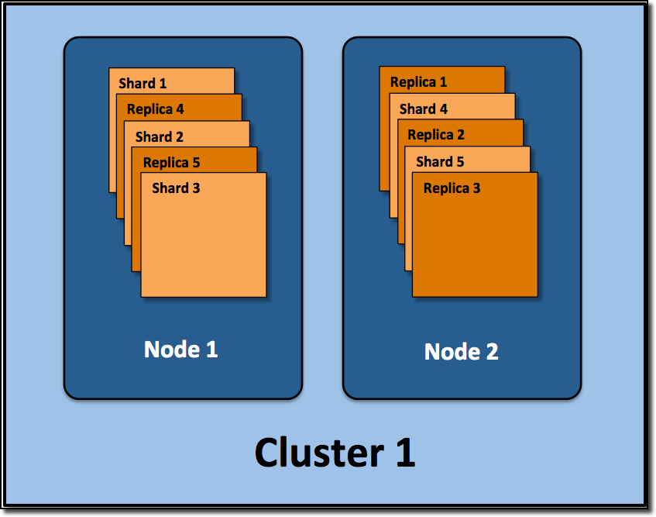
4.4
Cluster in Elasticsearch
It is a collection of one or more nodes. Cluster provides collective indexing and search capabilities across all the nodes for entire data.

Slide 12
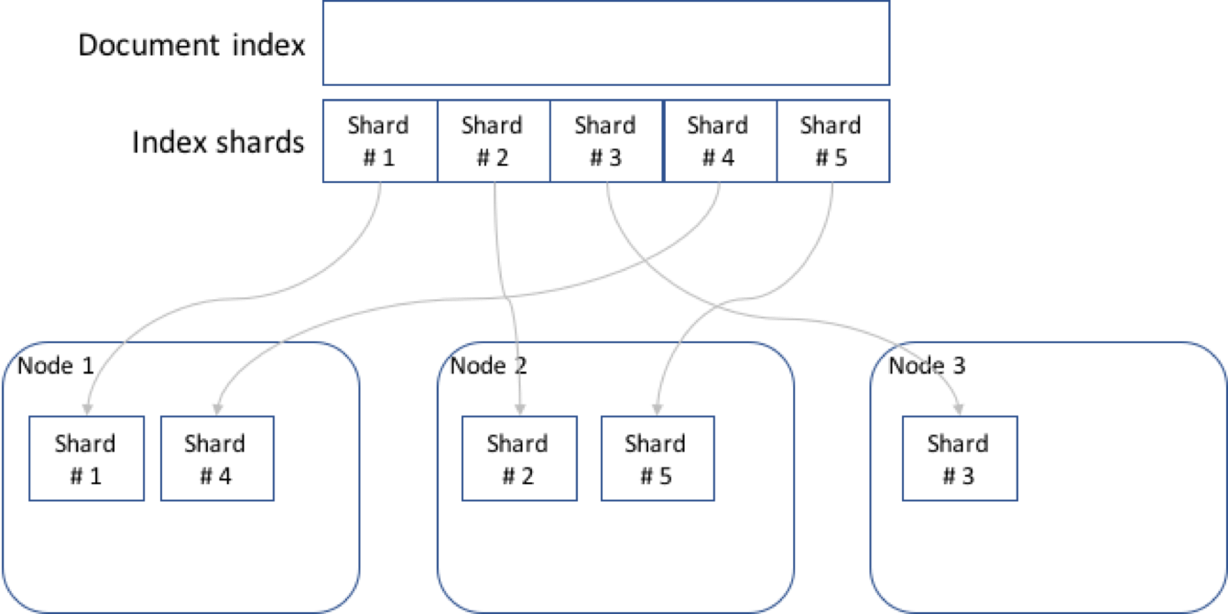
4.5
Shards in Elasticsearch
Indexes are horizontally subdivided into shards. This means each shard contains all the properties of document but contains less number of JSON objects than index

Slide 13
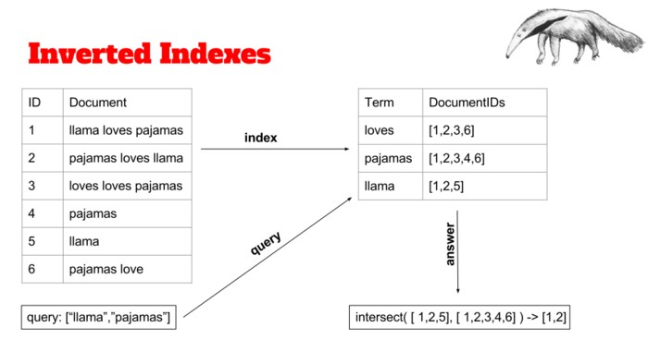
4.6
Inverted index in Elasticsearch
Elasticsearch uses a special data structure called "Inverted index" for very fast full-text searches. An inverted index consists of a list of all the unique words that appear in any document, and for each word, a list of the documents in which it appears.

Slide 14
5
Demo thao tác với Elasticsearch

Slide 15


