Slide 1
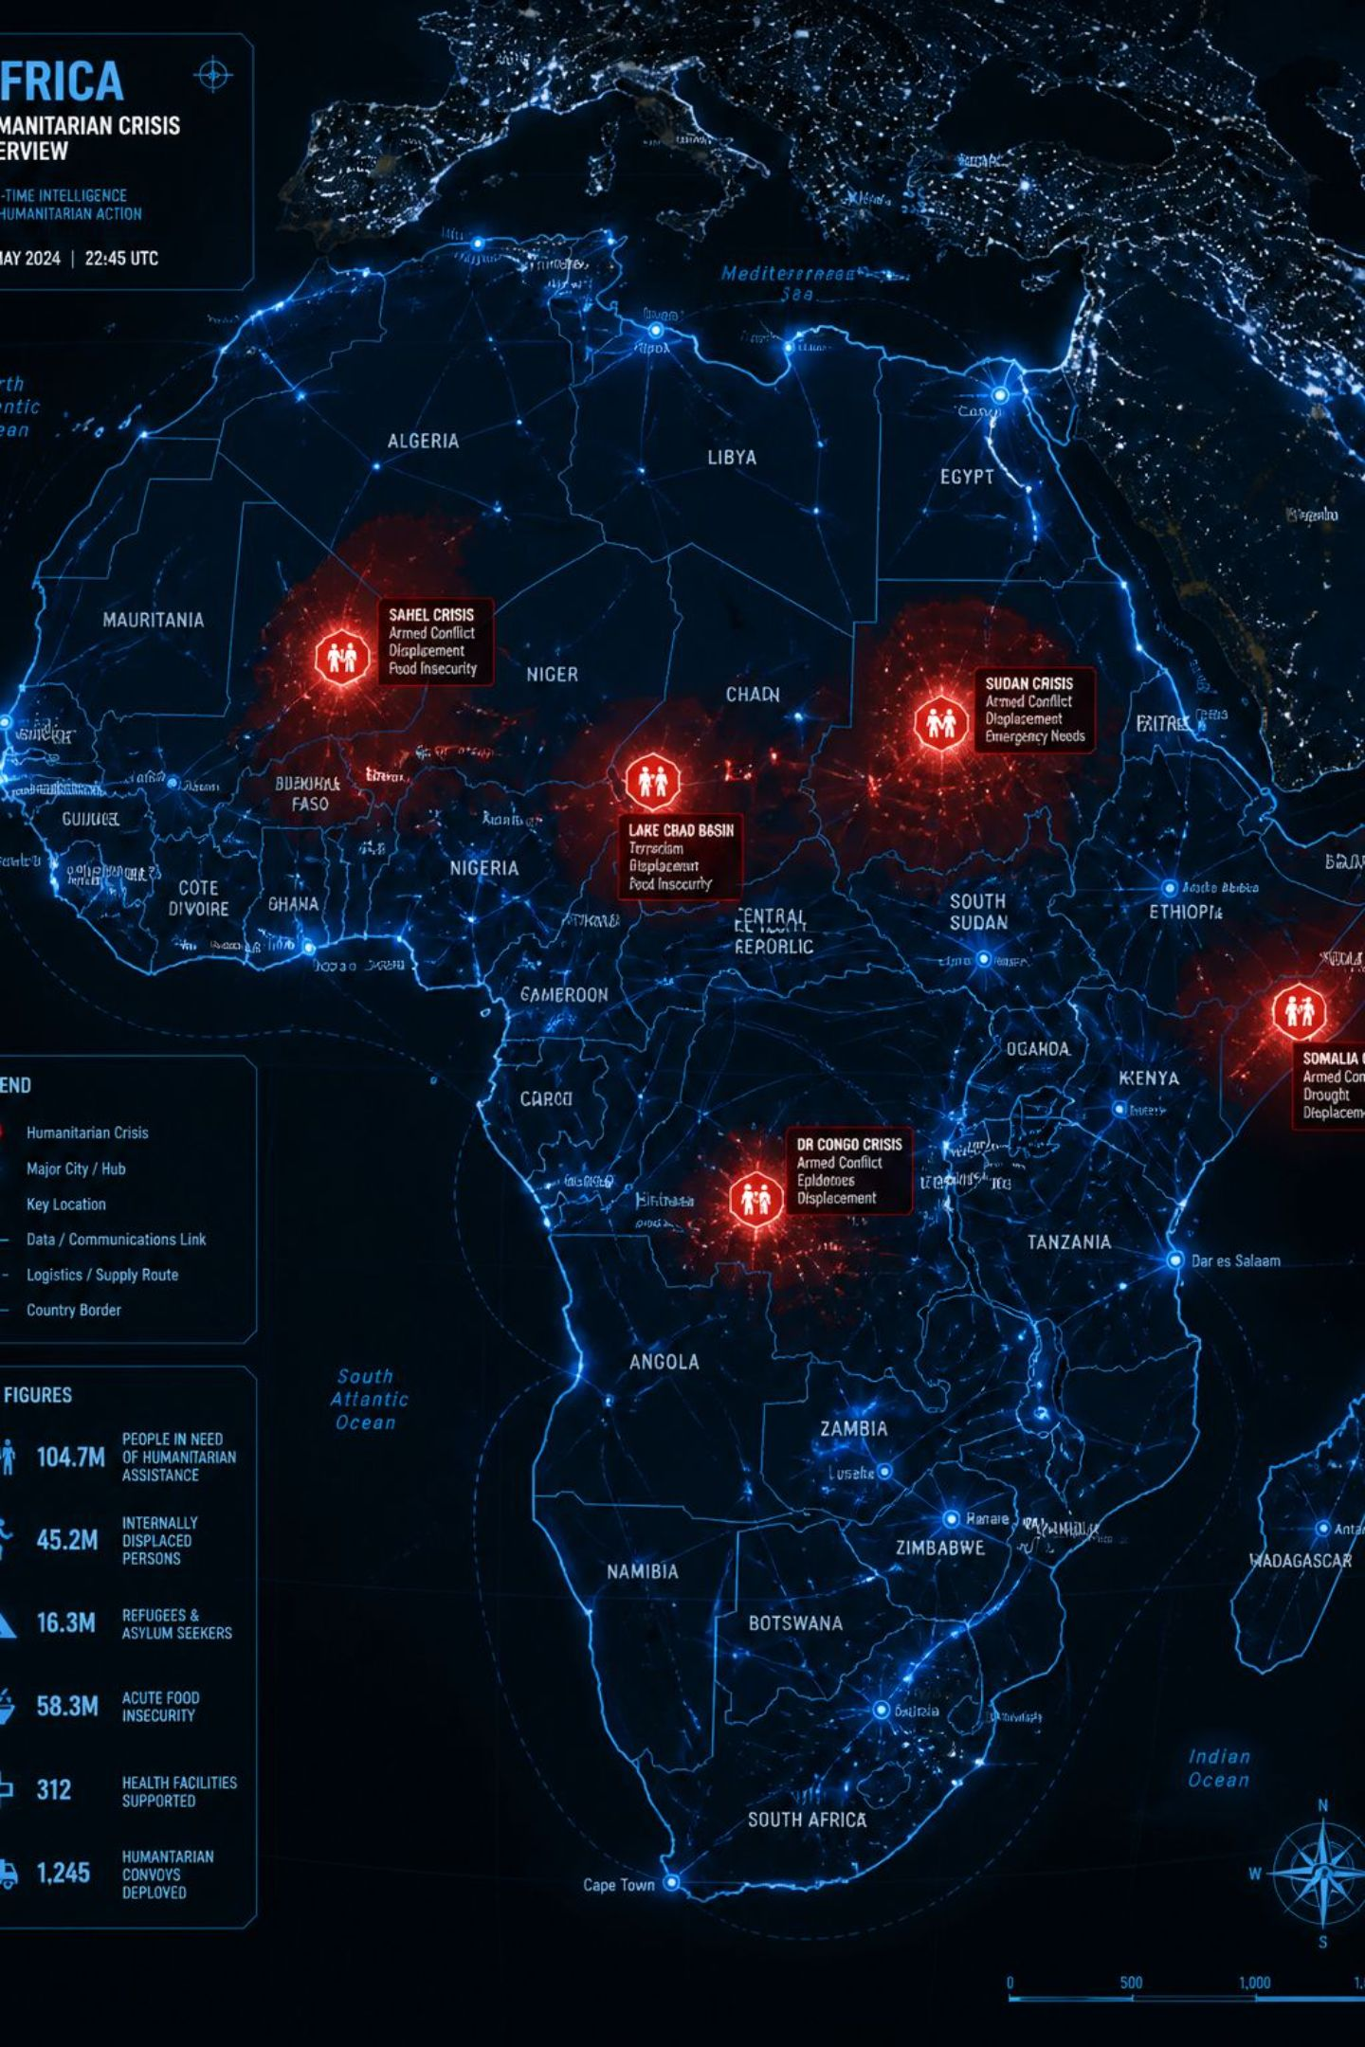
Humanitarian Data Ontology
A conceptual blueprint for building an Admin 2 × Month humanitarian data panel that preserves the provenance and meaning of each data source — linking conflict, climate, markets, and humanitarian reporting to food insecurity outcomes.
RESEARCH FRAMEWORK
ONTOLOGY DESIGN
ADMIN 2 × MONTH PANEL

Slide 2
This Week's Action Plan
Six prioritized tasks to complete the core humanitarian data panel prototype without waiting for the full ten-year, four-country pipeline.
Build One Prototype
1
Create an end-to-end Admin 2/month integrated table for one country-year using core sources: IPC, ACLED, CHIRPS, WFP prices, and ReliefWeb. Include GDELT only if the pipeline makes it easy.
2
Finalize the Ontology
Limit to four mechanisms: conflict, climate/agriculture, markets, and humanitarian reporting. Define no more than 3–5 features per mechanism.
3
Feature Specifications
For every feature, document: raw variable, source, spatial assignment rule, temporal aggregation rule, mathematical formulation, missing-value policy, and provenance/uncertainty flag.
4
Quantify Data Quality
Report: district-month coverage, missingness by source, proportion of exact vs. approximate geolocation, temporal availability, and duplicate or conflicting observations.
5
Select a Scientific Question
Preferably: "Do different humanitarian sources provide complementary or redundant observations of the same crisis mechanisms?"
6
Remove Non-Essential Sources
Place World Bank, IMF, and ICEWS in an optional extension list. They should not block completion of the core panel.

Slide 3
Ontology: Seven-Level Architecture
The main challenge is that each humanitarian dataset is built differently. They use different collection methods, spatial resolutions, and time scales. Because of that, we can't simply merge them together. The ontology provides a common framework that defines how each dataset is transformed into comparable features before everything is combined into a single integrated dataset.
01
02
03
Outcome of Interest
Humanitarian Mechanisms
Observation Sources
Food insecurity (IPC)
Conflict, climate, markets, reporting
ACLED, CHIRPS, WFP, ReliefWeb, VHI
04
05
06
Raw Variables
Transformation Rules
Engineered Features
Extracted fields per source
Spatial and temporal processing
Final indicators per mechanism
07
Integrated Data Panel
Admin 2 × Month unified dataset

Slide 4
Level 1: Outcome of Interest
Food Insecurity
Conceptual Distinction
The main outcome of interest is food insecurity, represented using the Integrated Food Security Phase Classification (IPC) — an internationally recognized framework classifying severity into five phases, from minimal (Phase 1) to catastrophe or famine (Phase 5).
Within the ontology, IPC is treated differently from all other datasets: it serves as the reference outcome, not an explanatory feature.
By placing food insecurity at the highest level, the ontology draws a clear distinction between the outcome variable and the explanatory variables derived from conflict, climate, markets, and humanitarian reporting datasets.
The remaining mechanisms may be associated with food insecurity but are not direct measurements of IPC classification

Slide 5




Level 2: Four Humanitarian Mechanisms
Each mechanism captures a distinct dimension of the humanitarian environment, avoiding the assumption that all datasets measure the same phenomenon.
Conflict & Insecurity
Climate & Agricultural Stress
Armed conflict, political violence, and insecurity disrupting agricultural production, displacing communities, interrupting supply chains, and restricting humanitarian access.
Environmental conditions — rainfall variability, droughts, and climate events — reducing crop yields, affecting livestock, and increasing food insecurity risk.
Market & Food Price Pressure
Humanitarian Reporting & Response
Rising food prices, market disruptions, and reduced market access limiting household purchasing power and increasing vulnerability to food insecurity.
Level of humanitarian activity and reporting associated with a crisis, providing context on severity and location — though reporting intensity is not a direct measure of need.

Slide 6
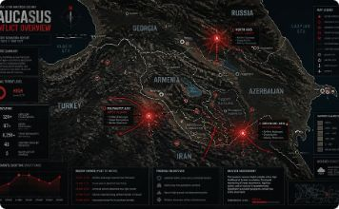
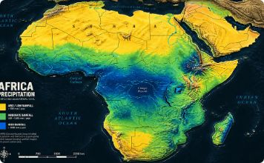
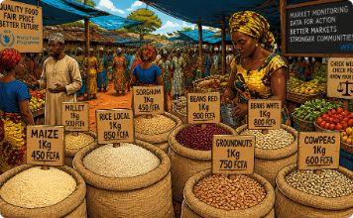

Level 3: Observation Sources
Mechanisms cannot be observed directly — they are represented through complementary datasets, each with its own collection methods, spatial resolution, and temporal frequency.
ACLED
CHIRPS
WFP Food Prices
ReliefWeb
Conflict & Insecurity — Records conflict events, political violence, protests, and fatalities. GDELT is an optional future extension for media-reported global news coverage.
Climate & Agricultural Stress — Satellite-derived rainfall estimates for assessing rainfall variability and potential agricultural stress.
Market & Food Price Pressure — Market-level prices for staple commodities, monitoring changes in food affordability and market conditions.
Humanitarian Reporting — Aggregates reports from governments, NGOs, and UN agencies on ongoing crises and humanitarian activities.

Slide 7


Vegetation Health Index (VHI)
The Vegetation Health Index (VHI) assesses vegetation health using satellite measurements of surface temperature and greenness.
It combines the Vegetation Condition Index (VCI), reflecting vegetation greenness, and the Temperature Condition Index (TCI), reflecting temperature. Low VHI values typically indicate vegetation stress, often linked to drought conditions.
VHI serves as an early indicator for potential agricultural stress and food insecurity, offering vital insights in climate-vulnerable regions.

Slide 8


Level 4: Transformation Rules
All raw data is processed to a common Admin 2 × Month spatial-temporal framework.
Conflict (ACLED)
Climate (CHIRPS & VHI)
Conflict events are assigned to Admin2 areas using their coordinates. Events are then grouped by month, allowing us to calculate the number of each event type, total fatalities, and conflict density for every district.
Monthly rainfall and vegetation data are overlaid with Admin2 boundaries. We then calculate summary statistics, such as average rainfall and average vegetation health, for each district. Since both datasets are already monthly, no additional time aggregation is needed.
Markets (WFP VAM)
Reporting (ReliefWeb)
Market observations are assigned to Admin2 areas using their coordinates. Prices are averaged by commodity and month, while keeping each commodity separate to reflect local food consumption patterns across countries.
ReliefWeb reports are grouped by country and month. Since most reports do not provide reliable Admin2 locations, reporting indicators are calculated at the country level rather than for individual districts.

Slide 9

Level 5: Raw Variables
Each source contributes specific raw variables extracted for feature engineering.
Mechanism
Source
Key Raw Variables
Conflict & Insecurity
ACLED
event_date, event_type (6 categories), latitude, longitude, fatalities, country, admin1
Climate & Agricultural Stress
CHIRPS
Monthly rainfall (mm)
Climate & Agricultural Stress
VHI
Monthly Vegetation Health Index
Markets & Food Price Pressure
WFP Food Prices
Market, commodity, price, currency, unit, date, latitude, longitude
Humanitarian Reporting
ReliefWeb
Date, primary country, themes (Food & Nutrition, Health, WASH, etc.), format
World Bank, IMF, and ICEWS are placed in an optional extension list — they do not block completion of the core panel.

Slide 10
Feature specification: Conflict & Insecurity
Feature
Description
Mathematical formulation
Spatial Assingment rule
Temporal aggregation rule
Missing Value Policy
conflict_event_count
Total number of conflict events occurring within an Admin 2 unit during the month.
Count of all conflict events within an Admin2 district during the month.
Assign each event to the corresponding Admin2 using ACLED coordinates.
Monthly count of all events
Missing values are set to 0
battles_count
Number of events classified as Battles.
Count of events where Event Type = "Battles".
Events grouped by Admin 2 administrative unit
Monthly sum
Missing values are set to 0
explosions_remote_violence_count
Number of events classified as Explosions/Remote Violence.
Count of events where Event Type = "Explosions/Remote Violence".
Events grouped by Admin 2 administrative unit 2
Monthly sum
Missing values are set to 0
violence_against_civilians_count
Number of events classified as Violence against Civilians.
Count of events where Event Type = "Violence Against Civilians".
Events grouped by Admin 2 administrative unit
Monthly sum
Missing values are set to 0
riots_count
Number of events classified as Riots.
Count of events where Event Type = "Riots".
Events grouped by Admin 2 administrative unit
Monthly sum
Missing values are set to 0
protests_count
Number of events classified as Protests.
Count of events where Event Type = "Protests".
Events grouped by Admin 2 administrative unit
Monthly sum
Missing values are set to 0
strategic_developments_count
Number of events classified as Strategic Developments.
Count of events where Event Type = "Strategic Developments".
Events grouped by Admin 2 administrative unit
Monthly sum
Missing values are set to 0
fatalities
Total reported fatalities associated with all conflict events during the month.
Sum of fatalities reported across all conflict events within the Admin2 disctric during the month
By Admin 2 level
Monthly sum
Missing values are set to 0
conflict_density
Number of conflict events per square kilometre of the administrative unit.
Conflict Event Count / Area of Admin2 (km2)
Area calculated from GADM Admin 2 polygons
Monthly
Missing values are set to 0
conflict_trend_pct
Percentage change in the total number of conflict events compared with the previous month.
(Current Month Event count - Previous Month Event count / previous Month Event count) * 100
By Admin 2 level
Monthly percentage change
Missing values are set to 0

Slide 11
Feature specification: Climate & Agricultural Stress
Feature
Description
Mathematical formulation
Spatial Assignment rule
Temporal aggregation rule
Missing Value Policy
vegetation_health_index_mean
Average Vegetation Health Index within an Admin 2 unit in the month.
Mean VHI across all raster cells within Admin 2 boundary
Mean VHI raster values for each admin 2 polygon
Monthly average.
Retain NaN if raster data are unavailable.
rainfall_max_mm
Highest monthly rainfall recorded within an Admin2 district (mm).
Maximum rainfall value across all CHIRPS raster cells within the Admin2 boundary.
Maximum CHIRPS raster value within each Admin2 administrative unit.
Monthly maximum.
Retain NaN if raster data are unavailable.
rainfall_min_mm
Lowest monthly rainfall recorded within an Admin2 district (mm).
Minimum rainfall value across all CHIRPS raster cells within the Admin2 boundary.
Minimum CHIRPS raster value within each Admin2 administrative unit.
Monthly minimum.
Retain NaN if raster data are unavailable.
rainfall_mean_mm
Average monthly rainfall within an Admin2 district (mm).
Mean rainfall across all CHIRPS raster cells within the Admin2 boundary.
Mean CHIRPS raster values calculated for each Admin2 administrative unit using zonal statistics.
Monthly average.
Retain NaN if raster data are unavailable.

Slide 12
Feature specification: Markets & Food Price Pressure
Feature
Description
Mathematical formulation
Spatial Assignment rule
Temporal aggregation rule
Missing Value Policy
commodity_price
Average monthly price of a selected staple commodity within an Admin2 administrative unit.
Average price of all market observations for the same commodity within an Admin2 administrative unit during a month.
Each market observation is assigned to an Admin2 administrative unit using its latitude and longitude coordinates
Market observations are grouped by Admin2 administrative unit, commodity, and calendar month.
Market observations with missing prices or invalid coordinates are excluded.
commodity_price_change_pct
Percentage change in the commodity price compared with the previous month.
((Current Month Price − Previous Month Price) ÷ Previous Month Price) × 100
Calculated using monthly average commodity prices for the same Admin2 administrative unit.
Calculated from consecutive monthly commodity prices after monthly aggregation.
Recorded as NA when either the current or previous month's price is unavailable.

Slide 13
Feature specification: Humanitarian reporting
Feature
Description
Mathematical formulation
Spatial Assignment rule
Temporal aggregation rule
Missing Value Policy
humanitarian_report_count
Number of ReliefWeb reports related to food insecurity within an Admin2 administrative unit during a month.
Count of ReliefWeb reports assigned to the same Admin2 administrative unit during a calendar month.
Reports are geocoded using the location information provided in ReliefWeb. Each report is assigned to an Admin2 administrative unit based on its reported location.
Reports are grouped by Admin2 administrative unit and calendar month. Each qualifying report contributes one count.
If no qualifying reports exist for an Admin2 administrative unit during a month, the feature is assigned a value of 0.
report_theme_count
Number of reports classified under each food insecurity theme (e.g., conflict, displacement, nutrition, food assistance).
Count of reports belonging to each thematic category within an Admin2 administrative unit during a month.
Reports are assigned to an Admin2 administrative unit using their reported location. Theme labels are retained from the ReliefWeb metadata or ontology classification.
Reports are grouped by Admin2 administrative unit, theme, and calendar month.
If no reports exist for a given theme during a month, the feature is assigned a value of 0.

Slide 14
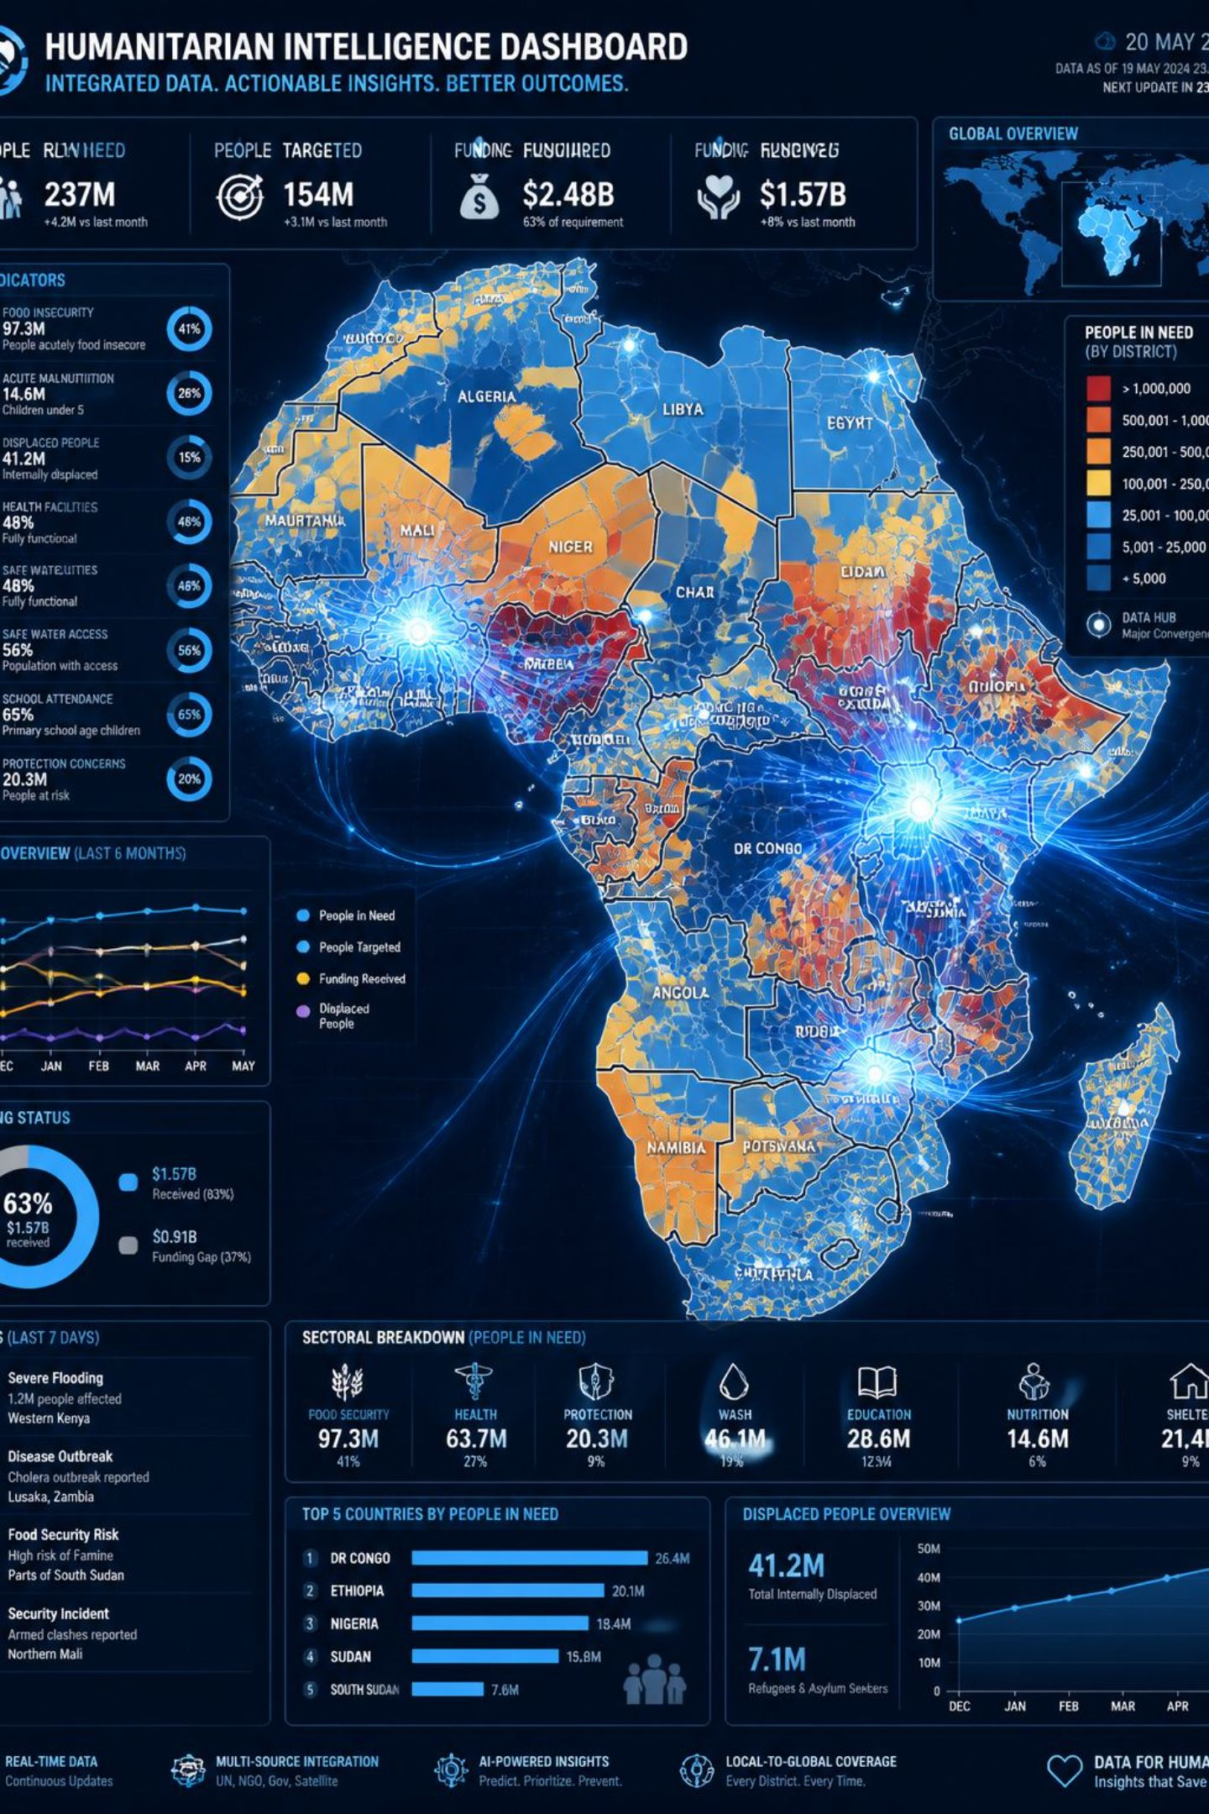
Level 7: Integrated Humanitarian Data Panel
The final ontology level combines all engineered features into a single Admin 2 × Month dataset — each record represents one administrative area during one month, with features from all four mechanisms unified while preserving source provenance.
Core Scientific Question
"Do different humanitarian sources provide complementary or redundant observations of the same crisis mechanisms?"

Slide 15
Next steps: Building prototype
Common Schema
Conflict & Insecurity
Market & Food Price Pressure
Climate / Agriculture
record_id
month
year
country
admin 1
admin 2
latitude
longitude
conflict_event_count
event_count
conflict_trend_pct
fatalities
rainfall_mean_mm
rainfall_min_mm
rainfall_max_mm
vegetation_health_index_mean
commodity_price
commodity_price_change_pct
Humanitarian Reporting
humanitarian_report_count
report_theme_count

