Slide 1
SEM Image Defect detection
Team Number: 17
105061804 Jie-Qi Huang 黃傑琦
2017.01.11

Slide 2
Agenda
Problem Motivation/Description
Technical Approach
Target Alignment
Width Measurement
Defect Detection
Some Results

Slide 3
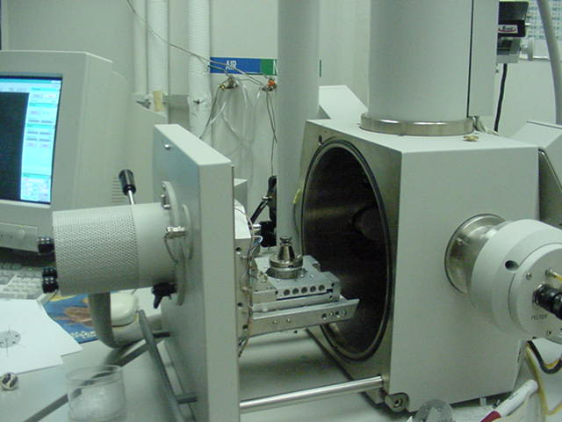
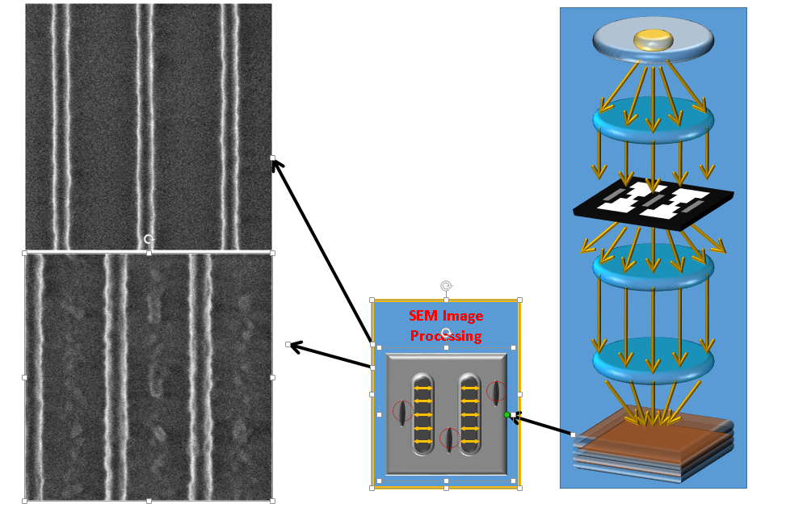
Introduction Scanning Electron Microscope for Semiconductor Mask Synthesis Flow
Scanning Electron Microscope (SEM) is a commonly used inexpensive metrology method to measure silicon result.
SEM images are grayscale 2D arrays representing the reflecting density of electrons.

Slide 4
Problem Motivation/Description
It would be helpful to replace manual inspection for more than thousands of images per day.
Increasing the productivity very much.
This project is aimed to process SEM images to align, measure and detect results automatically for manufacture flow.
based on Python and openCV libraries.

Slide 5

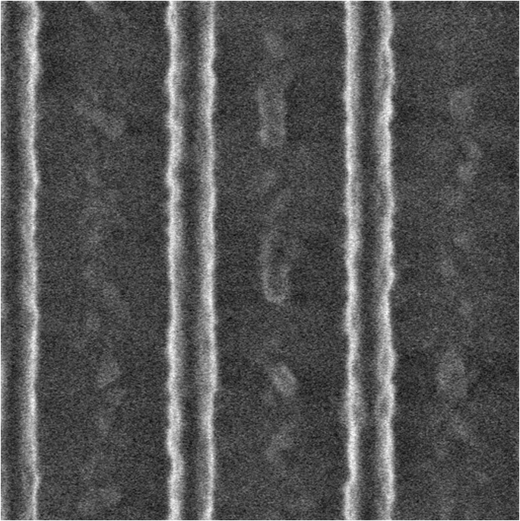
Problem :Image Refer Center with Position Offset

Slide 6
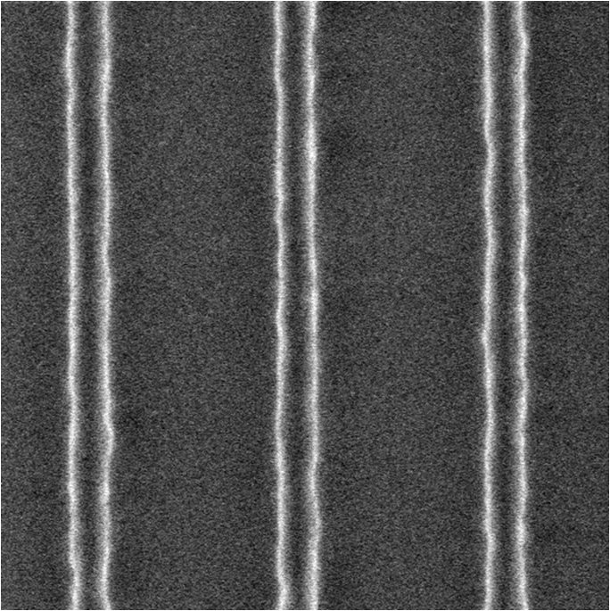
The Goal !! Offset auto-shift . Auto-defect detection.
SEM Image Processing

Slide 7
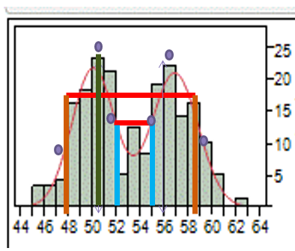
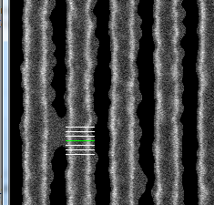
The Goal : Gaugelines Measurement in foreground Polygon

Slide 8
Technical Approach
Problem Motivation/Description
Technical Approach
Target Alignment
Width Measurement
Defect Detection
Some Results

Slide 9
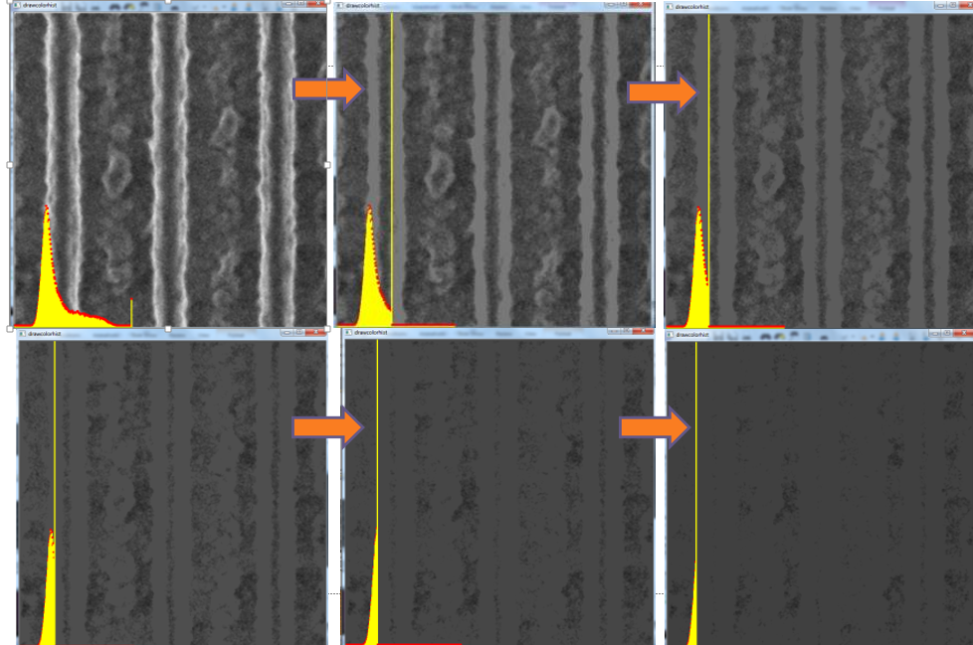
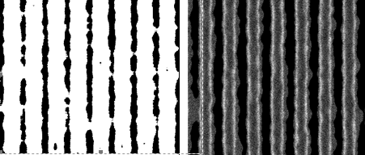
Phase1:Target Alignment
The enhancement is applied by 5x5 pixels of median filter and then take the initial foreground extraction by Otsu algorithm with Push histogram method we suggested, in the end it would offer an optimized threshold value for this original image.

Slide 10
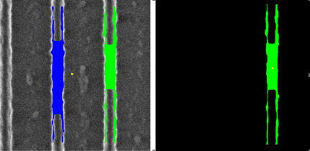
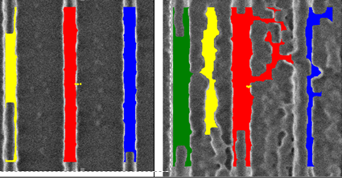
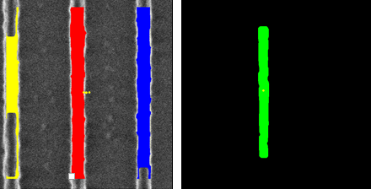
Phase1:Target Alignment
After the initial foreground extraction, it applied dilate and erode between 5x5 median filter again and again to get a smooth foreground contour.Then we take the foreground contouring byCHAIN_APPROX_TC89_KCOS algorithm.
After all, it dynamically generates some contours of every polygon object from the whole SEM image. And we choose one from them as the real reference center.

Slide 11
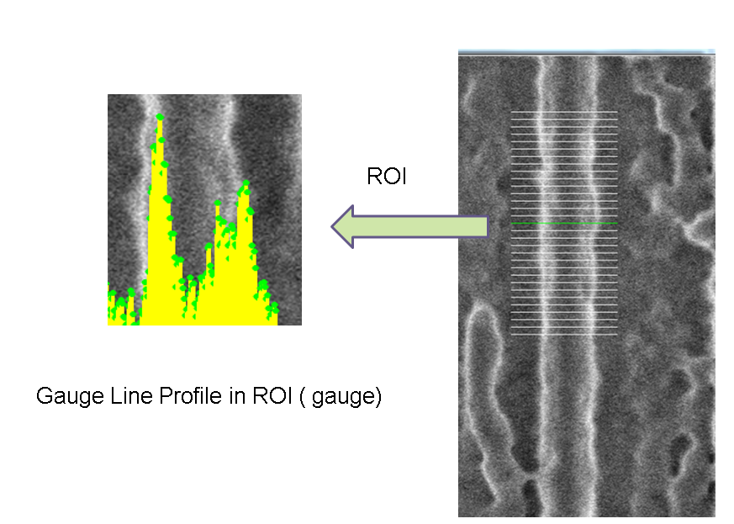
Phase2: Width Measurement
This phase would take the gauge lines in the best selecting foreground polygon. Here we apply a searching method called Peak-Peak search.
Step1:
Search peak to peak (p-p search) process.
Reference the Inner and outer factor.
Step2:
Inner search:
Between p-p, right search from left peak.
Between p-p, left search from right peak.
Step3:
Outer search:
Left search from left peak.
Right search from right peak.

Slide 12
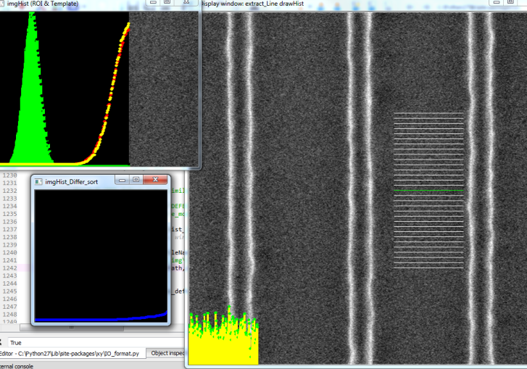
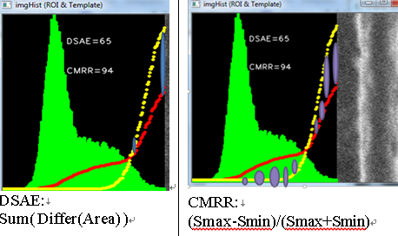
Phase3: Defect Detection
The experiment result for defect detection with CMRR Index:
CMRR<80: Clean.
100> CMRR >80: Defect.
For GS Defect detection with DSAE Index:
DSAE<7: Clean.
DSAE>7: Defect.

Slide 13
Some Results
Problem Motivation/Description
Technical Approach
Target Alignment
Width Measurement
Defect Detection
Some Results

Slide 14
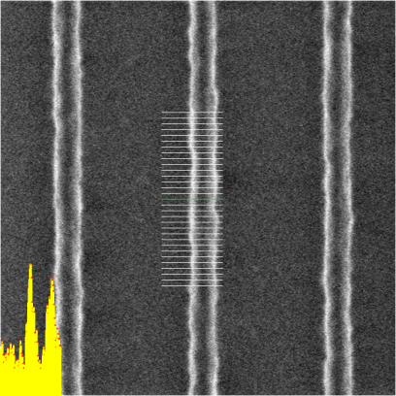
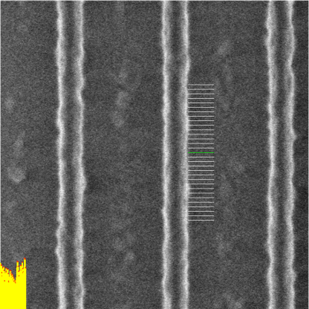
Phase1 Result Polygon Offset auto-shift and Measurement
No offset
offset

Slide 15
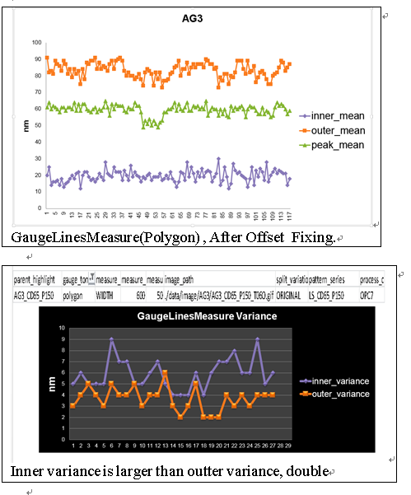
Phase2 Result
After Peak-Peak search.
To measure the distance between Left peak point and left outer point, and to measure the distance between right peak point and right outer point.

Slide 16
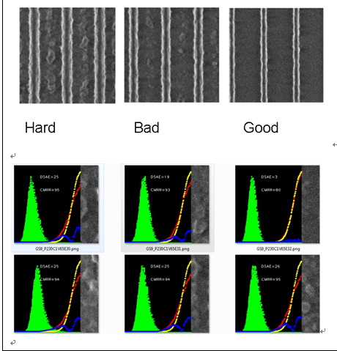
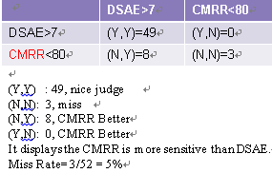
Phase3 Result
And give 26 Test image as the ground truth(52 ROI , labeled by human eyes), the miss rate by the system is 5 %.
The Test source quality include Good (also assigned for template ROI), Bad ( A litte defect), hard ( obvious defect). And to apply the detection to these images to judge the result belonging to defect or not.

Slide 17
DEMO
IF time enough then
Demo VIDEO (SEMdemo_VIDEO0155.3gp, 41 sec)
Else
Exit

Slide 18
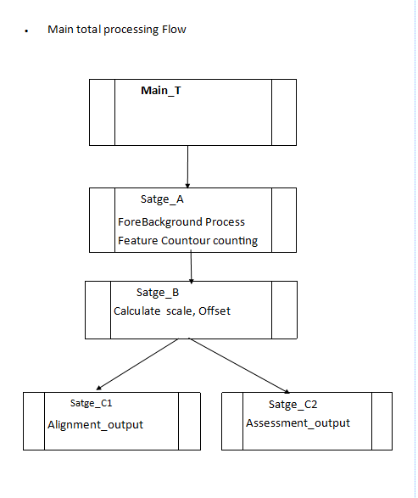
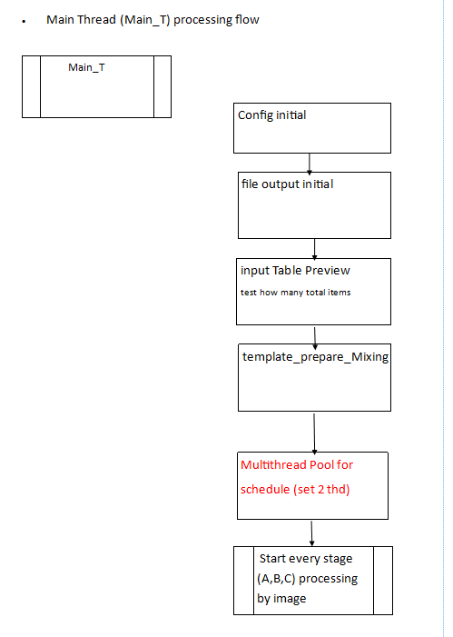
Code Process Flow

Slide 19
